Slide 1
JavaScript : Expressions & Conditionals
Chapter 02

Slide 2
Expressions & Conditionals
A fragment of code that produces a value is called an expression. Every value written literally is an expression for ex: 21 or “ISMT".

Slide 3
Operators in JavaScript
JavaScript operators are used to perform different types of mathematical and logical computations.
Some of the operators in JavaScript are:
Arithmetic Operators
Assignment Operators
Comparison Operators
Logical Operators
Conditional Operators

Slide 4
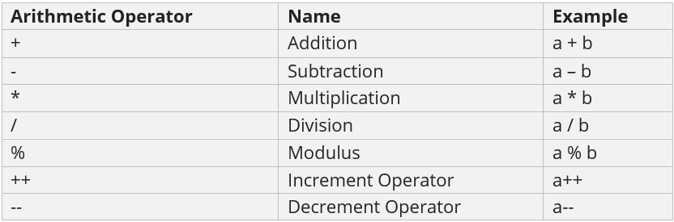
Arithmetic Operators
Arithmetic operators in JavaScript perform arithmetical operations, such as addition, subtraction, division, multiplication, etc.

Slide 5
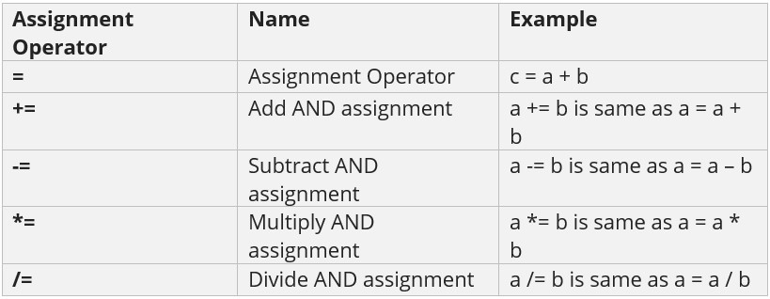
Assignment Operators
Assignment Operator when you need to assign values to a variable. It also includes the Arithmetic Assignment Operators

Slide 6
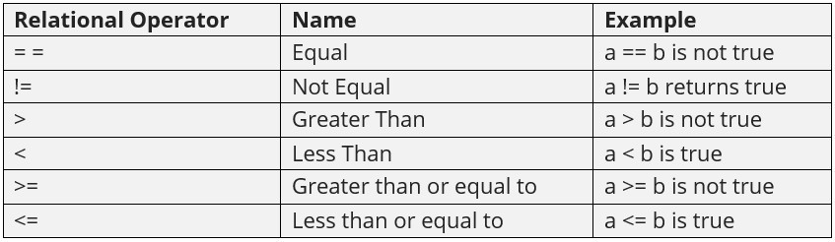
Relational/ Comparison Operators
Compare two values with JavaScript relational operators, which are also known as Comparison Operators. Let us say a = 3, b =5

Slide 7
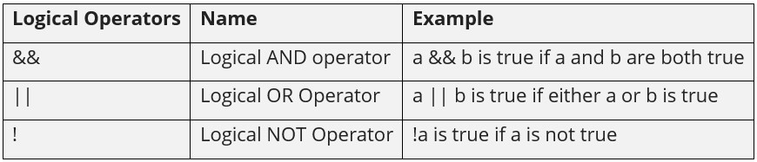
Logical Operators
Logical operators combine conditional statements. Considering Boolean variables, a and b. Let us see an example of Logical Operators in JavaScript:

Slide 8
Conditional Operator
Conditional operator evaluates Boolean expressions, with three operands. It is also known as the ternary operator. The role is to assign a value to a variable, from two given set options. The following is the syntax:
variable_name = (expression) ? value1 ( if true) : value2 (if false)
As shown above, if the condition is true, value 1 will get displayed, else value 2.

Slide 9
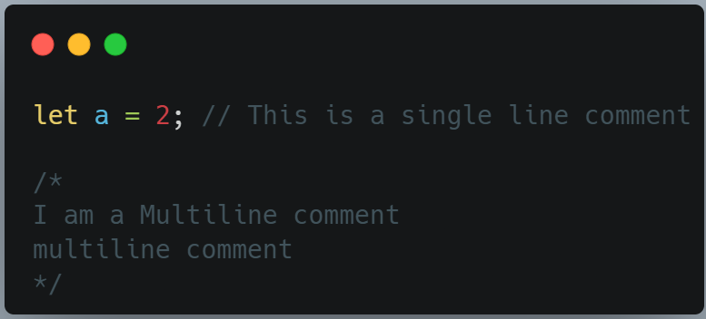
Comments in javascript
A comment in JavaScript can be written as follows:

Slide 10
Conditional Statements
JavaScript conditional statements allow you to execute specific blocks of code based on conditions. If the condition is met, a particular block of code will run; otherwise, another block of code will execute based on the condition.

Slide 11
Types of Conditional Statements
The types of Conditional Operators are:
if statement
if...else statement
if...else if...else statement
switch statement
ternary (conditional) operator

Slide 12
if Statement
The if statement evaluates a condition inside parentheses. If the condition is true, the block of code inside the curly braces {} runs. If it’s false, it skips that block.
Syntax:
if (condition) {
// code runs if condition is true
}

Slide 13
if-else Statement
The if-else statement will perform some action for a specific condition. Here we are using the else statement in which the else statement is written after the if statement and it has no condition in their code block.
Syntax:
if (condition) {
// code runs the if the condition in if is true
}
else {
// code runs if the condition in the if is false
}

Slide 14
else if Statement
The else if statement in JavaScript allows handling multiple possible conditions and outputs, evaluating more than two options based on whether the conditions are true or false.
Syntax:
if (condition1) {
// code to execute if condition1 is true
} else if (condition2) {
// code to execute if condition2 is true
} else {
// code to execute if none of the conditions are true
}

Slide 15
Switch Statement (JavaScript Switch Case)
The switch statement is a control structure in JavaScript that allows you to execute different blocks of code based on the value of a single expression. It’s a cleaner, more readable alternative to multiple if...else if statements when you need to compare one variable against many possible values.
Syntax:
switch (expression) {
case value1:
// code to execute if expression === value1
break;
case value2:
// code to execute if expression === value2
break;
default:
// code to execute if no case matches
}

Slide 16
Ternary Operator ( ?: )
The ternary operator is a compact shorthand for an if...else statement. It is called “ternary” because it takes three operands:
A condition to test.
An expression to evaluate if the condition is true.
An expression to evaluate if the condition is false.
Syntax:
let result = condition ? valueIfTrue : valueIfFalse;

Slide 17
JavaScript 02: practice set
Use logical operators to find whether the age of a person lies between 10 and 20?
Demonstrate the use of switch case statements in JavaScript.
Write a JavaScript program to find whether a number is Divisible by 2 and 3.
Write a JavaScript program to find whether a number is Divisible by either 2 or 3.
Print "You can Drive" or "You cannot Drive" based on Age being Greater than 18 using ternary operator.

Slide 18
JavaScript : loops & functions
Chapter 03

Slide 19
Loops in JavaScript
Loops in JavaScript are programming constructs that enable the repeated execution of a block of code until a specified condition is met. They are essential for automating repetitive tasks and processing collections of data.
The different types of loops are:
1. for loop
2. for in loop
3. for of loop
4. while loop
5. do while loop

Slide 20
for loop
for loop: This loop is used when the number of iterations is known beforehand. It consists of an initialization, a condition, and an increment/decrement statement.
Syntax:
for (initialization; condition; increment) {
// code to be executed
}

Slide 21
for in loop (Used for objects)
This loop iterates over the enumerable properties of an object, including inherited properties. It is generally not recommended for iterating over arrays due to potential issues with order and inherited properties.
Syntax:
for (let key in object) {
// code to be executed
}

Slide 22
for of loop (Used for objects)
This loop is used to iterate over iterable objects like arrays, strings, Maps, Sets, etc., directly accessing the values of each element.
Syntax:
for (let item of iterable) {
// code to be executed
}

Slide 23
while loop
This loop executes a block of code as long as a specified condition evaluates to true. The condition is checked before each iteration.
Syntax:
while (condition) {
// code to be executed
}

Slide 24
do while loop
Similar to the while loop, but the code block is executed at least once, and then the condition is checked after each iteration.
Syntax:
do {
// code to be executed
} while (condition);

Slide 25
FUNCTION IN JAVASCRIPT
A function in JavaScript is a block of code designed to perform a specific task.It runs only when it is called/invoked.
Syntax:
function functionName() {
// code to be executed
}

