Slide 1
Ultrasonic mic project notes

Slide 2
Methods:
1. ultrasonic generator 39khz to analog mems Mic
Analog multiplier to find phase shift
Use PIC to for the analog comparator.
2. ultrasonic generator 39khz to digital mems mic PDM output
Pico to drive the ultrasonic generator and PIC to provide the clock (3Mhz) to the two PDM mics.
PDM signal goes to buffer, fully differential amplifier, the comparator.

Slide 3
Method 1:
Drive the ultrasonic generator with function generator 39kHz.
Use scope to measure the analog signals of the two signal.
Use PIC12 to measure the analog comparator
Method 2:
Drive the ultrasonic generator with a pico
Use Pico or PIC to send clock to the two mems microphone
MEMS mic sends PDM to a receiving board that has low pass filtering and fully differential amplifier then the comparator.
Pico set the Vocm to Fully differential amplifier.
Pico reads the two signal from the two PDMs and shift the Vocm to tune the pulse width

Slide 4
TO DO
Buy PIC12F1840 and PicKit - done
Make MEMs PDM mic boards and send out for manufacturing - done
LTspice model the two methods to compare
Model ultrasonic crystal and add a pdm .wav file in it.

Slide 5
May 30 notes:
Rpi pico:
GPIO15 – pwm1, 39khz for ultrasonic generator
*GPIO1 – pwm2, clk signal for PDM mic
variable for frequency for Standard Mode & Ultrasonic Mode:
freq1= [1.024Mhz, 3.072Mhz]
GPIO10 – PDM1 mic power ON/OFF
GPIO11 – PDM2 mic power ON/OFF
GPIO17 – D Audio Amp notShutDown pin
GPIO26 – PDM2 Data in
GPIO18 – Dflipflop 2 output
*note: rpi pico has 16 PWMs but divide into slices of two GPIO, so have to avoid using the same slice if we want different frequency

Slide 6
June 14
PDM daughter board pinout
J2, Pin 1, YE – DO: PDM Data Out
J2, Pin 2, BK – SEL: Select
(jump to Vdd for rising edge reading, jump to GND for falling edge reading)
J3, Pin 1, RD – 3.3V: VDD
J3, Pin 2, WT – clk: clock signal in
J3, Pin 3, GN – GND: ground
DO YE

Slide 7
June 29
Tried using analog mic with D flip flop – it didn’t work
Tried using analog mic with ADC GPIO, but get a high steady value
Maybe worth trying to pull ADV Vref to 3.3 or 3V
TO DO:
Import PDM project and build file
Make counter works with state machine
Create array and store PDM data

Slide 8
July 9
Difficulty: had trouble getting PDM to trigger with the D flipflop
Will try to setup the time log with GPIO rising edge trigger first. Then try to set up the statemachine for interrupt call and store the time. Use _thread to run two cores. *statemachine runs on a fix frequency, so would have to manually set it to 125MHz.
Retying to use the analog mic and store the ADC value in an 2D array (time_us, ADC_val), use it as a LUT and use normalization to find the 50% (zero crossing) then do the time difference.

Slide 9
July 12
Trouble finding the exact number of cycles.
Tried to 1-bit DAC on a Dflipflop and it didn’t not work
Ordered analog multiplier to test – for analog mic
Ordered frequency counter to test – for analog mic
Ordered sigma delta modulator for the PDM
Change in windspeed changes the wavelength – the changes in wavelength is the same % change in the wind speed.

Slide 10
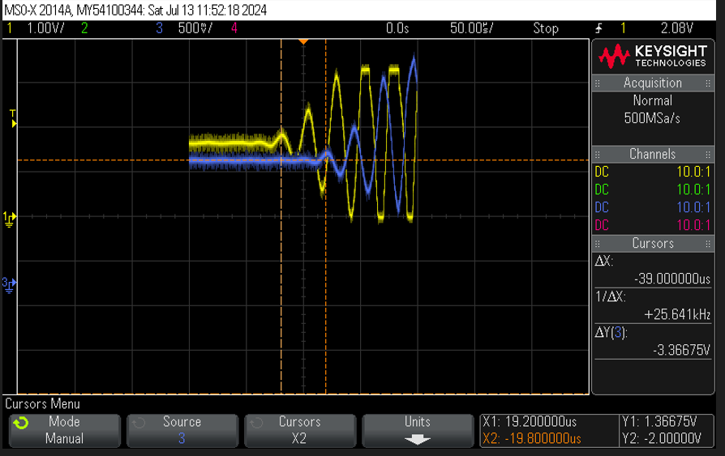
July 13
Moved the analog mic closer – d is now 1cm.
Also tried sending the pulses instead of continuous sinewave.
If I do trigger on a scope, the first mic waveform is leading by a cycle

Slide 11
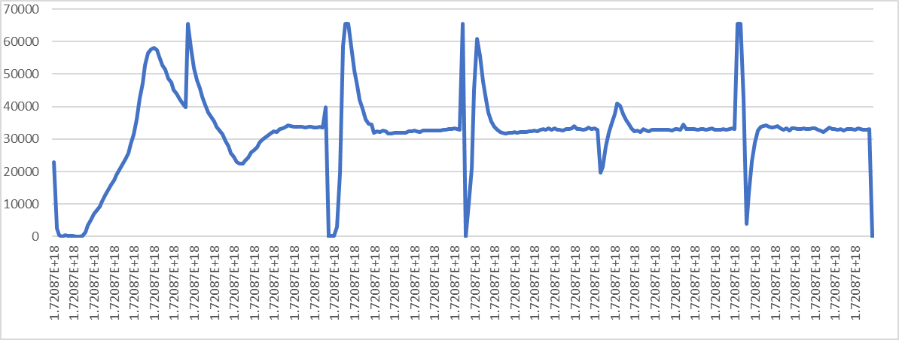
July 13
Moved the analog mic closer – d is now 1cm.
Also tried sending the pulses instead of continuous sinewave.
If I do trigger on a scope, the first mic waveform is leading by a cycle
Doing a 35ms pulse output on the digital amplifier seems to capture the beginning of the waveforms.
Now need to add two ADC arrays

Slide 12
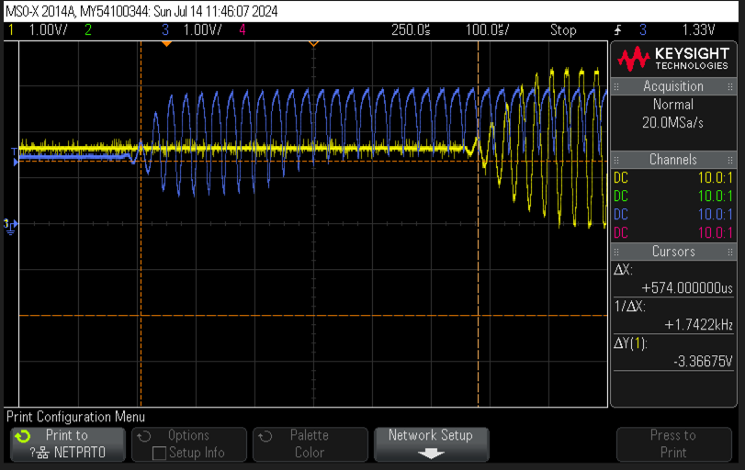
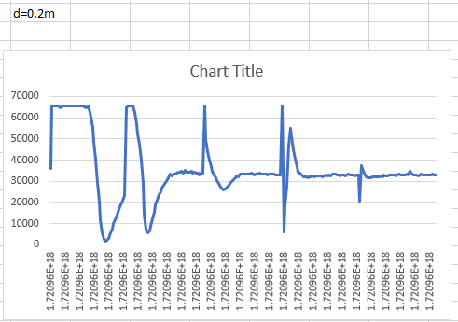
July 14
D =0.2m, the captured data with trigger works, but have to verify whether the mcu is able to capture the datas.

Slide 13
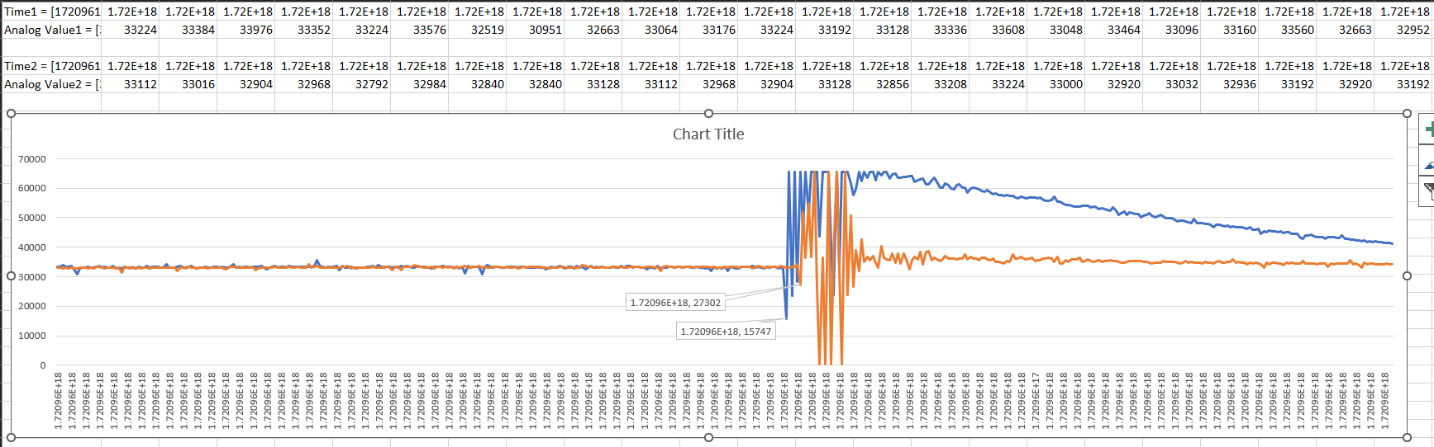
July 14
Seems like the mcu is fast enough to capture the waveforms

Slide 14
July 19
Reread the report on July 15, there are a few things we need to try.
Ie Vocm, comparator for 1.5V output, compare the pulse timestamp.

Slide 15
July 21
Received Analog multiplier and sigma-delta chip. Will try it out.
Tried analog multiplier – It needs +/-8V input rail, so couldn’t power it up using just the Pico or USB.
Try to build a comparator with Vocm.
Tried comparator op-amp, and the Vref is 3.3V, so the above voltage becomes a ripple. Also, the op-amp is not a fully differential op-amp, so no Vocm.
Todo:
1. buy fully differential op-amp
2. Try VCO, PLL, Frequency to voltage converter, and Phase lock loop
3. Try pico hardware_PLL

Slide 16
July 28
Ordering:
PLL (CD74HCT7046AE)
SOP28 to DIP SMT
PLL circuit (from youtube):
JK FF (CD4027BE)
Binary counter (CD4040BE)
PLL IC (CD4046BE)
DIY PLL:
Frequency Detector (MCH12140DG)
VCO (MC100EL1648)

Slide 17
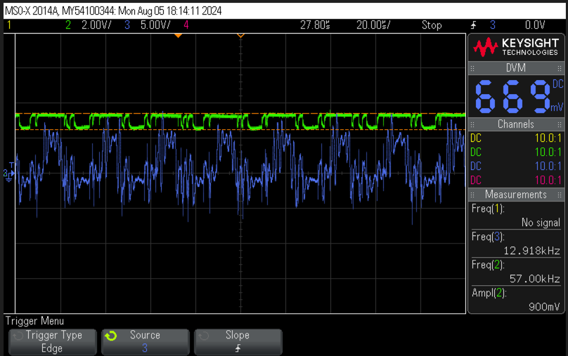
July 30
Will have to try PDM on Rpi sigma-delta decimation
Create a 16bit array (data_array[1..16] ), the moving average data
At 3.72Mhz, you want 48khz, so decimation 64
From PDM to Audio
Creating a PDM bit stream from the analog measurement of the membrane’s position is a well understood design problem that is closely related to a class of analog to digital converters called sigma delta converters.
Given the high data rate PDM bit stream, recovering a lower data rate PCM stream from it is easily done by applying a suitable low-pass filter with decimation. The requirements for these filters are also well understood, and tricks are known that make it easy to decimate by a power of two using only addition and subtraction². The usual practice for PDM microphones is to assume decimation by 64.
The Knowles microphone described expects to be clocked at any rate between 1 MHz and 3.25 MHz which when downsampled by a factor of 64 produces finished PCM audio samples at all the common PCM rates ranging from 16 kHz (1.024 MHz) to 48 kHz (3.072 MHz). If required by the telephone network, classic telephony samples at 8 kHz can be produced by a further decimation and conversion to either µLaw or aLaw representation.
In the next few installments we’ll document a stunt implementation of PDM decoding that works and produces a useful output. We’ll follow that with a more practical implementation that can serve more demanding applications.
*Triend to store ADC data into an array[16], but the GPIO output for the decimation is tied to the 3Mhz output for some reason…
*retried it, and it sort of works, but needs a lot of adjustment

Slide 18
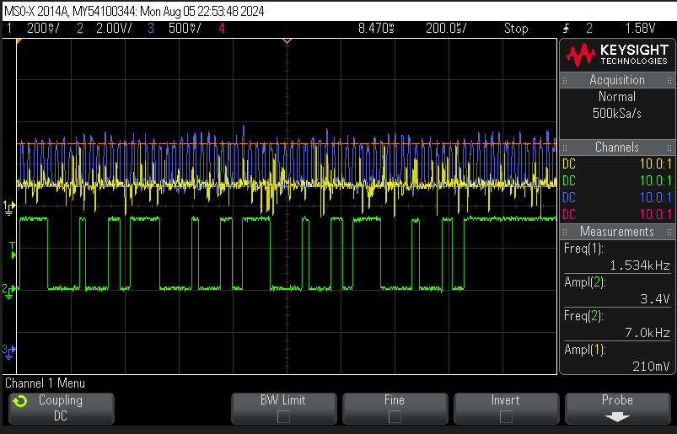
Aug 5
Will have to try PDM on Rpi sigma-delta decimation
Create a 16bit array (data_array[1..16] )
Did not do the moving average data
At 3.072Mhz, you want 48khz, so decimation 64
Scaled the ADC raw data into voltage
IF voltage > threshold, GPIO Out = 1
ELIF GPIO Out = 0,
**Next is to make sure the pulses are correct and not random. Then, feed it into the DFF and repeat for mic 2
*retried it, and it sort of works, but needs a lot of adjustment

Slide 19
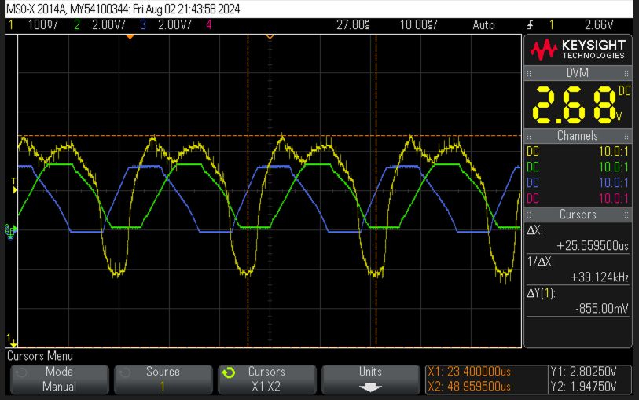
July 30
Will have to try PDM on Rpi sigma-delta decimation
Tried the analog mics with DFF
Mic1 as the input signal for DFF
Mic2 as the clk for DFF
Output width is the delay – at still air it is 25.5595us. This seems to work, the pulse width is the time delay.

Slide 20
Aug 5
Will try to put together a PPL IC (CD74HCT7046AE) with the two analog mics.
Tried it, and it works well. Need a low pass filter to clean up the Phase output pulse.

Slide 21
Aug 11
Tried to feed the two analog mic signals into a frequency detector (MCH12140DG) and the pulse width is the phase difference to the next amplitude.
Tried adding 0.1uF and 1nF caps to all signals and the PLL chip.
Aug 12:
Fed the analog signal to a JK FF (CD4027BE) and reduced the signal from 39kHz to 19.5kHz and successfully converted sine to squared wave.
JK wire notes:
Clock (PIN13) input to Mic output (sine)
Reset (PIN12) needs to pulled LOW
K1 (PIN11) needs to pulled HIGH
J1 (PIN10) needs to pulled HIGH
SET (PIN9) needs to pulled LOW

Slide 22
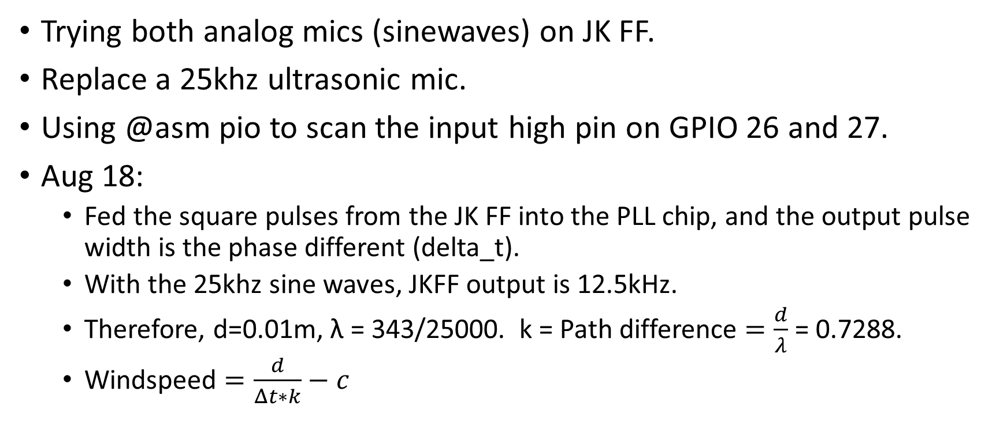
Aug 15
Trying both analog mics (sinewaves) on JK FF.
Replace a 25khz ultrasonic mic.
Using @asm pio to scan the input high pin on GPIO 26 and 27.
Aug 18:
Fed the square pulses from the JK FF into the PLL chip, and the output pulse width is the phase different (delta_t).
With the 25khz sine waves, JKFF output is 12.5kHz.
Therefore, d=0.01m, λ = 343/25000. k = Path difference $=\frac{d}{λ}$ = 0.7288.
Windspeed $=\frac{d}{Δt∗k}−c$

Slide 23
Aug 15
Interrupt in pico might be too slow…
Have to try to use the GPIO27 to trigger an output pin and probe it in a scope to see how fast it is.
Aug 20:
Tried machine.time_pulse_us on pin 27, we are getting a pulse width of 39us or 38 us but still fluctuates. * at still air, it is 40us. The limitation of this function is that it is in uS.
Would have to try .PIO to measure the pulse width.

Slide 24
Aug 22
Trying to use PIO to scan the rising edges of the two jkFF pulses.
Able to code in c in vscode now. Will try to make a pio program in Thonny first. If no success, we will go with c coding.

Slide 25
Aug 25
Tried the vscode to code in C for the statemachine, and it can compile the code successfully, but needs a lot of work for the PWM to the ultrasonic generator and scanning the rising edges of the Pins.
Tried the .PIO to measure the rising edge timing, but no success in measuring clean data. i.e. no advantage than the machine_pulse_us method.
.PIO as a timer in micropython could be it, but needs more work to understand it.
Also would need to try it on the new mcu (Pico 2).

Slide 26
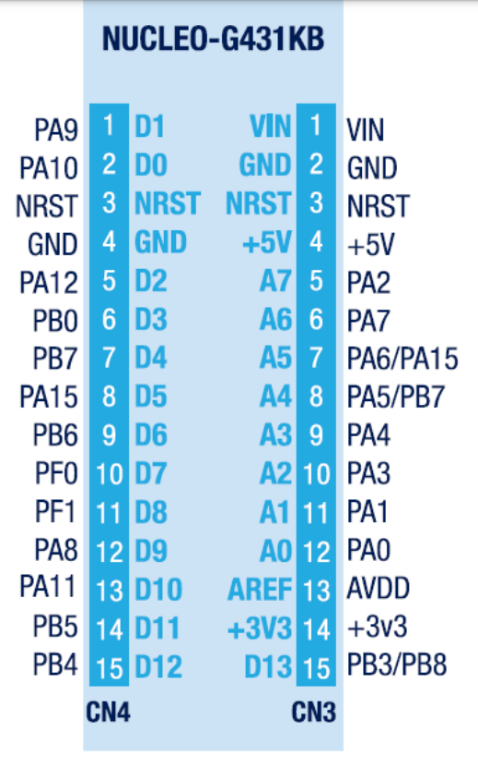
Sept 2
Trying the new stm32 mcu with a PWM output and the GPIO on/off for the ultrasonic generator.
Also will need to make a timer to time the rising edges.
PB6 =TIM4_CH1, PWM (25khz) for ultrasonic generator
TIM1 (PA8) clock for counting the rising and falling edge difference from the PLL pulse input
GPIOA_PIN5(PA5) & 6 (PA6) are for the rising edge input
GPIOA_PIN4(PA4) is a 25khz sinewave output for the speaker
GPIOA_PIN0 (PA0) for ADC temperature sensor input
GPIO!_PIN8 (PA8) is used for input capture in TIM1
GPIOB_PIN4 (PB4) is for the digital audio board NotShuntdown.
PB7 is I2C1 SDA to LCD
PA15 I2C1 SCL to LCD
Need to play around with the arr, crr and psc to get 25khz.
*done (arr = 6800-1, crr = arr/2-1) – done

Slide 27
Sept 3
Using Frequency Detector (MCH12140DG) with a low pass filter (1kR and 1.47uF) to get to 100hz. Measured the DC value. It is changes with windspeed.
689mV to 750mV – no wind, normal
910mV to 1V – no wind, blocking the closer microphone.
Also tried the cb4046be PLL chip, and it works better.
Update: pulled the shorting bar between VOC_out (pin3) and COMP_IN (pin4).
Along with this new pulse, main.py works okay using the machine.pulse_width_us

Slide 28
Sept 10
Programming State machine on stm32 – problem is it won’t switch state.
Sept 22 – fully ported the code and hardware over the stm32
For pin config see sept 2 notes
TIM1 is 170Mhz and it is used for counting the time delay for the two pulses.
Period = 1/170Mhz = 5.882ns, one tick is 5.882ns
So max range is 5.882ns*65536 = 385.48us
Might have to use prescalar of 17-1 to get 100ns per tick.
Pin PA0 connects to PLL CHIP (CD74HC7046A).pin2 (PC1_out)

Slide 29
Sept 30
Tested the pulse width measurement and it works.
To optimize, we still need to work on the path difference in the calculation.
Perhaps add the sample validation method from the paper.
Might be good to add the freeRTOS to schedule the tasks.
Also, need to add a temperature sensor to calibrate the speed of sound.
Lastly, add a LCD display to display the windspeed.

Slide 30
Oct 5
Added a temperature sensor (TMP36) to calibrate the wavelength.
Used dist/(delta_t*cal_val)= 331+0.61*temp [m/s] as the baseline for still air.
Cali_val = dist/(delta_t*v_sound), where v_sound = 331+0.61*temp. We hit calibrate once during still air and plug it back it into the windspeed formula to get the velocity change.
Oct 8: changed from a PWM squared wave to a 25khz sinewave. - done
Oct 13: adding LCD to display the data - done

Slide 31
Oct 19
Everything works on scanning the pulseW using input capture. However there is still a lot of noise in the system. Probably due to the turbulence in the air, and the tube reflecting the sound wave back.
Most GPIO inputs are done in DMA to free up the processor:
Temperature ADC is in DMA
Sinewave DAC is done in DMA
Pulse Width input capture is done in DMA
UART Terminal in DMA
I2C is NOT in DMA.
First, we need to look at the input capture function to eliminate the 0 reading. Then, we need to make an array to store the windspeed and do the average.
Secondly, we need to remake the 3D printed model for a smaller setup and a tube.
Lastly, sound insulation foam for the tube.
Wow, insulating the inner wall of the tube, produces a much cleaner pulse width in the signal – amazing!!!

Slide 32
Oct 27
I suspect the bridge platform still has some bouncing noise, so redoing the model to raise the mics and ultrasonic generator.
Nov 9:
remodelled a fan holder to hold a more powerful fan.
TODO:
Correct input capture pulse width function.
Put I2C in DMA mode – done
Only capture temperature once for calibration - done
Start thesis draft!!!! – started…

Slide 33
Dec 01
Discovered that the delay in the blink, get temperature, and send to lcd i2c is causing a race condition for the pulseW input capturing.
Now started freeRTOS to schedule the events
Implemented a freeRTROS scheduling using Mutex, and it seems to work better now. Now we need to smoothen the pulse width out and windspeed out with some filters.
Dec 7: working on adding the filter
Dec 8 – changed to 42.5mhz tim1 fclk, so 23.5241ns/tick
-still very jumpy, and having trouble stopping it from jumping -0.x to 0.8
Move the /100000000 ns to s division out of the pulseW to the windspeed calculation code
Dec 9 – added a rounding for the pulseW in 100ns then storing it in the array avg
Also rounding the temperature as well.
Dec 10 – changed to a D= 0.02m (20mm) fixture.
Discovered that the pulse actually leads (gets wider with windspeed). Hence, taking the absolute value of the windspeed. * abs converts into int, fabs keeps the float

Slide 34
Dec 26
Tried 170Mhz clk at 5.882ns per tick.
Tried 42.5Mhz clk at 23.52ns per tick,
Tried 34Mhz clk at 29.41ns per tick,
Tried 10Mhz clk at 100ns per tick. To reduce the noise and error
Tried 21.25Mhz (170/8) at 47.06ns/tick
Tried 17Mhz (170/10) at 58.82ns – works not bad
Tried 10.625Mhz (170/16) at 94.12ns/tick
/100ns per tick when fclk = 10Mhz; // 5.882ns/tick if 170Mhz clock; //23.52ns/tick at 42.5MHz; 28.57ns/tick @35Mhz

Slide 35
Jan 1, 2025
Changed to a 22khz ultrasonic transducer and change the sinewave to 22khz (f_sys_clk/(prescalar * 100)/period = 22khz
170Mhz/((1-1)* 100samples)/(77-1) = 22khz
Range is 25.6us to 5.882ns*65536 = 385.48us
Corresponds to speed 0m/s to 746657m/s (upper range = 747000m/s – 343 m/s).

Slide 36
Feb 15, 2025
There is a race condition in the JKFF.
We tried to use a master-slave JKFF to eliminate this. Also edge trigger jkff would be needed.
**feb 25, due to the race condition in the jkff, the PLL chip has an input frequence of sometimes leading and sometimes lagging, causing the output pulse to change with acoustic noise.
Use two edge trigger JKFF to help. It is better but still sometimes lead and sometimes lag. We can measure the windspeed at low noise.

