Slide 1
Week2

Slide 2
Write happy story to set up the day
Thomas was happy to work with data. Why you ask? Because today bayesian models would be explored. Thomas was proud to finally be learning about this topic, because Karsten lectured first years, and talked about the subject.
At that time, Thomas had no clue, that he would meet up to this class, and what capabilities this would give him.
- Live life, Feng Shui style

Slide 3
Recap from last week, week 1

Slide 4
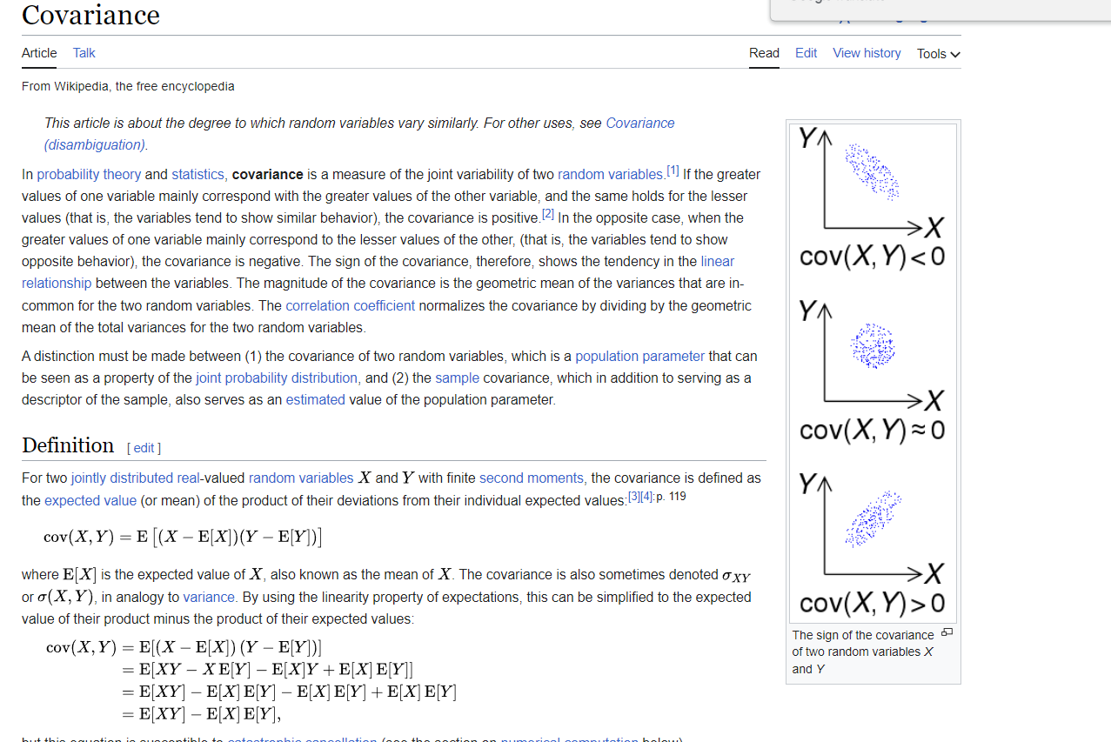
Covariance
First, lets display the covariance

Slide 5
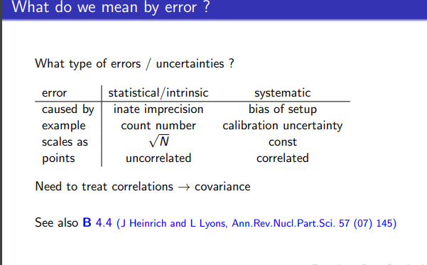
Question: How can systematic errors be dealt with

Slide 6
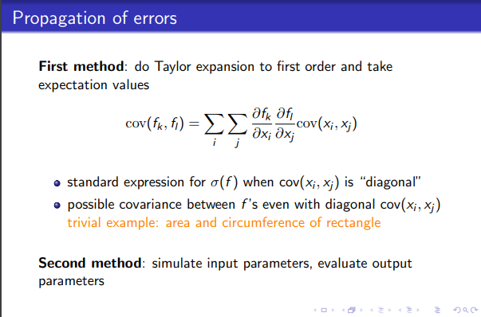
Need to use covariance, to treat errors

Slide 7
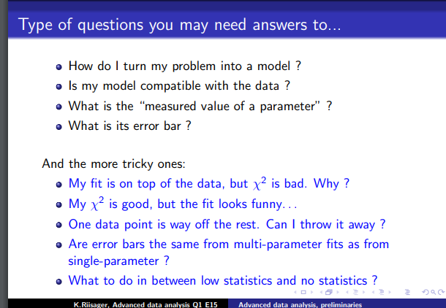

Slide 8
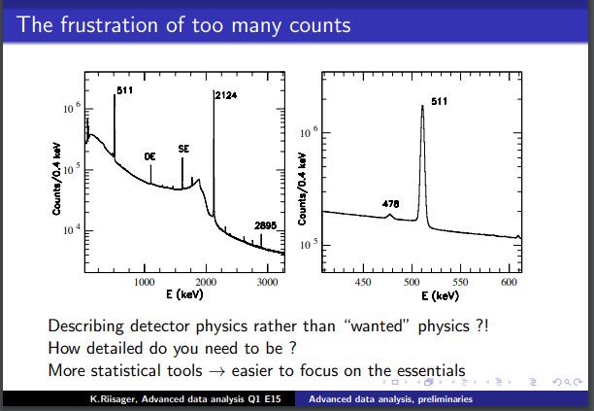

Slide 9
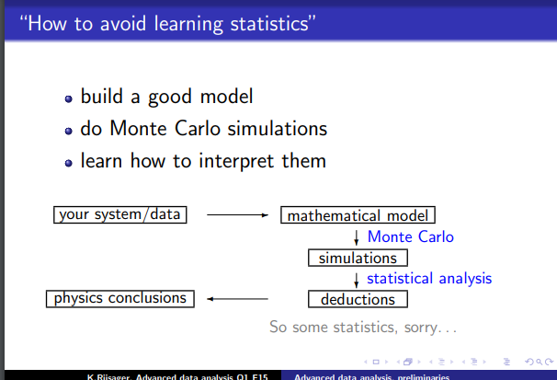
This is funny

Slide 10
