Slide 1
JAVA OOP SERIES · WEEKS 3–4 · CONDENSED EDITION
Abstraction in Java
Abstract Classes & Interfaces — Design Principles
abstract keyword & rules
partial implementation
interface design
multiple interfaces
default & static methods (Java 8)
abstract class vs interface
Dr. Arun Singh Yadav · Dept. of Computer Engineering & Applications, GLA University, Mathura
BCA / B.Tech — Object-Oriented Programming with Java

Slide 2
GETTING STARTED
02 / 39
What We'll Cover Today
01
Recap & What Is Abstraction
02
The abstract Keyword — Rules & Syntax
03
Abstract Classes — Partial Implementation
04
Interfaces — Declaration & Implementation
05
Multiple Interface Implementation
06
Default & Static Methods (Java 8)
07
Abstract Class vs Interface
08
Combined Example, Q&A & Takeaways

Slide 3
01 · RECAP & ABSTRACTION BASICS
03 / 39
The Four Pillars of OOP
1
2
3
4
Encapsulation
Inheritance
Polymorphism
Abstraction
Bundling data and methods, restricting direct access
Acquiring properties & behavior from a parent class
One interface, many forms — overloading & overriding
Hiding implementation, exposing only the essentials
◄ TODAY'S FOCUS
Java OOP Series · Abstraction in Java — Abstract Classes & Interfaces

Slide 4
01 · RECAP & ABSTRACTION BASICS
04 / 39
What Is Abstraction?
Abstraction is the process of hiding internal implementation details and exposing only the essential features and behavior of an object to the outside world.
Focuses on “WHAT” an object does, not “HOW” it does it
Reduces programming complexity for the user of a class
Achieved in Java using abstract classes and interfaces
WHY IT MATTERS
Lets you change internals without breaking callers
Separates the contract from the implementation
Foundation for clean frameworks, libraries & APIs
Java OOP Series · Abstraction in Java — Abstract Classes & Interfaces

Slide 5
01 · RECAP & ABSTRACTION BASICS
05 / 39
Driving a Car — Abstraction in Real Life
WHAT THE DRIVER SEES
WHAT'S HIDDEN (IMPLEMENTATION)
Steering wheel — to turn
Accelerator & brake pedals
Gear lever
Ignition button
Fuel injection & combustion cycle
Transmission gear ratios
Engine control unit (ECU) logic
Braking hydraulics
You use the interface (pedals, wheel) without knowing the implementation (engine internals) — exactly how abstract classes & interfaces work in Java.
Java OOP Series · Abstraction in Java — Abstract Classes & Interfaces

Slide 6
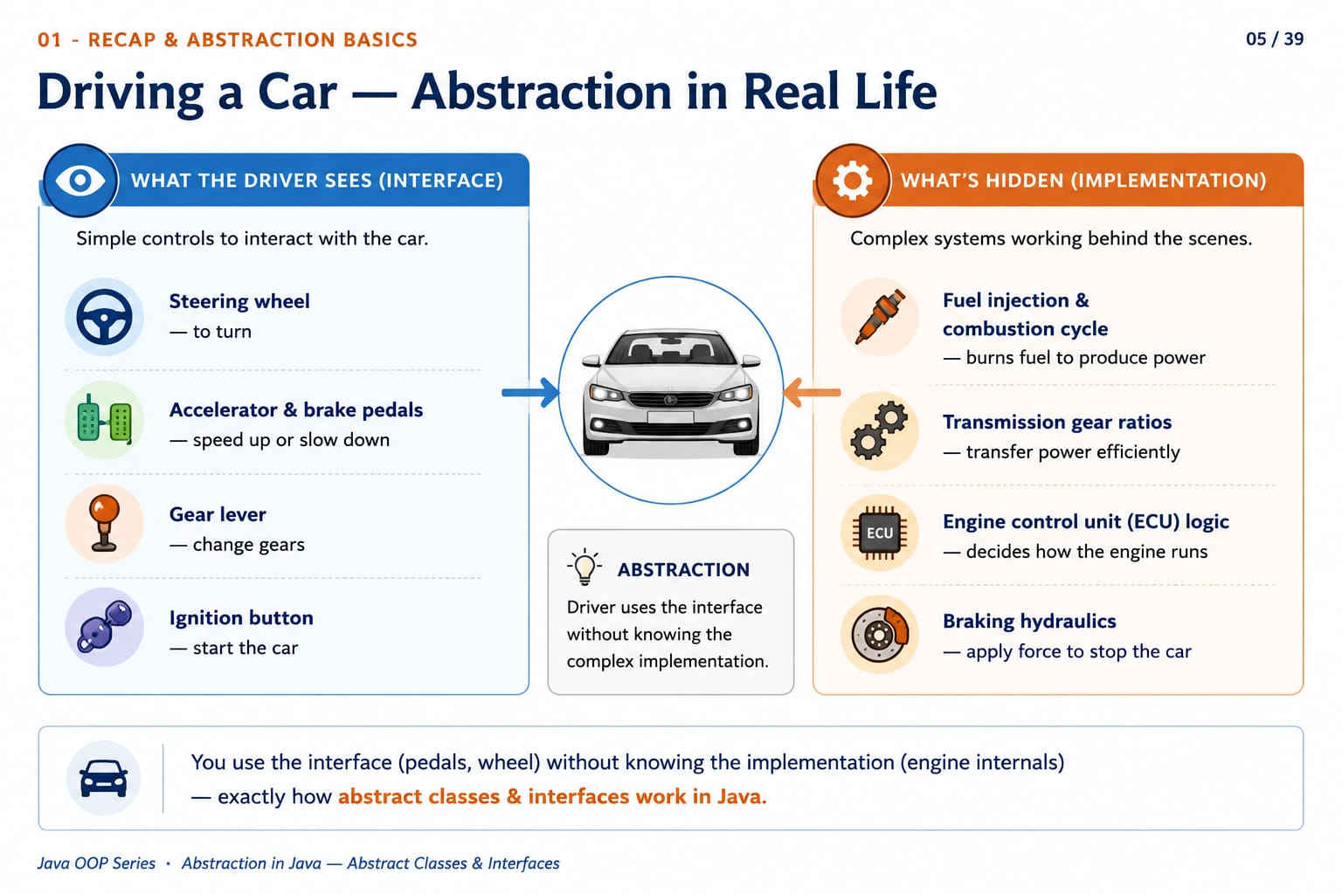

Slide 7
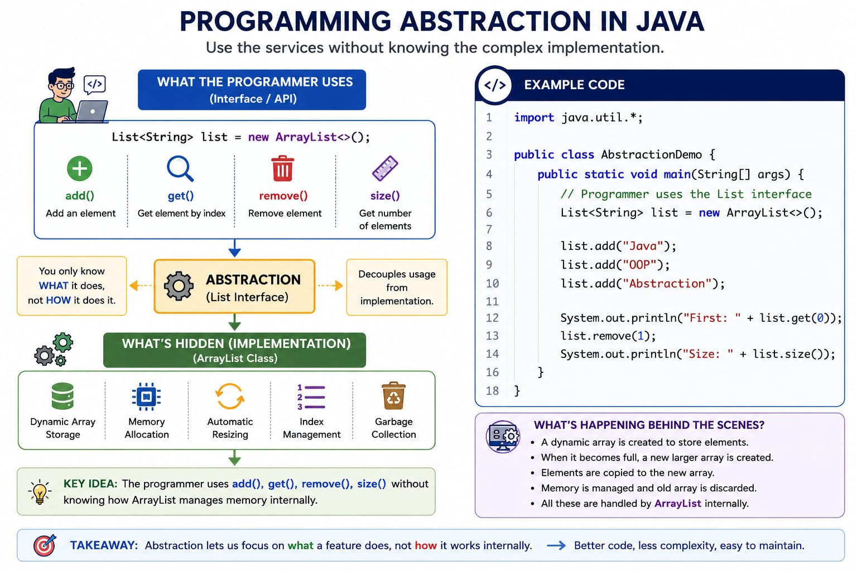

Slide 8
01 · RECAP & ABSTRACTION BASICS
06 / 39
Two Ways to Achieve Abstraction
Abstract Class
Interface
Declared with the abstract keyword
Can mix abstract & concrete methods
Supports 0–100% abstraction
A class extends only ONE abstract class
Best for closely related classes sharing code
Declared with the interface keyword
Traditionally fully abstract (pre-Java 8)
Java 8+: default & static methods allowed
A class can implement MANY interfaces
Best for unrelated classes sharing a capability
Java OOP Series · Abstraction in Java — Abstract Classes & Interfaces

Slide 9
TOPIC 01 OF 06 · ABSTRACT CLASSES & INTERFACES
01
ABSTRACT KEYWORD & RULES
The abstract Keyword & Rules
abstract marks a class or method as incomplete — meant to be finished by a subclass
An abstract class cannot be instantiated directly; it only exists to be extended
An abstract method has a signature but no body — it ends with a semicolon
07 / 39

Slide 10
TOPIC 01 · THE ABSTRACT KEYWORD
08 / 39
Declaring an Abstract Class & Method
READING THE SYNTAX
Animal.java
abstract before class makes the whole class abstract
makeSound() has no body — ends with a semicolon
sleep() has a full body — it's a normal method
A subclass MUST override makeSound()
1
abstract class Animal {
2
3
abstract void makeSound();
4
void sleep() {
5
6
System.out.println("Sleeping...");
7
}
8
}
RULE OF THUMB: if a method has no body, it MUST be declared abstract (or be part of an interface).
Java OOP Series · Abstraction in Java — Abstract Classes & Interfaces

Slide 11
TOPIC 01 · THE ABSTRACT KEYWORD
09 / 39
Rules for Abstract Classes & Methods
Rule | Applies To | Explanation
Cannot be instantiated | Class | new Animal() is a compile-time error, even with a constructor
Can have constructors & fields | Class | Used when a subclass calls super(...) during construction
≥1 abstract method ⇒ class is abstract | Class | If a class owns one abstract method, it must be declared abstract
No method body | Method | Declaration ends directly with a semicolon
Cannot be private, static, or final | Method | Each of these would block the overriding abstraction requires
Java OOP Series · Abstraction in Java — Abstract Classes & Interfaces

Slide 12
TOPIC 01 · THE ABSTRACT KEYWORD
10 / 39
Do's & Don'ts — Abstract Keyword
DO'S
DON'TS
Declare the class abstract the moment it owns one abstract method
Give the abstract class a constructor to initialise shared fields
Override every abstract method in the first concrete subclass
Don't write new Shape() — abstract classes can't be instantiated
Don't add a body { } to an abstract method — only a semicolon
Don't mark an abstract method static, final, or private
Java OOP Series · Abstraction in Java — Abstract Classes & Interfaces

Slide 13
TOPIC 01 · THE ABSTRACT KEYWORD
11 / 39
Code Example — Polymorphic Reference
Shape.java
Output
1
abstract class Shape {
1
Circle area = 78.5398...
2
String name;
3
Shape(String n) { name = n; }
4
abstract double area();
5
void display() {
6
System.out.println(name +
KEY POINTS
7
" area = " + area());
8
}
Shape s = new Circle(5) — abstract type, concrete object
Polymorphic reference holds the concrete object
s.display() calls Circle's own area()
9
}
10
class Circle extends Shape {
11
double radius;
12
Circle(double r) {
13
super("Circle"); radius = r;
14
}
15
double area() {
16
return Math.PI * radius * radius;
17
}
18
}
Java OOP Series · Abstraction in Java — Abstract Classes & Interfaces

Slide 14
TOPIC 01 · INTERVIEW PREP
12 / 39
Interview Q&A — Abstract Keyword
Q1
Can an abstract class have a constructor?
Q2
Can an abstract method be static?
Yes — it runs via super() when the subclass object is created, to set up shared state.
No. Static methods aren't overridden polymorphically, which defeats the purpose of leaving it unimplemented.
Q3
Can you create an object of an abstract class?
Q4
Is an abstract class with zero abstract methods valid?
Not directly. You can only hold a reference of that type pointing to a concrete subclass object.
Yes — a valid way to block instantiation while still sharing common code (Template pattern).
Java OOP Series · Abstraction in Java — Abstract Classes & Interfaces

Slide 15
TOPIC 02 OF 06 · ABSTRACT CLASSES & INTERFACES
02
PARTIAL IMPLEMENTATION
Abstract Class = Partial Implementation
Some behavior is implemented (shared code); some is left abstract for subclasses
Shared logic lives once in the parent — no duplication across subclasses
This is the classic Template Method design pattern
13 / 39

Slide 16
TOPIC 02 · ABSTRACT CLASSES
14 / 39
Why Partial Implementation Matters
1
Code reuse
2
Enforced contract
3
Best of both worlds
Concrete methods are written once in the parent and inherited by every subclass — no duplication.
Abstract methods force every subclass to supply its own specific behavior — nothing is forgotten.
Combines the flexibility of polymorphism with the efficiency of shared implementation.
Java OOP Series · Abstraction in Java — Abstract Classes & Interfaces

Slide 17
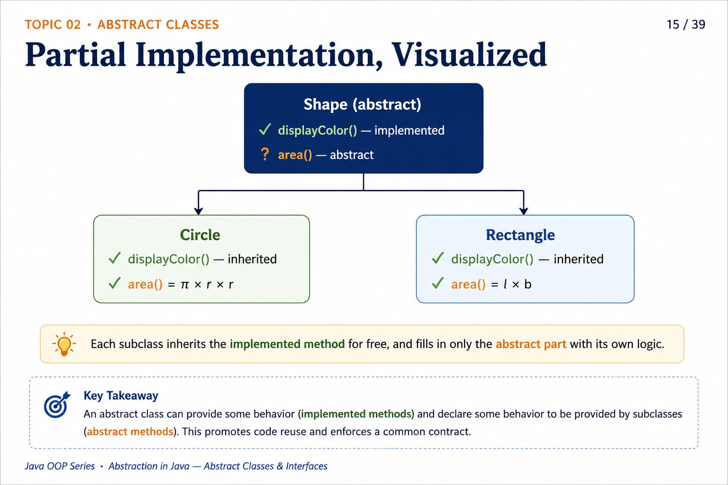

Slide 18
TOPIC 02 · ABSTRACT CLASSES
16 / 39
Code Example — Template Method Pattern
PaymentProcessor.java
Output
1
abstract class PaymentProcessor {
1
Charged via UPI
2
void process(double amt) {
2
Receipt sent.
3
validate(amt);
4
charge(amt);
5
System.out.println("Receipt sent.");
6
}
WHAT'S HAPPENING
7
void validate(double amt) {
8
if (amt <= 0)
process() is concrete — fixed shared workflow
charge() is abstract — subclass-specific step
UpiPayment supplies only charge()
9
throw new IllegalArgumentException();
10
}
11
abstract void charge(double amt);
12
}
13
class UpiPayment extends PaymentProcessor {
14
public void charge(double amt) {
15
System.out.println("Charged via UPI");
16
}
17
}
Java OOP Series · Abstraction in Java — Abstract Classes & Interfaces

Slide 19
TOPIC 02 · ABSTRACT CLASSES
17 / 39
Common Mistakes With Abstract Classes
Mistake | Why It Fails
new Shape() | Compile error — an abstract class can never be instantiated, even with a public constructor
Forgetting to override area() | Compile error in the first concrete subclass — every inherited abstract method MUST be implemented
private abstract double area(); | Illegal combination — private methods cannot be overridden, contradicting abstract
Marking class abstract unnecessarily | If every method has a body, there's no design reason to forbid instantiation
Java OOP Series · Abstraction in Java — Abstract Classes & Interfaces

Slide 20
TOPIC 03 OF 06 · ABSTRACT CLASSES & INTERFACES
03
INTERFACE DECLARATION & IMPLEMENTATION
Interface Declaration & Implementation
An interface is a pure contract — 100% abstraction with no shared state
A class agrees to the contract using implements, not extends
Every field is implicitly a constant; every method is implicitly public
18 / 39

Slide 21
TOPIC 03 · INTERFACES
19 / 39
What Is an Interface?
An interface is a reference type that defines a contract of behavior — a set of methods a class promises to implement, without dictating how.
Declared using the interface keyword
Traditionally — only abstract methods & constants
Java 8+ — also default and static methods
Java 9+ — also private helper methods
THINK OF IT AS
A capability — “what can this object DO?”
e.g. Comparable → “can be compared”
e.g. Runnable → “can be run as a task”
Java OOP Series · Abstraction in Java — Abstract Classes & Interfaces

Slide 22
TOPIC 03 · INTERFACES
20 / 39
Interface Fields & Method Types
Method Type | Description
Abstract | No body — implicitly public abstract
default (Java 8) | Has a body — shared default behavior
static (Java 8) | Has a body — called via InterfaceName.method()
private (Java 9) | Has a body — internal helper only
Drawable.java
1
interface Drawable {
2
String UNIT = "px";
3
// implicitly public static final
4
void draw(); // public abstract
5
}
Interface fields are implicitly public static final — they must be initialized at declaration; there is no constructor to assign them later.
Java OOP Series · Abstraction in Java — Abstract Classes & Interfaces

Slide 23
TOPIC 03 · INTERFACES
21 / 39
Code Example — Implementing a Contract
Drawable.java
Output
1
interface Drawable {
1
r=5.0px
2
String UNIT = "px";
3
void draw();
4
}
KEY POINTS
5
class Circle implements Drawable {
Drawable d = new Circle(5) — interface type reference
draw() must be public — can't narrow visibility
UNIT is a shared constant on the interface
6
private double radius;
7
Circle(double r) { radius = r; }
8
public void draw() {
9
System.out.println("r=" +
10
radius + UNIT);
11
}
12
}
Java OOP Series · Abstraction in Java — Abstract Classes & Interfaces

Slide 24
TOPIC 03 · INTERFACES
22 / 39
Do's & Don'ts — Interfaces
DO'S
DON'TS
Mark overriding methods public explicitly for readability
Use @Override so the compiler verifies the contract is fulfilled
Model independent capabilities (Runnable, Comparable) as interfaces
Don't add a mutable instance field — only constants are allowed
Don't reduce the access of an overriding method below public
Don't expect or write a constructor inside an interface
Java OOP Series · Abstraction in Java — Abstract Classes & Interfaces

Slide 25
TOPIC 04 OF 06 · ABSTRACT CLASSES & INTERFACES
04
MULTIPLE INTERFACE IMPLEMENTATION
Multiple Interface Implementation
Java blocks multiple class inheritance, but allows multiple interface inheritance safely
A class can implement any number of interfaces, comma-separated
This grants “can-do” capabilities without the diamond problem on state
23 / 39

Slide 26
TOPIC 04 · MULTIPLE INTERFACES
24 / 39
Why Classes Can't, But Interfaces Can
MULTIPLE CLASS INHERITANCE ✖
MULTIPLE INTERFACES ✓
If class D could extend both B and C, and both inherited greet() from A, which version does D run? The classic “Diamond Problem.”
Before Java 8, interface methods carried NO implementation — only signatures. With no bodies to conflict, a class can safely implement any number of interfaces.
Java avoids this by allowing a class to extend only ONE class.
1
class X implements A, B, C {
2
// must implement every method
3
}
Java OOP Series · Abstraction in Java — Abstract Classes & Interfaces

Slide 27
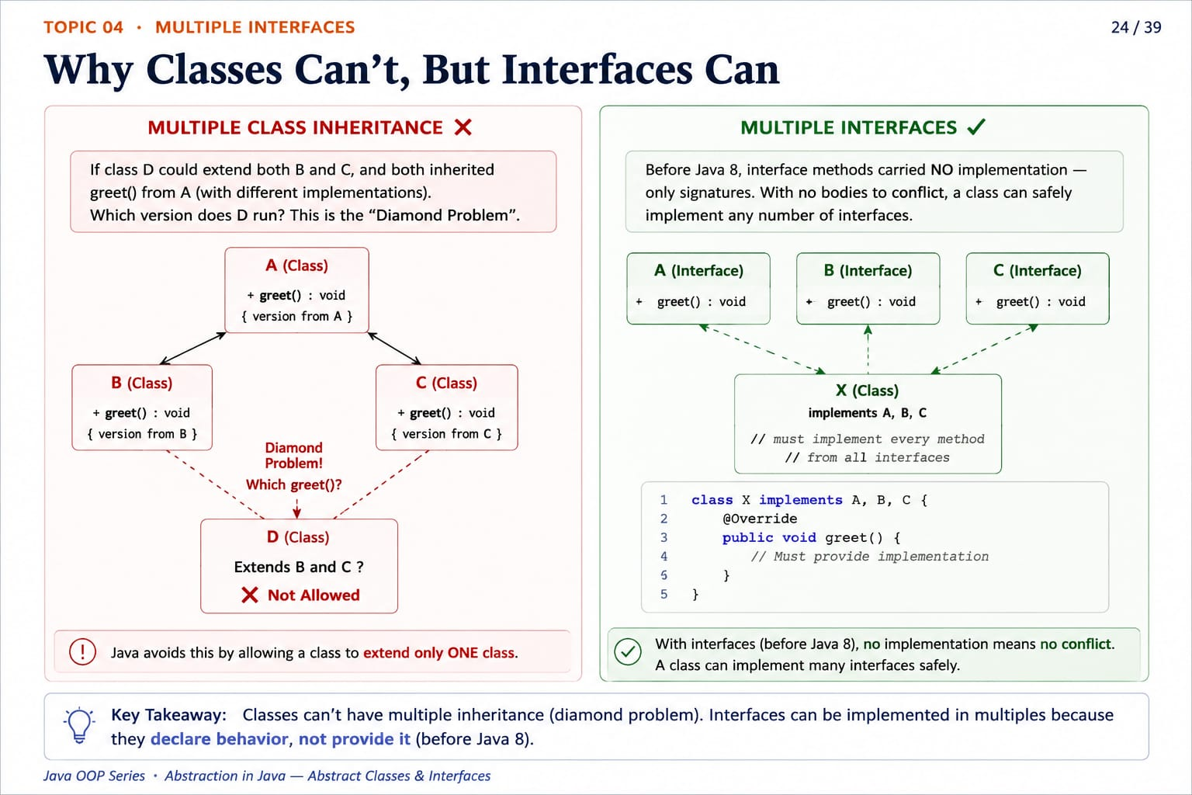

Slide 28
TOPIC 04 · MULTIPLE INTERFACES
25 / 39
Code Example — A Duck Can Fly AND Swim
Duck.java
Output
1
interface Flyable {
1
Duck flies
2
void fly();
2
Duck swims
3
}
4
interface Swimmable {
CALLING IT
5
void swim();
6
}
1
Duck d = new Duck();
2
d.fly();
7
class Duck implements Flyable, Swimmable {
3
d.swim();
8
public void fly() {
9
System.out.println("Duck flies"); }
10
public void swim() {
11
System.out.println("Duck swims"); }
12
}
Java OOP Series · Abstraction in Java — Abstract Classes & Interfaces

Slide 29
TOPIC 04 · MULTIPLE INTERFACES
26 / 39
Multiple Interfaces — Don't Forget
1
No limit
2
Implement everything
There is no limit to how many interfaces a single class may implement.
Every abstract method from every implemented interface must be provided.
3
Shared signatures
4
Qualify name clashes
If two interfaces share an identical abstract method signature, one implementation satisfies both.
Constant name clashes across interfaces must be qualified: InterfaceName.CONSTANT.
Java OOP Series · Abstraction in Java — Abstract Classes & Interfaces

Slide 30
TOPIC 05 OF 06 · ABSTRACT CLASSES & INTERFACES
05
DEFAULT & STATIC METHODS (JAVA 8)
Default & Static Interface Methods
Java 8 let interfaces evolve without breaking existing implementing classes
default methods carry a body and are inherited automatically
static methods belong to the interface itself — called via the interface name
27 / 39

Slide 31
TOPIC 05 · JAVA 8
28 / 39
Default Methods — Why & How
THE PROBLEM: before Java 8, adding any method to a published interface broke every class that already implemented it.
THE FIX: default methods — an interface method WITH a body, inherited automatically and optionally overridable.
KEY POINTS
Vehicle.java
default keyword goes before the return type
Method HAS a body, just like a normal method
Implementing classes inherit honk() automatically
Overriding it is optional, not required
1
interface Vehicle {
2
void start();
3
default void honk() {
4
System.out.println("Beep!");
5
}
6
}
Java OOP Series · Abstraction in Java — Abstract Classes & Interfaces

Slide 32
TOPIC 05 · JAVA 8
29 / 39
The Diamond Problem Returns — & Its Fix
class Car implements Vehicle, Alarm ✖
Both interfaces default honk() differently — which one wins?
Compile-time error: Java forces an explicit resolution.
Car.java
1
class Car implements Vehicle, Alarm {
2
public void honk() {
3
Vehicle.super.honk();
4
System.out.println("Custom!");
5
}
6
}
1
Must override
2
InterfaceName.super
3
Mix or replace
The class is REQUIRED to provide its own honk() once a conflict exists.
Lets you explicitly call a specific interface's default implementation.
Combine both parents' logic, pick one, or write something entirely new.
Java OOP Series · Abstraction in Java — Abstract Classes & Interfaces

Slide 33
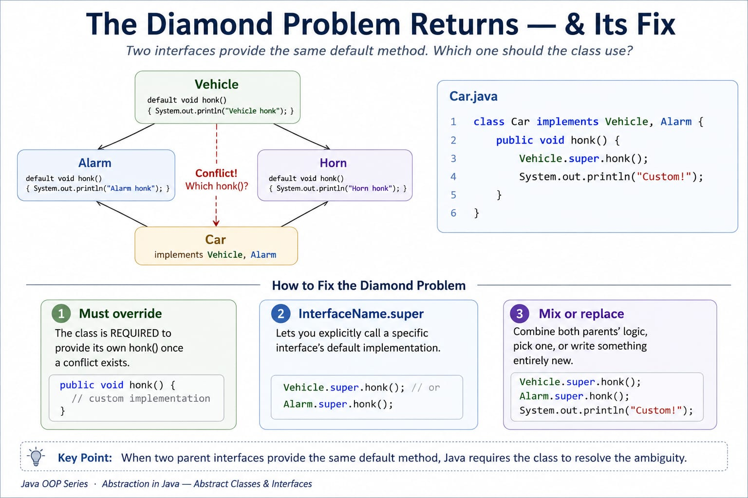

Slide 34
TOPIC 05 · JAVA 8
30 / 39
Static Methods in Interfaces
RULES
MathOps.java
Must have a method body
Called as InterfaceName.method(), never obj.method()
NOT inherited by implementing classes
Cannot be overridden — only re-declared elsewhere
1
interface MathOps {
2
static int square(int n) {
3
return n * n;
4
}
5
}
6
// usage: MathOps.square(5);
A static interface method belongs to the INTERFACE itself — useful for factory or validation helpers closely tied to the interface's purpose.
Java OOP Series · Abstraction in Java — Abstract Classes & Interfaces

Slide 35
TOPIC 05 · JAVA 8
31 / 39
Default vs Static Interface Methods
Feature | default Method | static Method
Called via | Object reference (obj.method()) | Interface name (Interface.method())
Inherited by implementing class | Yes | No
Overridable | Yes, by implementing classes | No — only hidden/redeclared
Typical purpose | Common default behavior | Utility / factory helper methods
Java OOP Series · Abstraction in Java — Abstract Classes & Interfaces

Slide 36
TOPIC 06 OF 06 · ABSTRACT CLASSES & INTERFACES
06
ABSTRACT CLASS VS INTERFACE
Abstract Class vs Interface
When to choose which one?
What changed in Java 8?
Diamond problem — who handles it better?
32 / 39

Slide 37
TOPIC 06 · COMPARISON
33 / 39
Abstract Class vs Interface — At a Glance
Criterion | Abstract Class | Interface
Inheritance | extends — single only | implements — multiple allowed
Multiple inheritance | Not supported | Fully supported
Fields | Any type, any modifier, mutable | Implicitly public static final
Constructor | Yes — invoked via super() | No — cannot be instantiated
Concrete methods | Yes, freely | Only via default/static/private (8/9)
Relationship modeled | “is-a” with shared state | “can-do” capability / contract
Java OOP Series · Abstraction in Java — Abstract Classes & Interfaces

Slide 38
TOPIC 06 · DESIGN GUIDELINE
34 / 39
When to Reach for Each One
DO'S
DON'TS
Choose an abstract class when subclasses share real state and code (“is-a” hierarchy)
Choose an interface when unrelated classes need a common capability (“can-do”)
Reach for an interface when you need multiple inheritance of type
Don't use an abstract class just to share a couple of constants
Don't force unrelated classes into one hierarchy just to reuse a method
Don't assume Java 8 default methods make abstract classes obsolete
Java OOP Series · Abstraction in Java — Abstract Classes & Interfaces

Slide 39
TOPIC 06 · REAL-WORLD
35 / 39
Real Examples You Already Use
Abstract Classes in the JDK
Interfaces in the JDK
AbstractList — base for ArrayList, LinkedList
AbstractMap — base for HashMap, TreeMap
InputStream / OutputStream — I/O base classes
HttpServlet — base for web servlets
Comparable<T> — “can be compared” (compareTo)
Runnable — “can be run as a task” (run)
Serializable — “can be converted to bytes”
List, Map, Set — Collections Framework contracts
Java OOP Series · Abstraction in Java — Abstract Classes & Interfaces

Slide 40
PUTTING IT TOGETHER
36 / 39
Using an Abstract Class AND an Interface
ONE CLASS, TWO SOURCES
Dog.java
extends Animal → inherits eat() contract + breathe()
implements Trainable → adds train() + reward()
Dog gets the best of both worlds
1
abstract class Animal {
2
String name;
3
Animal(String n) { name = n; }
4
abstract void eat();
5
void breathe() { /* shared */ }
6
}
7
interface Trainable {
8
void train();
9
default void reward() { /* treat */ }
10
}
Output
11
class Dog extends Animal implements Trainable {
12
Dog(String n) { super(n); }
1
Rex is eating.
13
void eat() { /* ... */ }
2
Rex is breathing.
14
public void train() { /* ... */ }
3
Rex sits on command.
15
}
4
Good job! Treat.
Java OOP Series · Abstraction in Java — Abstract Classes & Interfaces

Slide 41
PUTTING IT TOGETHER
37 / 39
Quick Fire — Common Interview Questions
Q1
Can an abstract class have a constructor? Why is it useful if the class can't be instantiated?
Q2
Can an interface have instance (non-static) fields?
Q3
Can an abstract class implement an interface without implementing all its methods?
Q4
Why are interface fields implicitly public static final?
Q5
What happens if two implemented interfaces have a default method with the same signature?
Q6
Can a class be both abstract and final? Why or why not?
Java OOP Series · Abstraction in Java — Abstract Classes & Interfaces

Slide 42
WRAP-UP · RECAP
38 / 39
Key Takeaways
abstract keyword marks classes/methods as incomplete & non-instantiable
Abstract classes provide PARTIAL implementation — mix concrete & abstract
Interfaces declare a CONTRACT — implemented via the implements keyword
A class can implement MULTIPLE interfaces (no diamond problem, pre-Java 8)
default methods (Java 8) add backward-compatible behavior to interfaces
static methods (Java 8) are interface-level utilities, not inherited
Choose abstract class for shared code & IS-A; interface for CAN-DO contracts
Java OOP Series · Abstraction in Java — Abstract Classes & Interfaces

Slide 43
THANK YOU
Questions on Abstract Classes & Interfaces?
NEXT IN THE SERIES
Week 5 — Polymorphism Deep Dive: Method Overloading vs Overriding, Dynamic Method Dispatch
Department of Computer Engineering & Applications · Java OOP Series · prajnixlabs.in

