Slide 1
CS Fundamentals | OOP Series
Java Strings
Comprehensive Student Notes — CharSequence, Immutability, String Pool & Methods
Immutability
String Pool
StringBuffer
StringBuilder
Tokenizer
Methods
Interview Q&A
MCQ
// Java String — sequence of chars
String name = "GLA University";
// Immutable — new object created
name = name.concat(" Mathura");
System.out.println(name.length()); // 20
System.out.println(name.charAt(0)); // G
System.out.println(name.toUpperCase());
✓ Immutable — value cannot change after creation
✓ Stored in String Constant Pool (if literal)
✓ Each char stored in 16-bit UTF-16 encoding
✓ Implements CharSequence & Serializable
✓ Rich API: 50+ built-in methods
Department of Computer Applications | GLA University, Mathura

Slide 2
Table of Contents
01
What is a String?
Definition, UTF-16, memory layout
08
String Methods Part 1
length, charAt, concat, equals
02
String Creation
Literal vs new keyword, String Pool
09
String Methods Part 2
toUpperCase, toLowerCase, substring
03
CharSequence Interface
Hierarchy and implementing classes
10
String Methods Part 3
trim, indexOf, startsWith, endsWith
04
String · StringBuffer · StringBuilder
Properties, syntax, when to use
11
Interview Questions
Top 10 most-asked interview Q&As
05
StringTokenizer
Breaking strings into tokens (+ figure)
12
MCQ — Set 1
Questions 1 to 3 with answer keys
06
Immutable Strings
Why strings are immutable, examples
13
MCQ — Set 2
Questions 4 to 6 with answer keys
07
String vs StringBuffer
Full feature-by-feature comparison

Slide 3
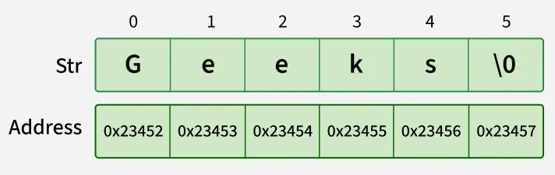
1 · What is a String?
In Java, a String is an object that stores a sequence of characters enclosed in double quotes.
Each character is stored in 16 bits using UTF-16 encoding.
🔒
📦
📝
⚡
Immutable
Object Type
UTF-16
Array of Chars
Once created, the value cannot be changed. Any modification creates a new String object.
A String is an object (not a primitive). It lives in heap or String Constant Pool.
Every character occupies 16 bits. Supports full Unicode — letters, emoji, symbols.
Internally acts like a char[] array. Index 0 = first character, index n-1 = last.
Memory Layout of a String (Figure from Document):
Str "Geeks" occupies 6 × 16-bit cells at contiguous memory addresses.

Slide 4
2 · Ways to Create a String
Method 1 — String Literal (Static Memory / String Constant Pool)
Memory Model
STACK
STRING
CONSTANT POOL
String str = "GLA University";
// JVM checks String Pool first — reuses if exists
str →
"GLA University"
Method 2 — Using new Keyword (Heap Memory)
str2 →
String str = new String("Welcome");
// Always creates new object in heap (non-pool)
HEAP (non-pool)
"Welcome"
String Literal: JVM first checks if the same string exists in the pool. If yes, reuses same object (memory efficient).
new String(): JVM always creates a new object in heap (non-pool). The literal also goes into pool separately.
Prefer string literals for memory efficiency. Use new String() only when you explicitly need a heap copy.

Slide 5
3 · CharSequence Interface & Implementing Classes
CharSequence is an interface in java.lang that represents a readable sequence of char values. It provides basic methods for working with character sequences.
Core Methods Provided
Class Hierarchy
length()
Returns the total number of characters
«interface»
CharSequence
charAt(int index)
Returns char at the specified position
subSequence(start, end)
Returns a sub-range of the sequence
String
StringBuffer
StringBuilder
StringTokenizer
toString()
Converts the sequence to a String
Immutable
Thread-safe
Faster
Tokenize
// String
String s = "gla";
// StringBuffer (thread-safe)
StringBuffer sb = new StringBuffer("GLA");
// StringBuilder (single-threaded)
StringBuilder sq = new StringBuilder();
sq.append("GFG");
💡 All four classes implement CharSequence, which means they can be used interchangeably wherever a CharSequence is expected — e.g., in String.contains(CharSequence s).

Slide 6
4 · String · StringBuffer · StringBuilder
String
StringBuffer
StringBuilder
▸ Immutable — value cannot change
▸ Mutable — modify in place
▸ Mutable — modify in place
▸ Thread-safe (effectively)
▸ Thread-safe (synchronized)
▸ NOT thread-safe (no sync)
▸ Stored in String Constant Pool
▸ Stored in Heap memory
▸ Stored in Heap memory
▸ Creates new object on every change
▸ No new object on modification
▸ Faster than StringBuffer
▸ Best for fixed/constant text
▸ Best for multi-threaded programs
▸ Best for single-threaded programs
String s = "Hello";
s.concat(
" World"); // s unchanged!
s = s +
" World"; // new object
StringBuffer sb = new StringBuffer("Hi");
sb.
append(" World");
sb.
insert(0,"Start ");
StringBuilder sq = new StringBuilder();
sq.
append("Hello");
sq.
reverse(); // olleH

Slide 7
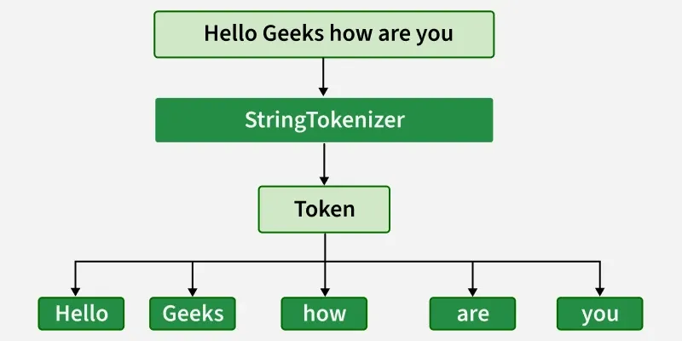
5 · StringTokenizer — Breaking Strings into Tokens
What is StringTokenizer?
StringTokenizer — Process Flow (Figure from Document):
StringTokenizer breaks a string into smaller pieces called tokens based on a delimiter (default: whitespace). It maintains a current position inside the string and advances token by token.
import java.util.StringTokenizer;
StringTokenizer st = new StringTokenizer("Java String Example");
while (st.hasMoreTokens()) {
System.out.println(st.nextToken());
}
// Output: Java | String | Example
💡 Useful Methods: hasMoreTokens() — checks if more exist | nextToken() — returns next token | countTokens() — total count remaining | nextToken(delim) — change delimiter on the fly.

Slide 8
6 · Immutable Strings in Java
In Java, String objects are immutable — once created, their value cannot be changed.
Any modification creates a new String object instead of modifying the original.
Memory Diagram
"Sachin" (Object 1)
Example 1 — Reference NOT reassigned (s stays "Sachin")
s →
String s = "Sachin";
s.concat(" Tendulkar"); // new object created, s ignores it
System.out.println(s); // prints: Sachin
new object created
"Sachin Tendulkar" (Object 2)
s still points to "Sachin" — NOT to the new object!
Example 2 — Reassign reference (s now points to new object)
Why Immutable?
String name = "Sachin";
name = name.concat(" Tendulkar"); // reassigned to new object
System.out.println(name); // prints: Sachin Tendulkar
✓ Security — can't modify passwords/URLs after passing ✓ String Pool — safe to share across threads ✓ Caching — hashCode computed once, reused ✓ Thread-safe — no synchronization needed

Slide 9
7 · String vs StringBuffer vs StringBuilder
Feature | String | StringBuffer | StringBuilder
Mutability | Immutable | Mutable | Mutable
Thread Safety | Safe (effectively) | ✓ Thread-safe (synchronized) | ✗ Not thread-safe
Performance | Slowest (on many changes) | Slower (sync overhead) | Fastest of three
Storage | String Constant Pool (literal) | Heap memory | Heap memory
Memory | New object per modification | Same object modified | Same object modified
Concatenation | + or concat() — creates new obj | append() — in-place | append() — in-place
Use when | Fixed/constant text values | Multi-threaded environment | Single-threaded, high perf.
Since Java | 1.0 | 1.0 | 1.5 (Java 5)
✓ Use String for constants, config values, display text
✓ StringBuffer for multi-thread
⚡ StringBuilder for best performance

Slide 10
8 · String Methods — Part 1
import java.util.*; // always available from java.lang — no import needed for String methods
length()
charAt(index)
concat(str)
Returns number of characters
Returns char at given index (0-based)
Joins two strings together
String s = "Hello";
s.length();
// → 5
String s = "Hello";
s.charAt(
1); // → e
String s1 = "Hello";
s1.concat(
"World"); // → HelloWorld
equals(str)
equalsIgnoreCase(str)
Compares content of two strings
Compares strings ignoring case
"Java".equals("Java"); // → true
"java"
.equals("Java"); // → false
"java".equalsIgnoreCase("JAVA"); // → true
🚨 NEVER use == to compare Strings. Use .equals() for content comparison. == checks memory addresses, not values.

Slide 11
8 · String Methods — Part 2
toUpperCase()
toLowerCase()
replace(old, new)
Converts all chars to uppercase
Converts all chars to lowercase
Replaces characters or substrings
"hello".toUpperCase(); // → HELLO
"HELLO".toLowerCase(); // → hello
"Java".replace('a', 'o');
// → Jovo
substring(s, e)
contains(seq)
replace() variants
Extracts from index s to e (e excluded)
Checks if string contains given text
// Replace char with char:
"Java".replace('a','o');
// → Jovo
// Replace substring:
"I love cat".replace(
"cat","dog");
// → I love dog
"Programming".substring(0, 6);
// → Progra
"Java Programming".contains("Java");
// → true

Slide 12
8 · String Methods — Part 3
trim()
indexOf()
endsWith()
Removes leading and trailing whitespace
Returns first occurrence index
Checks if string ends with given suffix
" Hello ".trim();
// → Hello
"Banana".indexOf('a');
// → 1
"Java Prog".endsWith("ing");
// → true
lastIndexOf()
startsWith()
Quick Summary
Returns last occurrence index
Checks if string starts with given prefix
• length() → size
• charAt(i) → char
"Banana".lastIndexOf('a');
// → 5
"Java Prog".startsWith("Java");
// → true
• concat() → join
• equals() → compare
• toUpperCase()
• substring(s,e)
• contains()
• replace()
• trim() → clean
• indexOf() → find

Slide 13
Top 10 Java String Interview Questions
Q1. Why are Strings immutable in Java?
Q6. What is String interning?
For security, caching hashCode, safe sharing in String Pool, and thread-safety without synchronization.
Using str.intern() places the string into the pool and returns the pool reference, enabling == comparison.
Q2. What is the String Constant Pool?
Q7. How does String concatenation work with +?
A special heap area where JVM stores String literals to reuse them and save memory.
Compiler converts + into StringBuilder.append() calls under the hood — especially in loops, this creates many temp objects.
Q3. Difference between == and .equals()?
Q8. When to use StringBuffer vs StringBuilder?
== compares memory addresses (references). .equals() compares actual character content.
StringBuffer in multi-threaded code (synchronized). StringBuilder in single-threaded code for better performance.
Q4. Difference: String, StringBuffer, StringBuilder?
Q9. What is charAt() and indexOf() difference?
String: immutable. StringBuffer: mutable + thread-safe. StringBuilder: mutable + faster (not thread-safe).
charAt(i) returns the character at index i. indexOf(ch) returns the index (position) of the first occurrence of ch.
Q5. Output of: String s="A"; s.concat("B"); print(s)?
Q10. Can a String be null? What happens if you call methods on null?
Prints A. concat() creates a new object but s still points to original "A" — immutability in action.
Yes, String can be null. Calling any method on a null reference throws NullPointerException at runtime.

Slide 14
MCQ — Set 1 (Multiple Choice Questions) Q1 – Q3
Q1. What is the default value of an uninitialized String variable?
Q2. What does "Hello".charAt(1) return?
Q3. Which method converts a String to uppercase?
A) "" (empty string)
A) 'H'
A) upper()
✓ B) null
✓ B) 'e'
B) toUpper()
C) 0
C) 'l'
✓ C) toUpperCase()
D) undefined
D) '1'
D) makeUpper()
Answer:
Answer:
Answer:
B) null — Reference types default to null in Java.
B) 'e' — Index starts at 0: H=0, e=1, l=2, l=3, o=4.
C) toUpperCase() — defined in java.lang.String.

Slide 15
MCQ — Set 2 (Multiple Choice Questions) Q4 – Q6
Q4. Output? String s="Sachin"; s.concat(" T"); System.out.println(s);
Q5. Which class is thread-safe for mutable string operations?
Q6. What does "Java".substring(1, 3) return?
A) Sachin T
A) String
"A) "Jav"
✓ B) Sachin
B) StringBuilder
B) "ava"
C) T
✓ C) StringBuffer
✓ C) "av"
D) Compile Error
D) StringTokenizer
D) "va"
Answer:
Answer:
Answer:
B) Sachin — Strings are immutable. concat() creates new object; s still points to "Sachin".
C) StringBuffer — It is synchronized (thread-safe). StringBuilder is NOT synchronized.
C) "av" — substring(1,3) extracts index 1 to 2 (end index 3 is EXCLUDED).

