Slide 1
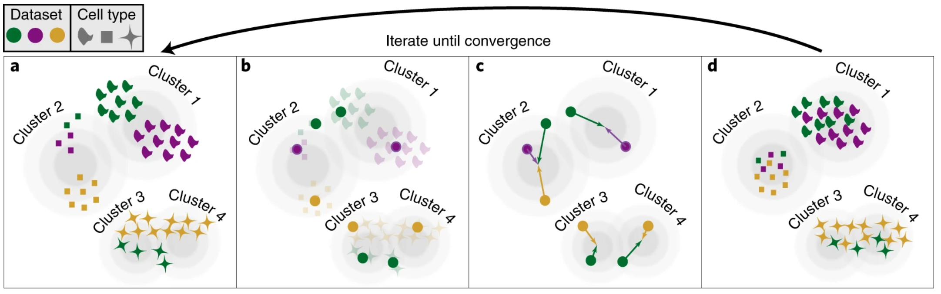
Integration
Before
After

Slide 2
Harmony at a glance
Assign cells to multiple clusters - maximise diversity of datasets within each cluster
Calculate global centroid for each cluster and dataset-specific centroids for each cluster
Within each cluster, calculate a correction factor for each dataset based on the centroids
Correct each cell with a cell-specific factor: combination of dataset correction factors and cell’s cluster assignments

Slide 3
Input
Cells embedded in lower dimensional space I.e. a matrix of cells (rows) and top N PCs (columns).
Metadata assigning each cell to its respective dataset and possibly to other covariates
Parameters
Number of clusters
Sigma: How much weight we want to give to distance of a cell from cluster centroids
Theta: How much weight we want to give to cluster diversity
Lambda: Shrinkage of dataset coefficients (how heavily we want to correct)
Output
Same embedding as input with coordinates corrected to remove batch effect(s)

Slide 4
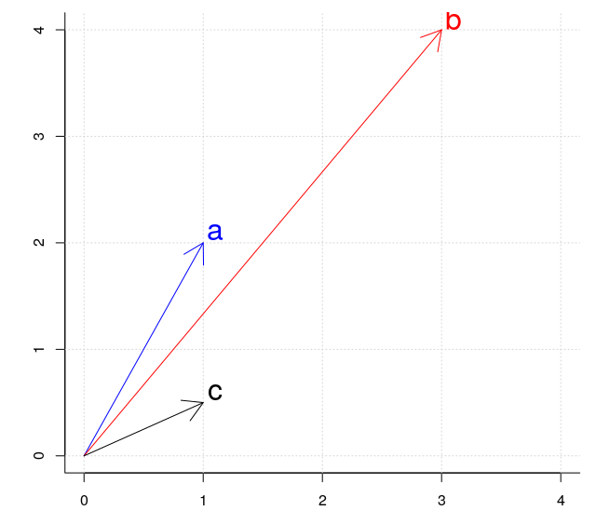
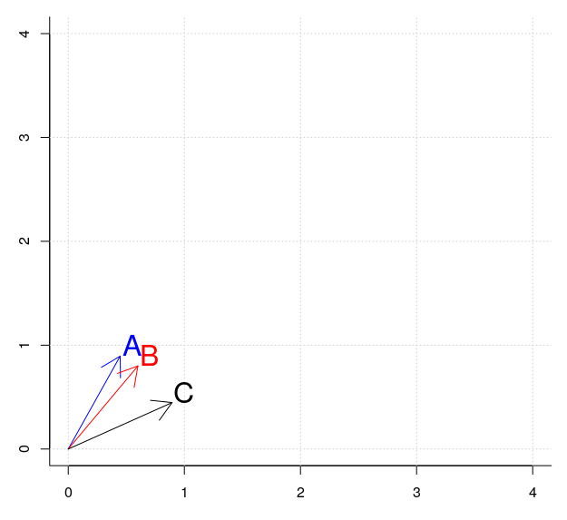
Cosine distance

Slide 5
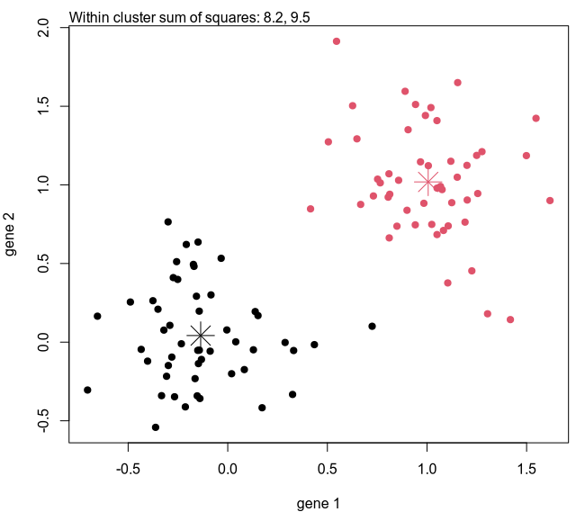
Vanilla k-means clustering Minimize sum of square distance between cells and centroid
kmeans(x, 2)

Slide 6
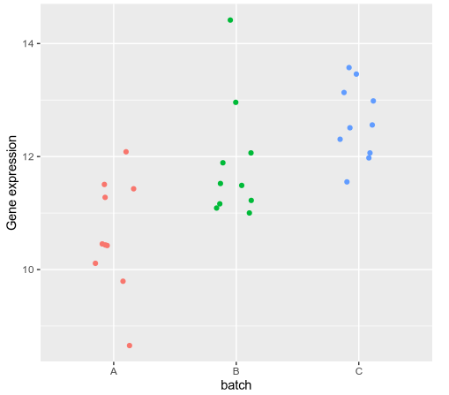
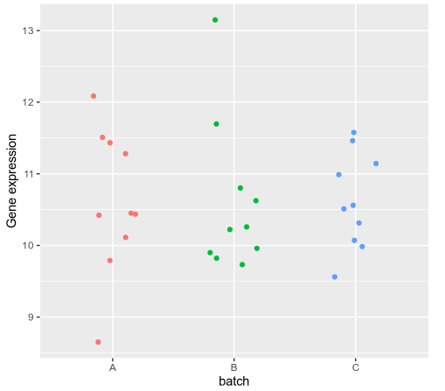
Regress-out (a.k.a. normalization, adjust-for, correct)
fit <- lm(gex ~ batch, data=dat)
Coefficients:
Estimate
(Intercept) 10.617
batchB 1.265
batchC 1.995
Corrected A = gex
Corrected B = gex - batchB
Corrected C = gex - batchC

Slide 7
