Slide 1
Quenched Bond Disorder in Non-Collinear Magnets
Santanu Dey
Technische Universität Dresden

Slide 2
Content
Quenched disorder: Random fields
  Random fields and the Imry-Ma criterion.
  Separate lower critical dimension for discrete and continuous symmetry.
Quenched disorder: Random couplings
  Bond disorder in frustrated non-collinear magnets.
  Rigid in-commensurability domains.
An example
  Disordered triangular lattice Heisenberg antiferromagnet.
  Experiments on related systems

Slide 3
Quenched Disorder: Random Fields
Lower critical dimensions

Slide 4


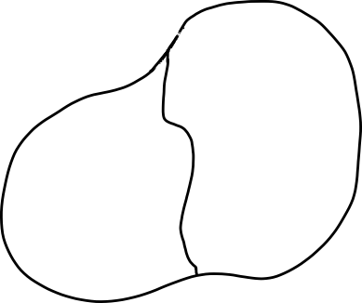
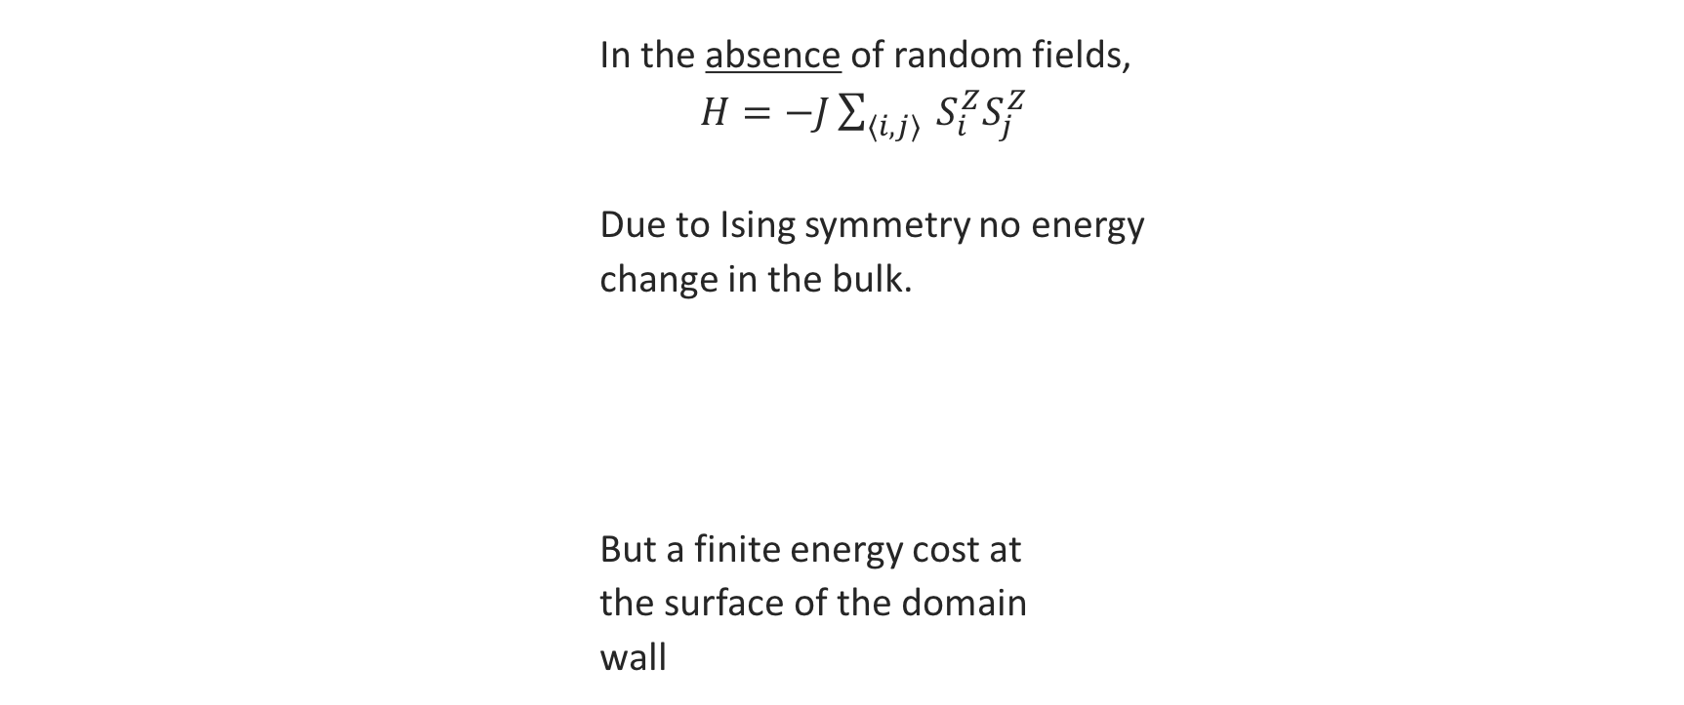
Random fields and the Imry-Ma criterion
A simple picture with Ising spins:
      In the absence of random fields,
      $H=−J\sum_{⟨i,j⟩}{ S_{i}^{Z}S_{j}^{Z}}$
      Due to Ising symmetry no energy
      change in the bulk.
      But a finite energy cost at
      the surface of the domain
      wall
$$∆E_{bulk}\sim 0$$
$$∆E_{surface}\sim L^{d−1}$$

Slide 5
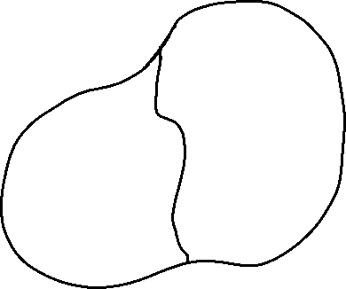



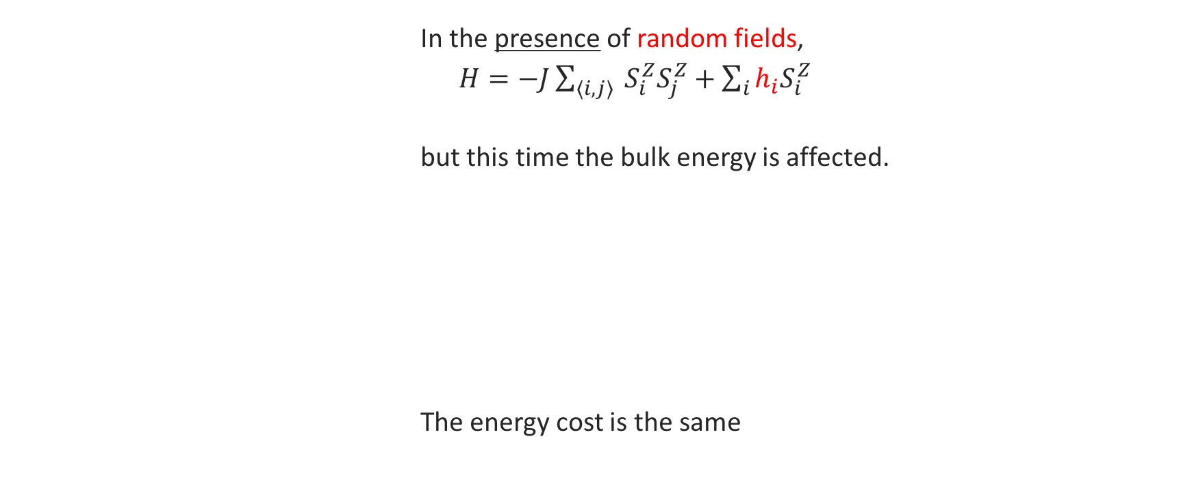
Random fields and the Imry-Ma criterion
A simple picture with Ising spins:
      In the presence of random fields,
      $H=−J\sum_{⟨i,j⟩}{ S_{i}^{Z}S_{j}^{Z}}+\sum_{i}{h_{i}S_{i}^{Z}}$
      but this time the bulk energy is affected.
      The energy cost is the same
$$∆E_{bulk}\sim \sum_{i}{h_{i}ΔS_{i}^{Z}}\sim \sum_{i}{h_{i}}< |\sum_{i}{h_{i}|}∼L^{\frac{d}{2}}$$
A “typical value” for
possible energy gain.
$$\overline{h}$$
$$∆E_{surface}\sim L^{d−1}$$

Slide 6

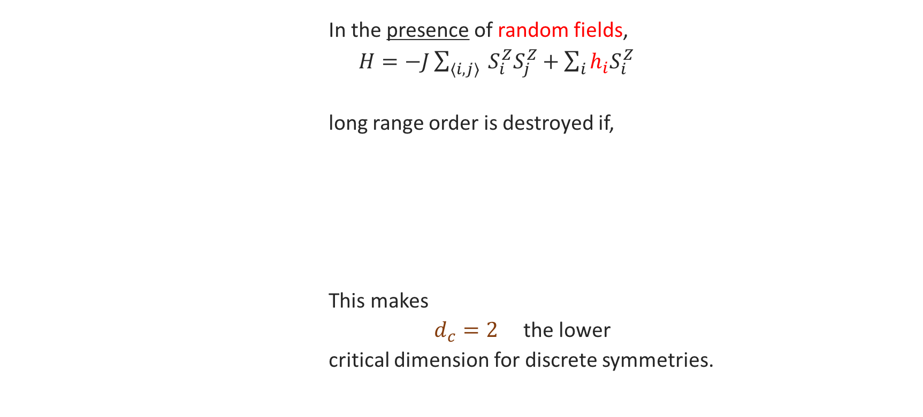
Random fields and the Imry-Ma criterion
A simple picture with Ising spins:
      In the presence of random fields,
      $H=−J\sum_{⟨i,j⟩}{ S_{i}^{Z}S_{j}^{Z}}+\sum_{i}{h_{i}S_{i}^{Z}}$
      long range order is destroyed if,
      This makes
      $d_{c}=2$ the lower
      critical dimension for discrete symmetries.
$$∆E_{bulk}≥∆E_{surface}⟹ L^{\frac{d}{2}}≥L^{d−1}⟹ d≤2$$
Favoured!
Y. Imry and S.-k. Ma, Phys. Rev. Lett. 35, 1399 (1975)
G. Grinstein and Shang-keng Ma, Phys. Rev. Lett. 49, 685 (1982)

Slide 7

Random fields and the Imry-Ma criterion
Rough domain walls:
Domain walls can be rough and ill defined
Domain wall thickness scales as,
$w_{d}\left(L\right)∝L^{\frac{5−d}{2}}$
implying that for $L≤3$ domain walls thickness, $w_{d}\left(L\right)≫L$, which, once included in the energy estimate gives a critical dimension,
$d_{c}=3$ [1,2]
But an even more careful analysis shows that the scaling is in fact,
$w_{d}\left(L\right)∝L^{\frac{5−d}{3}}$
for $d>2$, the ratio $\frac{w}{L}→0$ , implying, $d_{c}=2$ [3]
[1] E. Pytte, Y. Imry, and D. Mukamel,Phys. Rev. Lett. 46, 1173 (1981)
[2] K. Binder, Y. Imry, and E. Pytte, Phys. Rev. B 24, 6736(R) (1981)
[3] G. Grinstein and Shang-keng Ma, Phys. Rev. Lett. 49, 685 (1982)

Slide 8

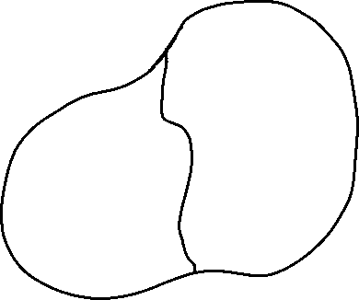
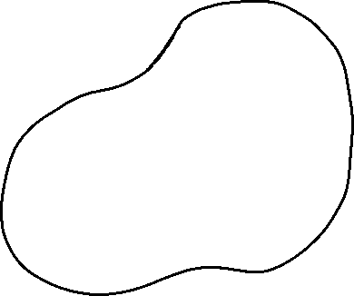




Random fields and the Imry-Ma criterion
For continuous symmetries:
      A random field Heisenberg model for illustration,
      $H=−J\sum_{⟨i,j⟩}{ {\vec{S}}_{i}.{\vec{S}}_{j}}+\sum_{i}{{\vec{h}}_{i}.{\vec{S}}_{i}}$
      Order parameter can smoothly vary
      between domains, costing less
      energy
      So the lower critical dimension
      for continuous symmetries is,
$$∆E_{bulk}\sim L^{d/2}$$
$$∆E_{surface}\sim L^{d−2}$$
$$d_{c}=4$$
$$L$$
Y. Imry and S.-k. Ma, Phys. Rev. Lett. 35, 1399 (1975)
$$ΔE_{surface}=∫d^{d}x{∇θ}^{2}\sim L^{d−2}$$

Slide 9
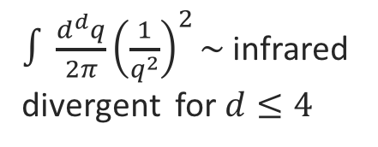



Random fields and the Imry-Ma criterion
Goldstone modes and infrared divergence:
The order parameter field couples with the random fields, $\overline{h_{r}h_{r^{′}}}=h_{0}^{2}δ_{rr^{′}}$
$$\sum_{r}{h_{r}φ_{r} }$$
This leads order parameter fluctuation
$$〈φ_{r}〉=\sum_{r^{′}}{h_{r^{′}}〈φ_{r}φ_{r^{′}}〉=\sum_{r^{′}}{h_{r^{′}}χ_{rr^{′}}}} \\ ⇒\overline{〈φ_{r}^{2}〉}=h_{0}^{2}\int{\frac{d^{d}q}{{\left(2π\right)}^{d}}χ{\left(q\right)}^{2}}$$
Hence, the lower critical dimension for random field systems with continuous symmetry is,
$$d_{c}=4$$
$∫\frac{d^{d}q}{2π}{\left(\frac{1}{q^{2}}\right)}^{2}\sim$ infrared divergent for $d≤4$
Goldstone modes, $χ\left(q\right)∼\frac{1}{q^{2}}$
Y. Imry and S.-k. Ma, Phys. Rev. Lett. 35, 1399 (1975)
A. Aharony, Solid State Comm., 28, 8, 667 (1978)

Slide 10
Quenched Disorder: Random Couplings
Lower critical dimension of disordered non-collinear magnets: Infrared divergence

Slide 11
Single bond impurity
Local reorientation for non-collinear magnets
In a non-collinear Heisenberg antiferromagnet
In a collinear Heisenberg antiferromagnet
Bond disorder is weaker and it does not break time reversal invariance.

Slide 12

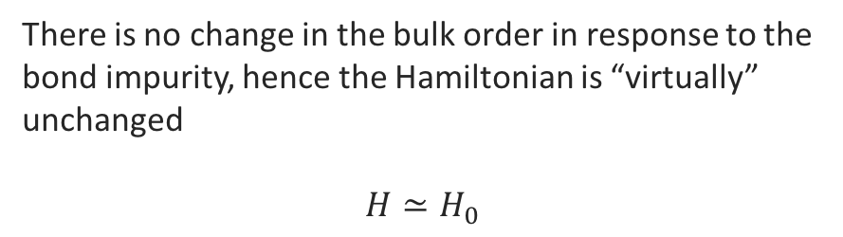

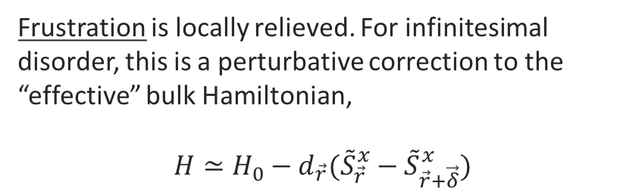









Single bond impurity
Local reorientation for non-collinear magnets
In a non-collinear magnet
In a collinear magnet
$$\tilde{z}$$
$$+ΔJ$$
$$\tilde{z}$$
$$+ΔJ$$
$$\tilde{x}$$
$$∼h_{\vec{r}}$$
$$\tilde{x}$$
$$\tilde{x}$$
$$\tilde{z}$$
$$\tilde{x}$$
$$\tilde{z}$$
Frustration is locally relieved. For infinitesimal disorder, this is a perturbative correction to the “effective” bulk Hamiltonian,
$$H≃H_{0}−d_{\vec{r}}({\tilde{S}}_{\vec{r}}^{x}−{\tilde{S}}_{\vec{r}+\vec{δ}}^{x})$$
There is no change in the bulk order in response to the bond impurity, hence the Hamiltonian is “virtually” unchanged
$$H≃H_{0}$$

Slide 13






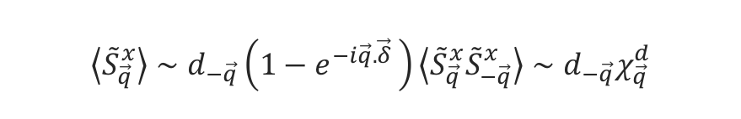
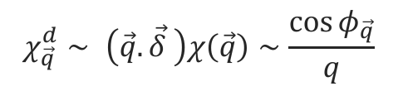
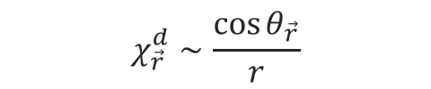
Single bond impurity
Dipolar response for the Goldstone modes
In a non-collinear magnet
In a linear response approximation this leads to finite expectation value of transverse spin fluctuation.
If we consider the Goldstone modes, $\left\langle {\tilde{S}}_{\vec{q}}^{x}{\tilde{S}}_{−\vec{q}}^{x}\right\rangle =χ\left(\vec{q}\right)∼\frac{1}{q^{2}}$ , the response is dipolar,
In 2D, the real space response is also dipolar
$$\left\langle {\tilde{S}}_{\vec{r}}^{x}\right\rangle ∼d_{{\vec{r}}^{′}}\left(\left\langle {\tilde{S}}_{\vec{r}}^{x}{\tilde{S}}_{{\vec{r}}^{′}}^{x}\right\rangle −\left\langle {\tilde{S}}_{\vec{r}}^{x}{\tilde{S}}_{{\vec{r}}^{′}+\vec{δ}}^{x}\right\rangle \right)$$
$$\tilde{z}$$
$$+ΔJ$$
$$∼d_{{\vec{r}}^{′}}χ_{\vec{r}{\vec{r}}^{′}}$$
$$∼h_{\vec{r}}$$
$$\tilde{x}$$
$$\left\langle {\tilde{S}}_{\vec{q}}^{x}\right\rangle ∼d_{−\vec{q}}\left(1−e^{−i\vec{q}. \vec{δ} }\right)\left\langle {\tilde{S}}_{\vec{q}}^{x}{\tilde{S}}_{−\vec{q}}^{x}\right\rangle ∼d_{−\vec{q}}χ_{\vec{q}}^{d}$$
$$\tilde{z}$$
$$\tilde{x}$$
Frustration is locally relieved. For infinitesimal disorder, this is a perturbative correction to the “effective” bulk Hamiltonian,
$$H≃H_{0}−d_{\vec{r}}({\tilde{S}}_{\vec{r}}^{x}−{\tilde{S}}_{\vec{r}+\vec{δ}}^{x})$$
$$χ_{\vec{q}}^{d}∼ \left(\vec{q}. \vec{δ} \right)χ\left(\vec{q}\right)∼\frac{\cos{φ_{\vec{q}}}}{q}$$
$$χ_{\vec{r}}^{d}∼\frac{\cos{θ_{\vec{r}}}}{r}$$

Slide 14
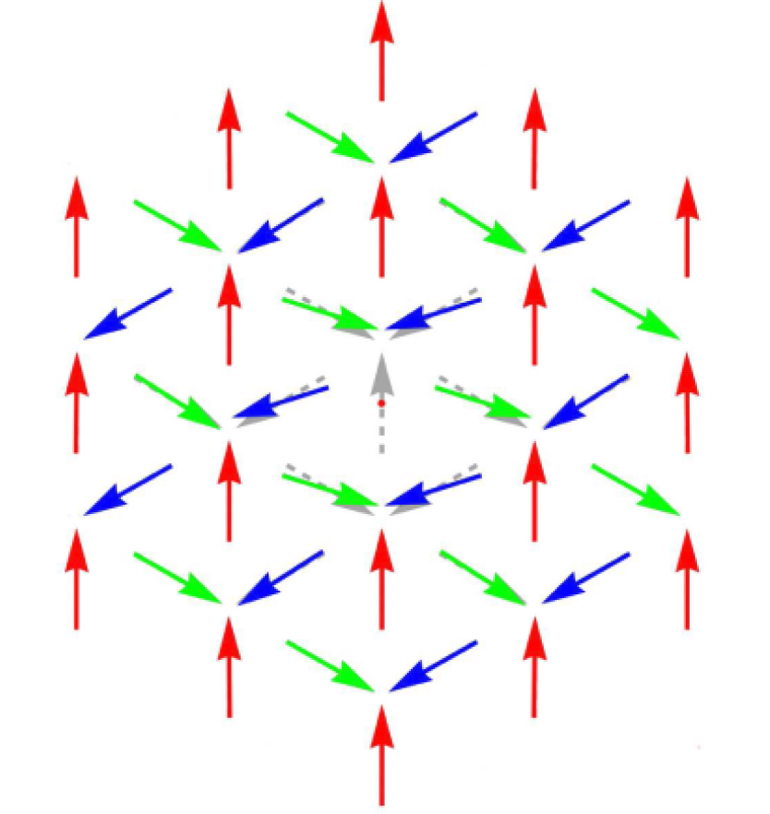
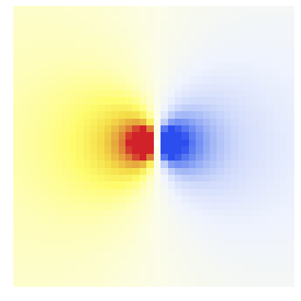
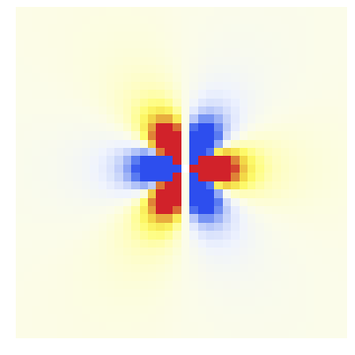


Single bond impurity
Dipolar response in 2D
Bond impurity: Dipolar response
$$δθ_{r}∼\frac{1}{r}$$
Vacancy: Octupolar response
$$δθ_{r}∼\frac{1}{r^{3}}$$
A. Wollny, L. Fritz, and M. Vojta, Phys. Rev. Lett. 107, 137204 (2011)

Slide 15





Concentration of bond impurity
Infrared divergence driven by disorder
Bond impurity: Dipolar response
  For a distribution of random bond impurities,
  For a disordered system, one expects the impurity magnitudes, $d_{\vec{r}}$ to be uncorrelated.
$$S_{\vec{r}}^{⊥}=\sum_{{\vec{r}}^{′}}{χ_{\vec{r}{\vec{r}}^{′}}^{d}d_{{\vec{r}}^{′}}}$$
$\overline{d_{\vec{r}}d_{\vec{r}′}}=d_{0}^{2}δ^{d}( \vec{r}− \vec{r}′)$
This implies that the transverse correlation has a divergent contribution,
$$\overline{{S_{\vec{r}}^{⊥}}^{2}}=d_{0}^{2}\sum_{\vec{r}′}{{χ^{d}}_{\vec{r} {\vec{r}}^{′}}^{2}}=d_{0}^{2}\int{\frac{d^{d}q}{{\left(2π\right)}^{d}}{χ^{d}}_{\vec{q}}^{2}}∼∫d^{d}q{\left(\frac{1}{q}\right)}^{2}$$
The integral diverges for $d≤2$.
Hence the lower critical dimension for bond disordered non-collinear magnets is,
$$d_{c}=2$$

Slide 16
Quenched Disorder: Random Couplings
The Energetics Argument for the Lower Critical Dimension

Slide 17
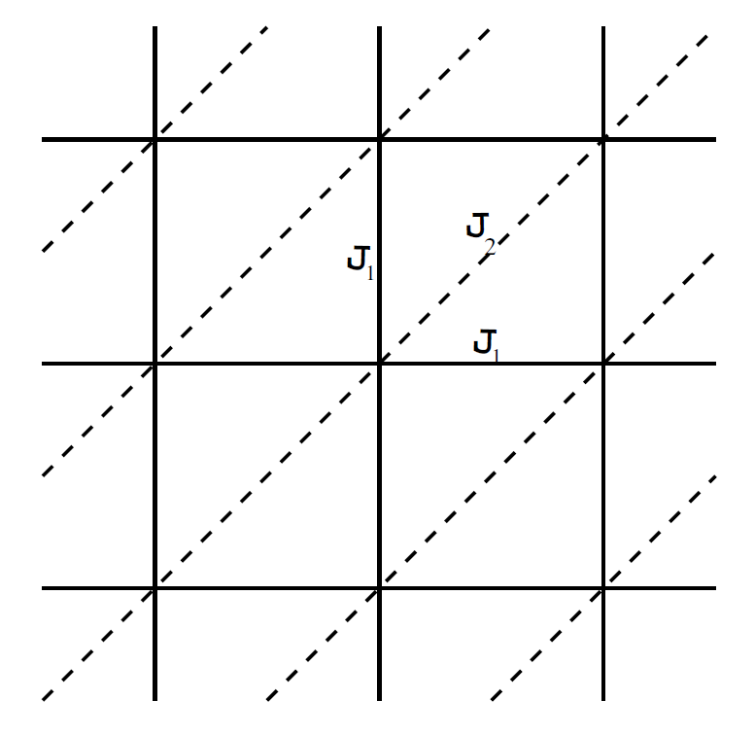


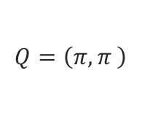
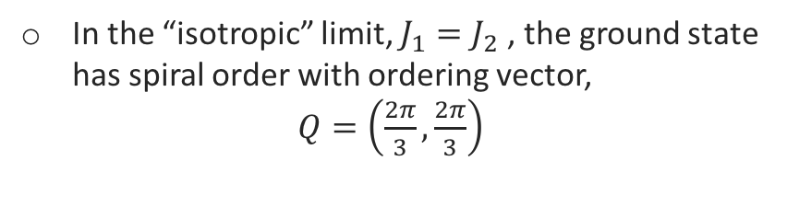
Incommensurability domains
Incommensurate order in non-collinear magnets
Our test system: The triangular lattice Heisenberg model
Claim: In a system with random couplings, some rare regions emerge with a particular bond anisotropy orientation.
$$\frac{J_{2}}{J_{1}}=\frac{1}{2}$$
Néel order
Spiral order
$$Q=\left(π,π \right)$$
$$Q=\left(\cos^{−1}{−\frac{J_{1}}{2J_{2}}},\cos^{−1}{−\frac{J_{1}}{2J_{2}}}\right)$$
In the “isotropic” limit, $J_{1}=J_{2}$ , the ground state has spiral order with ordering vector,
$Q=\left(\frac{2π}{3},\frac{2π}{3}\right)$
A. Yoshimori, J. Phys. Soc. Jpn. 14, 807 (1959)

Slide 18



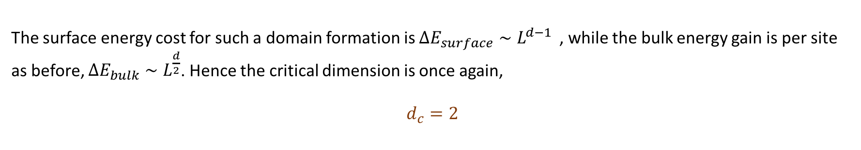
Incommensurability domains
Sharp domain boundaries
Rare regions with particular bond anisotropy:
In a lattice there is a discrete number of possible bond anisotropy orientation.
In a typical sample they define sharp domain walls
The incommensurate ordering vectors follow the suit
$$J_{2}>J_{1}$$
$$J_{1}>J_{2}$$
$$Q=\left(\cos^{−1}{−\frac{J_{1}}{2J_{2}}},\cos^{−1}{−\frac{J_{1}}{2J_{2}}}\right)$$
The surface energy cost for such a domain formation is $ΔE_{surface}∼L^{d−1 }$ , while the bulk energy gain is per site as before, $ΔE_{bulk}∼L^{\frac{d}{2}}$. Hence the critical dimension is once again,
$$d_{c}=2$$

Slide 19
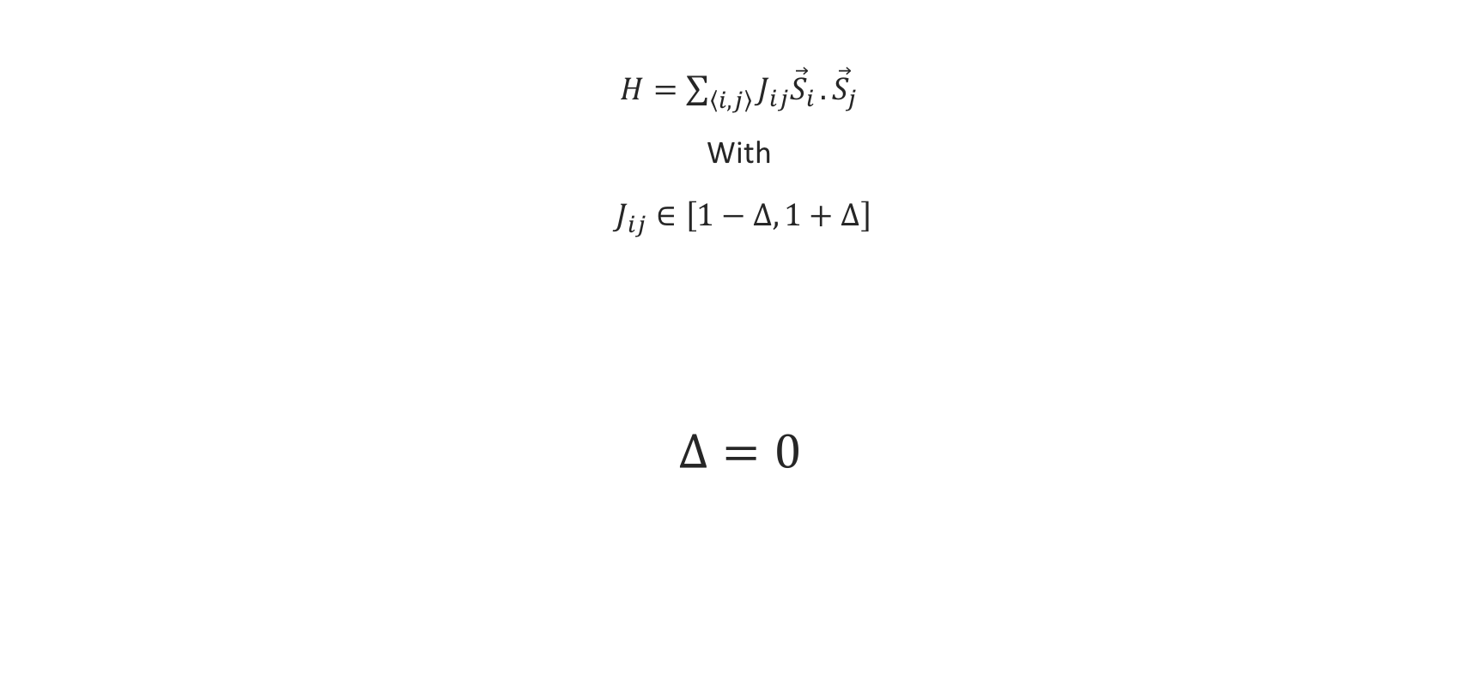
Incommensurability domains at d=2
Disordered triangular lattice Heisenberg model
$H=\sum_{〈i,j〉}{J_{ij}{\vec{S}}_{i}}.{\vec{S}}_{j}$
With
$J_{ij}∈\left[1−Δ,1+Δ\right]$
$$Δ=0$$

Slide 20
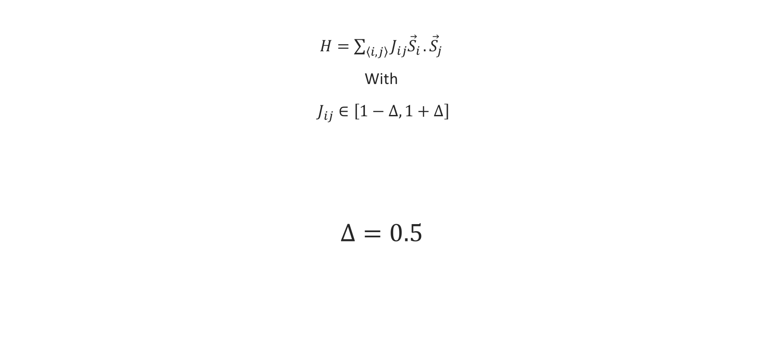
Incommensurability domains at d=2
Disordered triangular lattice Heisenberg model
$H=\sum_{〈i,j〉}{J_{ij}{\vec{S}}_{i}}.{\vec{S}}_{j}$
With
$J_{ij}∈\left[1−Δ,1+Δ\right]$
$$Δ=0.5$$

Slide 21
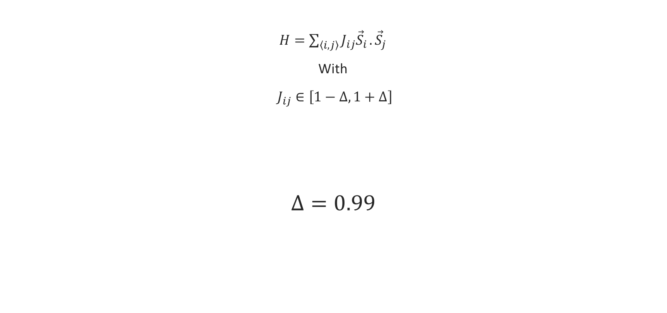
Incommensurability domains at d=2
Disordered triangular lattice Heisenberg model
$H=\sum_{〈i,j〉}{J_{ij}{\vec{S}}_{i}}.{\vec{S}}_{j}$
With
$J_{ij}∈\left[1−Δ,1+Δ\right]$
$$Δ=0.99$$
Domain size decreases with disorder!

Slide 22
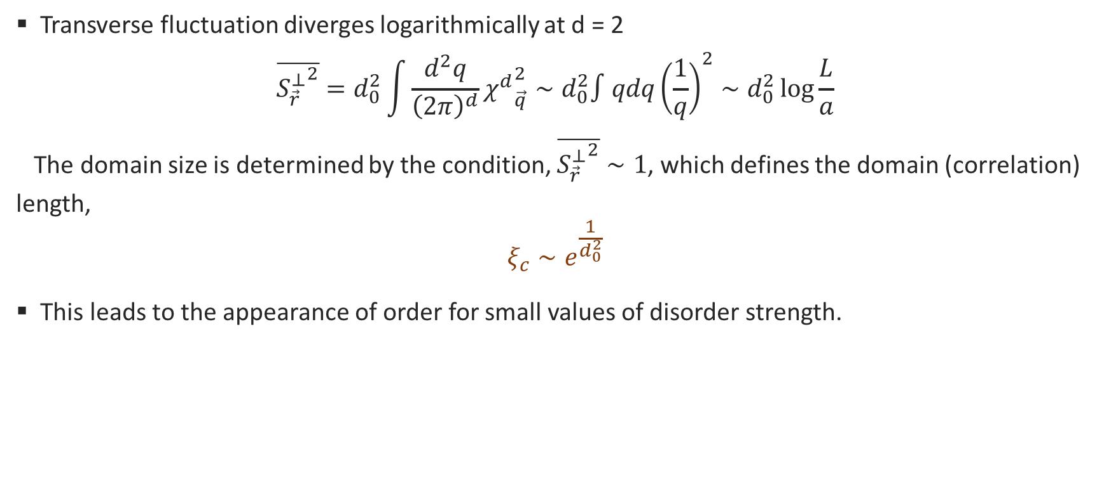
Properties at the critical dimension $d_{c}=2$
Logarithmic divergence
Transverse fluctuation diverges logarithmically at d = 2
$$\overline{{S_{\vec{r}}^{⊥}}^{2}}=d_{0}^{2}\int{\frac{d^{2}q}{{\left(2π\right)}^{d}}{χ^{d}}_{\vec{q}}^{2}}∼d_{0}^{2}∫qdq{\left(\frac{1}{q}\right)}^{2}∼d_{0}^{2}\log{\frac{L}{a}}$$
The domain size is determined by the condition, $\overline{{S_{\vec{r}}^{⊥}}^{2}}∼1$, which defines the domain (correlation) length,
$$ξ_{c}∼e^{\frac{1}{d_{0}^{2}}}$$
This leads to the appearance of order for small values of disorder strength.

Slide 23
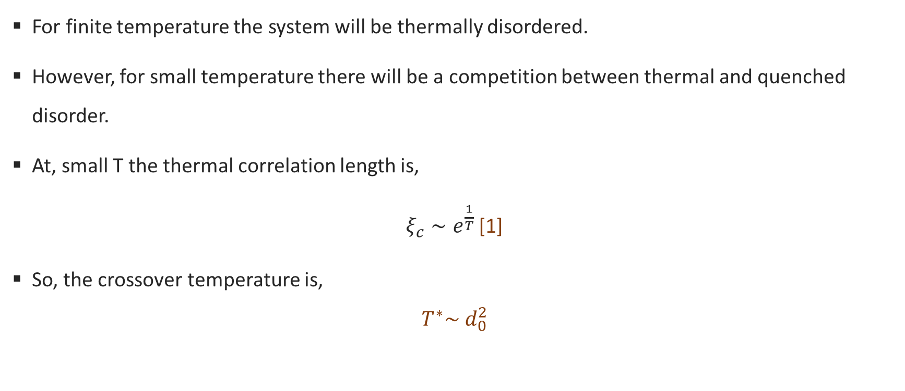
Properties at the critical dimension $d_{c}=2$
Finite temperature
For finite temperature the system will be thermally disordered.
However, for small temperature there will be a competition between thermal and quenched disorder.
At, small T the thermal correlation length is,
$ξ_{c}∼e^{\frac{1}{T}}$ [1]
So, the crossover temperature is,
$$T^{∗}\sim d_{0}^{2}$$
[1] S. Chakravarty, B. I. Halperin, and D. R. Nelson,Phys. Rev. B 39, 2344 (1989)

Slide 24
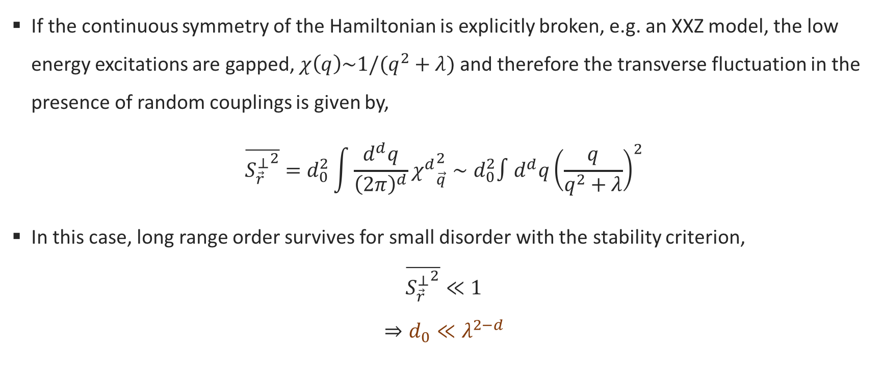
Beyond 2D
Gapped excitations
If the continuous symmetry of the Hamiltonian is explicitly broken, e.g. an XXZ model, the low energy excitations are gapped, $χ\left(q\right)\sim 1/(q^{2}+λ)$ and therefore the transverse fluctuation in the presence of random couplings is given by,
$$\overline{{S_{\vec{r}}^{⊥}}^{2}}=d_{0}^{2}\int{\frac{d^{d}q}{{\left(2π\right)}^{d}}{χ^{d}}_{\vec{q}}^{2}}∼d_{0}^{2}∫d^{d}q{\left(\frac{q}{q^{2}+λ}\right)}^{2}$$
In this case, long range order survives for small disorder with the stability criterion,
$$\overline{{S_{\vec{r}}^{⊥}}^{2}}≪1$$
$$⇒d_{0}≪λ^{2−d}$$

Slide 25
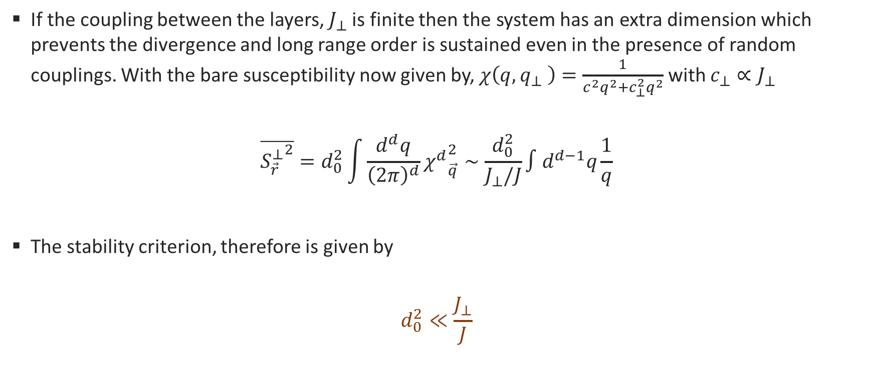
Beyond 2D
Layered quasi-2D system
If the coupling between the layers, $J_{⊥}$ is finite then the system has an extra dimension which prevents the divergence and long range order is sustained even in the presence of random couplings. With the bare susceptibility now given by, $χ\left(q,q_{⊥} \right)=\frac{1}{c^{2}q^{2}+c_{⊥}^{2}q^{2}}$ with $c_{⊥}∝J_{⊥}$
$$\overline{{S_{\vec{r}}^{⊥}}^{2}}=d_{0}^{2}\int{\frac{d^{d}q}{{\left(2π\right)}^{d}}{χ^{d}}_{\vec{q}}^{2}}∼\frac{d_{0}^{2}}{J_{⊥}/J}∫d^{d−1}q\frac{1}{q}$$
The stability criterion, therefore is given by
$$d_{0}^{2}≪\frac{J_{⊥}}{J}$$

Slide 26
An example
Microscopics and experiments on disordered triangular lattice antiferromagnet

Slide 27
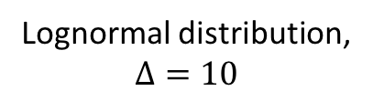

Disordered triangular lattice Heisenberg model
Disorder distribution
Disordered $J_{1}−J_{2}$ Heisenberg model
$$H=\sum_{〈i,j〉}{J_{ij}^{(1)}}{\vec{S}}_{i}.{\vec{S}}_{j}+α\sum_{〈〈i,j〉〉}{J_{ij}^{(2)}}{\vec{S}}_{i}.{\vec{S}}_{j}$$
with, $J_{ij}^{\left(1,2\right)}∈P(J,Δ)$
From weak to stronger disorder
  Rectangular distribution, $P\left(J,Δ\right)=\frac{1}{2Δ}, J∈[1−Δ,1+Δ]$
  Lognormal distribution, $P\left(J,Δ\right)=\frac{1}{\sqrt{2π} (Δ J)}e^{−\frac{{(log{J}−1)}^{2}}{2Δ^{2}}}$
Lognormal distribution,
$$Δ=10$$

Slide 28
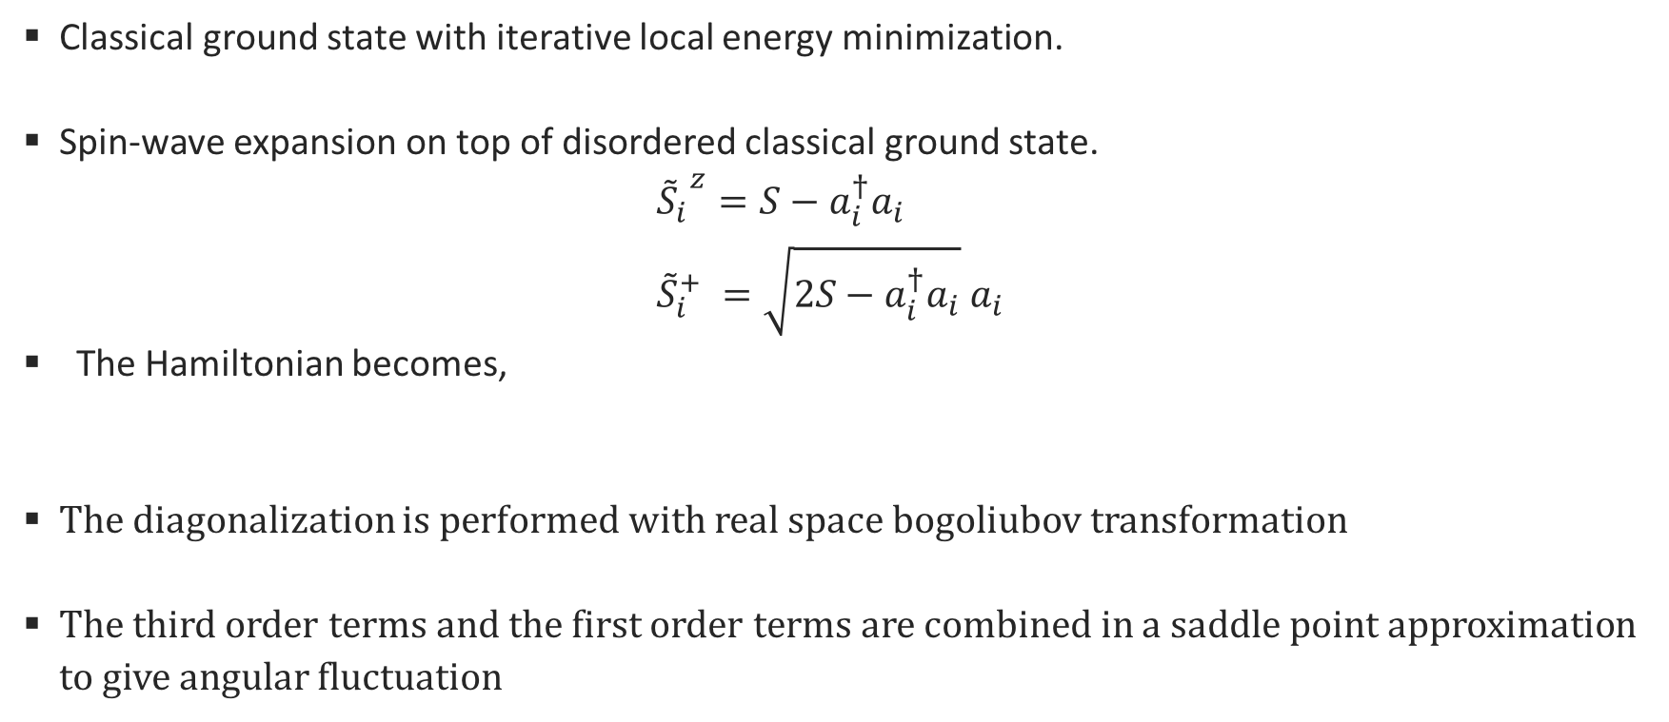
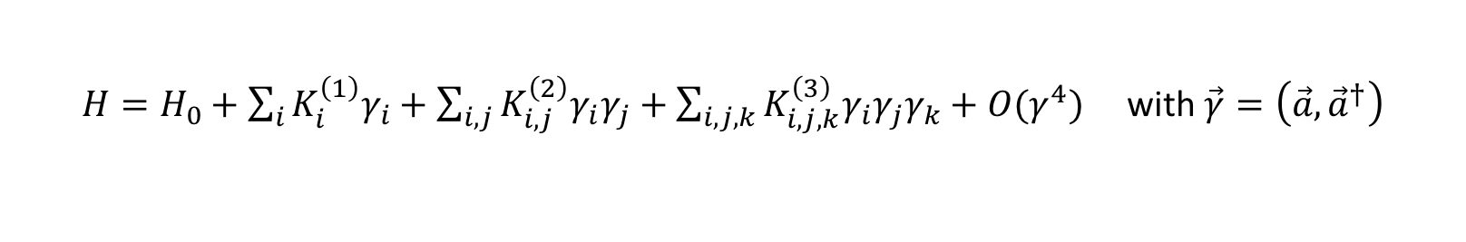
Disordered triangular lattice Heisenberg model
Spin-wave theory
Classical ground state with iterative local energy minimization.
  Spin-wave expansion on top of disordered classical ground state.
  $${{\tilde{S}}_{i}}^{z}=S−a_{i}^{†}a_{i} \\ {\tilde{S}}_{i}^{+} =\sqrt{2S−a_{i}^{†}a_{i}}{ a}_{i}$$
  The Hamiltonian becomes,
  The diagonalization is performed with real space bogoliubov transformation
  The third order terms and the first order terms are combined in a saddle point approximation to give angular fluctuation
  $H=H_{0}+\sum_{i}{K_{i}^{\left(1\right)}γ_{i}}+\sum_{i,j}{K_{i,j}^{\left(2\right)}γ_{i}γ_{j}}+\sum_{i,j,k}{K_{i,j,k}^{\left(3\right)}γ_{i}γ_{j}γ_{k}}+O(γ^{4})$ with $\vec{γ}=\left(\vec{a},{\vec{a}}^{†}\right)$

Slide 29
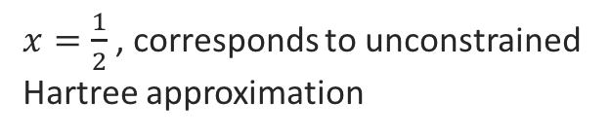

Disordered triangular lattice Heisenberg model
Mean-field theory
Slave fermion representation to capture the spin singlet formation.
$${\vec{S}}_{i}=\frac{1}{2}\sum_{α,β}{f_{iα}^{†}{\vec{σ}}_{α,β}f_{iβ}}$$
  Decoupling in both singlet and magnetic channel,
  With the mean-field parameters given by,
  $$2χ_{ij}^{NN(NNN)}=\left(1−x\right)\sum_{α}{J_{ij}f_{iα}^{†}f_{jα}}, {\vec{B}}_{i}=\frac{x}{2}\sum_{j∈NN,NNN,α,β}{f_{jα}^{†}{\vec{σ}}_{α,β}f_{jβ}} \\ \sum_{α}{f_{iα}^{†}f_{iα}}=1$$
  $$H=−\sum_{〈i,j〉,α}{\left(χ_{ij}^{NN}f_{iα}^{†}f_{jα}+h.c.+NNN\right)+\frac{1}{2}\sum_{i,α,β}{{\vec{B}}_{i}.f_{iα}^{†}{\vec{σ}}_{α,β}f_{iβ}}}$$
$x=\frac{1}{2}$ , corresponds to unconstrained Hartree approximation

Slide 30

Disordered triangular lattice Heisenberg model
Amplifying quantum effects
Structure factor $χ\left(Q\right)/L^{2}$

Slide 31

Disordered triangular lattice Heisenberg model
Disordered magnon modes
Dynamic structure factor $χ\left(ω, Q\right)$

Slide 32
Disordered triangular lattice Heisenberg model
Composite glass
Valence bonds at higher disorder

Slide 33
Disordered triangular lattice Heisenberg model
Composite glass
Valence bonds at higher disorder

Slide 34
Disordered triangular lattice Heisenberg model
Composite glass
Valence bonds at higher disorder

Slide 35



Experiments on triangular lattice
Spin-glass signature in $YbZnGaO_{4}$
Magnon modes
Thermal conductivity, $\frac{κ}{T}=\frac{κ_{0}}{T}+n T^{β−1}$
Ma et. al, arxiv:1709.00256 (2017)

Slide 36

Experiments on triangular lattice
Spin-glass signature in $YbZnGaO_{4}$
Very small non-phonon contribution $\frac{κ_{0}}{T}$
1000 times smaller than QSL candidate
$$EtMe_{3}Sb[Pd{\left(dmit\right)}_{2}]$$
It is postulated that disorder induced spin
Glass signature might explain this behavior.
Thermal conductivity, $\frac{κ}{T}=\frac{κ_{0}}{T}+n T^{β−1}$
Ma et. al, arxiv:1709.00256 (2017)

Slide 37
Summary
Random bond disorder destroys order in non-collinear magnets below or at the critical dimension 2.
However, relatively large domain sizes at the critical dimension creates a semblance of an ordered phase.
Quantum fluctuation makes the effect of disorder more pronounced.

Slide 38
Thank you!

