Slide 1
Basic Hangman Game
Gwen Lacovic

Slide 2
Introduction:
Hangman game that displays each letter guess (correct/wrong)
The game ends after either the word is guessed correctly, or player enters the maximum of 7 incorrect guesses
There is also stickman figure that is updated after each wrong guess from player

Slide 3
Project Details:
The ability to choose between single player or multiplayer
Single player has randomly selected word
Multiplayer can use entered or chosen word
Words limited to exactly six-letters in length
Stickman figure includes head outline, body, two arms, two legs, and head color fill

Slide 4
Three stages of program:
Start choice
Single player or Multiplayer
Hangman game

Slide 5
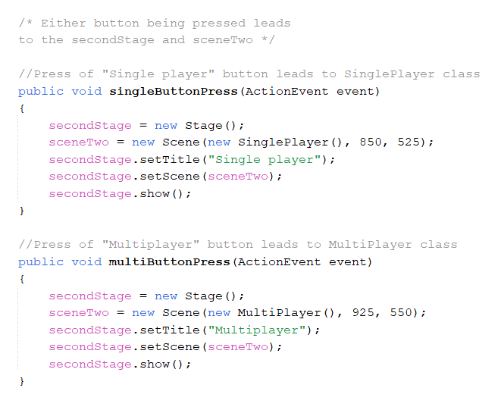
Stage 1: StartChoice
Two buttons (“Single player” and “Multiplayer”)
SinglePlayer or MultiPlayer is started with the second stage, based on either action event after one of the two buttons is pressed

Slide 6
Stage 2: SinglePlayer
One “Start Game” button
After the button press, a word is randomly selected in action event, and it leads to third stage hangman game
The wordOptions class contains an array with various six-letter words, and a generator to randomly select one

Slide 7
Stage 2: MultiPlayer
Text field for player to enter their own six-letter word
Or they can choose from one of the 18 provided buttons for example words
Either action event starts the third stage hangman game with selected word
Action event of text field does not work until user enters exactly six-letters
(Along with letters being the only characters in the input)

Slide 8
Stage 3: HangmanGame
Contains parts to play the game:
Text field for entering a single letter guess
“YES” button to confirm that guess after entered
If the guess is correct, letter is displayed in word label
If the guess is wrong, it is shown in area for the incorrect letters, and the stickman figure is updated as well
After game ends, tells the player if they won or lost

Slide 9
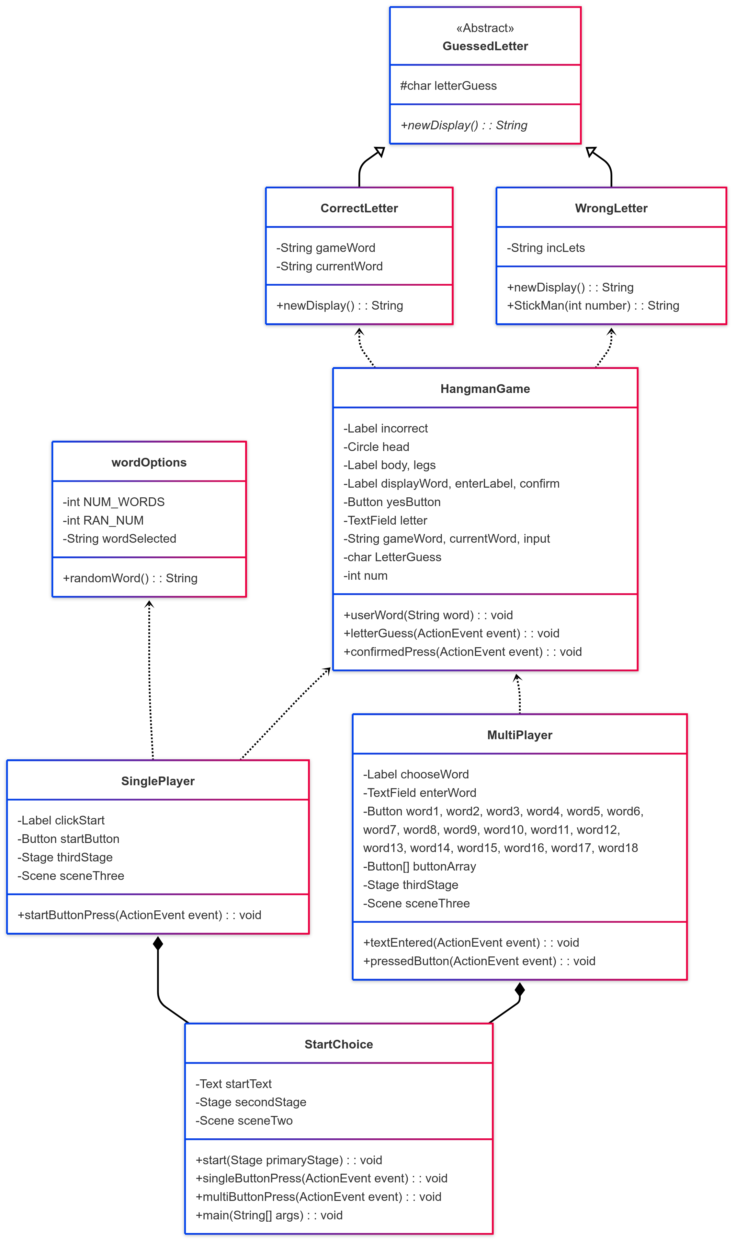
UML Class Diagram

Slide 10
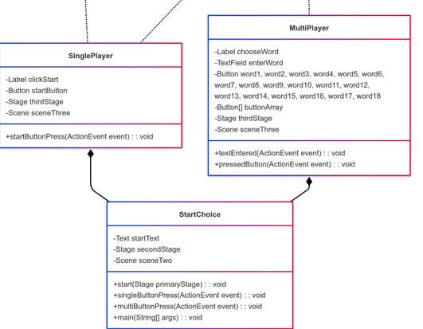
StartChoice
Has a SinglePlayer or MultiPlayer, based on which button the player presses
The StartChoice needs either one of them to work properly and continue to rest of game

Slide 11
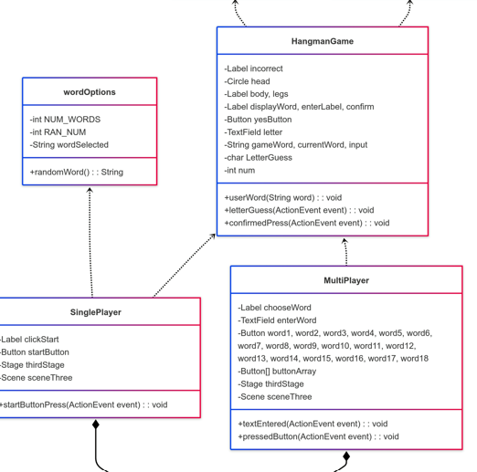
SinglePlayer
Depends on the wordOptions for the randomly selected word
Both depend on HangmanGame for its userWord method (which sets the game word)
Single and MultiPlayer

Slide 12
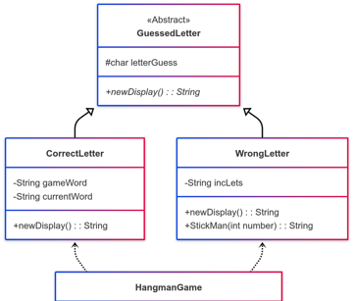
CorrectLetter and WrongLetter
HangmanGame
Uses both CorrectLetter and WrongLetter during its game
Are two subclasses of the GuessedLetter class. They both inherit its letterGuess, and each define the newDisplay method differently using that letter

Slide 13
Difficulties faced during project:
Figuring out how to get the word choice, from text field or button in multiplayer, into the game word of stage three hangman
(Which is now the purpose of the userWord method)
Working out how to build stickman figure towards the end of making program
Wanted it to look more detailed, but ended up just having circle outline then fill for the head. Along with one label for the body and arms, and another for the legs

Slide 14
Demo of the Application

