Slide 1
FIFA 20
Yihnew Eshetu (yte9pc)
Travis Vitello (tjv9qh)
Binyong Liang (bl9m)
Gladies Huilin (hc5hq)

Slide 2
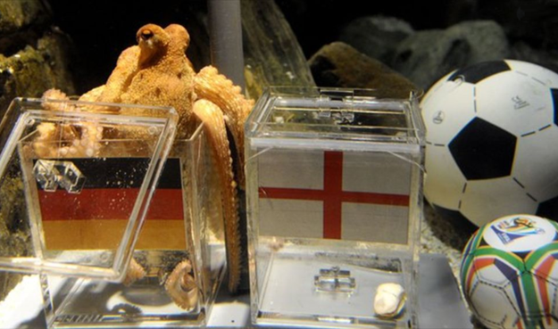
Introduction
Over 3.5 billion viewed the 2018 FIFA World Cup
Over 10 million players play FIFA 20
FIFA Ultimate Team (FUT)
Build a team of players from multiple nationality and leagues
Buy and sell players to manage and improve your team
Notes:
Travis

Slide 3

About the Data
Scrapped from https://www.futbin.com/20/players?page=1&version=gold
Data represents player info from FIFA 20 video game
Over 16000 active professional players from 159 countries
Datapoints includes features like
Country, Club, Position, League
Overall Rating, Dribbling, Pace, Shooting, etc
Notes:
Travis

Slide 4
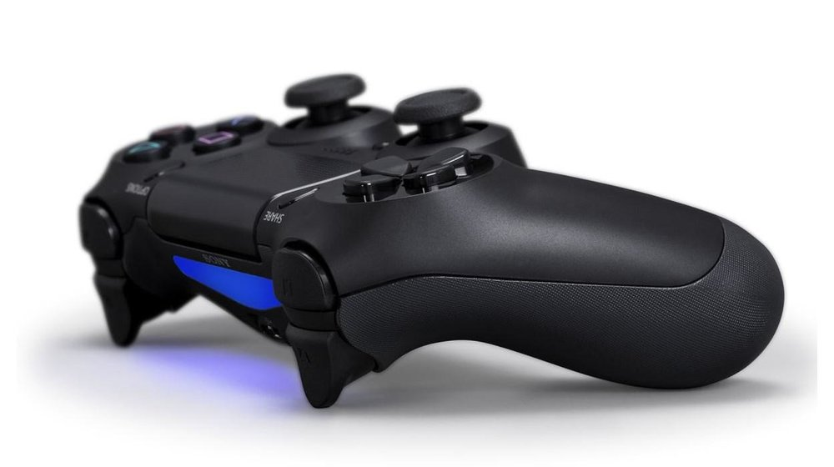
User Stories
Users
Video gamer
EA developer
Player rater
Few user stories
As an EA developer, I want to visual graph of players skills distribution
As a video gamer, I want to build the best team based on any formation
As an EA developer, I want to understand the variation of players skill stats
As a video gamer, I want to be able to compare players
As a player rater, I want to know the top players for each skill set
Notes:
Binyong

Slide 5

Beyond the Original Specifications
Using beautifulsoup scrapped data from https://www.futbin.com/20/players?page=1&version=gold
Using Bokeh for user friendly interactive app
Running Bokeh on server to allow real-time update
Notes:
Yihnew

Slide 6
Statistical Analysis

Slide 7
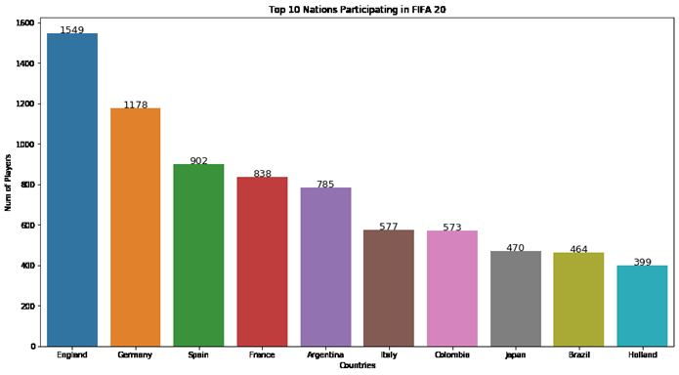
FIFA Top 10 Countries
The top three participating countries based on the numbers of players are England, Germany and Spain

Slide 8
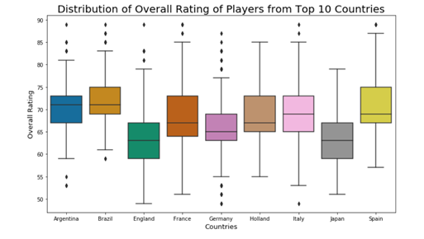
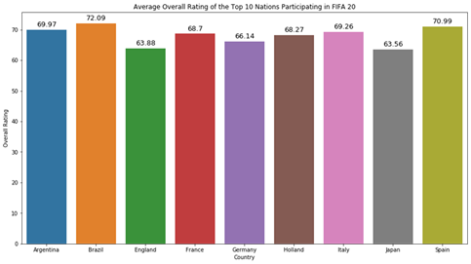
Countries Aggregate Overall Ratings
▪Brazil has the highest mean overall rating
▪Japan has the lowest mean overall rating
▪Germany has the largest distribution and has many outliers

Slide 9
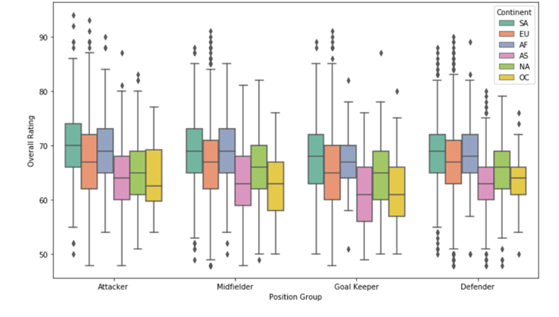
Continents Aggregate Overall Ratings
South America has highest number of elite players compared to other continents. Oceania and Asia have the lowest
South America, Europe and Africa are the top three performing continents in the position groups Attacker, Midfielder, Goal Keeper and Defender
Attacker and Midfielder score higher than that Defender and Goalkeeper.

Slide 10
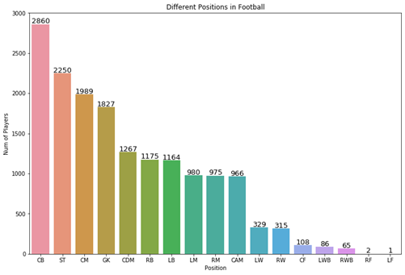
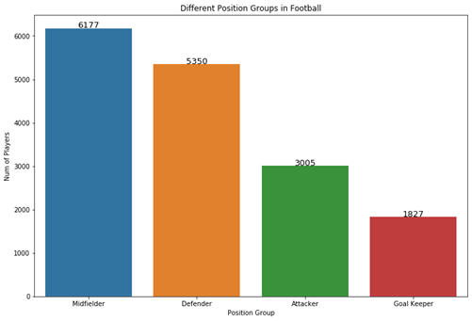
Comparative Player Numbers in Position
(group)
•Greatest player numbers for position: Center Back (CB), Striker (ST), and Central Midfielder (CM)
•The most common position group is Midfielder

Slide 11
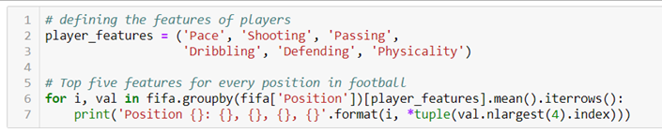
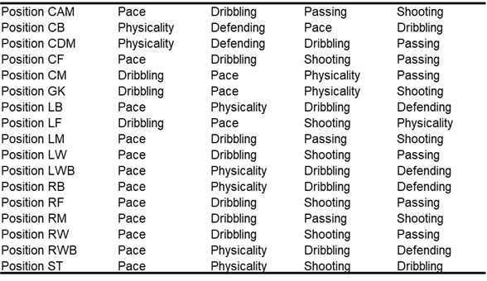
Top 4 Skill Set for Each Position
Identification of skill sets for each position aids in the selection of players when creating the ideal team

Slide 12
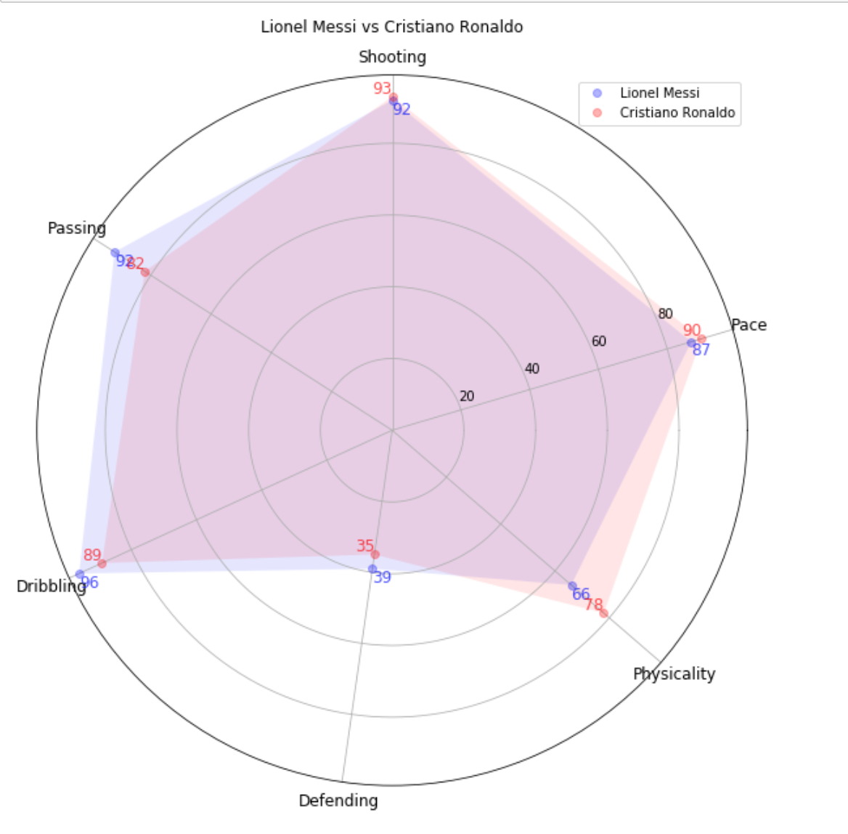
Compare 2 Players

Slide 13
Demoing
Interactive application
Scatter plot
Histogram
Best starting 11
bokeh serve --show FIFAAPP.ipynb
Notes:
Yihnew
Huilin
Binyong

Slide 14
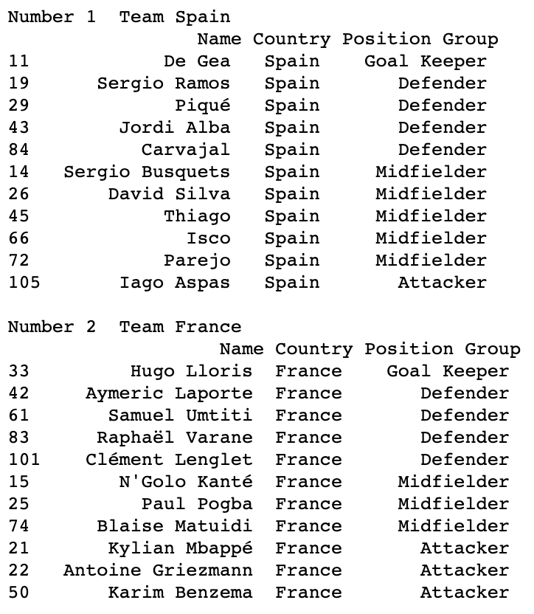
Best National Teams
Spain
France
Brazil
Germany

Slide 15
Testing
Unit testing
Webscrapping algorithm
Structure of data
Best player algorithm
Best formation algorithm
Update functions
Total of 24 unittests
Notes:
Travis

Slide 16
Conclusion
Scrapped and cleaned data
Completed defined user stories
Statistical analysis
User friendly interface using Bokeh
Unittesting
Work in scrum like environment
Notes:
Yihnew

Slide 17


Improvements
Scrape historical data to provide trend of players
Incorporate a predictive ML model
Allow users to to build a team and provide analysis (team chemistry and strength)
Drill down to individual player from best 11
Notes:
Yihnew

