Slide 1

Enhancing Physics Problem Solving in LLM Agents with Knowledge Graphs and Symbolic Math Tools
Sviatoslav Gladkykh
MSc Graduation Project
Eindhoven University of Technology
Supervisor: Mykola Pechenizkiy
Tutor: Bram Schut

Slide 2
Motivation
Large Language Models (LLMs) are strong in general conversation, but weak in physics problem solving.
Physics requires conceptual reasoning + precise math.
Goal: Make LLMs transparent, accurate, efficient and adaptable to other STEM fields.

Slide 3
Challenges
Need benchmarks covering conceptual + numerical physics.
Need rich and structured well knowledge source.
Parse and transform knowledge source into a Knowledge Graph.
Ensure symbolic math verifier integrates smoothly.
Orchestrate tools well, preventing agent from hallucinations or endless loops.

Slide 4
Research Questions
RQ1: How does retrieval from a structured knowledge graph compare to vector-based retrieval for physics question answering?
RQ2: What is the relative and combined impact of using knowledge retrieval and mathematical tools on the accuracy and reliability in multi-step derivations while ensuring physical consistency?
RQ3: How does the proposed physics-informed LLM agent perform against general-purpose LLMs, physics-fine-tuned models, and state-of-the-art methods under the same evaluation setup?

Slide 5
Research Sub-questions
Which KG construction and retrieval approaches perform the best in physics problem solving?
Which symbolic and (or) numeric tools perform the best in physics problem solving?
Which types of questions / topics in physics benefit most from KG retrieval and symbolic verification?
How can retrieved subgraphs be linked back to the source textbook passages to enable citation, fact checking, and hallucination mitigation?
… (as needed or if time permits)

Slide 6
Time-permitting research questions
Can an auxiliary corpus of solved Q&A be leveraged for few-shot guidance or case-based retrieval to further improve the agent’s task execution?
Can the agent be extended to multimodal physics tasks (e.g., diagrams, plots), and what uplift results on multimodal benchmarks relative to generic and physics-tuned multimodal LLMs?
Can the approach scale to master’s/PhD/olympiad-level problems with an appropriately enriched knowledge base, and how does it compare with existing solutions on very challenging benchmarks?
Can verifiable rewards be defined for each reasoning step of the agent, enabling reinforcement learning to further improve performance and consistency?
… (if time permits and interesting questions arise)

Slide 7
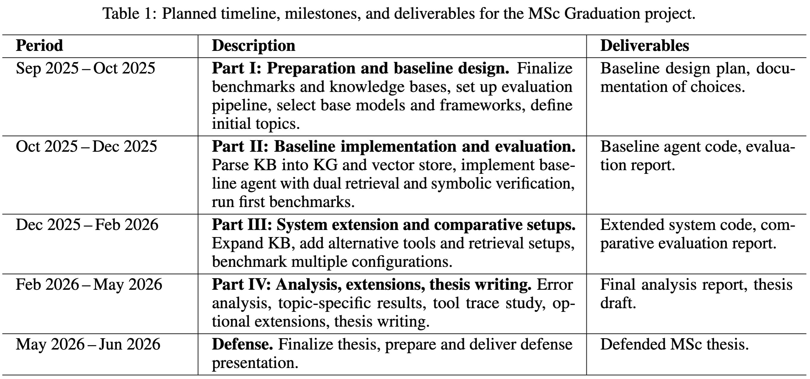
Research plan & timeline
Notes:
feasibility study

Slide 8
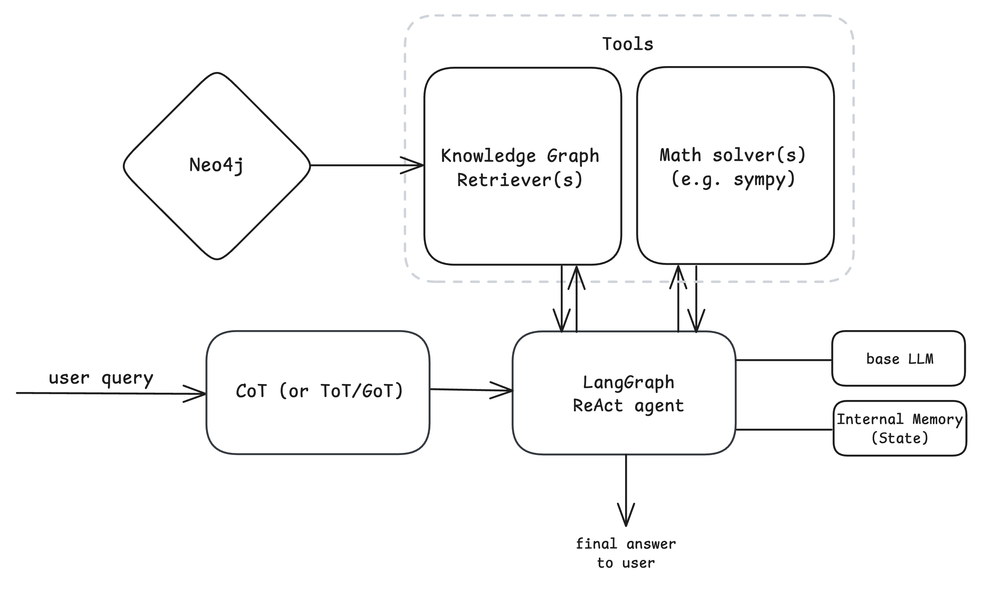
System Design

Slide 9
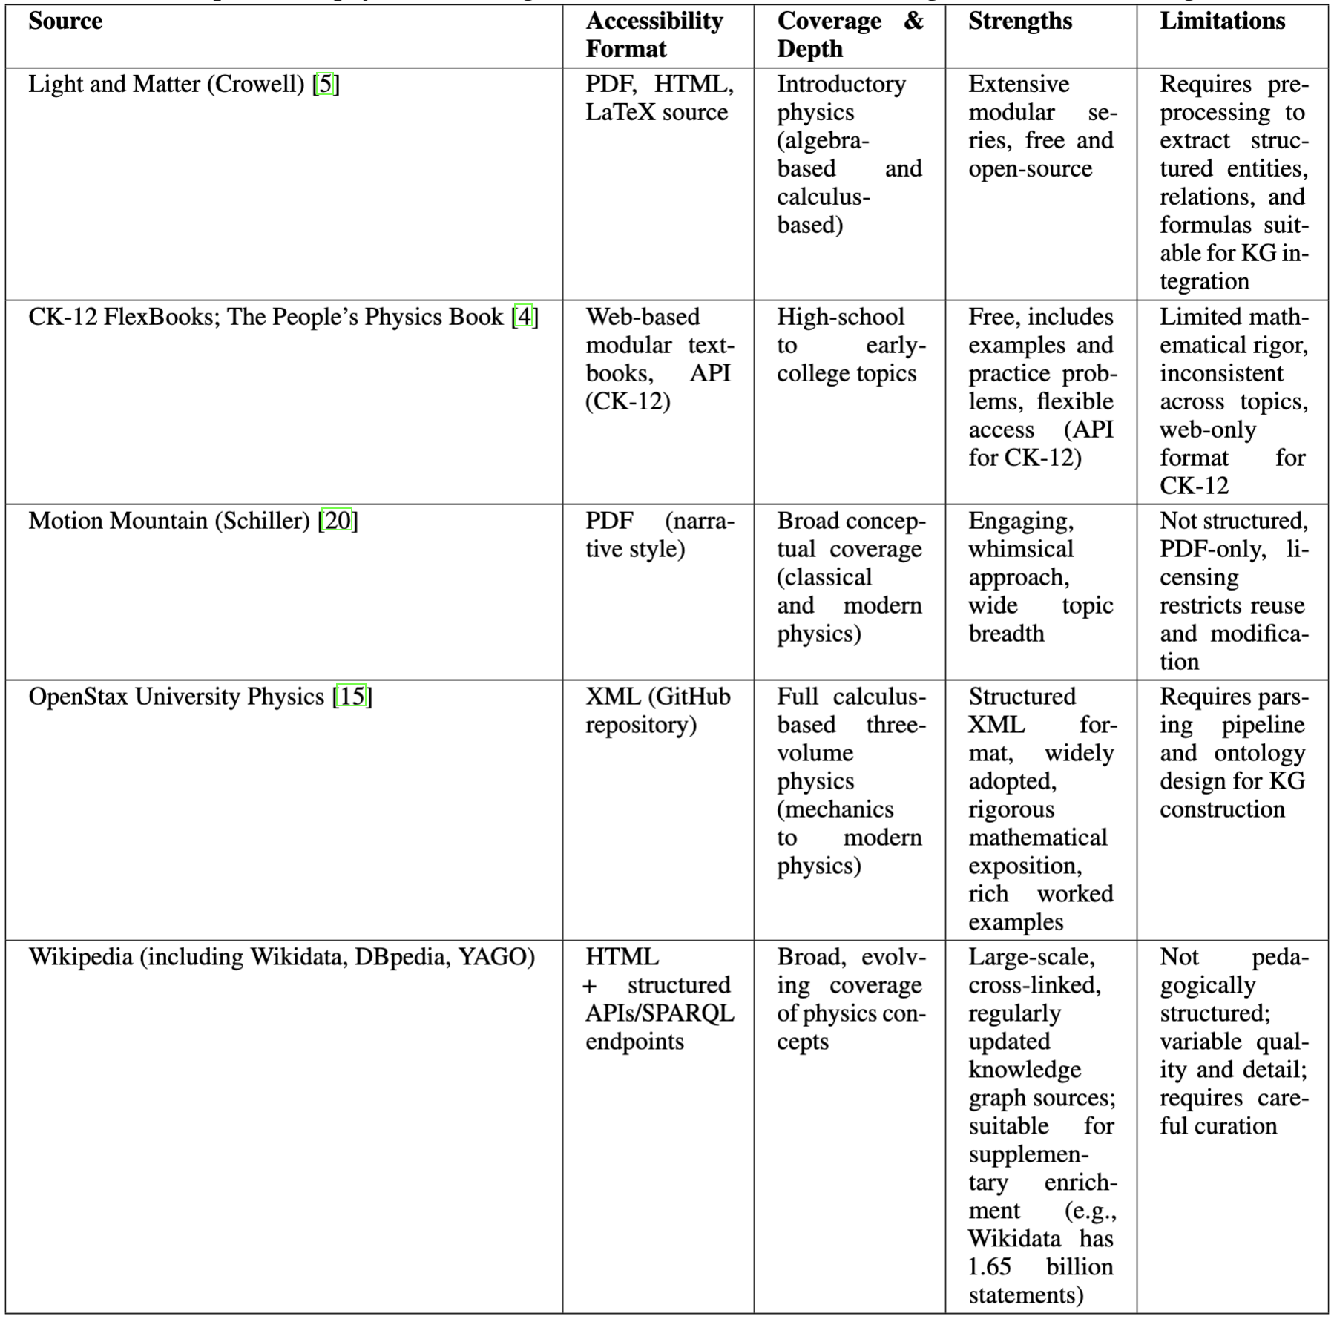
Knowledge bases

Slide 10
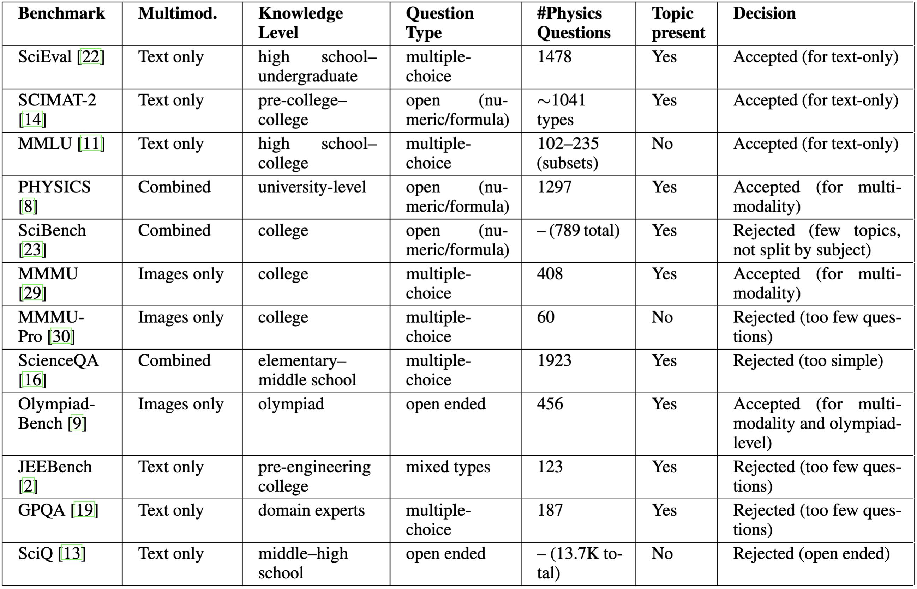
Benchmarks
Notes:
extend benchmark to my need

Slide 11
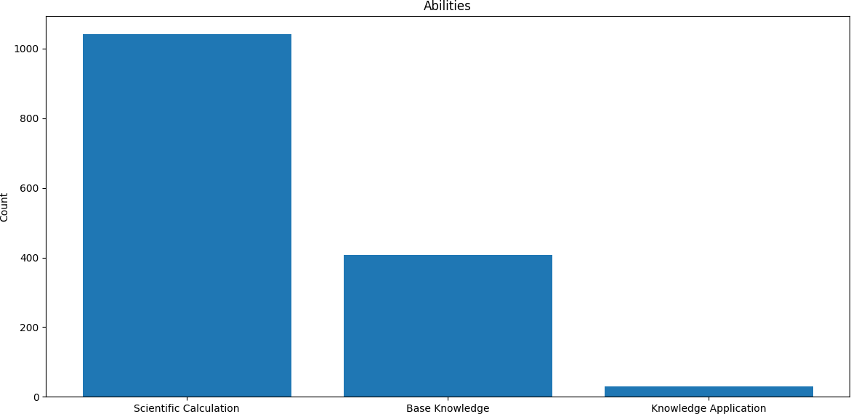
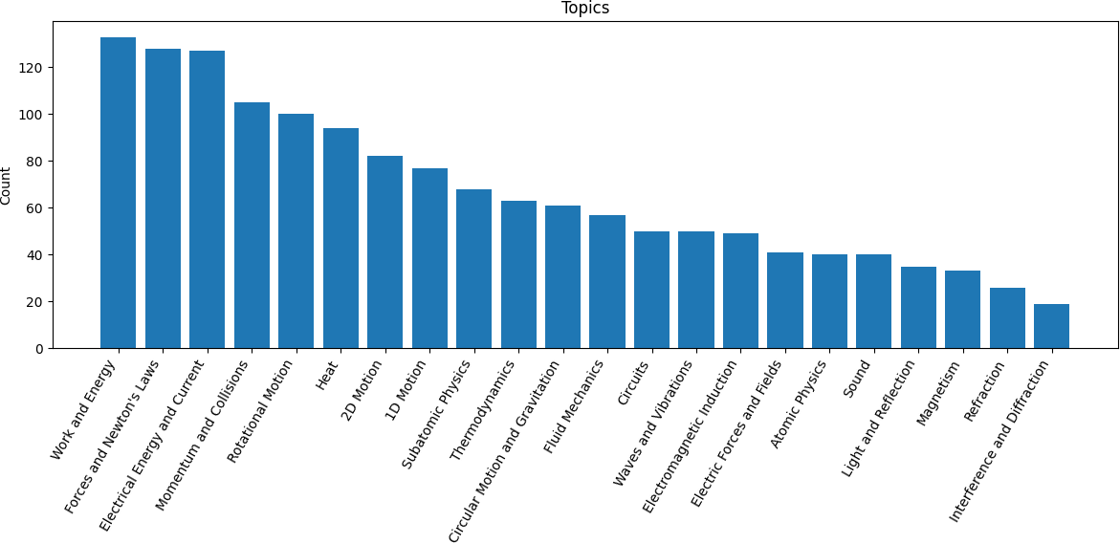
SciEval
Upper high school – early undergraduate physics 1,478 multiple-choice questions in “physics” category

Slide 12
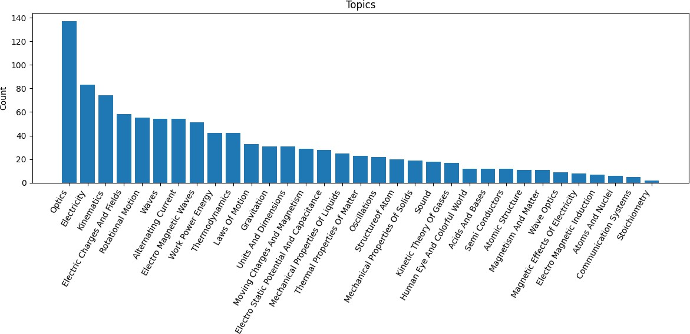
SCIMAT-2
Upper high school – early undergraduate physics
~1,041 numeric questions in “science” category

Slide 13
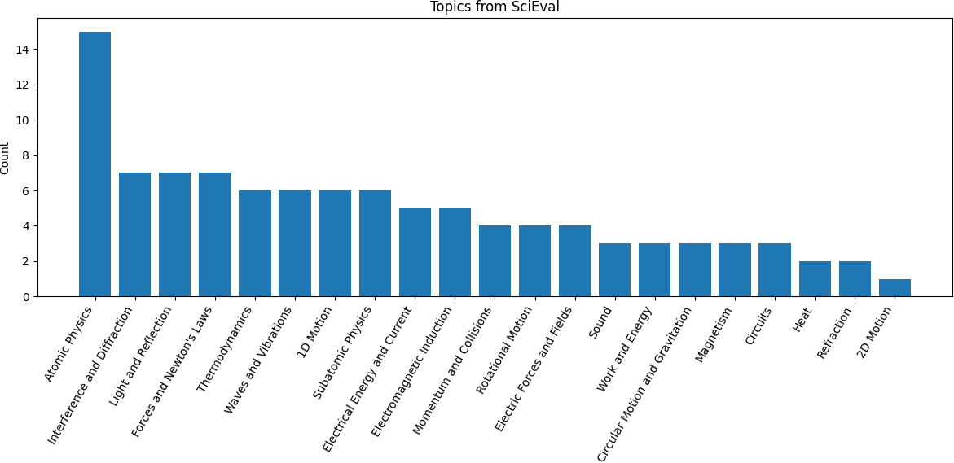
MMLU (college physics)
102 multiple-choice questions
topics not specified, we use a logistic classifier trained on question embeddings from SciEval dataset

Slide 14
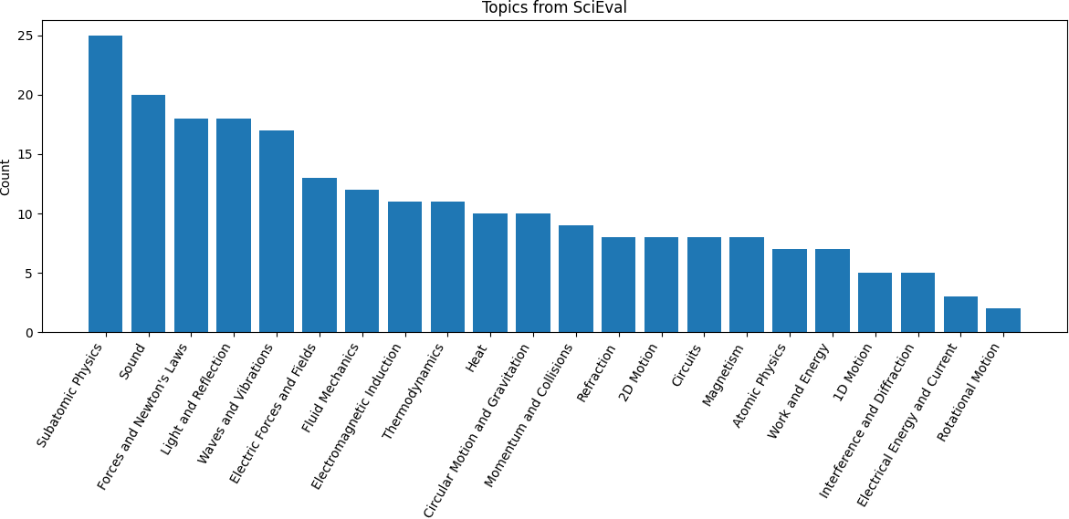
MMLU (conceptual physics)
235 multiple-choice questions
topics not specified, we use a logistic classifier trained on question embeddings from SciEval dataset

Slide 15
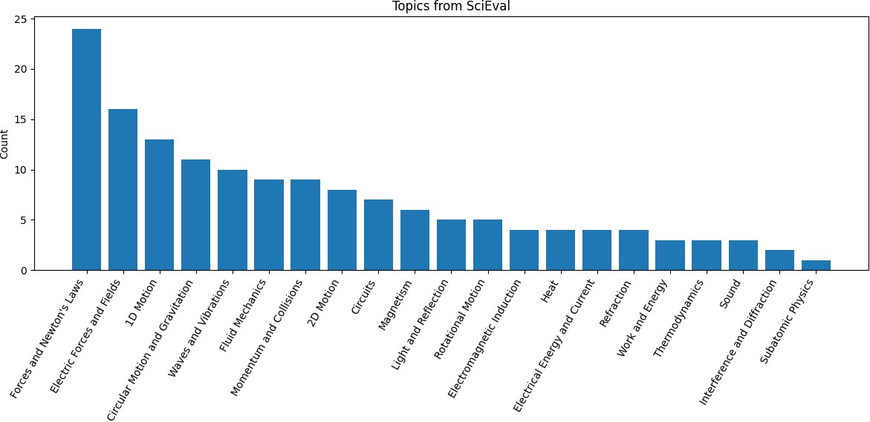
MMLU (high school physics)
151 multiple-choice questions
topics not specified, we use a logistic classifier trained on question embeddings from SciEval dataset

Slide 16
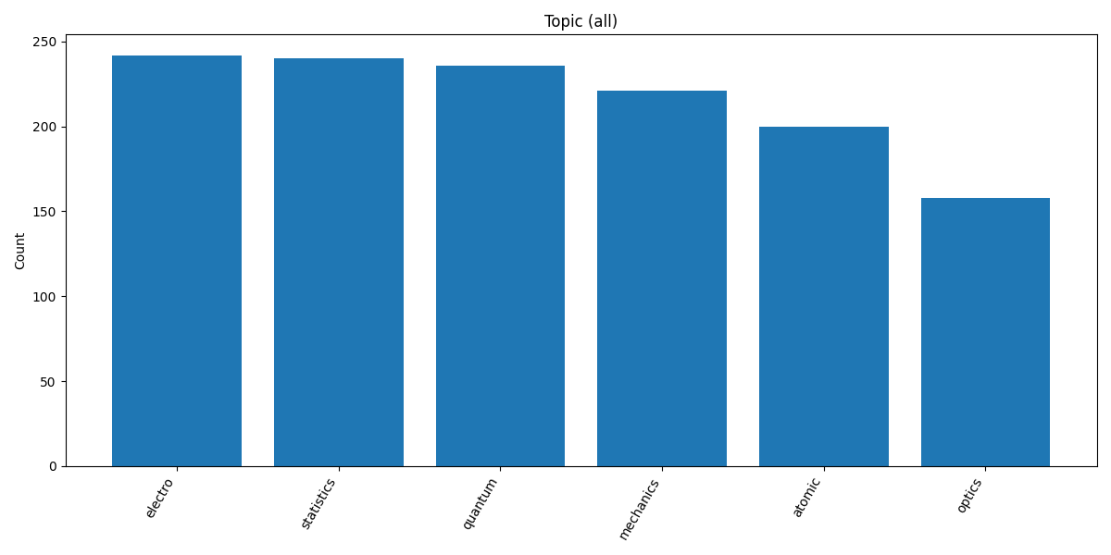
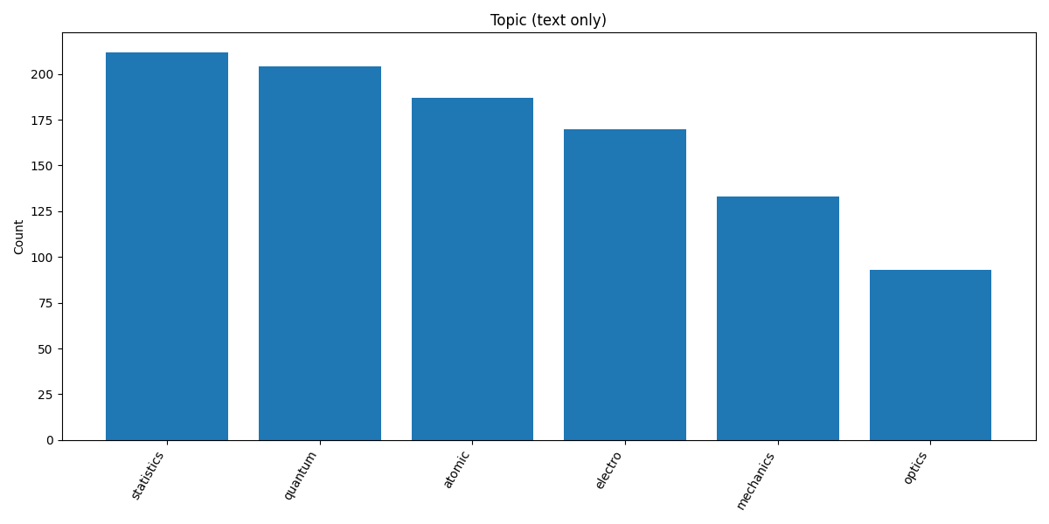
PHYSICS
University-level
1297 open (numeric formula) questions (999 without images)

Slide 17
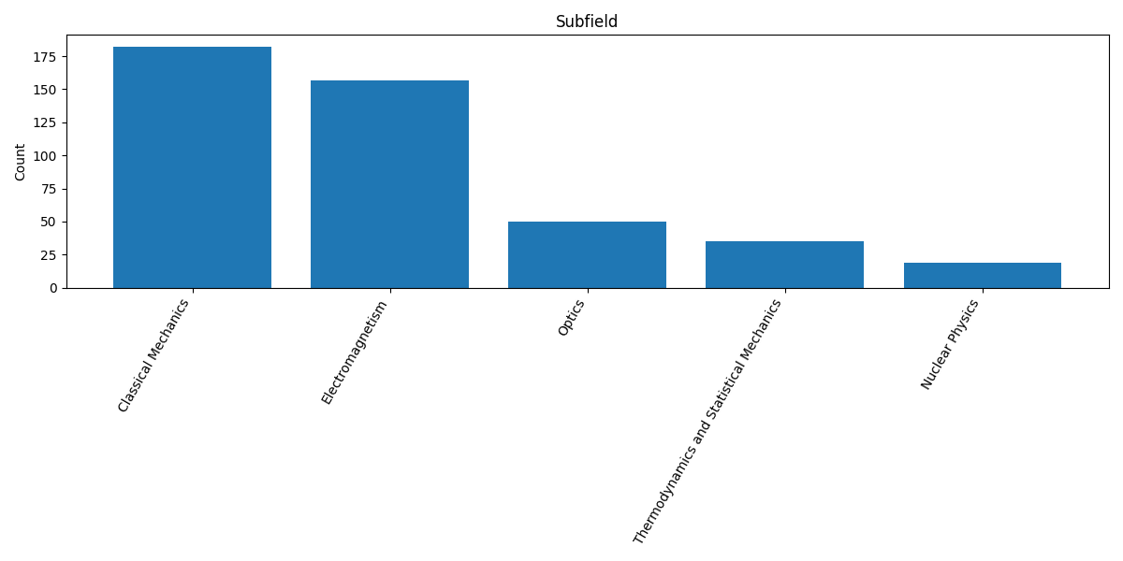
MMMU
College-level
408 multiple-choice physics questions, all with images

Slide 18
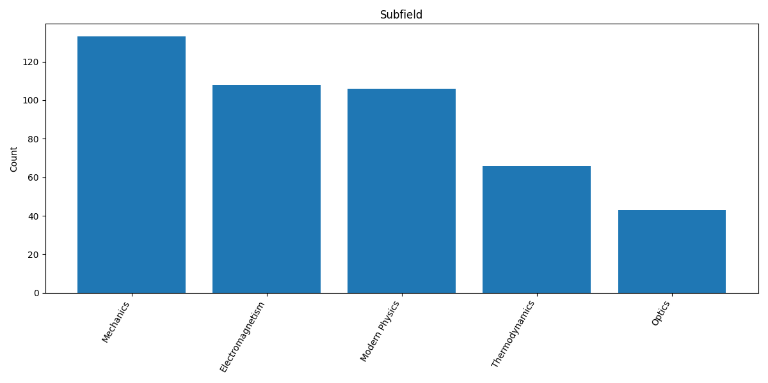
Olympiad-Bench
Olympiad-level
456 multiple-choice physics questions, all with images

Slide 19
Expected contributions
Resource-efficient adaptation of LLMs to STEM domains.
Transparent reasoning traces (facts + algebra steps).
Open-source code, KG, and evaluation artifacts.
Potential applications in education, tutoring, scientific reasoning.

Slide 20
Risks & Mitigation
Computational resources – API fallback.
Parsing difficulties – LLM-assisted extraction, additional resources
Knowledge Graph may underperform – hybrid or vector fallback
Insufficient accuracy gains – investigation, improvements, focus on transparency & traceability

Slide 21
Conclusion
Novel agent combining Knowledge Graphs + Symbolic Math Tools.
Systematic evaluation on physics benchmarks.
Aim: accurate, explainable, and efficient physics-aware LLM assistant.

