Slide 1


AN IMPROVED TCP CONGESTION CONTROL ROUTING PROTOCOL FOR WIRED-CUM-WIRELESS NETWORKS
Submitted by: GLADSON.V.MANUEL (080105601032)
ANVIN JOHNSON (080105601005)
ALLEN JOSEPH (080105601003)
Guided by: Prof. J.VIJIPRIYA

Slide 2
ABSTRACT
TCP is a connection oriented protocol that offer reliable data transfer
But TCP is not well suited for several emerging applications including streaming and real time audio and video because it increases end-to-end delay and delay variations.
This project helps to increase the network throughput by efficient low cost routing and congestion control mechanism.
The routing algorithm finds out optimal path and the congestion control algorithm, NRDC reduce the packet collision and packet loss.
Simulations are done using ns2, a discrete event simulator.

Slide 3
INTRODUCTION
TCP/IP is the commonly used protocol for communication.
TCP connection itself is facing several challenges such as packet loss, congestion, routing cost etc.
We have proposed a scheme of protocol to over come the throughput degradation by applying a congestion control algorithm over routing algorithm.
The proposed NRDC algorithm together with routing protocol to provide better network throughput.

Slide 4
EXISTING SYSTEM
In the existing system the transmission of a data packet is made possible by a routing algorithm alone, no mechanism for congestion control is considered.
In the existing system packet loss cannot be identified easily and thus the number of retransmission is high.
The congestion cause packets to be retransmitted which leads to high throughput degradation.
The protocols used are ExOR and MORE and both leads to packet over hearing too.

Slide 5
DRAWBACKS OF EXISTING SYSTEM
Energy consumption for routing is high.
Packet loss is not considered.
Congestion can occur any time, cannot identify it.
Minimum network throughput

Slide 6
PROPOSED SYSTEM
In this system we couple a congestion control algorithm with a routing algorithm. So that after finding an optimal low cost path for packet data transmission, congestion control is also done over this route.
The congestion control mechanism helps to avoid the packet loss and packet collision while transmission.
Bellman ford algorithm is used to route the packets to the destination nodes.
The proposed system performs the task of controlling the congestion window size by considering round trip time and acknowledgement for the packet before the timeout..

Slide 7
SYSTEM ARCHITECTURE
Sender
Congestion Control
Routing algorithm
Congestion Avoidance (NRDC)
Fast Retransmission
Low cost route
Transmission
Link Failure
Reciever

Slide 8
ADVANTAGES OF PROPOSED SYSTEM
Avoid packet overhearing.
Minimize energy cost.
Collision detection & avoidance.
Maximize network TCP throughput.

Slide 9
SYSTEM REQUIREMENTS
Hardware Requirements
Processor : Core 2duo/dual core/AMD athelon
RAM : 1GB
Monitor : 15’’ color
Keyboard : Standard 102 keys
Mouse : 3 buttons
Hard Disk : 120GB
Software Requirements
Operating System : Linux trisquel
Software : Network Simulator (nsallinone 2.35)

Slide 10
MODULES
Experimental Setup
The wired network topology consist of eight nodes.
Each node is connected with neighbouring nodes with 100MB bandwidth and 20ms delay duplex wired connection.
The drop tail queue and distance vector routing algorithm are used.
Routing
The routing protocol which we use bellman-ford algorithm.
Bellman–Ford is in its basic structure very similar to Dijikstra’s algorithm, but instead of greedily selecting the minimum-weight node not yet processed to relax, it simply relaxes all the edges, and does this |V | − 1 times, where |V | is the number of vertices in the graph.

Slide 11
Congestion control
A congestion control mechanism is given to the efficient low cost routing path which is find out by the routing algorithm.
The congestion control algorithm which we use in this system is the NRDC algorithm, which is based on the additive increase and multiplicative decrease algorithm.
The procedure of NRDC algorithm is as following:
Start slowly, increase gradually to find equilibrium
Add a small amount to the sending speed each time interval without loss
For a window-based algorithm W_{i+1} = W_{i}(α -(2*W_{i})) each RTT, where α > 1 typically
Respond to congestion rapidly
Divide sending window by some factor β=2 each interval loss seen
For a window-based algorithm W_{i} = W_{i} / β each RTT, where β = 2 typically.

Slide 12
Result: TCP Throughput
A lot of experiments on wired network topology and wired cum wireless network topology are carried out to test performance of NRDC–TCP with existing tcp variants BIC and ILLINOIS with efficient routing protocol DVR and DSDV respectively using NS2.
From xgraph a better performance of NRDC-TCP agent is observed and gives better performance in the value of mean throughput obtained after a simulation of 50 milliseconds.

Slide 13
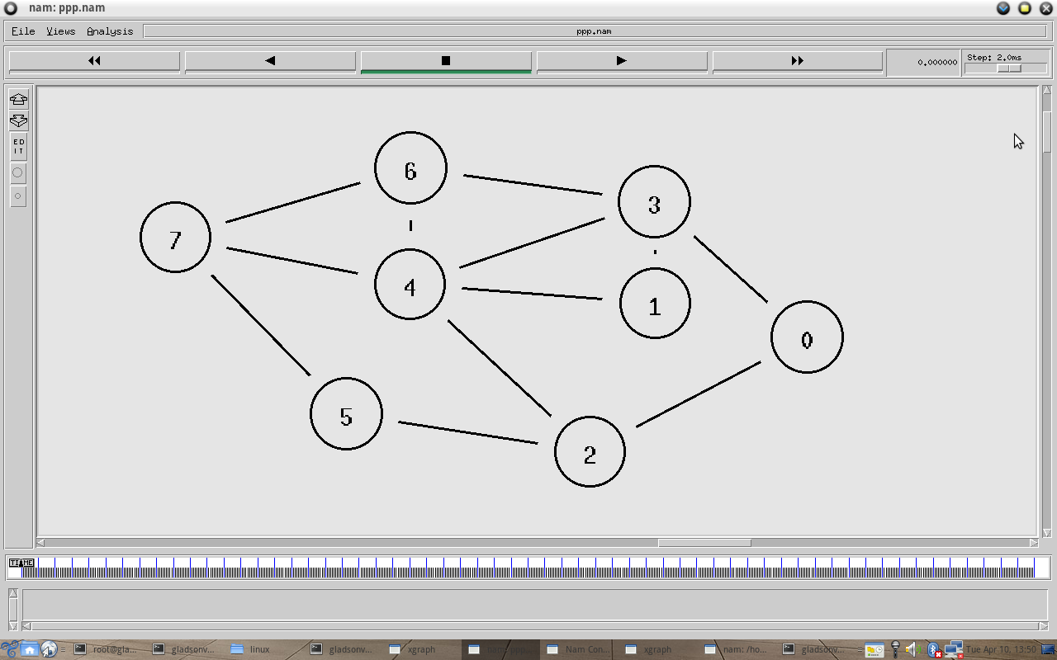
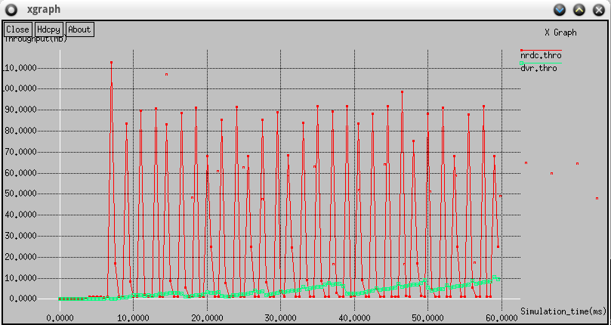
SCREEN SHOTS
Wired Network Topology
Comparison of NRDC with DVR

Slide 14
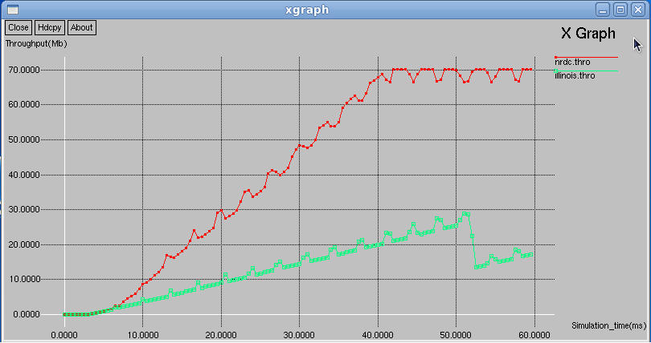
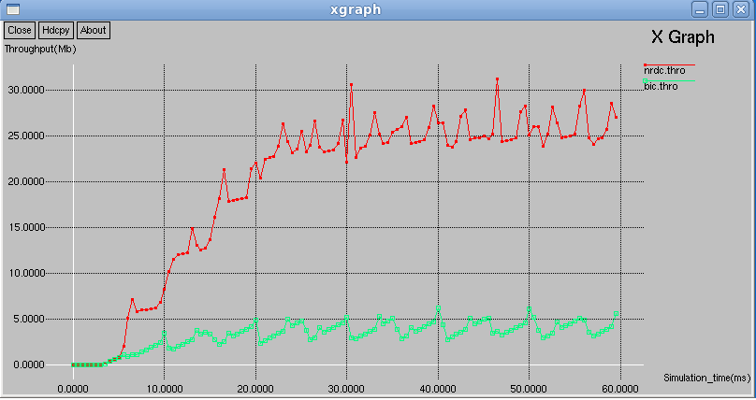
Comparison of NRDC with ILLINOIS
Comparison of NRDC with BIC

Slide 15
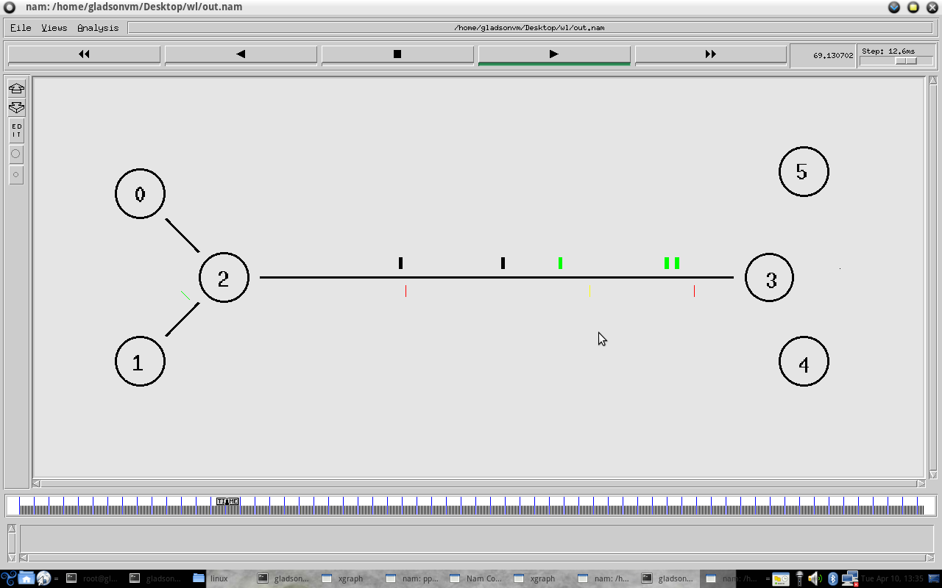
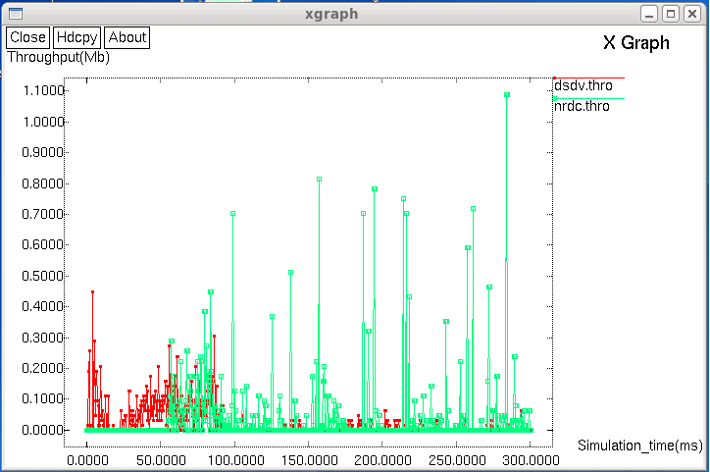
Wired-cum-Wireless Network Topology
Comparison of NRDC with DSDV

Slide 16
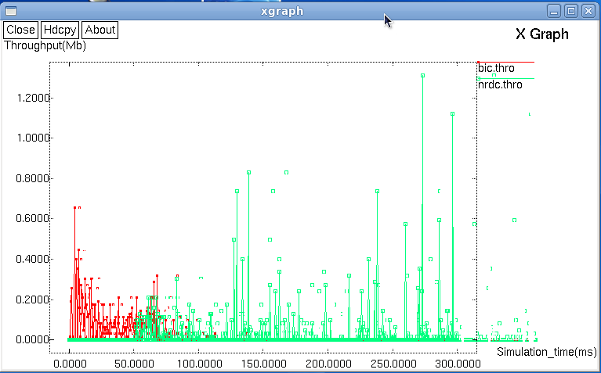
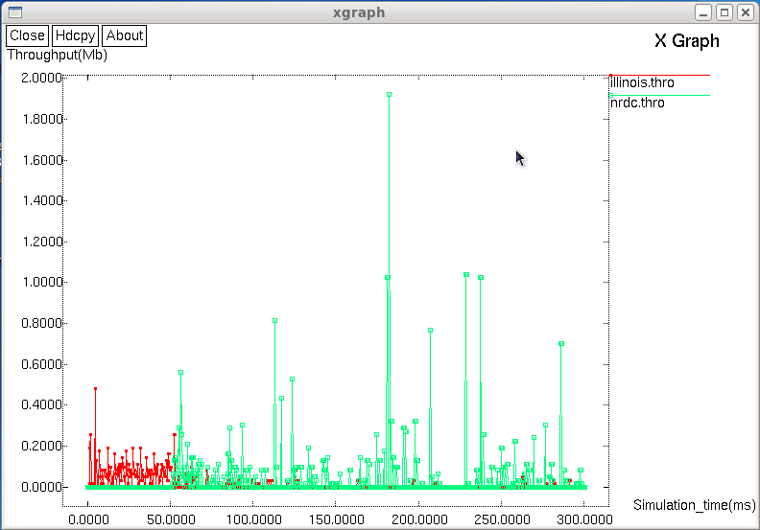
Comparison of NRDC with BIC
Comparison of NRDC with ILLINOIS

Slide 17
CONCLUSION & FUTURE ENHANCEMENT
We have designed a system for increasing the network throughput and to reduce the packet loss in a TCP network.
This system can be implemented in any TCP networks to increase the overall performance and the throughput of the network transmission.
The NRDC algorithm which we established in this system finds out efficient route and applies congestion avoidance over that route.
The future enhancement of our project is that by improving the equations for increasing and decreasing the congestion window size, we can reduce the packet loss. Our system shows a packet loss of 8%.

Slide 18
REFERENCES
Yu Wang, Member, IEEE, Weizhao Wang, Student Member, IEEE, and Xiang-Yang Li, Member, IEEE, Efficient Distributed Low-Cost Backbone Formation for Wireless Networks ; VOL. 17, NO. 7, JULY 2006.
Jun Cheol Park and Sneha Kumar Kasera School of Computing, University of Utah; Expected Data Rate: An Accurate High-Throughput Path Metric For Multi-Hop Wireless Routing, the IEEE SECON 2005 proceedings.
Haibo Zhang and Hong Shen; Energy-Efficient Beaconless Geographic Routing in Wireless Sensor Networks, VOL. 21, NO. 6, JUNE 2010.
C. Wang, Member, IEEE, B. Li, Senior Member, IEEE, K. Sohraby, Upstream Congestion Control in Wireless Sensor Networks Through Cross-Layer Optimization VOL. 25, NO. 4, MAY 2007.
M. Chandrasekaran And R.S.D Wahida Banu, Performance Evaluation Of Polynomial Congection Control Algorithms Mimd-Poly And PIPD-Poly In TCP Networks, VOL. 20, NO. 5, JUNE 2009.

