Slide 1
Library preparation
Please revise these slides before the workshop

Slide 2
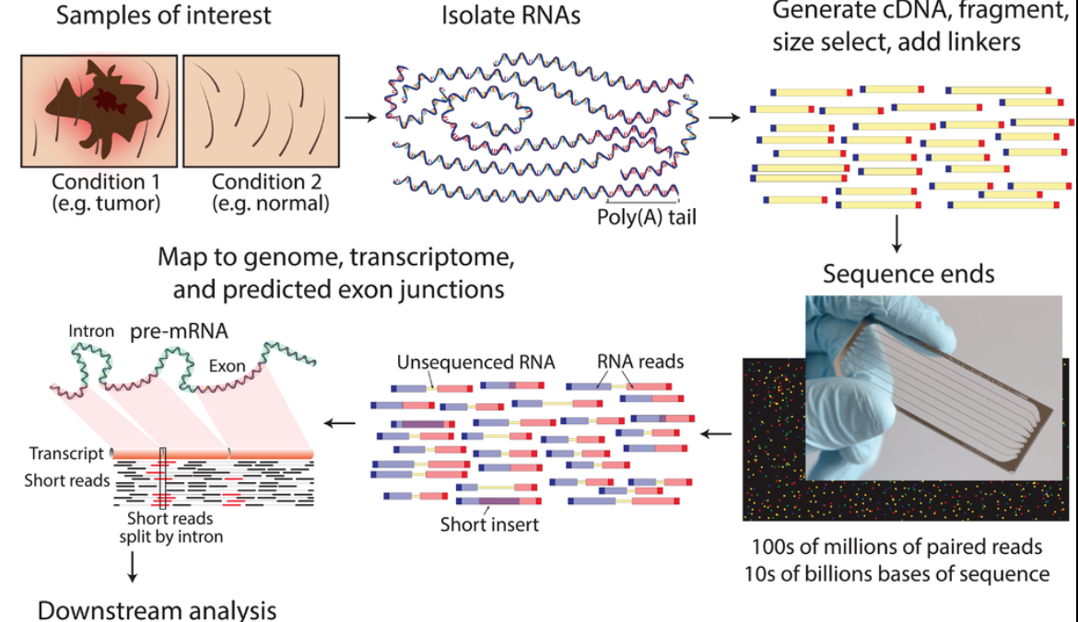
RNA-seq - experiment
mean length of 300 bp (typically ranging 200–700 bp
https://www.wikiwand.com/en/RNA-Seq

Slide 3
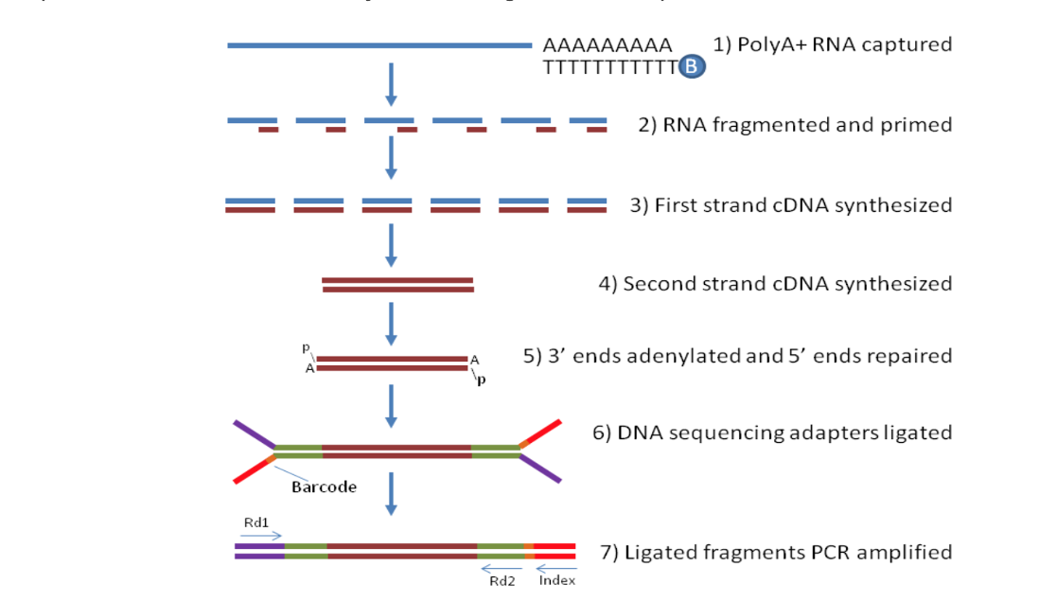
How does the bulk-RNA-seq technology work?
Notes:
From http://rockefelleruniversity.github.io/RU_RNAseq/
More details here: https://rnaseq.uoregon.edu/#rna-prep-overview

Slide 4
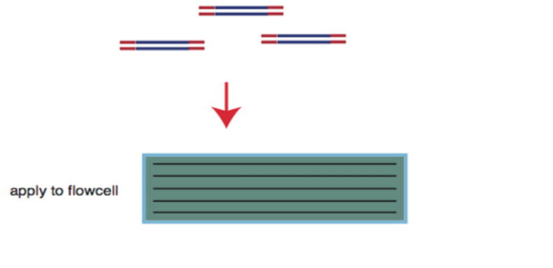
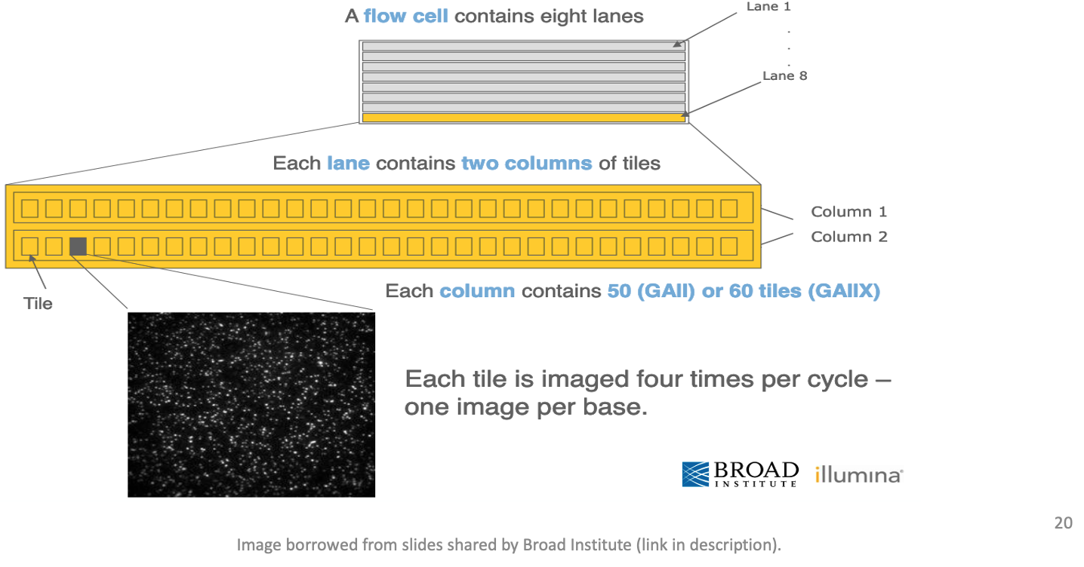
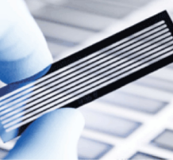
Flow cell organization for sequencing
cDNA library is applied to a flow cell
Notes:
From https://www.broadinstitute.org/files/shared/illuminavids/sequencingSlides.pdf

Slide 5
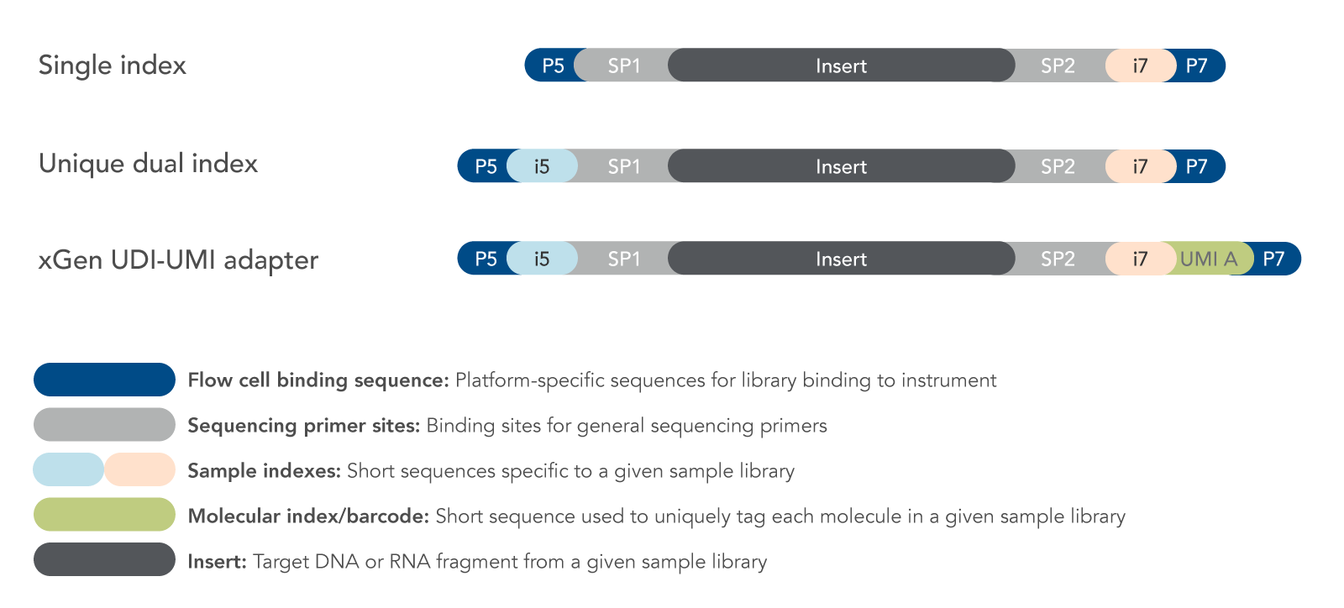
Fragments preparation for the sequencer
Notes:
From http://rockefelleruniversity.github.io/RU_RNAseq/
More details here: https://rnaseq.uoregon.edu/#rna-prep-working-with-rna

Slide 6
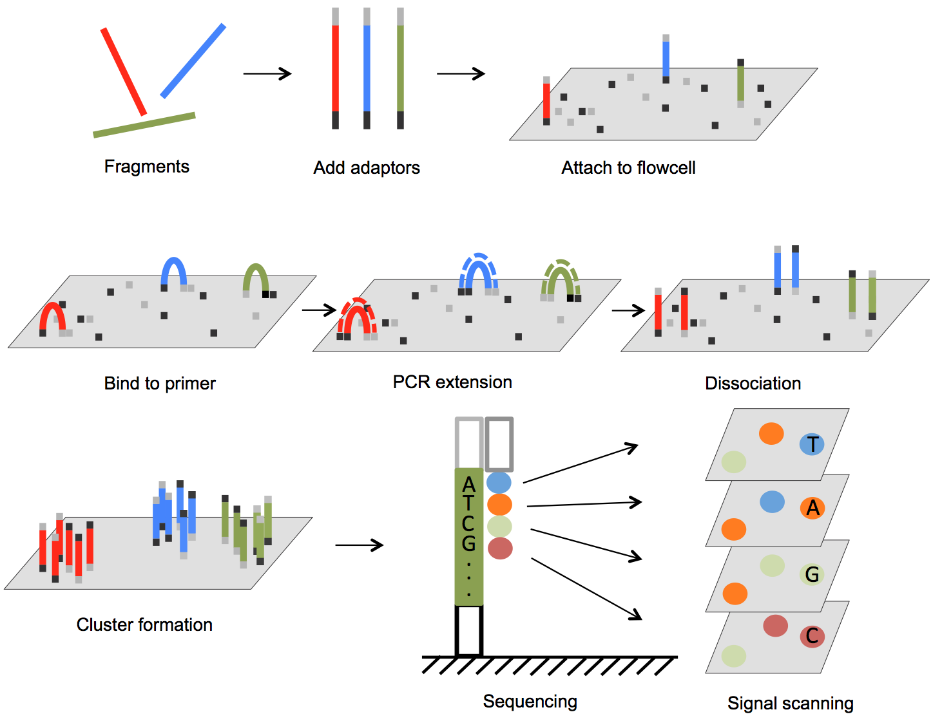
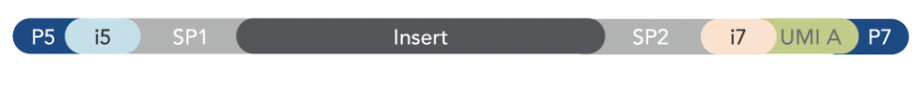

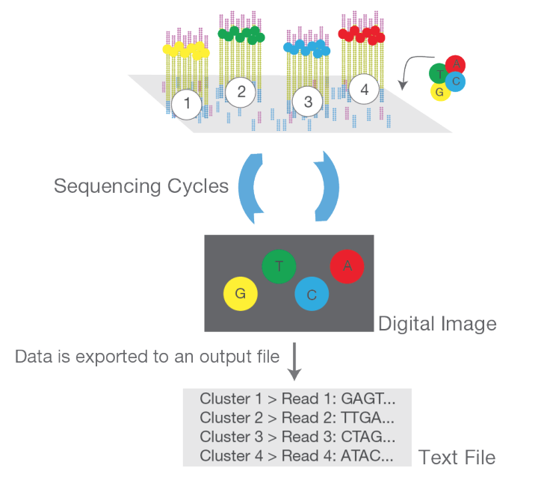

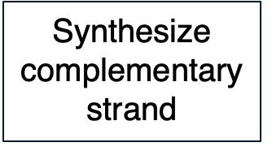

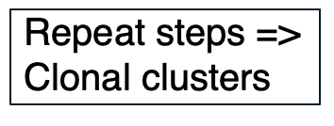
DNA fragments immobilized on flow cell & amplified into clonal clusters
ds cDNA > ss cDNA
From DOI: 10.5772/61657 and https://www.illumina.com/content/dam/illumina-marketing/documents/products/illumina_sequencing_introduction.pdf
Notes:
Cluster amplification: https://youtu.be/3URxJD5k3T8

Slide 7
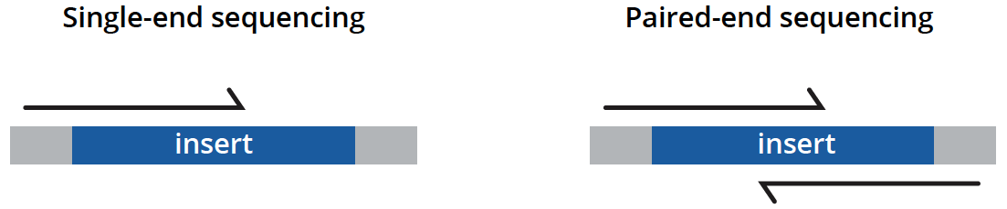
Types of sequencing
unidirectionally - sequencing from one end only
less expensive, is typically reserved for quantifying gene expression in well-annotated genomes and analyzing small RNA molecules.
bidirectionally - both ends of DNA fragments to be sequenced
usually recommended for most applications as it provides richer data and permits longer library insert sizes.
https://www.genewiz.com/
Notes:
Suggesting reading https://bmcbioinformatics.biomedcentral.com/articles/10.1186/s12859-020-3484-z

Slide 8
Library preparation affects the downstream analysis
RNA quality is fundamental
RNA extraction method can affect the transcript abundance
Choice of platform and library preparation protocol

Slide 9


