Slide 1
We start at 1.05

Slide 2
Material for this workshop
Workshop materials
  Slides
  Hands-on data and scripts
Please drop your questions in the chat (to everyone) or unmute yourself

Slide 3


Machine Learning using R
Michela Traglia
Ayushi Agrawal
September 24th, 2026
‹#›

Slide 4
Introductions
Michela Traglia
Associate Director
Ayushi Agrawal
Senior Bioinformatician

Slide 5
Poll1 . Have you ever used any of these methods?
(Please select all that applies)
Clustering
Principal Component Analysis
UMAP/tSNE
Linear or logistic regression
Random Forest
None of the above

Slide 6
What to expect from this workshop
Our aim is to give a basic overview of the logic behind machine learning methods and how they work.
We will go over some questions that you may have:
What are the differences between AI, ML, DL?
Which are the types of machine learning?
Which are the steps to build a prediction model?
What is overfitting in ML?
How can you evaluate the prediction model? Which metrics should I use?
In our demo session you will practice how to work with a real dataset and two simple ML algorithms in R

Slide 7
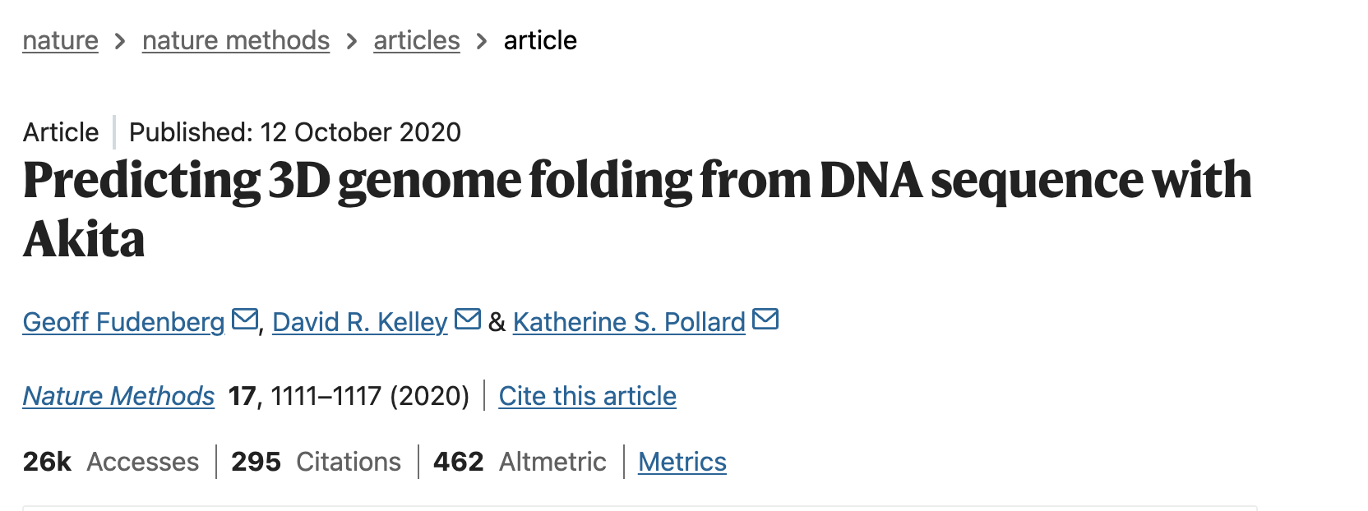
How Machine Learning can inform biomedical research
https://www.nature.com/articles/s41592-020-0958-x
Input: ~1 million base pairs (1 Mb) of DNA sequence
Training based on experimental chromatin conformation capture data — Hi‑C and Micro‑C contact maps — from human cell lines - contact frequency between bp
Method: Convolutional neural network
Output: a 3D contact map - a matrix showing predicted contact frequencies between all pairs of 2,048‑bp regions within that window.
Notes:
https://www.nature.com/articles/s41592-020-0958-x

Slide 8
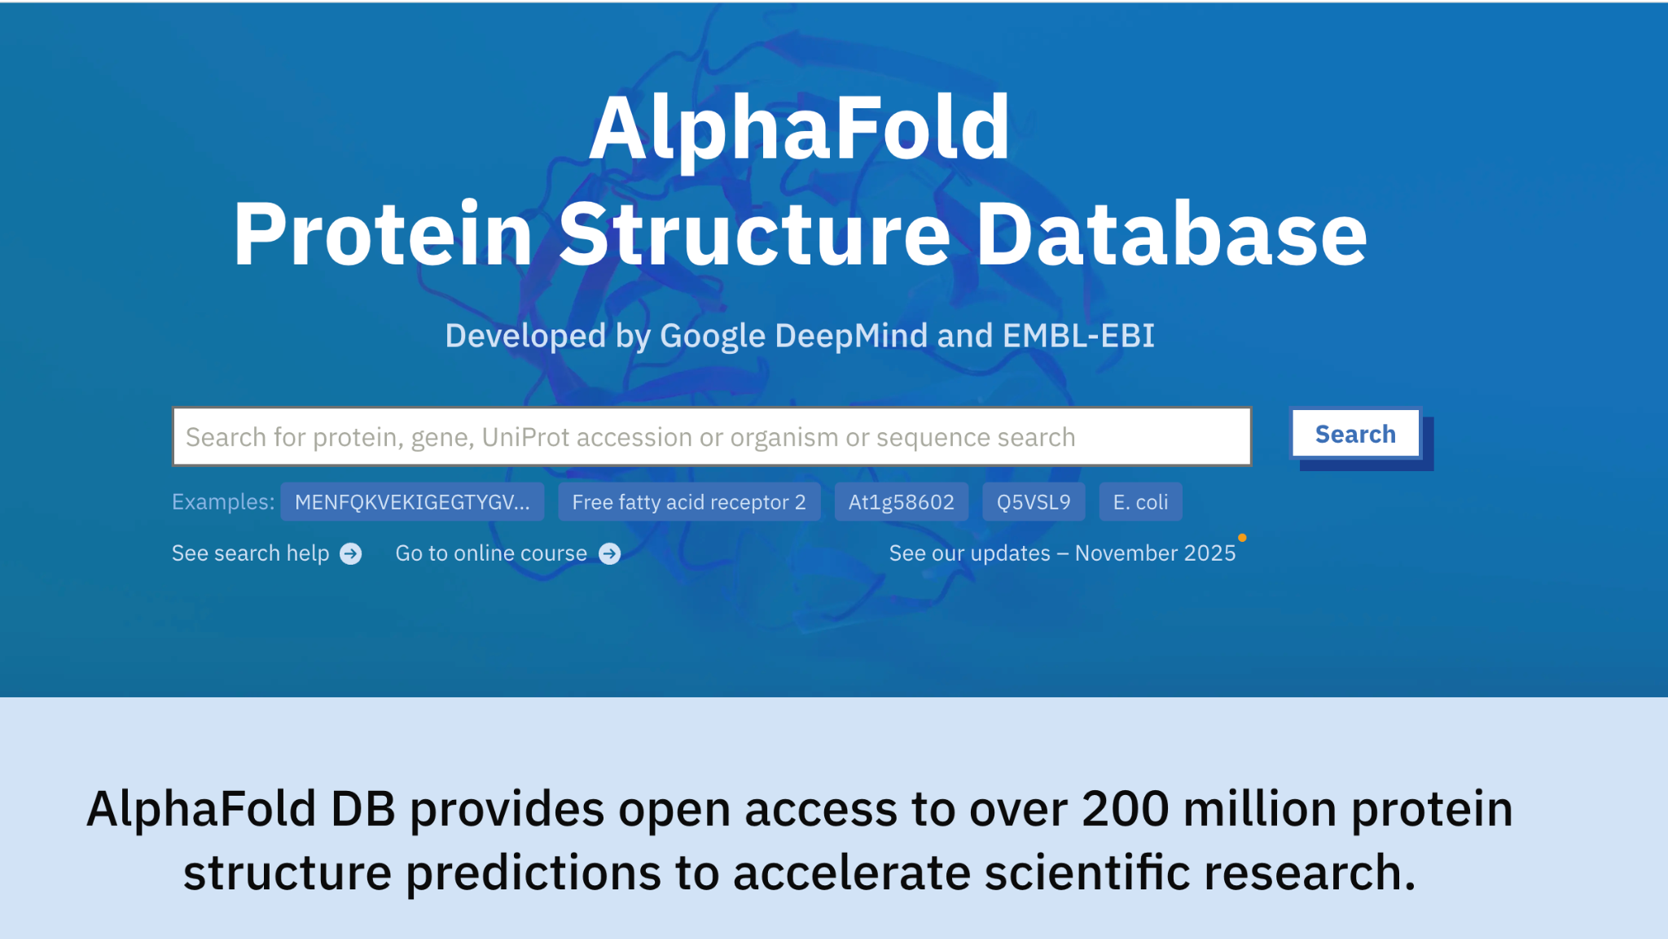
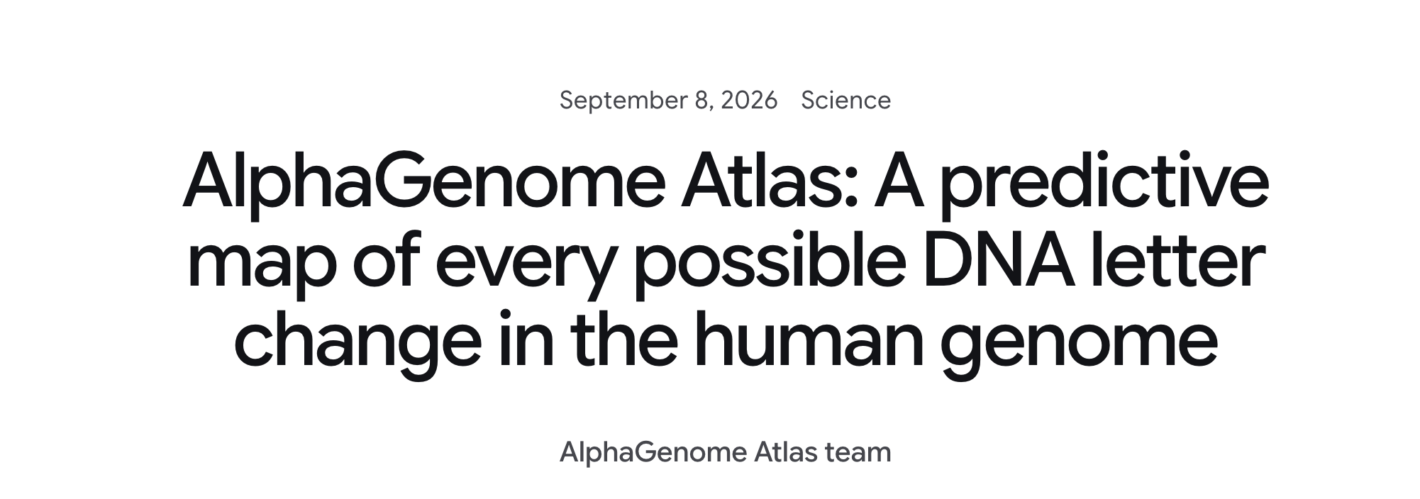
How Machine Learning can inform biomedical research
Deep learning system developed by DeepMind to predict 3D protein structures from amino acid sequences.
Trained on ~200,000 experimentally solved protein structures
Most recent database release contains over 200 million entries
https://www.nature.com/articles/s41586-021-03819-2
Notes:
https://alphafold.com/

Slide 9
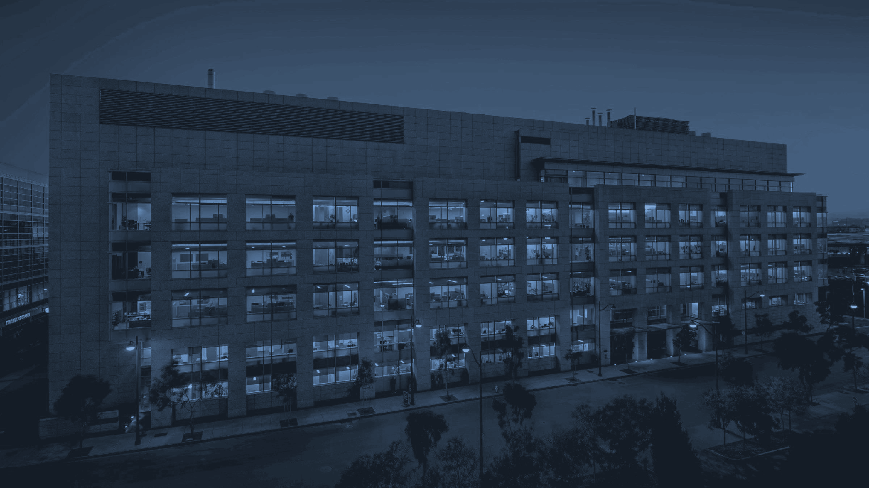

Outline
Basic concepts of AI, ML, DL
Unsupervised and Supervised Machine learning definition
Supervised machine learning workflow
  Features selection
  Concepts of bias/variance, and over and underfitting
  Hyperparameters
  Model evaluation
Algorithms overview
Hands-on on supervised and unsupervised ML methods
Introductory Machine Learning for Biologists
• Min-Gyoung Shin
November 1, 2021
‹#›

Slide 10
AI universe - basics

Slide 11
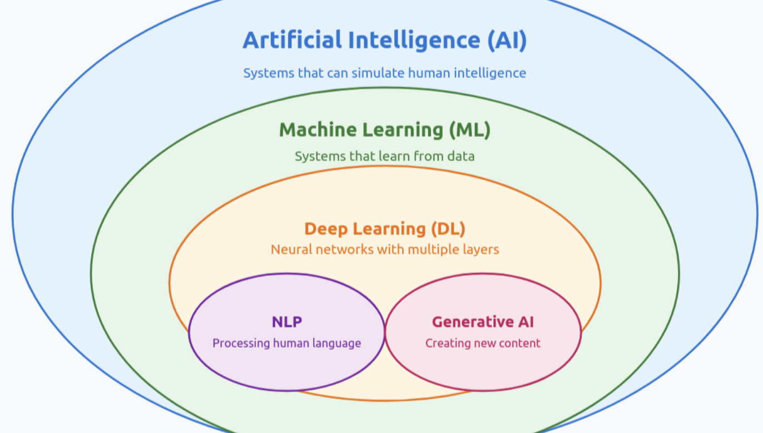

Slide 12
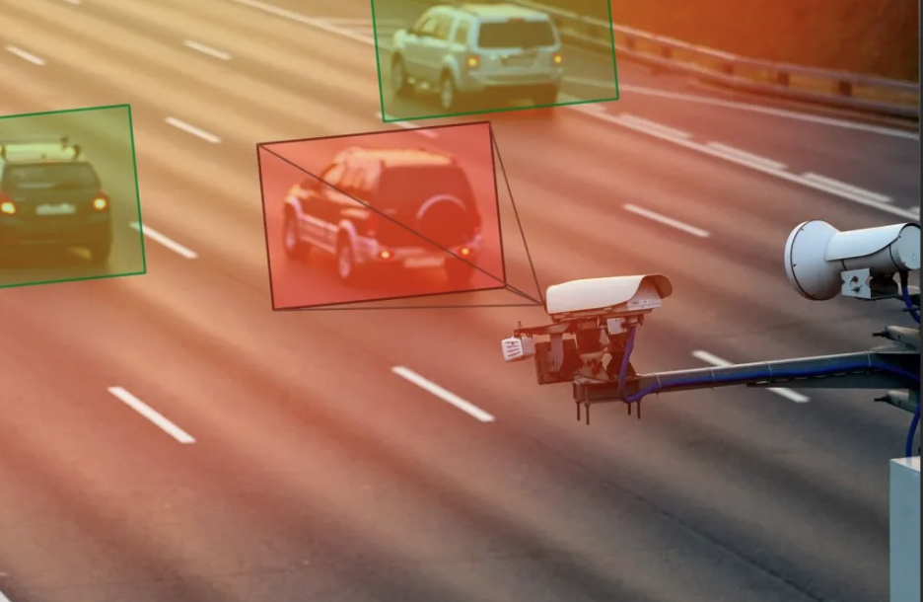
AI definition and examples
Task-specific algorithms
Rules-driven (IF-THEN)
Perform human preset tasks
Needs clear logic - limited flexibility
Applications:
Early chess game
Speed limit enforcement systems

Slide 13
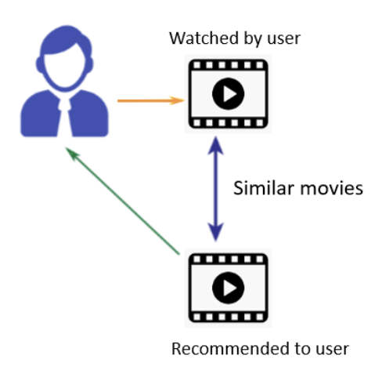
ML definition and examples
Uses algorithms trained on data sets to learns patterns -> outcome and create models capable of predict outcome
Data-driven
Improve over time without being programmed
Easy to interpret
Applications:
clinical prediction
virtual assistant
movie recommendation

Slide 14
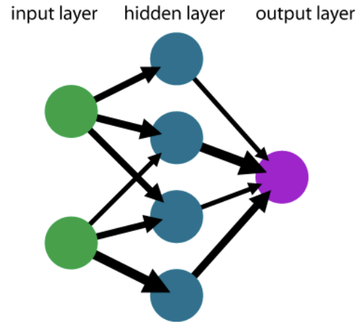
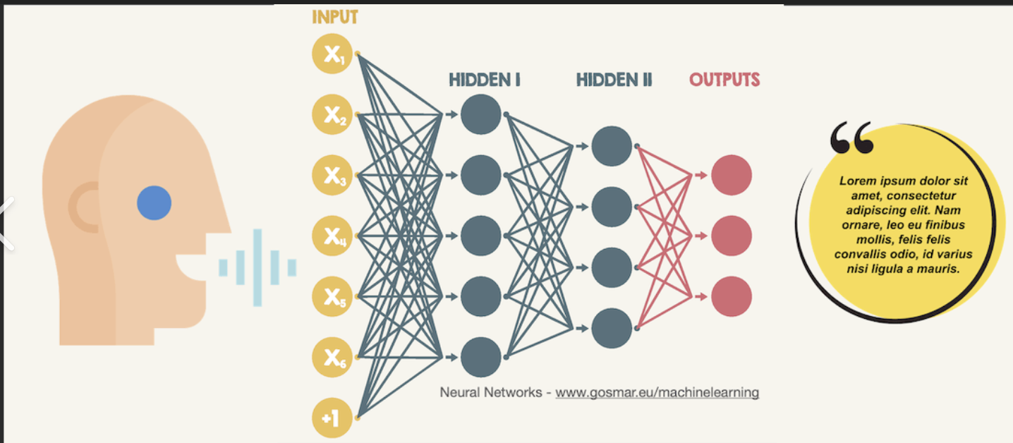
Deep learning definition and example
Mimic the human brain
More complex problems - more data needed
Select features and recognize patterns
Relationship-driven
Adapt the strength of the connections based on the learning of the information
Applications:
Image recognition
Natural language processing (NLP) to understand language

Slide 15
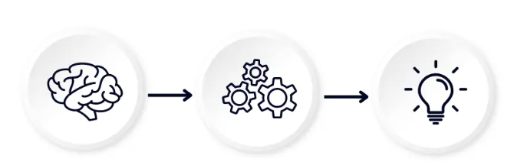
Generative AI and Large Language Model (LLM) - examples
Basic concepts of AI, ML, DL
Patterns -> generate new content (image, text, code)
LLM is NLP+GenAI
Use the neural network trained on massive amounts of text
Understand a sentence and predict next word (human-like language)
Based on attention - importance of every word in relation with all the other words to build a meaningful sentence
Applications:
GPT, Claude, Google gemini
AI - Core position paper

Slide 16
Machine Learning

Slide 17
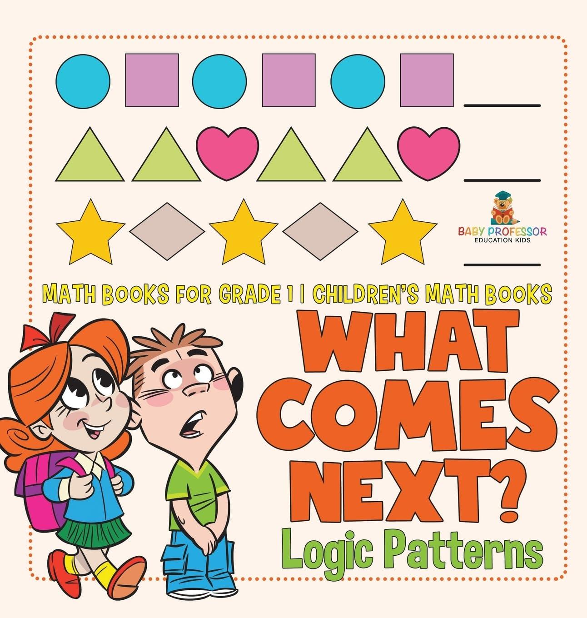
Aim of ML
Find patterns across a set of variables or features with the aim to define groups or predict a label

Slide 18
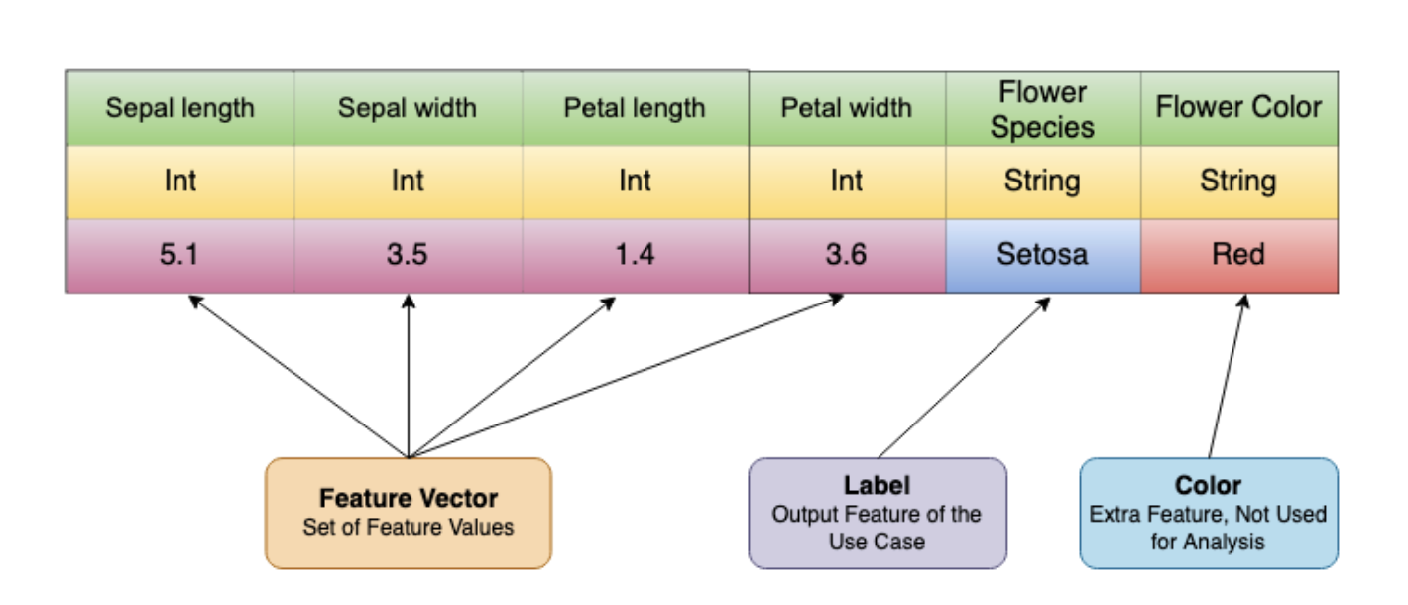
Input space
Data points that we need to group or classify
Collected features, characteristics, biological measures, variables for each data point
Feature vector is an n-dimensional vector of values of features that represent the data points
Input space -> transformed space where each dimension corresponds to a feature useful for learning (scaling the data, ...)
Easier to capture the underlying patterns in the data

Slide 19
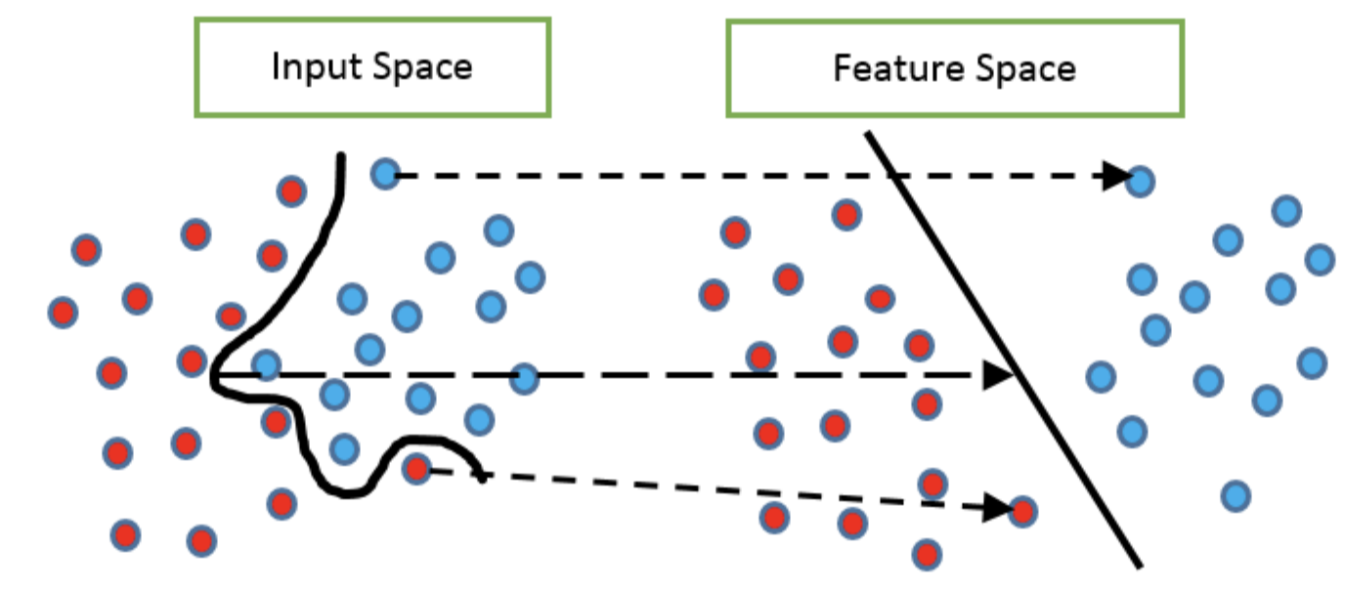
Feature space
The multidimensional space formed by all input features (variables) of a dataset
Each data point is a vector in this space
More features -> need more data to reliably learn patterns
Rule of thumb: Sample size should grow exponentially with the number of features
Sample size (10-30 times) >> number of features
More complex model -> more samples
Small datasets in high-dimensional spaces -> overfitting risk.

Slide 20
In biomedical research we aim to define groups of patients, mice, etc…given some biological characteristics
features
c1c2 c3
Groups
1
2
3
2
1
Patient 1
Patient 2
Patient 3
Patient 4
Patient 5
c1, c2, c3 are the features, (ex. gene expression of 3 genes)
c1 = high gene1 expression
low gene1 expression
Find patterns across characteristics (features) -> subgroups of patients

Slide 21
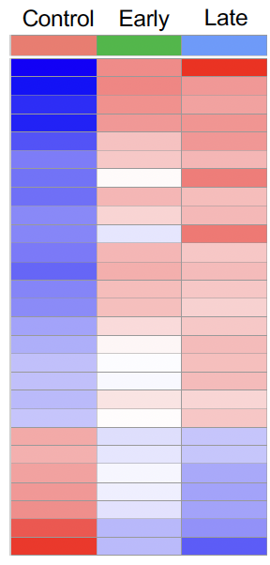
Find groups of genes with similar gene expression by condition
Analyse gene expression in control, early disease and late disease patients
Find patterns within each group
Find patterns between groups
Heatmap comparing gene expression changes in control, early disease and late disease groups
gene1
gene2
gene3
gene N
We identified two main clusters of genes with opposite gene expression trends across the three groups of interest

Slide 22
We want to predict an outcome based on a set of characteristics
features
c1 c2 c3
labels
Disease
yes
no
no
no
yes
Patient 1
Patient 2
Patient 3
Patient 4
Patient 5
The features c1, c2, and c3 can be categorical or continuous variables
c1 = smoking Y smoking N
Find patterns across characteristics (features)
Learn the relationship with the label
Predict the outcome on a new dataset
Features=Blood biomarkers levels -> outcome = disease/cancer

Slide 23
Machine Learning categories
Unsupervised:
Find patterns of unlabeled data (unknown categories/outcome) and subgroup
Supervised:
Find a model that maps input data to labeled data (known categories/outcomes) and predict outcomes in new dataset
Semi-supervised:
Use a small group of labeled data (some known outcomes) to learn and to predict a large group of unlabeled data
Reinforcement Learning (RL):
A system learn how to interact with the environment - observe, action, award and penalties

Slide 24
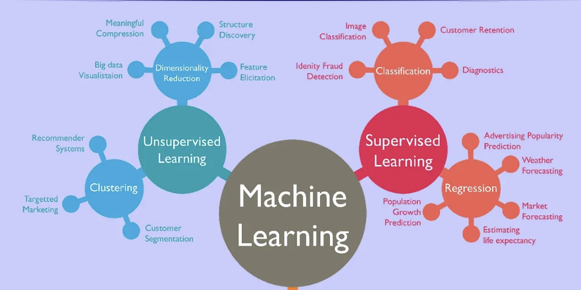
We focus on two main Machine Learning approaches

Slide 25
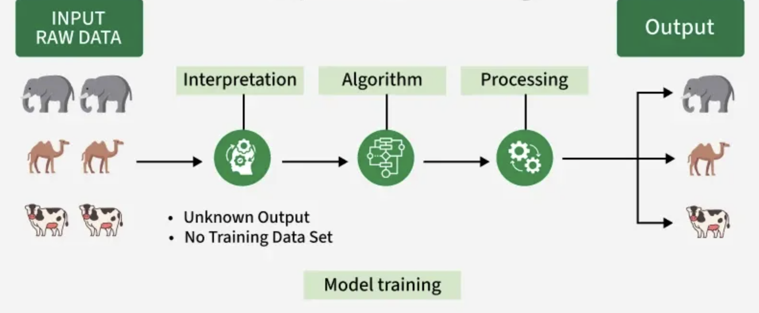
UNSupervised
Unsupervised Learning
Main approaches: Dimensionality reduction and clustering
Features for each animal: color, weight, …
The model is provided with the features of unlabeled data in order to identify relevant patterns that could discriminate the 3 different animals
Image from https://www.geeksforgeeks.org/machine-learning/unsupervised-learning/

Slide 26
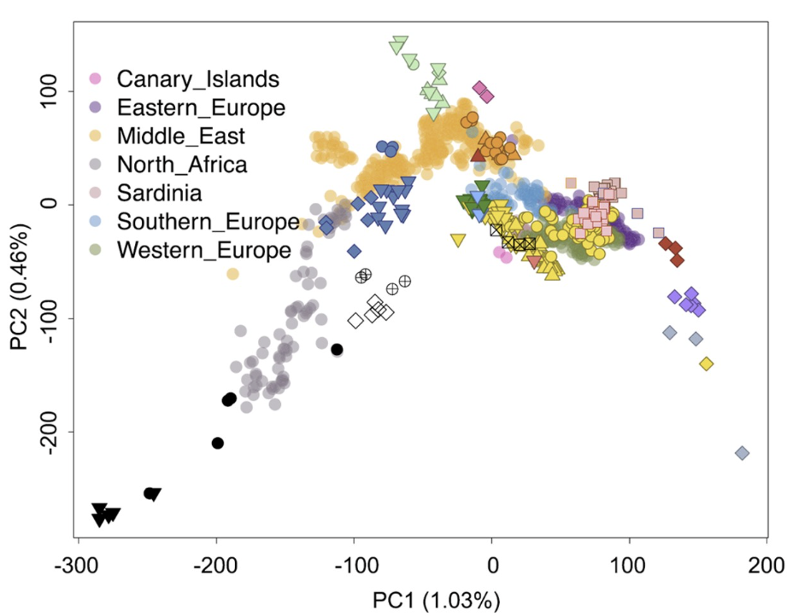
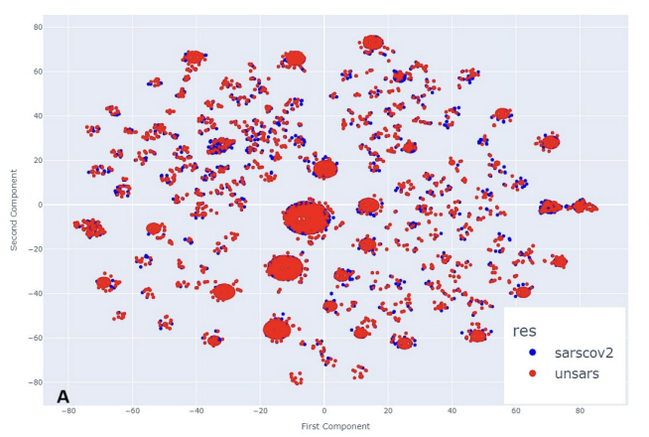
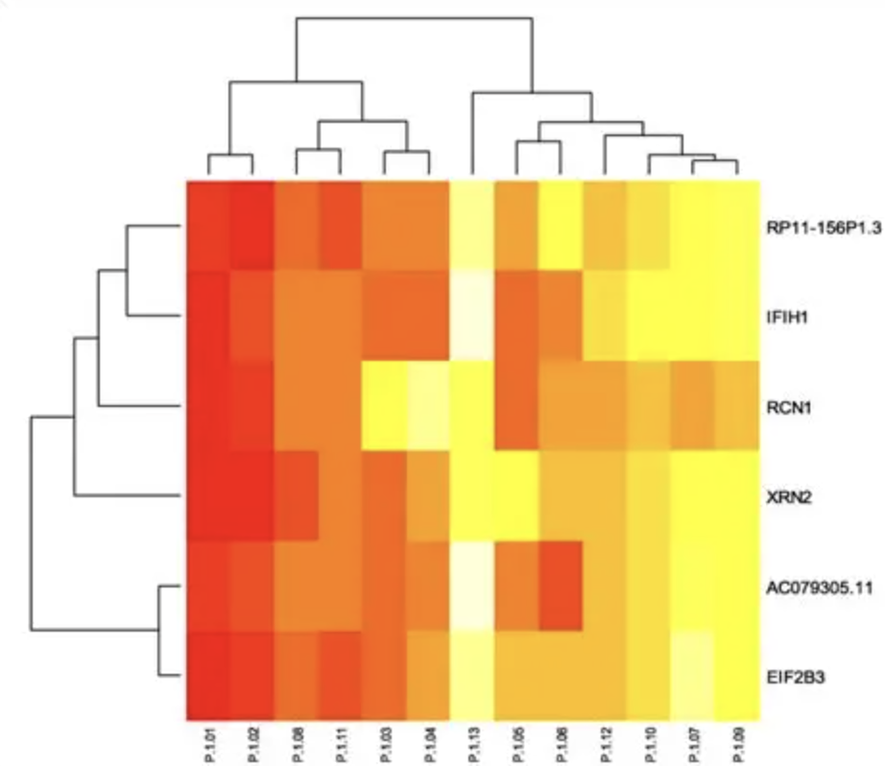
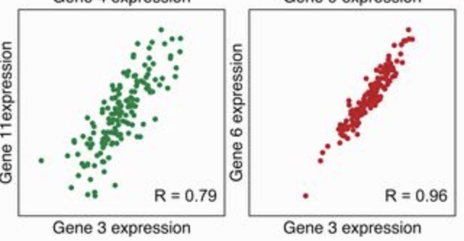
Unsupervised methods: the machine finds the hidden structure of the data
PCA - genetic ancestry
K-means clustering of patients showing similar symptoms of SARS-COVID19
Association - find co-occurrence of gene expression and define groups
Hierarchical clustering of heatmap of DEGs
gene 3+6= D1
gene 3+11=D2
gene
sample ID

Slide 27
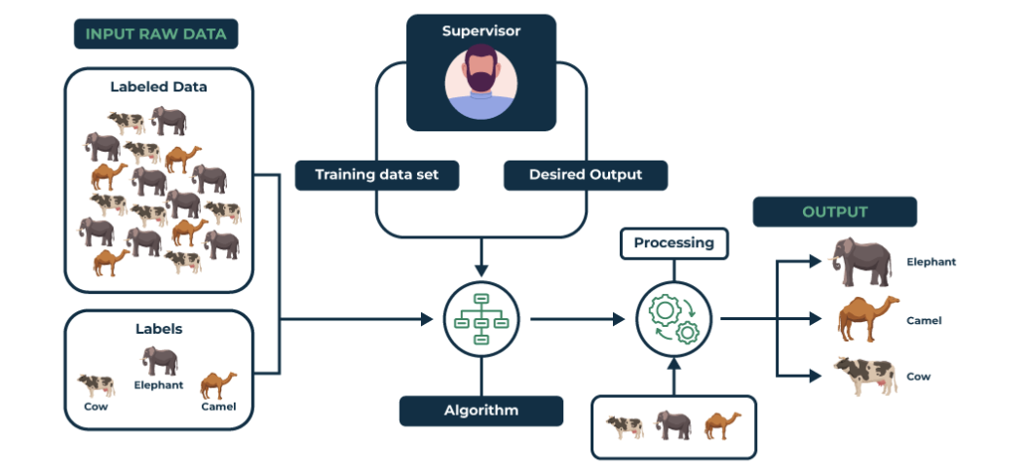
Supervised Learning
color=grey and weight=5000 kg -> elephant
color=tan and weight=1000 kg -> camel
color=spotted white and black and weight=1000 kg -> cow
color=light brown and weight=1000 kg -> cow
Cow or camel?
color=brown and weight~1000 kg

Slide 28
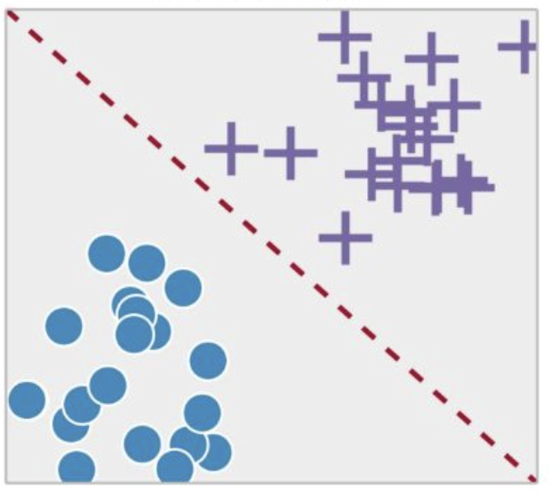
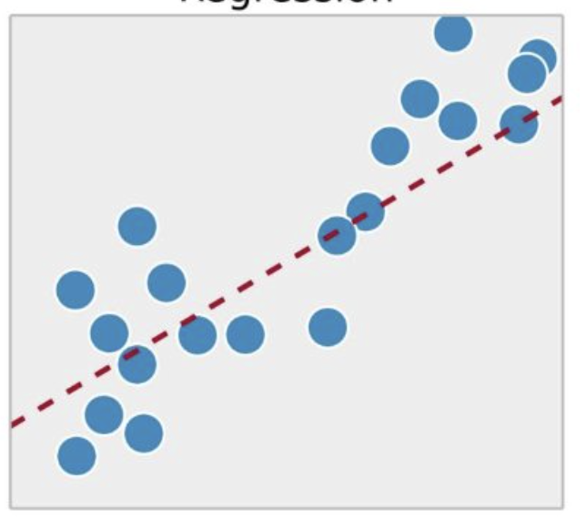
Supervised learning approaches
Classification - Model features to best predict categorical outcomes (disease affected vs unaffected or disease subtypes)
Regression - Model features to best predict continuous traits (human biomarker levels, mice histological measures)

Slide 29
Regression models for association analysis vs ML
Association analysis:
Is this SNP significantly associated with levels of cholesterol?
Is age and BMI associated with thyroid dysfunction?
Response variable (outcome/trait) and the predictor variable/s
Find the association between these two variables
Find the effect of the predictor on a the response variable
Estimate the statistical significance
ML analysis:
How well a set of features (age, BMI) can predict the thyroid dysfunction in a independent set of patients?
Find the best prediction

Slide 30
Poll 2. I performed a knockout experiment. I want to
cluster genes based on gene expression similarity.
What approach will you apply?
Supervised
Unsupervised

Slide 31
Poll 3. We have measured the brain volumes and brain gene expression in a group of mice.
We want to predict the brain volume measures using mice gene expression levels.
Which model will you apply?
Supervised regression model
Supervised classification model

Slide 32
Supervised machine learning analysis workflow

Slide 33
1.Define your biological question and what you want to predict
Classify individuals with a disease
Classify patients with a disease subtype
…
What is important? What would you like to minimize in your prediction?
individuals wrongly classified as affected / wrongly classified as non affected?
patients wrongly assigned to one disease subtype?
Costs, invasive diagnosis, therapies…

Slide 34
2. Which algorithm works best for my question and type of data?
Each algorithm fits the data in a different way
Each model may work best depending on your questions
Consider apply more than one method and compare (e.g. SuperLearner function in R applies multiple approaches)
Notes:
https://github.com/ecpolley/SuperLearner
https://rdrr.io/cran/SuperLearner/f/vignettes/Guide-to-SuperLearner.Rmd

Slide 35
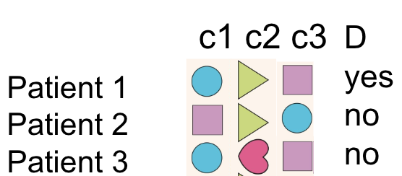
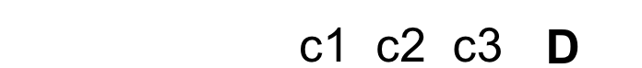
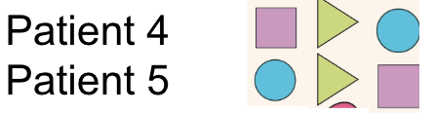
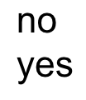
How much of the data to train the model?
features
c1 c2 c3
labels
D
yes
no
no
no
yes
Training set
Patient 1
Patient 2
Patient 3
Patient 4
Patient 5
Test set
yes
All dataset? -> how to evaluate the prediction on new data?
The dataset will be split in two sets - training (majority of the samples) and test dataset
Important! No same subjects in the training and test set or model overestimation
Ex. Training 70% - Test 30% or Training 80% - Test 20%
Be careful when splitting imbalanced case/controls data sets
Be careful with missing data
The model learn on the training set -> save the model -> predict the outcome of the labeled test set

Slide 36
How can we generate a prediction model that is ‘good enough’? How can we evaluate ‘good enough’?
Selecting the right set of features
Fitting the right model on the training
Tuning the algorithm parameters
Evaluating the model performance based on your expectation -> change the model accordingly

Slide 37
4. Feature selection
Biological question: I want to predict IVF success rate (label)
Which features may be the most useful?
number of baseline follicles
mother age
sperm motility
mother height
donor/partner age
maternal ancestry
alcohol consumption

Slide 38
Data leakage
Biological question: I want to predict IVF success rate (label)
In the predictive model, can I use the feature ‘child born date’?
Information from outside the training data accidentally influences the model during training
Incorrect use data that are related to the outcome to predict
Predict if a student pass the exam
Include ‘hours of study per day’ and ‘grade’

Slide 39
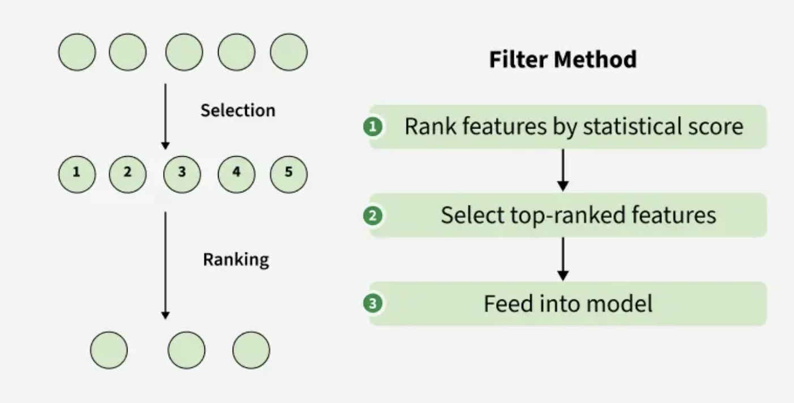
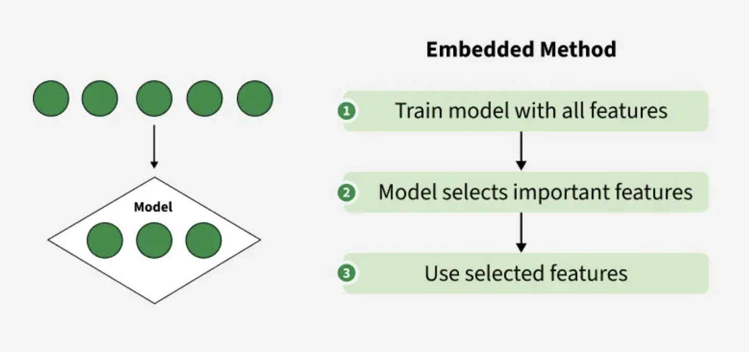
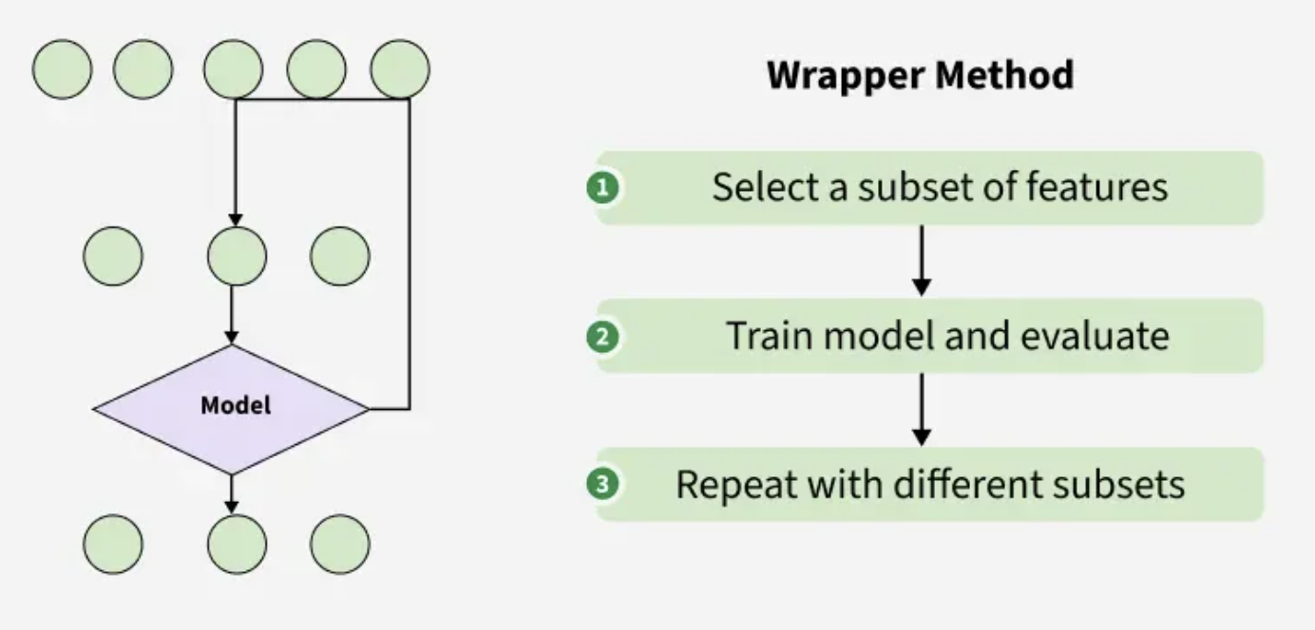
Feature selection methods and advantages
Learn on only important features
Reduce computation time
Easier understanding of the model behavior
Reduces complexity with high-dimensional data

Slide 40
Break
See you in 5 minutes

Slide 41

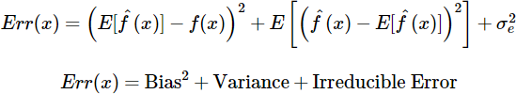
5. Fitting the Training model
Good prediction model = good fitting of your data
Balance of Bias and Variance
Bias
Variance
Bias: model fails to capture the true relationship between input and output
Variance: model learns noise from the data and fails to generalize

Slide 42
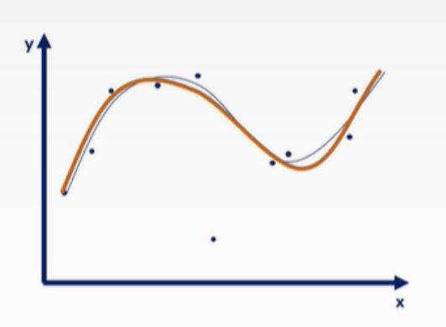
Good fitting

Slide 43
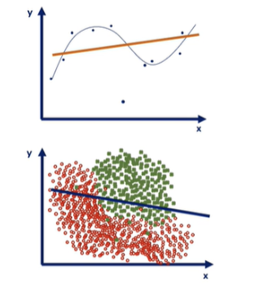
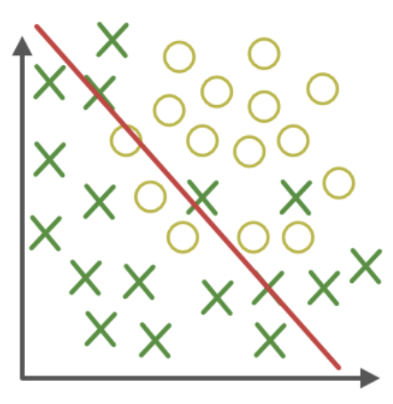
High bias (low variance)
Model too simple, underfitting ->
poor performance on the training and on the test
Tips:
Add more informative features / interaction terms
More complex model

Slide 44
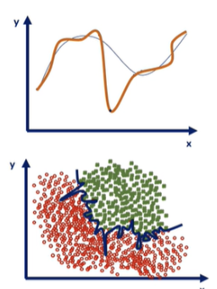
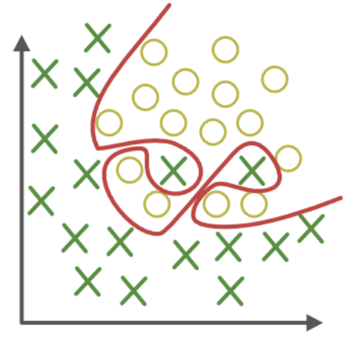
High variance (low bias)
Model fit too close the data capturing noise, overfitting
Great performance on the training set
Poor performance on the test/not generalizable
Tips:
Remove features from the model
More data

Slide 45
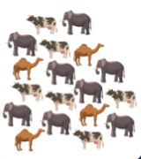
How can we select a model that balances variance & bias?
Cross Validation
k-Fold CV
TRAINING SET split in K folds

Slide 46
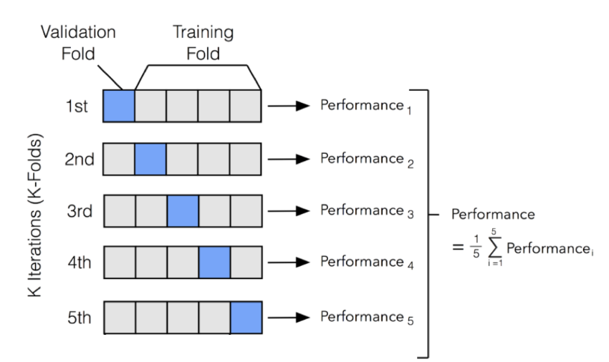
Cross validation is an iterative process
Iteration 1
1 fold SET
K-1 folds TRAINING SET

Slide 47
Cross validation is an iterative process
Iteration 2
1 fold SET
The model is trained and tested on multiple data splits
Bias and variance can be balanced
K-1 folds TRAINING SET

Slide 48
Cross validation approaches and R packages
k-Fold CV
Leave-One-Out CV - maximizing the data training
Repeated k-Fold CV - repeat n times the k folds random selection
Stratified k-Fold - keep proportion of each class
Several R packages:
caret
rsample
SuperLearner - stratified CV

Slide 49
6. Hyperparameters tuning to find the best model configuration and improve the prediction on new data
Variables that change how the algorithm works
Some algorithms needs hyperparameters tuning (set the number of decision trees, …) or learned from data (number of selected features, …)
Use a range of parameters and Cross Validation to help parameters selections
Choose the best set of parameters

Slide 50
7. Performance evaluation
Most models output a probability/score
If so, set a cutoff to transform score to labels
Evaluate how well predicted labels match the actual outcome
Labelled Test set
P
cutoff=0.5
True labels
Patient 4
Patient 5
0.1
0.45
10% confidence that the input belongs to class YES
45% confidence that the input belongs to class YES
no
no
YES NO
True labels
Patient 4
Patient 5
no
no
0.1 0.9
0.45 0.55

Slide 51
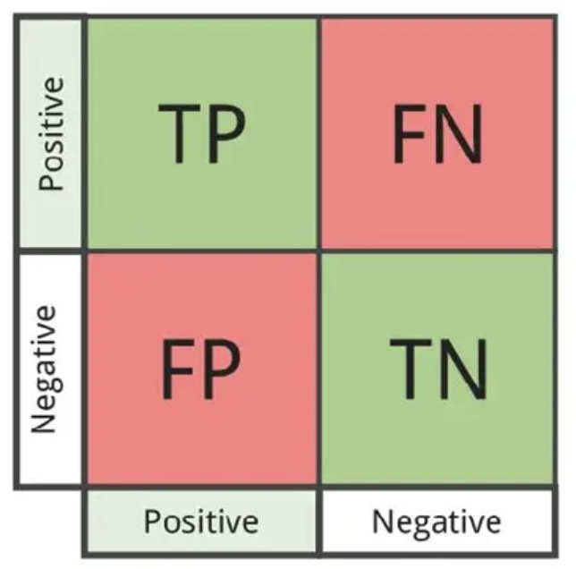
Count predicted and actual labels and evaluate
c1 c2 c3
D
yes
no
no
no
yes
Patient 6
Patient 7
Patient 8
Patient 9
Patient 10
TP
FP
1
1
predicted
predicted
FN
TN
1
2
2
P
cutoff=0.5
Patient 6
Patient 7
Patient 8
Patient 9
Patient 10
0.8
0.1
0.2
0.55
0.45
yes
no
no
yes
no
actual
actual
T: True; F: False
P: Positive; N:Negative

Slide 52
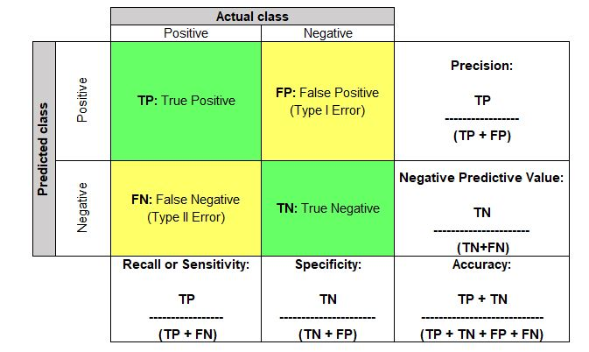
Confusion matrix and metrics
% of positive predictions that are actually correct
1
1
predicted
% of negative predictions that are actually correct
1
2
actual
% of outcome correctly predicted
% of negative correctly predicted
% correctly predicted overall (e.g. yes and no)
TPR

Slide 53
Metrics interpretation
High precision - when the model predicts positive is usually right
High recall - only few positive outcome are missed
High specificity - very few false positive
High accuracy - most predictions are correct

Slide 54
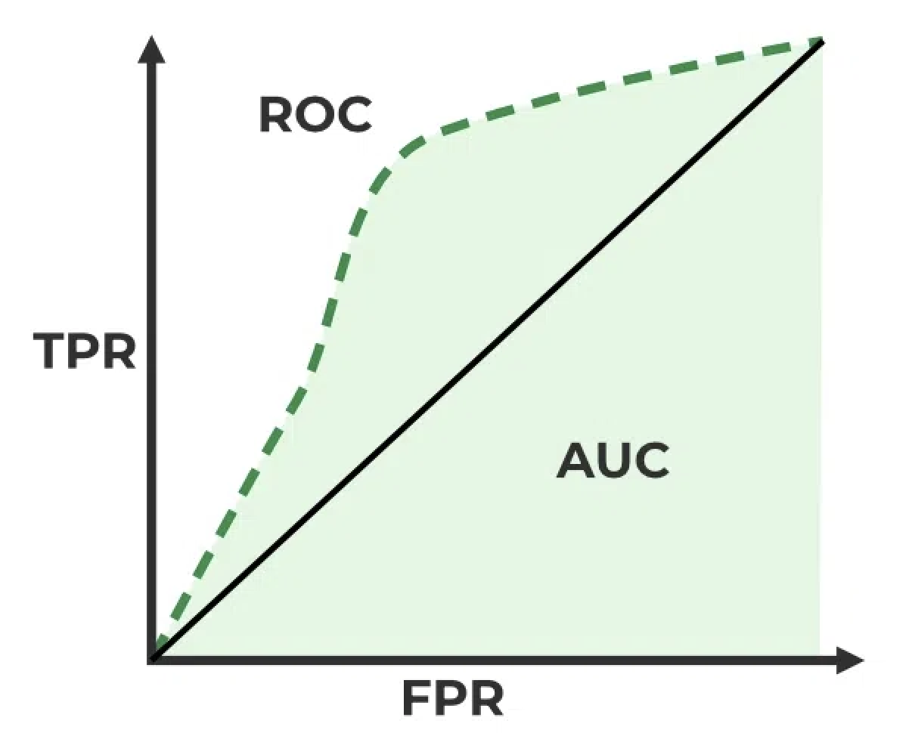


ROC (Receiver Operating Characteristic) and AUC (Area Under the ROC Curve)
ROC - performance curve of TPR vs FPR across thresholds
how many actual positives are correctly predicted as positive
AUC: good >0.5 - 1 perfect - below 0.5 poor
How well the model classify / separate positive and negative classes
how many actual negatives are incorrectly predicted as positive

Slide 55
Break
See you in 5 minutes
Please fill the survey
https://www.surveymonkey.com/r/bioinfo-training

Slide 56
ML algorithms

Slide 57
Poll 4. I have behavioral measures on a set of mice and I want to find subgroups of mice with similar behavior.
Which learning method will you apply?
Supervised learning method
Unsupervised learning method

Slide 58
Poll 5. I have a cohort of individuals with variants information and disease status.
I want to generate a machine learning model to predict disease status.
Which learning method will you apply?
Supervised learning method
Unsupervised learning method

Slide 59
Unsupervised ML: K-means clustering steps
Partitioning data into k clusters by minimizing the within-cluster sum of squared distances (Lloyd algorithm).
Decide k number of clusters expected
Start: Random centers (centroids)
Take the sum of the squared distance between data points and all centers
Assign a cluster membership to each data point
Compute new centers
End: if the centers donʼt change OR meet iteration threshold

Slide 60
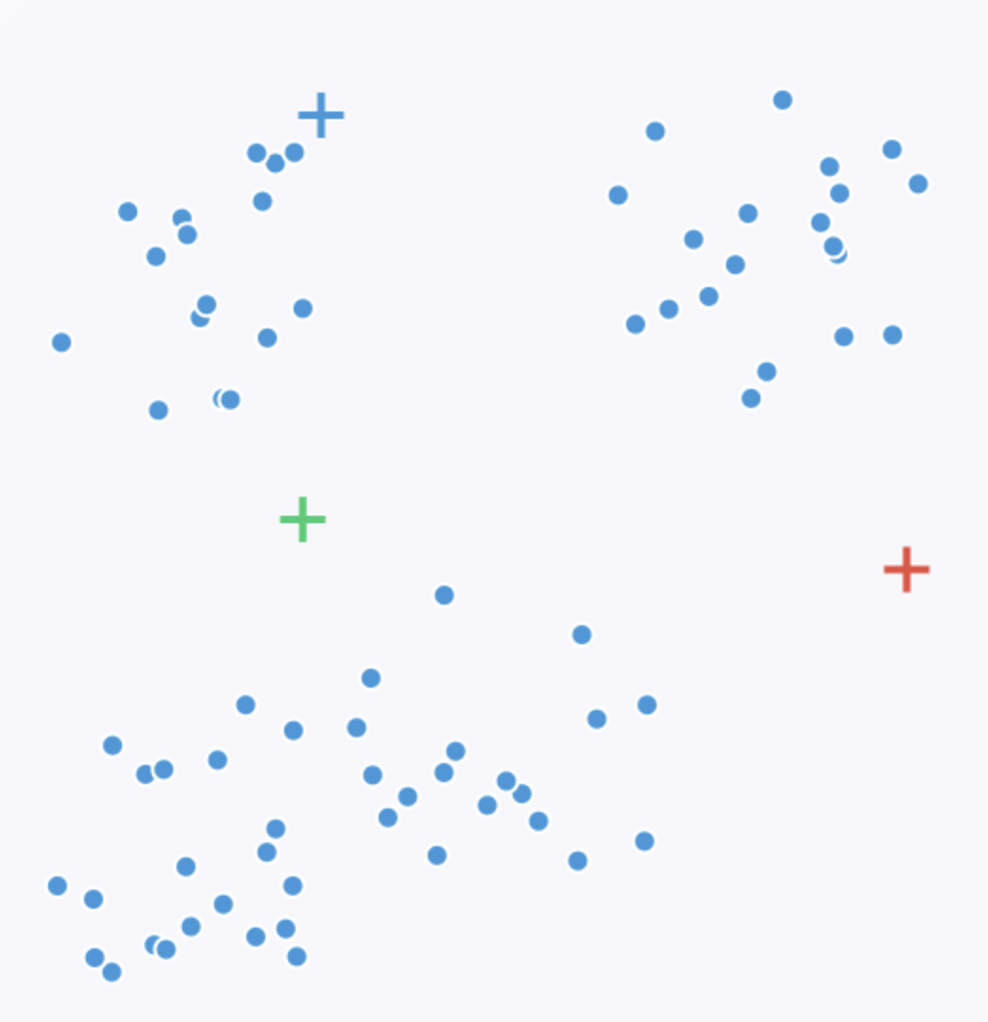
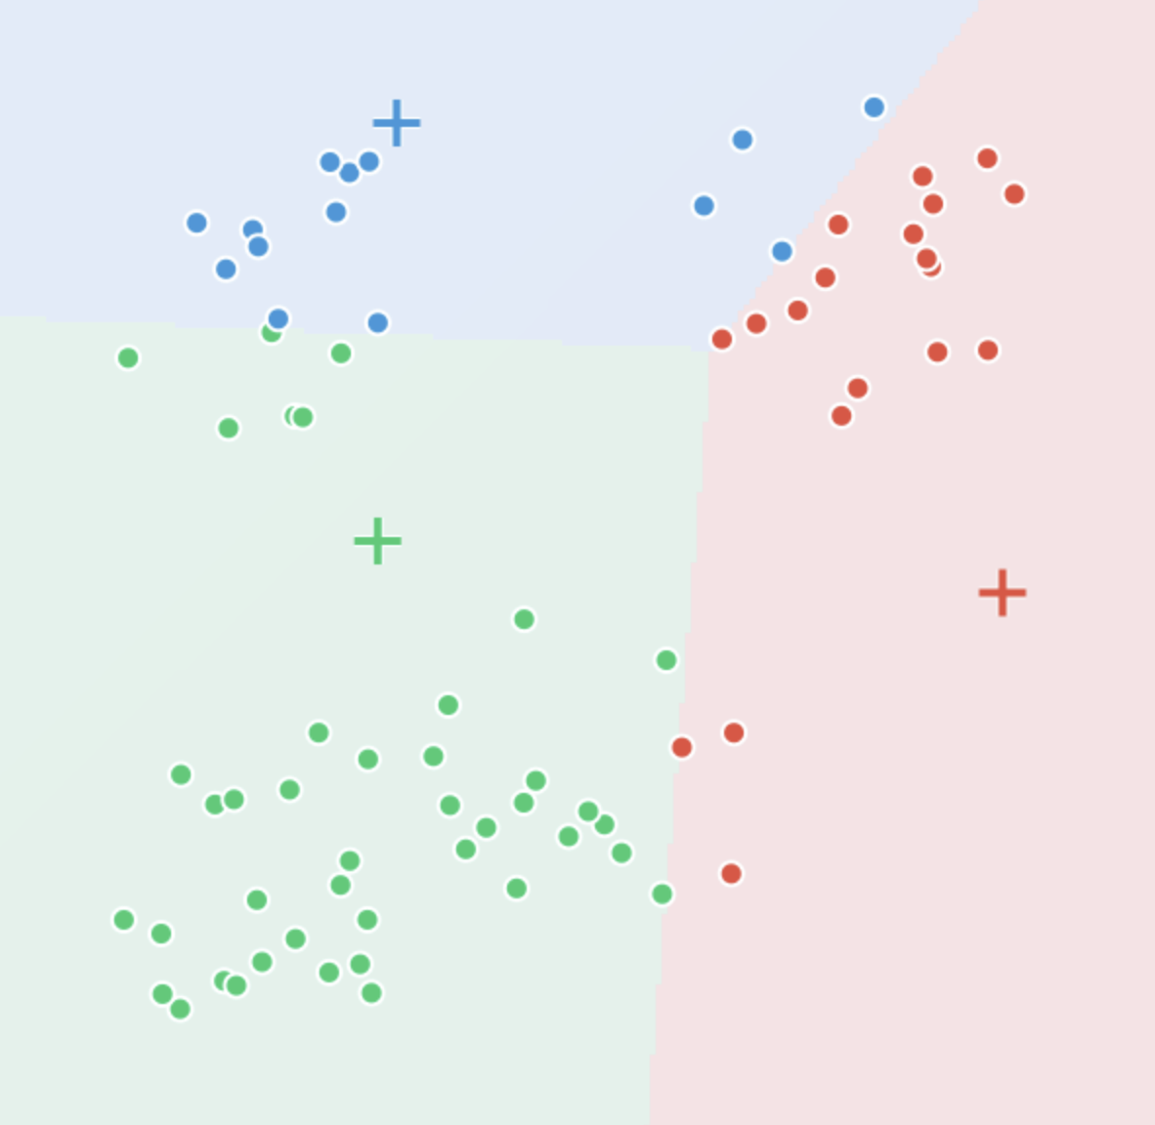
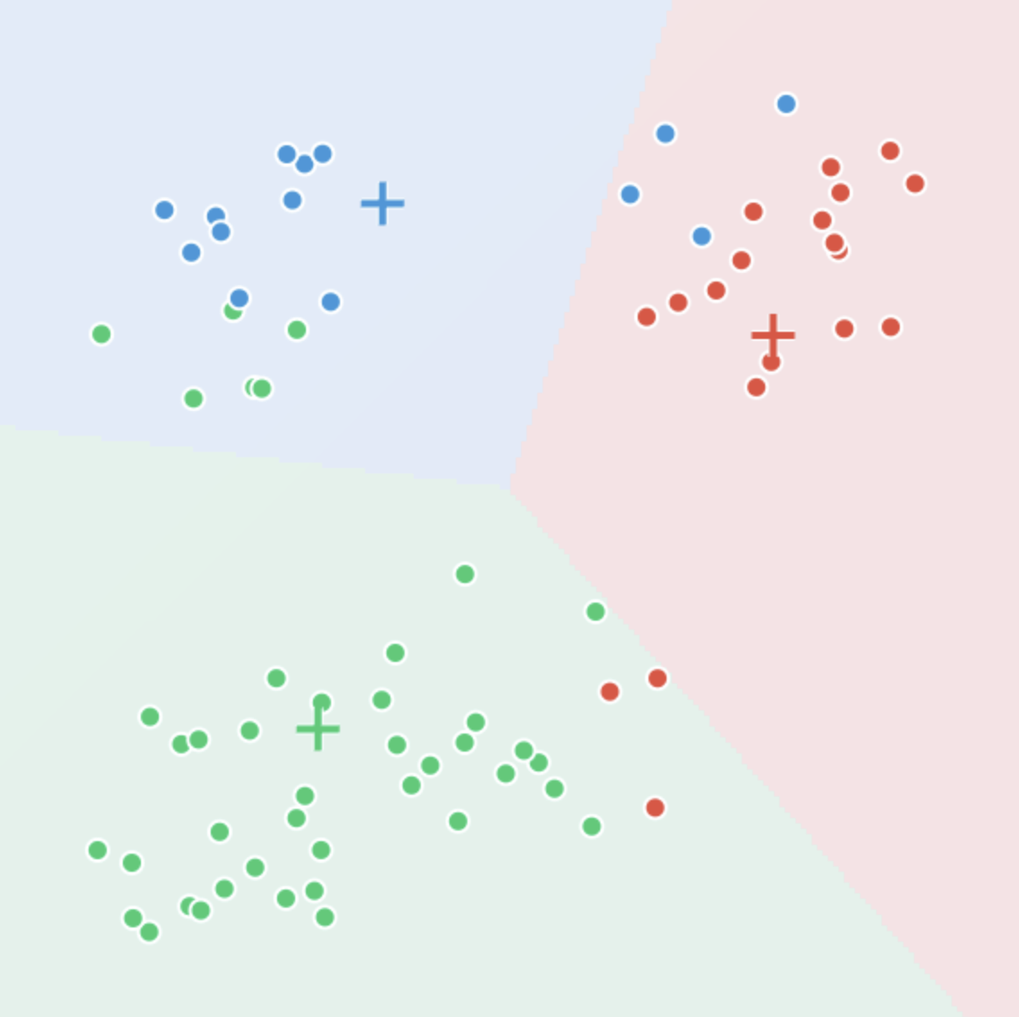
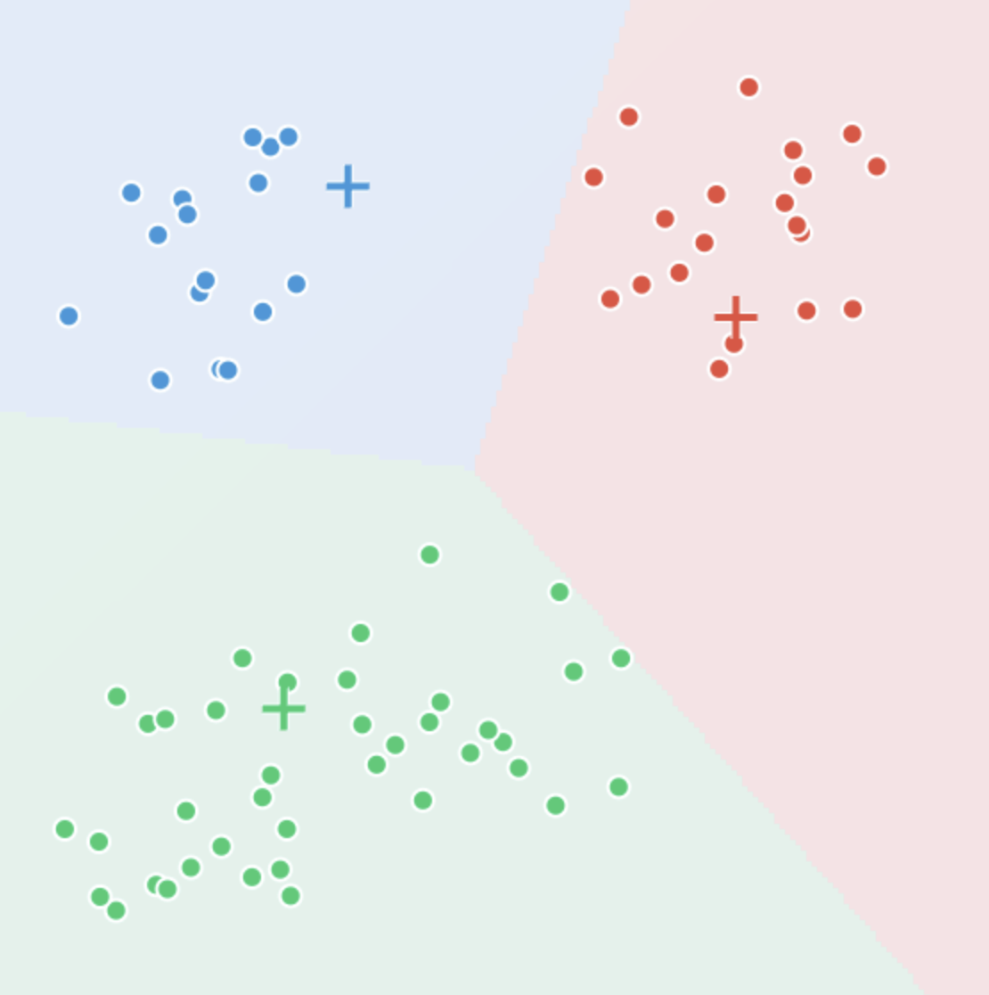
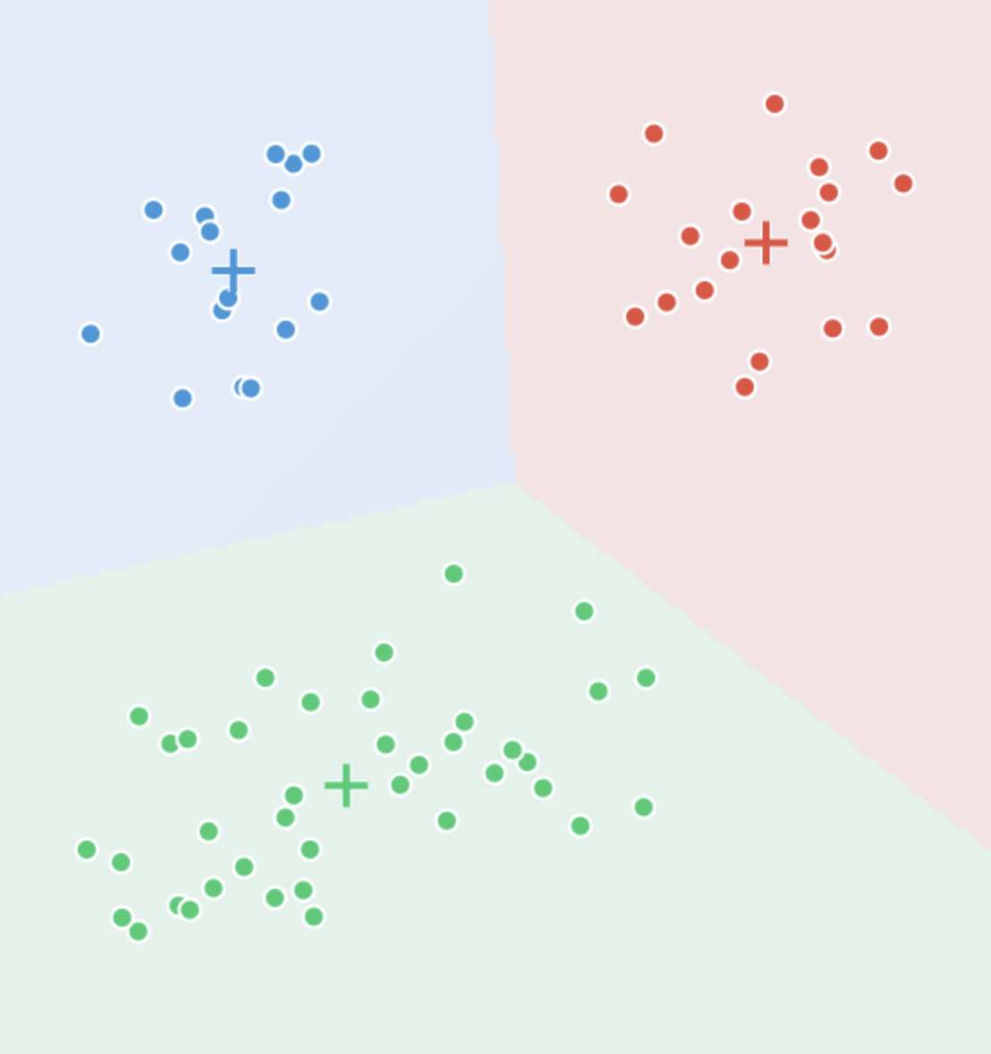
K-means clustering iterations
i=1
i=2
i=3
final setting

Slide 61
K-means clustering Pros and Cons
Pros:
Simple and fast
Cons:
Sensitive to the initial random selection of centers
Computationally expensive
Sensitive to the scale of data and outliers
47

Slide 62
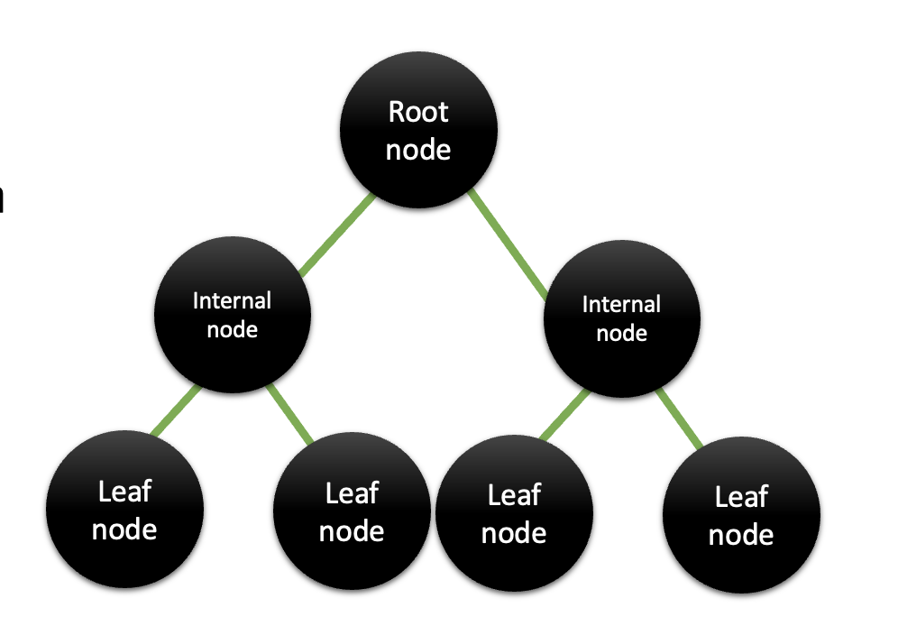
Supervised ML: Decision Tree
Supervised approach
Map of the possible outcomes of a series of related choices
Splitting data based on features
Decision tree
Node: decision points based on features values
Leaf node: label - final predictions
Edge: connection between nodes - outcomes of the decision

Slide 63
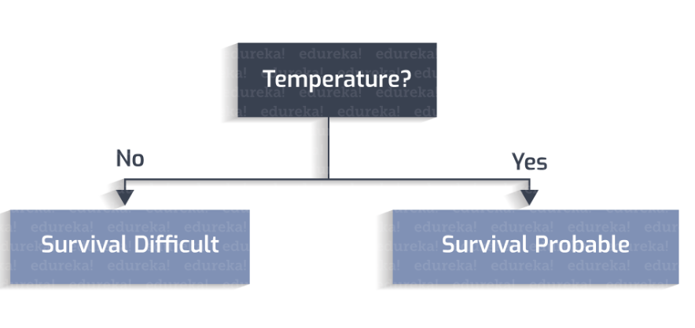
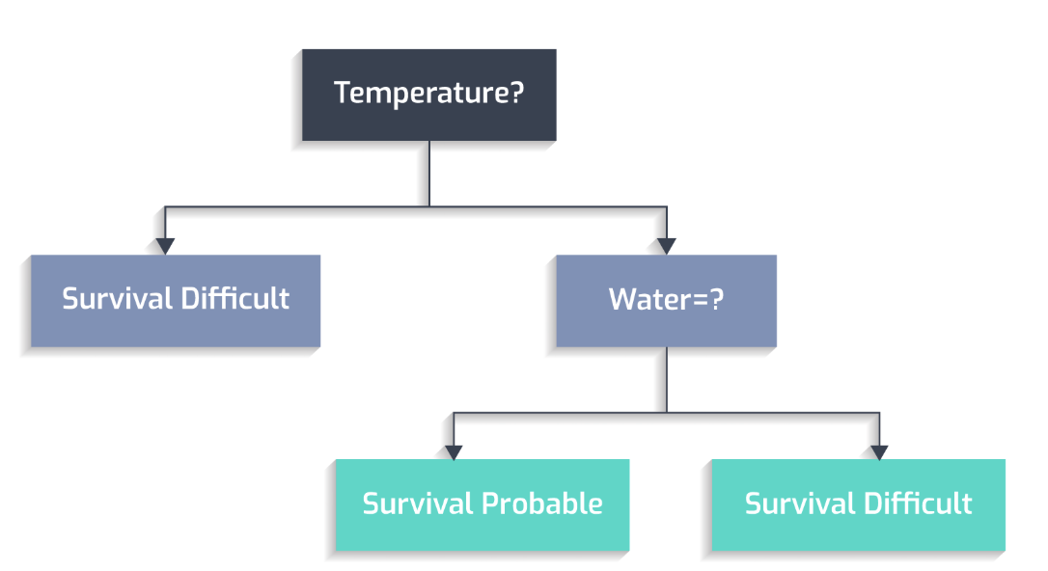
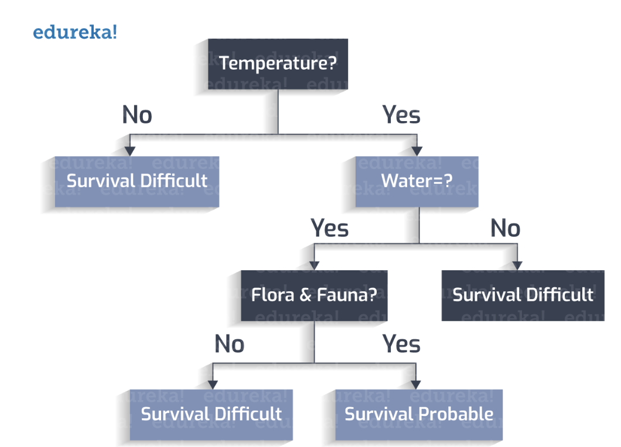
Decision tree answer a big question by a sequence of simple questions that lead to a clear decision
We have discovered a new planet - we ask the question whether would be possible to live there
Range of survival temperature 0-100C
Is there water?
Are there animals/plants?

Slide 64

How does a decision tree work
Start with all data at the root
Choose the best feature to split the data using metrics like:
Gini Impurity - how impure a node is (0 pure)
Split the data into subsets.
Repeat recursively until:
All data in a node belongs to the same class, or
Maximum depth is reached.
proportion of class i in the node

Slide 65
Decision tree example
Alzheimer’s disease and healthy individuals
30% AD
Patients
age > 55yo
Patients
Patients
30% AD
70% AD
learning impairment

Slide 66

Random Forest
Random Forest = Ensemble of many decision trees
Uses bagging (bootstrap aggregation): trains trees on random samples of data
Randomly selects a subset of features at each split (mtry in R)
Left out ⅓ - out of bag samples
Each tree votes; the majority vote is the final prediction of oob samples
oob error rate - Reduces overfitting compared to a single tree
More robust and accurate

Slide 67

XGBoost (Extreme Gradient Boosting)
XGBoost = trees built sequentially, each one correcting the previous tree’s mistakes
Uses gradient boosting: each new tree fits the residual errors of the trees before it
Predictions are combined by a weighted sum of all trees, not a vote
Built-in regularization (L1/L2) and a learning rate help control overfitting
Often more accurate than Random Forest, but has more parameters to tune

Slide 68
Random Forest vs XGBoost
Random Forest (Bagging)
XGBoost (Boosting)
Trees trained in parallel, independently of each other
Each tree trained on a random bootstrap sample
Combined by majority vote / average
Reduces variance by averaging over many trees
Fast to train — trees can run in parallel
Fewer hyperparameters to tune
Great robust baseline, harder to squeeze out extra accuracy
Trees trained sequentially, each depends on the last
Each tree trained to fit the residual errors (the loss gradient — exact for regression, an approximation for classification)
Combined by weighted sum (additive model)
Reduces bias by targeting mistakes directly; controls variance via regularization
Slower to train — trees depend on each other
More hyperparameters (learning rate, depth, regularization)
Often wins on accuracy, needs careful tuning to avoid overfitting

Slide 69

XGBoost example
Predicting IVF success rate — same dataset and features as our feature selection example
any single tree can split on multiple feature
Each new tree focuses on the patients the previous trees got wrong — the final prediction is their weighted sum

Slide 70
Break
See you in 5 minutes
Please fill the survey
https://www.surveymonkey.com/r/bioinfo-training

Slide 71
Where to find the algorithms in R and Python
Unsupervised methods:
PCA (stats::prcomp() or princomp(), FactoMineR)
k-means (stats::kmeans())
UMAP/ tSNE (umap, Rtsne, Seurat, etc)
Supervised methods:
LDA (MASS)
kNN (caret, class, …)
Naive Bayes (e1071, ..)
Random forest (randomForest, ranger, SuperLearner, ..)
Xgboost (xgboost)
Support Vector Machine (e1071, ..)
Neural Network (nnet, keras, …)
Python packages and tutorials available in scikit-learn

Slide 72
Take-home messages
Building a good supervised model is a iterative process select features, manage bias/variance, tune hyperparameters, evaluate, and repeat
The right features matter more than the number of features
Balance bias and variance so that the model generalizes
Tune parameters on validation data, never on the test set
A model is only as good as its performance on data it has never seen

Slide 73
Your feedback is important to us!
Please take the survey ~3 min:
https://www.surveymonkey.com/r/bioinfo-training26

Slide 74
Upcoming workshops at Gladstone:
Introduction to RNaseq analysis
September 28-29
AI fluency for Biologists
October 5-6
Single Cell RNA-Seq Analysis using R
October 12-13
Introduction to Pathway Analysis
October 15
Statistics of Enrichment Analysis Methods
October 22-23
Linear Mixed Effects Models Using R
October 26-27

Slide 75
Hands-on

Slide 76

Dataset
Coronavirus Disease 2019 (COVID-19) Clinical Data Repository: https://covidclinicaldata.org/
A COVID-19 clinical dataset to introduce machine learning concepts. The dataset contains patient symptoms, vitals, and COVID-19 test outcomes.
We use predictor variables (symptoms, comorbidities, vitals) to estimate the probability of an outcome variable (positive or negative COVID-19 test).
Important note: Our focus is on building technical skills in machine learning. Although some symptoms or combinations of symptoms may correlate with test results, our goal is not to build a highly predictive model for COVID-19. Instead, we use this dataset to motivate exploration of ML techniques and concepts.

Slide 77


