Slide 1
ISO 27001 REQUIREMENTS
Prepared by Quality Solutions Limited

Slide 2
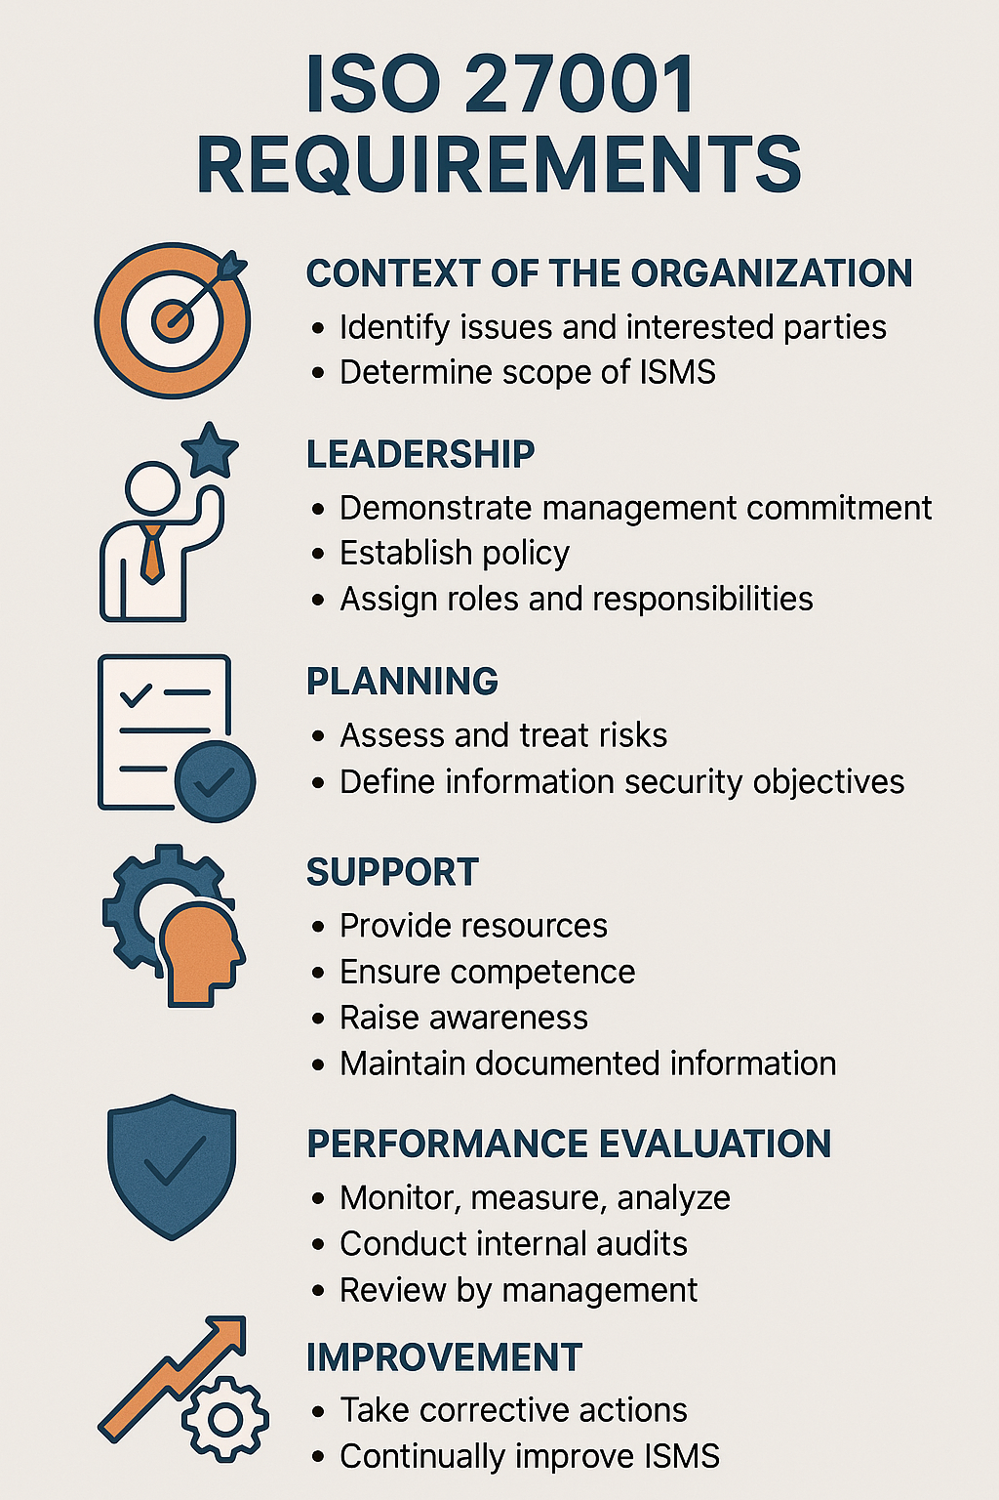
ISO 27001 Infographic

Slide 3
🌍 1. Context of the Organization
• Identify internal and external issues affecting information security.
• Define interested parties and their requirements.
• Establish the scope of the ISMS.

Slide 4
👥 2. Leadership
• Top management commitment to ISMS.
• Establish and communicate information security policy.
• Assign roles, responsibilities, and authorities.

Slide 5
⚙️ 3. Planning
• Conduct risk assessment and risk treatment.
• Set measurable information security objectives.
• Develop risk treatment plan aligned with business goals.

Slide 6
🧰 4. Support
• Provide necessary resources (people, tech, budget).
• Ensure competence and awareness.
• Establish communication processes.
• Maintain documented information.

Slide 7
🔄 5. Operation
• Carry out risk assessments regularly.
• Implement and manage risk treatment plan.
• Control outsourced processes and supplier relationships.

Slide 8
📊 6. Performance Evaluation
• Monitor and measure ISMS effectiveness.
• Conduct internal audits.
• Perform management reviews.

Slide 9
🚀 7. Improvement
• Take corrective actions for nonconformities.
• Apply continual improvement to strengthen ISMS.

Slide 10
🛡️ Annex A – Controls
• 93 controls grouped into 4 themes:
• Organizational (policies, compliance, incident management).
• People (training, awareness, screening).
• Physical (facility access, environmental security).
• Technological (encryption, backup, monitoring).

