Slide 1
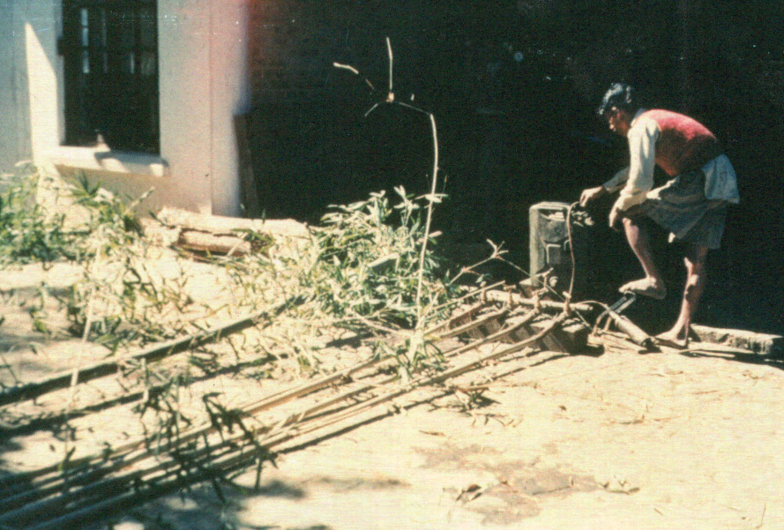
TRANSFER OF TECHNOLOGY MODEL
VILLAGE BAMBOO PRESERVATION UNIT
INTERNATIONAL NETWORK FOR BAMBOO AND RATTAN

Slide 2
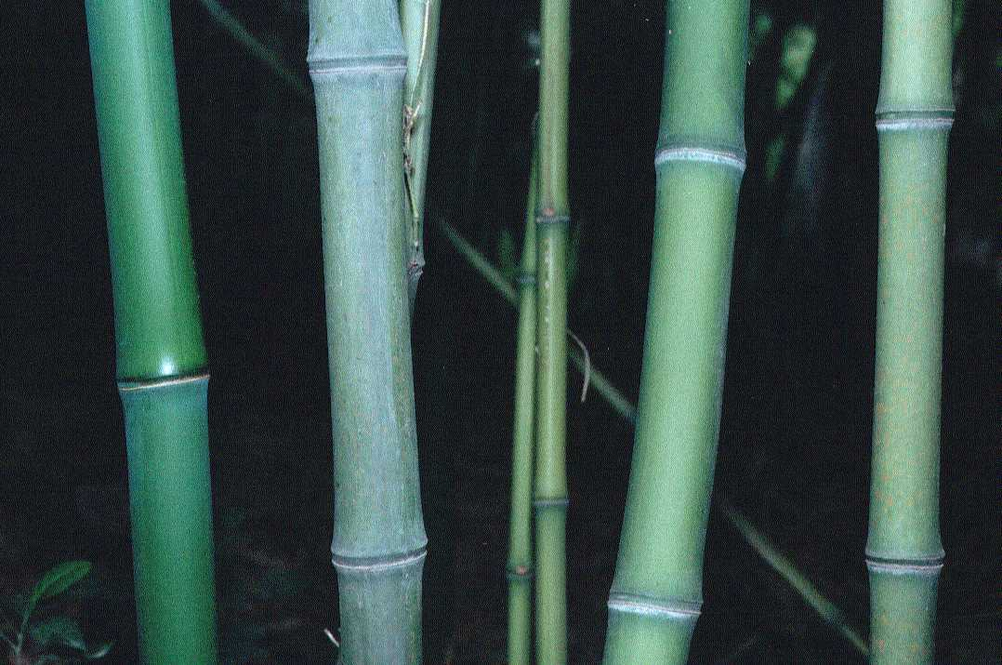
Why bamboo?
Bamboos grow more rapidly than trees and start to yield within three or four years of planting.
Plantation establishment requires minimal capital investment and builds upon the inherent plant-cultivation skills of local farmers and foresters.
Bamboos can be harvested annually and non-destructively.
Bamboos are excellent for rejuvenating degraded lands and protecting against soil erosion.
Bamboos may easily be intercropped with shallow-rooted crops.
As well as the culms, all other parts of the bamboo plant can be used in rural livelihoods - shoots for food, leaves for fodder, and branches for items such as brooms and for firewood.

Slide 3
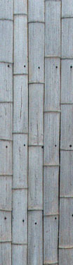
Why preserve bamboos?
Bamboos are a natural material and will decay with time. They are also susceptible to insect and fungal attack.
Preserving bamboos increases the durability of the culms and increases the lives of the products they are used to produce. It also increases the safety of any structures in which they are used as load bearing members. If used as structural components they need to be replaced less often which reduces costs in the long term.
Preserved bamboos fetch higher prices than non-preserved bamboos.

Slide 4
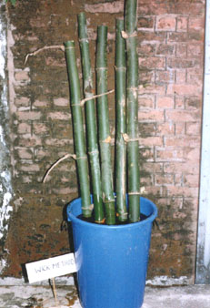
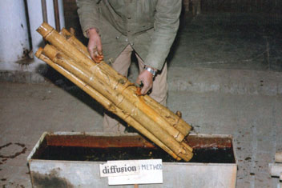
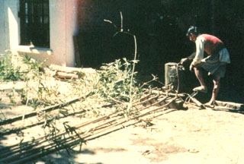
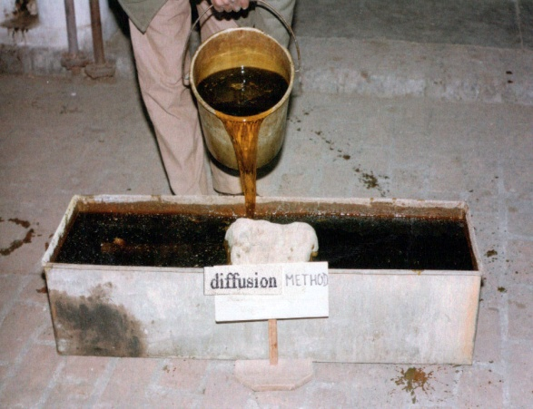
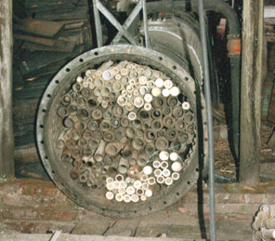
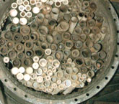
What are the main methods of bamboo preservation?
1. Sap displacement: The 2. Diffusion process: Culms 3. Boucherie process:
sap of the bamboo is are fully immersed in Preservative is pumped
replaced by preservative. preservative. through the bamboo.
4. Hot and cold process: 5. Full cell (Bethel) process: 6. Empty cell process: As the
Bamboo is kept in hot Preservative is forced into Bethel process, but pressure
preservative for 2-3 the bamboo under high is released in the vessel to
hours. pressure. expel excess preservative.

Slide 5
Main development attributes of a village bamboo preservation unit
Reduces dependence on timber resources and thereby increases environmental protection and conservation.
Permits rehabilitation of degraded lands through increased areas of bamboo plantations.
Creates income-generating opportunities for bamboo growers who will supply the unit, and employment for unskilled and semi-skilled workers at the unit.
Requires minimal capital investment to establish.
Promotes greater acceptability of bamboo, with consequent benefits for all aspects of the community involved with bamboo.

Slide 6
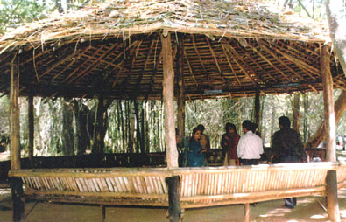
Some salient facts
Bamboo culms have a life of only 3 years once severed from the plant, and often much less.
The earliest preservation treatment for bamboo was soaking in water. This is still effective on a very small scale and for a short time, but modern preservatives are more effective in the long term.
As a primary processing activity the preservation unit is ideally established as one of the central core units in a broader, community-based, bamboo development programme, along with a bamboo splitting and slivering unit and a bamboo propagation unit.
Preservation of bamboo is an intermediate stage between cultivation and final processing and requires good linkages to the final processors.
Treated bamboo can be sold for double the price of untreated bamboo.
Photo: A hut made of preserved bamboo

Slide 7
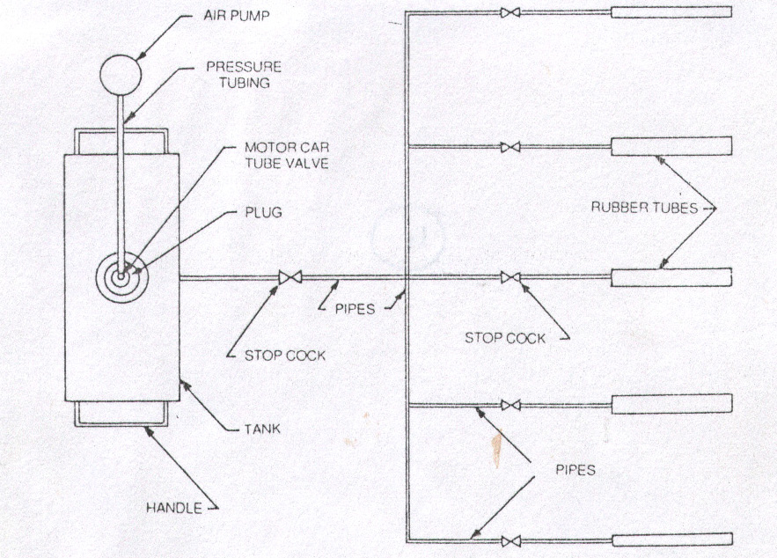
Requirements for success
Sustained supply of bamboos.
Some technically-trained personnel to manage and maintain the unit.
A small amount of start up capital.
Willingness of the village community to establish a cooperative.
Proper linkages to the users of the treated culms.
Left: Schematic diagram of the modified Boucherie preservation process.

Slide 8
Financial aspects of a village bamboo preservation unit
START UP COSTS (US Dollars)
Steel drum for steeping
and sap displacement. $5
Steel tank for diffusion or $500
masonry tank for diffusion. $200
Boucherie equipment.
(for 50 bamboos at a time) $500
Hot and Cold bath $2000
Pressure cylinder $5000
RUNNING COSTS
Bamboo purchase 10-15 cents/m
Treatment cost 5-8 cents/m

Slide 9
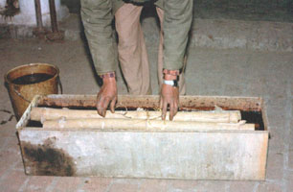
For further information
See
TOTEMs
Bamboo preservation by sap displacement.
Rattan oil curing, bleaching and preservation
Websites
INBAR: www.inbar.int
FRI Dehradun: www. envfor.nic.in/icfre/fri/fri.html
Books
Bamboo Preservation Techniques -
A Review. 1994.
By Sathish Kumar, K.S. Shukla, Indra Dev,
P.B. Dobriyal. Published by INBAR and ICFRE
(available as text file at:
http://www.inbar.int/publication/publmain.asp?catecode=pp)
Contact
INBAR, Beijing 100101-80, China
Forest Research Institute, 40 Trevor road, New Forest, Dehradun, 248 006, India

