Slide 1
Intro to Vim
Subil Abraham
Oak Ridge Leadership Computing Facility
Oak Ridge National Laboratory
January 20, 2021

Slide 2
Questions to answer
What is Vim?
How do I use Vim?
Where can I learn more about Vim?

Slide 3
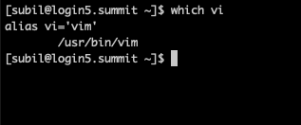
What is Vim?
“Vim is a highly configurable text editor built to enable efficient text editing. It is an improved version of the vi editor distributed with most UNIX systems”
Modal command-line text editor
Common in HPC environments
Edit source code, job submission scripts, config files, & others!
Vi and Vim are often used synonymously
Vim is a superset of Vi

Slide 4
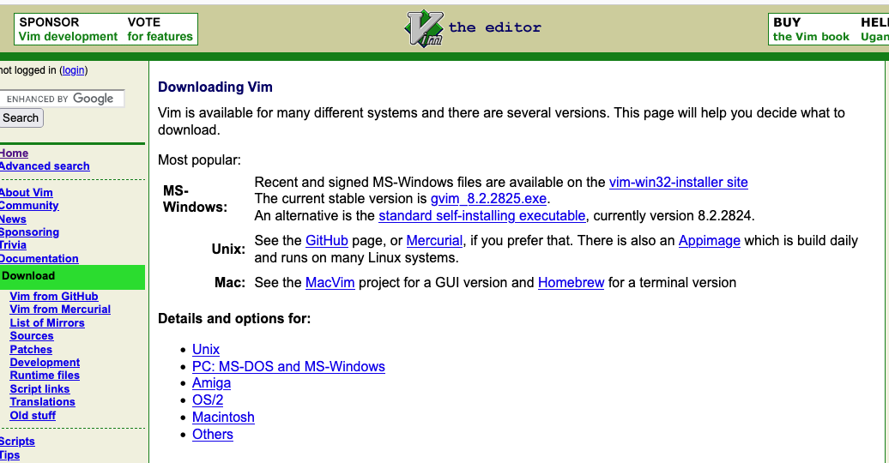
Installing Vim
Available by default on all OLCF systems
Easily installable to your own laptop to edit your own files

Slide 5
How do I use Vim?
Let’s go to the command line
$ cd foundational_hpc_skills/intro_to_vim
$ vim intro_vim_with_exercises.txt

Slide 6
Where can I learn more about Vim?
In command line: $ vimtutor
vim-adventures.com
www.vim.org/docs
Help reference in Vim: `:help`
Cheatsheet: https://vimsheet.com/
There are many cheatsheets online so later pick whichever you find most useful.

