Slide 1

Operating System CPU Scheduling Simulator

Slide 2

PROJECT DESCRIPTION
This project is designed primarily to create a CPU scheduling GUI application. This will improve our understanding of a typical process scheduling algorithm and how it works. It also incorporates skills and knowledge that we have earned in previous class discussions pertaining to the said topic.

Slide 3
In this project, the behavior of the different scheduling algorithm was taken into consideration:
First Come First Serve (FCFS)
Shortest Job First (SJF)
Shortest Remaining Time First (SRTF)
Round Robin (RR)
Priority (Prio)

Slide 4
SYSTEM WALKTHROUGH
This project is designed primarily to create a CPU scheduling GUI application.
The program is not a system program, it is just a typical user application.
The program simulator was programmed in Java language.
Java Swing was used for the Graphical User Interface to show the following components

Slide 5
4. The description of the simulated process includes the following information:
Number of processes
Arrival time of the process
Number of CPU burst
5. The application was capable of receiving input values from the user for the number of processes, arrival time, burst time and priority.
6. Import data was also implemented.
7. At the end of simulation, the simulator shall display the Gantt Chart

Slide 6
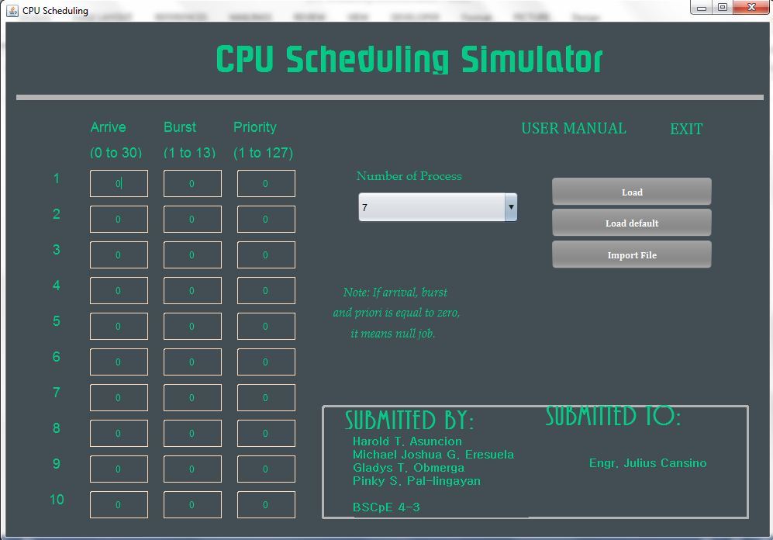
SIMULATION OUTPUT

Slide 7
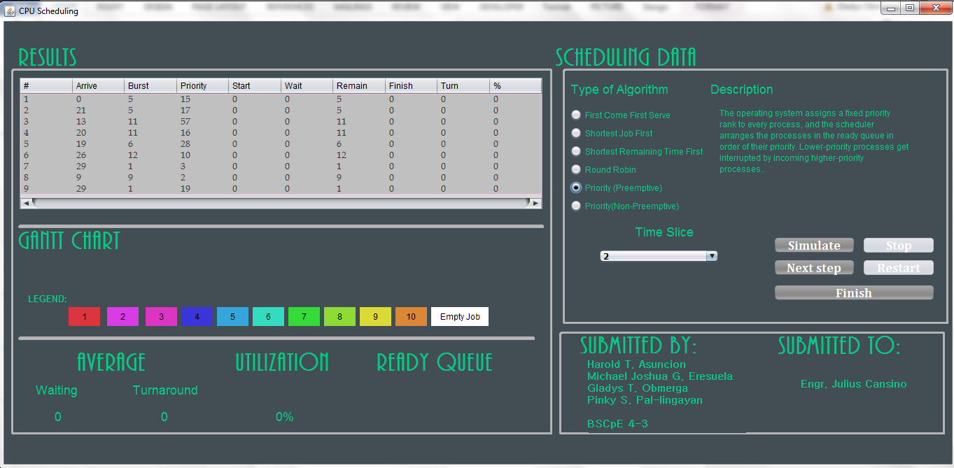

Slide 8
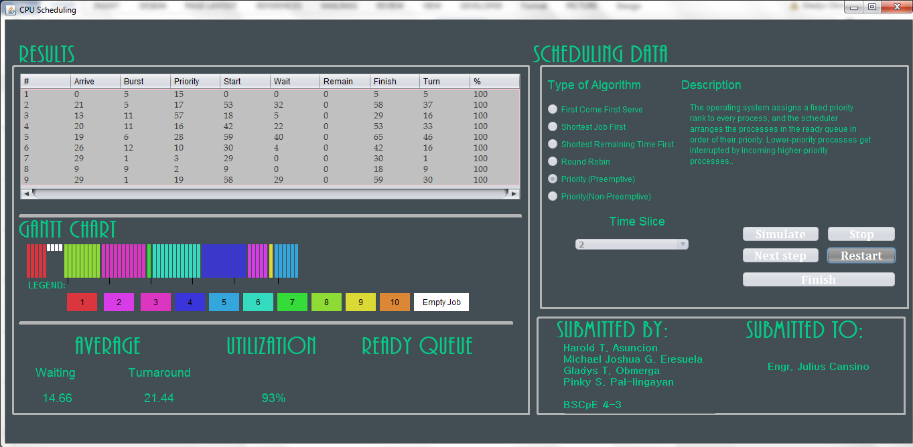

Slide 9
T H A N K
Y O U !

