Slide 1
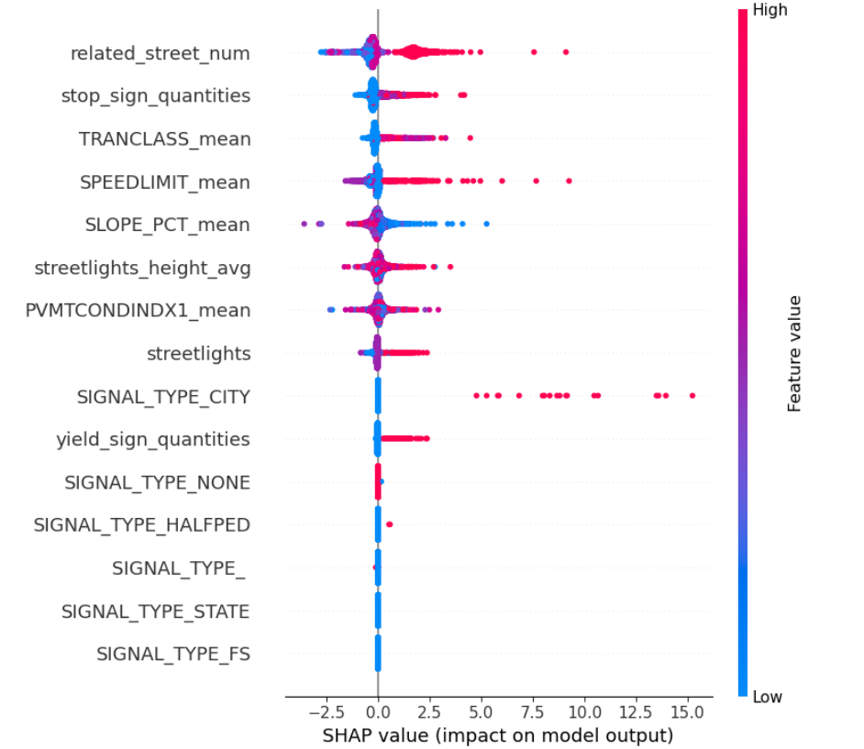
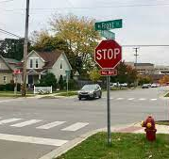
Non-traffic lights intersection, rows: 13813
Mean of collision_rate: 1.5477098868215942
Random Forest：
Cross-validation scores: [ 8.85100644 9.32176777 8.65582848 8.72829925 10.03720718]
Mean squared error on test set: 8.905118645565846

Slide 2
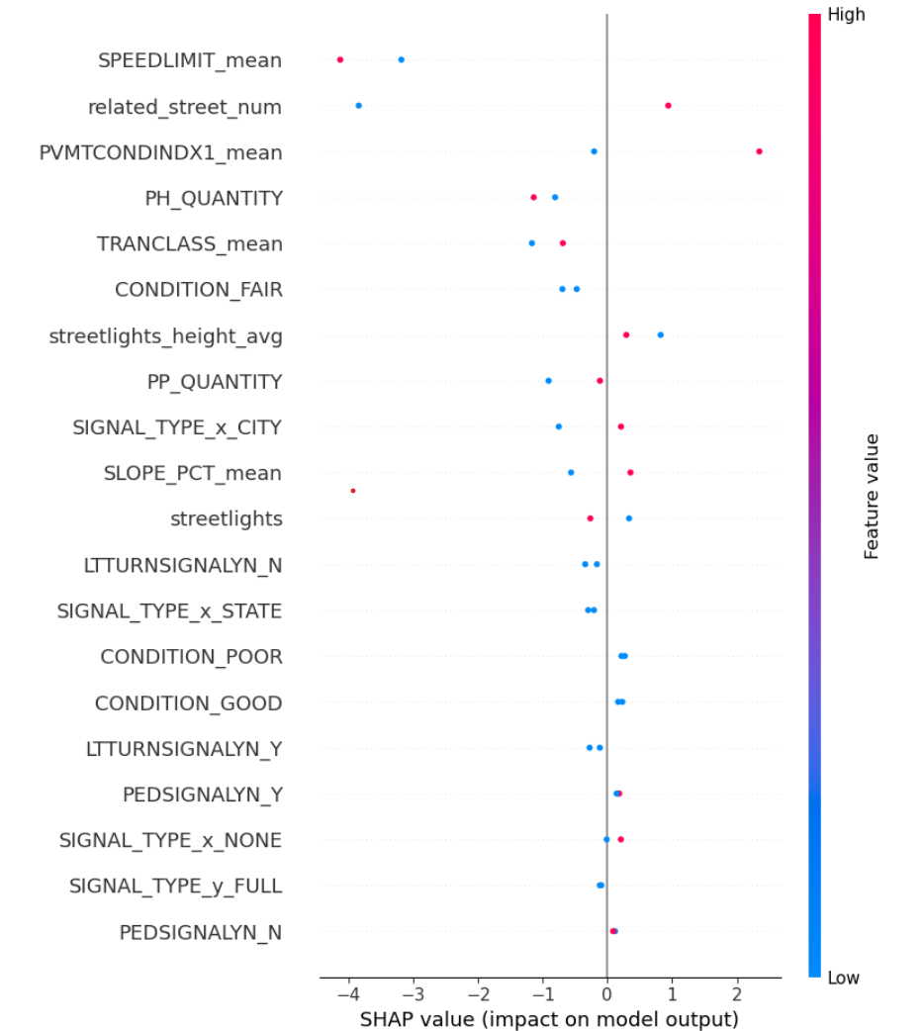
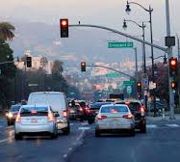
traffic lights intersection, rows: 1102
Mean of collision rate: 17.05255595886268
Random Forest：
Cross-validation scores: [214.09171394 130.87544993 155.27798708 184.00003655 214.75248902]
Mean squared error on test set: 14.182536111111109

