Slide 1
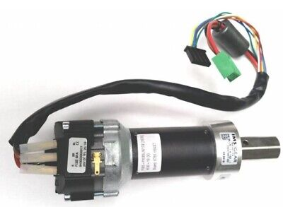
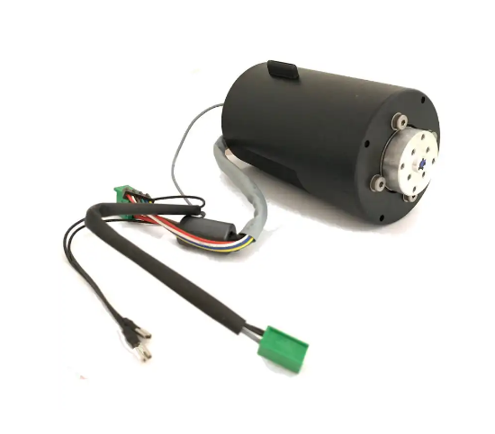
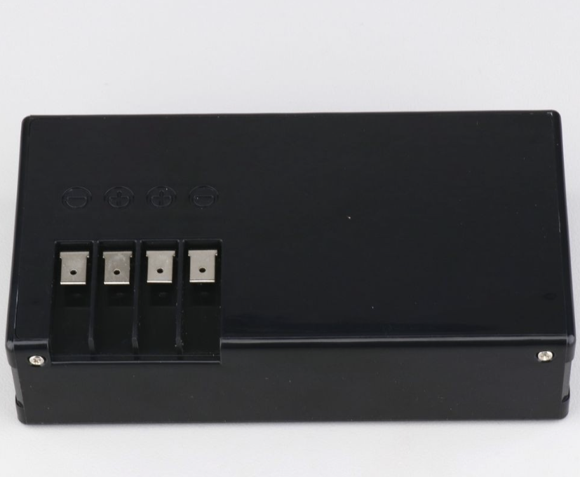
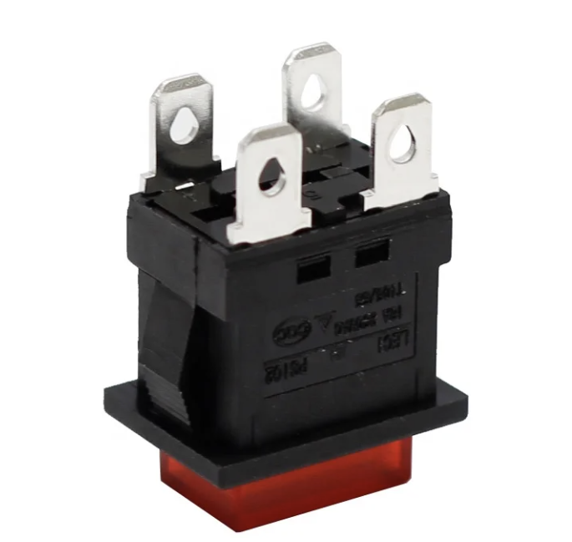

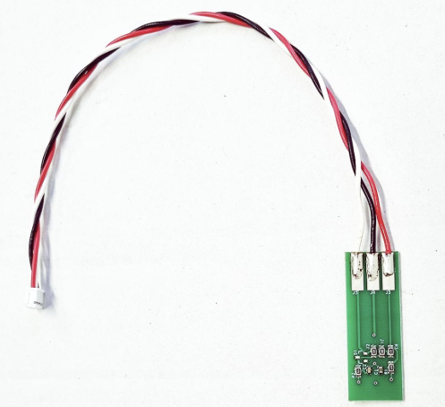
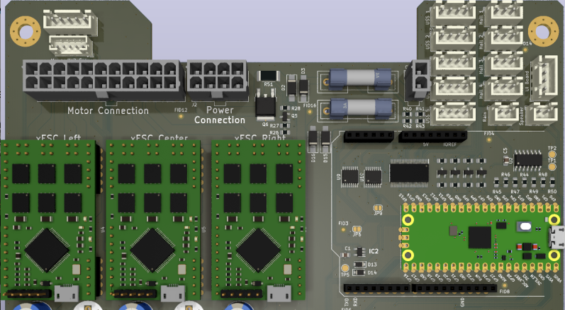

Left drive motor
Ambrogio L30 – Openmower mainboard wiring diagram
Mowing motor
Power switch
Battery
W
Schottky
V
U
Hall2
C+
Hall1
Hall3
GND
+5V
B-
B+
Right drive motor
W
Lift Sensor
V
Hall2
U
Hall1
Hall3
GND
+5V
+5V
SIG
GND
Same as Right motor
W
Openmower mainboard
V
U
Hall2
Hall1
Hall3
GND
+5V
Emergency Stop push button
GND
SIG

