Slide 1

LISA Analysis Tools Workshop
April 15–18, 2024
Talk by: Michael Katz, NASA MSFC

Slide 2



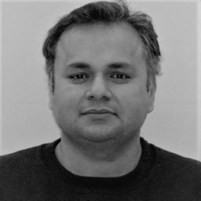
LATW Organizing Committee
Michael Katz
NASA MSFC
Argyro Sasli
Aristotle University
of Thessaloniki
Rodrigo Tenorio
University of the Balearic Islands
IAC3 & IEEC
Aristotle University of Thessaloniki
Durgesh Rai
NASA GFSC

Slide 3
Structure of the workshop
Intro talk
Background info
Source information
Tutorials
Group work
Tasks and questions
Webpage:
indico.physics.auth.gr/e/LATW
Codes/install:
github.com/mikekatz04/LATW
LATW Slack
1 Tutorial in the morning with 15 min coffee break midway
1+ hr lunch break.
1 Tutorial in the afternoon with 15 min coffee break midway.
Mon, Tues, Wed:
Thursday is challenge/workday.
Notes:
Minimal (not zero) barriers to access compared to in-person
Cost
Location
Capacity
Environmental Impact
Easier for caretakers

Slide 4
How to approach the workshop
A lot of material (not easy either)
Not a lot of theory or background. A lot of coding.
Focus on the coding for now
Take it slow, read the documentation, and try things
Discuss with your group (share screen when needed)
Remember the individual codes have tutorials!
These are examples, they work, but are not ready for a paper…

Slide 5
Why experiment? Why try new things?
Iterate towards the best setup for remote workshops.
Easier on the organizers. Reproducible and low-cost.
More opportunities for Early career scientists to learn and interact with the community.
Remote workshops allow much greater access. This cannot be understated. Improves DEI.
If we want to make positive change, we need to try new things. Those who can access and afford to put on and attend in-person workshops will decide to keep doing it this way. During the pandemic we had to do remote workshops, sharply increasing accessibility. Imagine the immediate and immense decrease in access that occurred in our field when remote workshops ceased to exist.
Notes:
Minimal (not zero) barriers to access compared to in-person
Cost
Location
Capacity
Environmental Impact
Easier for caretakers

Slide 6
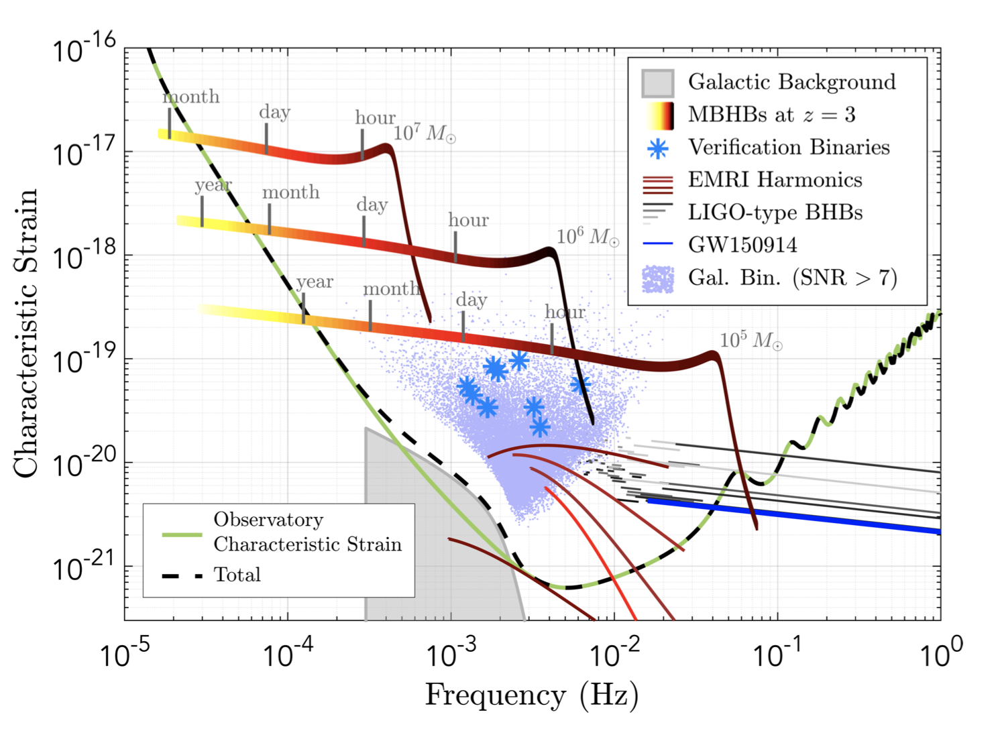
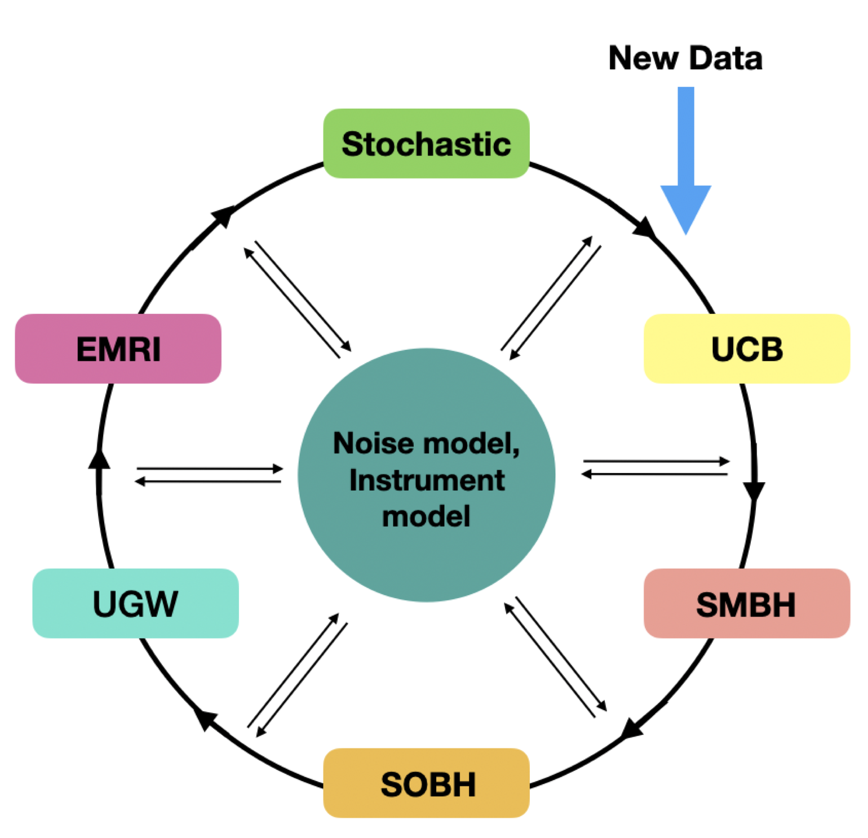
LISA Global Fit
LISA Proposal
Fit multiple source types
All in one data stream
Fit noise and instrumental information
Gaps, glitches, sensitivity drift, etc.
No source-free data
Extremely large-dimensional statistical fit
Low-latency analysis
Large variety of stakeholder interests
Littenberg+2020

Slide 7
What is LISA Analysis Tools?
Cohesive set of tools with similar structure, documentation, and tutorials designed for LISA analysis.
Open-source
Community-oriented and community-developed
High-performance computing across CPU nodes and/or GPUs.

Slide 8
Hierarchical Structure within LAT Environment
Fast and accurate waveform generation
Prototyping sub-global fit analyses
Building your own global fit
Publicly available full global fit pipeline

Slide 9
Codes in within LISA Analysis Tools
LISA Analysis Tools (lisatools)
Fast EMRI Waveforms (few)
BBHx (bbhx)
GBGPU (gbgpu)
fastlisaresponse (fastlisaresponse)
Eryn (eryn)
All under github.com/mikekatz04 except FEW: github.com/BlackHolePerturbationToolkit

Slide 10

Future plans
Stochastic backgrounds
Product-space MCMC
Flexible ODE integrators
Global fit code coming
Integrate lisacattools (Littenberg+)
More waveform types (e.g. EMRIs, lisabeta)
GPU parallelized multiple ensemble samplers
GPU pip install
If you are interested in doing the work of one of these projects, please let me know.

Slide 11
Tutorial 1: LISA Analysis Tools basics
Detector setup
Sensitivity information
Orbits
Data Container
Analysis Container
Compute Likelihoods, SNR, etc.
Combine detector setup + data.
Data, Residual, or Template

