Slide 1

PlayStation 2 Architecture
Irin Jose
Farid Momin
Quy Ngo
Olivia Wong

Slide 2
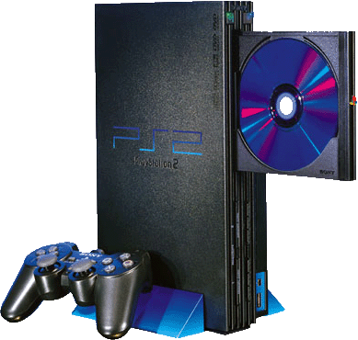
Presentation Overview
PS2 Specifications
PlayStation 2 System Architecture
Emotion Engine
  CPU Core, Floating Point Unit (FPU)
    Caches (instruction and data)
  Vector Units (VU0 and VU1)
  Direct Memory Access Controller (DMAC)
I/O Processor
Graphics Synthesizer
MIPS connection to the PS2

Slide 3
PS2 Specifications
CPU: 128-bit MIPS- based central Processing Unit
System Clock Frequency: 294.912 MHz
Cache memory:
Instruction: 16 KB
Data: 8 KB
Main memory: Direct RDRAM
Memory Size: 32 MB
Memory Bus Bandwidth: 3.2 GB per second
Clock Frequency: 147.456 MHz
Embedded DRAM: 4 MB
DRAM Bus Bandwidth: 48 GB per second
Emotion Engine CPU Core: CPU (R3000)
Emotion Engine CPU Clock Frequency: 36.864 MHz

Slide 4
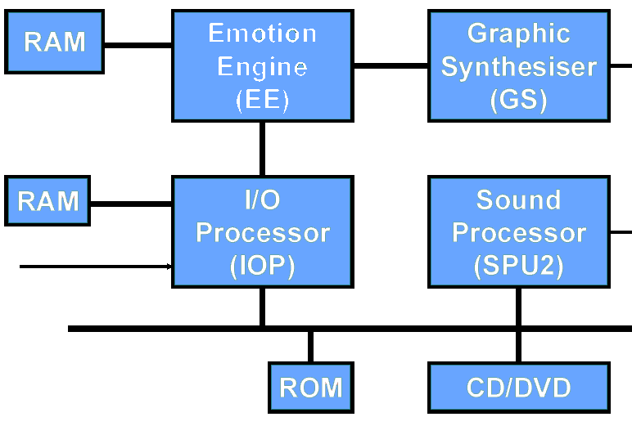
PS2 System Architecture

Slide 5
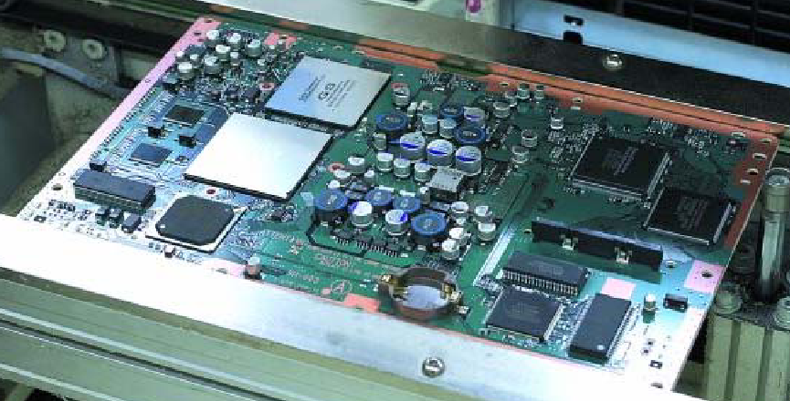
PS2 System Architecture
Emotion Engine (EE)
  Provides a connection between main memory, RAM, IOP and GS.
I/O Processor (IOP)
  Provides connection from EE
  to external devices (i.e. controllers,
  memory cards, USB devices, etc.).
Graphics Synthesizer (GS)
  Provides video output for PS2.
Sound Processor (SPU2)
  Provides audio output for PS2.

Slide 6
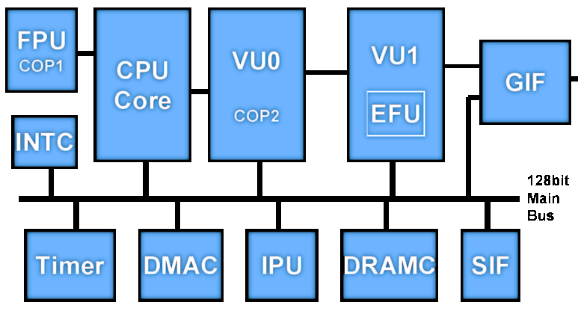
Emotion Engine

Slide 7
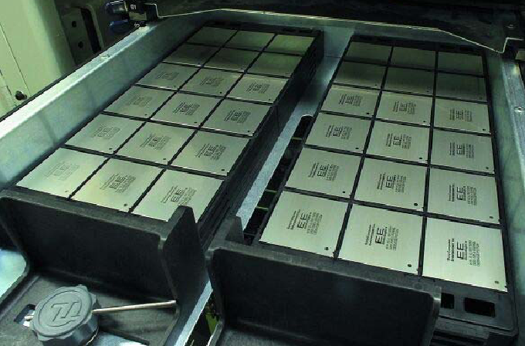
Emotion Engine
CPU Core
  128-bit CPU RISC (MIPS IV subset)
  300 MHz clock
  32 Mb main memory
Cache
  16 Kb Instruction Cache
  8 Kb Data Cache
    Small cache since majority of data
    transfer is dynamic and is not needed
    in cache for long periods of time.
  16 Kb Scratch Pad
    If larger DCACHE is required,
    scratch pad is used.
    Requires 1 clock cycle to access.

Slide 8
Emotion Engine
Vector Unit 0
Operation in Coprocessor mode
  32-bit instructions mixed in with integer, FPU, branch instructions
Set of 32, 128-bit floating point registers
  Register can carry 4, 32-bit single precision floating-point number
Contains 16, 16-bit integer registers for integer computation
Includes 8K data memory and 8K instruction memory

Slide 9
Emotion Engine
Vector Unit 1
Similar to Vector Unit 0
  Contains an extra functional unit named Elementary Functional Unit
    Performs the basic calculations required for geometry calculations
Includes 16K of data memory and 16K instruction memory
  Extra memory required for the geometry calculations
Multiple paths to get data to the graphics interface unit

Slide 10
Emotion Engine
Direct Memory Access Controller (DMAC)
  Contains 10 channels
  Controls data transfers between main memory and
  processors/scratch pad.
  Bus bandwidth of 2.4Gb/sec.
  Transfer of data does not stall the CPU,
  which allows for an increase in performance.
  Transfers must be aligned to 128bits.

Slide 11
I/O Processor (IOP)
Handles all USB, firewire, and game controller traffic
Takes your controller input and sends it to the Emotion Engine so that it can update the state of the game world appropriately
Contains 2 clock frequencies
Includes 2MB of IOP memory

Slide 12
Graphics Synthesizer
Its job is to render the display lists that the Emotion Engine sends to it
Contains 4MB of embedded DRAM for storing frame buffers, Z buffer and textures
  Quick at polygon setup and fill rate operations
Supports points, triangles, strips, fans, lines, and poly-line and decals

Slide 13
MIPS connection to the PS2
The Playstation 2 is powered by a MIPS III 2-issue superscalar with 128-bit multimedia extension
Emotion Engine Processors
MIPS based floating point coprocessor
Two floating point vector unit coprocessors
  Vector Units 0
  Vector Units 1

Slide 14




Game Time
What is the “heart” of the PS2?
How many vector units does the PS2 have?
Name one other component, besides the Emotion Engine, that is part of the PS2 architecture?

Slide 15
References
arstechnica.com/reviews/1q00/playstation2/ee~1.html
  Jon Stokes
www.mips.com
“The Technology Behind PlayStation 2” by Paul Holman of Sony Computer Entertainment Europe VP of Technology
“Introducing PS2 to PC Programmers” by David Carter of SCEE Technology Group

