Slide 1
Online Appointment- Pet Clinic (Capstone DevOps CI-CD Project)
November 2019
Presented by:
Rajib Chowdhury
Md Wasim Akram

Slide 2
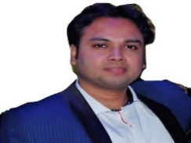
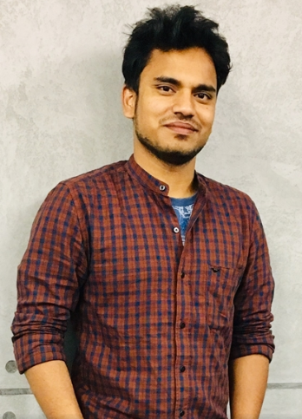
Team:
Rajib Chowdhury
Md Wasim Akram
DevOps – MAS capability
Infrastructure – CIS capability
Journey So far:
1. Team working in different shifts (Day shift & Night shift)
2. Different technology backgrounds of team members (DevOps & Infrastructure)
3. Exploring ways to collaborate and contribute towards the project
4. Exploring technologies, features beyond classroom learning
5. Sharing of experiences and learning

Slide 3
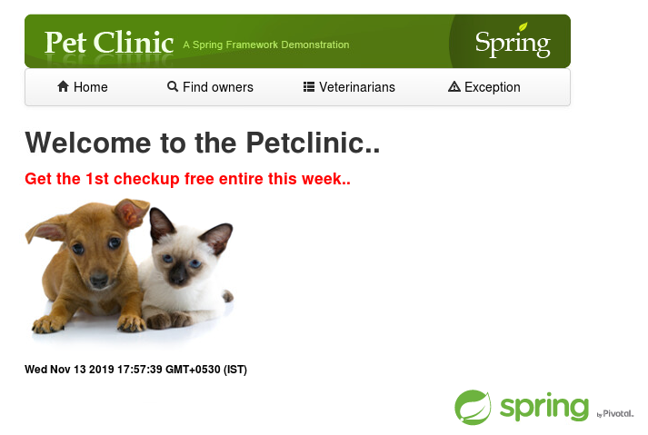
Pet Clinic: Currently pet owners need to visit or call a pet clinic for getting appointment/change of appointment/registering pets. This involves additional time, cost and effort. An efficient web application is needed through which the pet owners can easily takes appointment, registering pets into a pet clinic hassle free. Features: 1. Available Pet Doctors 4. Book appointment 2. Register new Owner 5. Modify appointment 3. Register new Pet 6. Free consultation/Offers
Capstone application and its features:
Application Snapshot:

Slide 4













Tools used & additional tools explored:
1.Jenkins(CI) 2.GitLab(VCS) 3.Nexus(Artifactory) 4.SonarQube(Code Analysis & Quality)
5.Jacoco(Code Coverage Report) 6.JMeter(Performance testing) 6.Ansible(Continuous Release)
7.Docker(Container Deployment) 8.CAdvisor(Continuous Monitoring) 9. Source Code(Code)
10. Maven(Code Compile Packaging) 11. Junit(Unit Test)

Slide 5









Tools integration with respect to capstone project: CI-CD View
Development
Continuous Monitoring
Source Code Management
Continuous Deployment
Continuous Build
Continuous Release
Continuous Unit Test
Orchestration
Binary Management
Performance Testing
Code Quality Analysis
Code Coverage

Slide 6



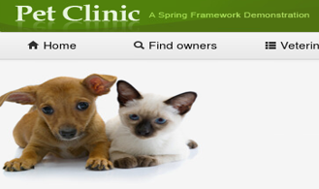











CI-CD Flow Diagram
Legends
Auto trigger build jobs in Jenkins
Dev Pipeline
Master Pipeline
Dev branch
Master branch
Push to Gitlab repo
*Dev Deployment
Stages and commits to local git
Webhook
Dev Environment
Build Docker image
Docker hub image
versioning
Docker container deployment
Approve merge request
Submit merge request
If Ok
If not Ok
*Check Dev deployment
Prod Environment
Prod Deployment

Slide 7
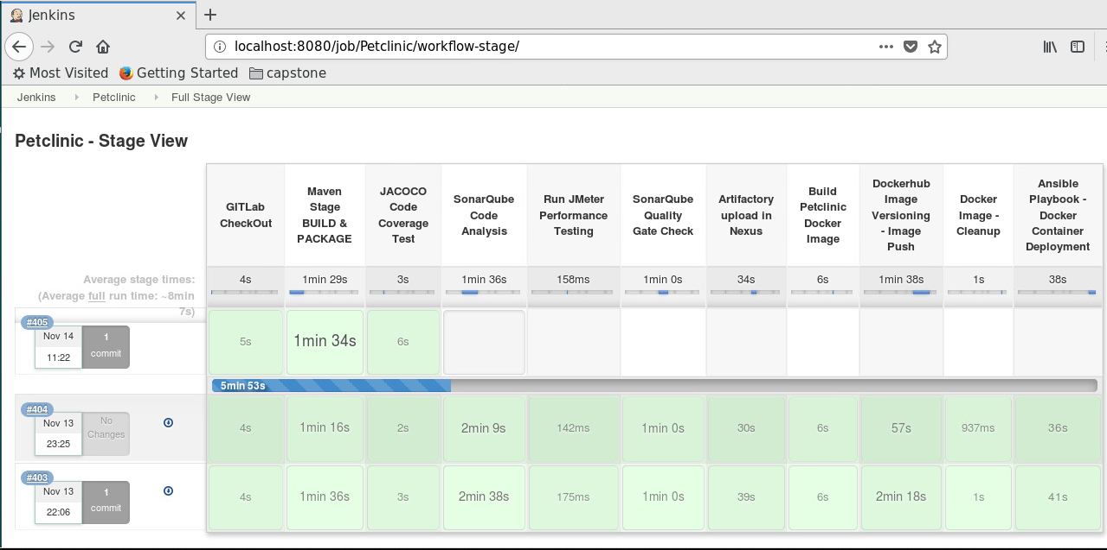
Tools integration with respect to capstone project: Pipeline View

Slide 8
Future Scope for improvement: Pet Clinic: We have the following scope for improvement and adding features in the future upgrades: 1. Dynamic DB 2. Doctor’s login and prescription 3. Micro services implementation 4. Email notification

Slide 9
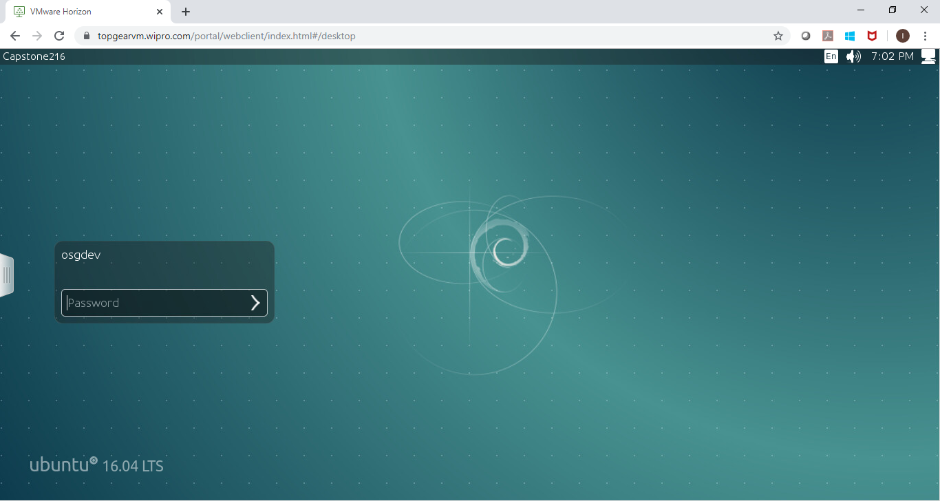
Demonstration of the application: Let’s see the Application in actual.. Login to the Capstone VDI. Gitlab Repository URL: DevOpsProfessional_Batch17_CapstoneProject_OnlineAppointment_ThePetClinic

Slide 10

Q&A:

Slide 11
Thank You!!!

