Slide 1

Premier League game winner predictor
Glanda Darie-Teofil
Subject : FML

Slide 2
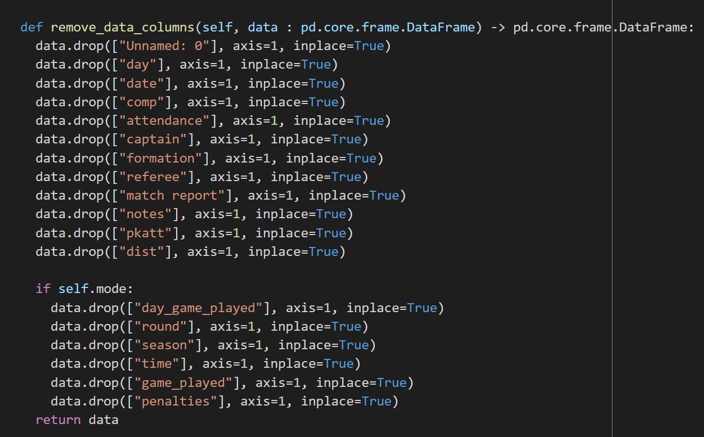


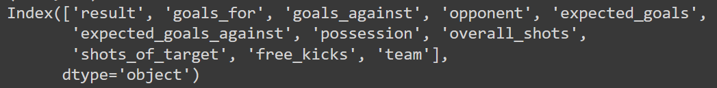
Cleaning data
shape
from
to
or
shape
from
to
Features + label

Slide 3
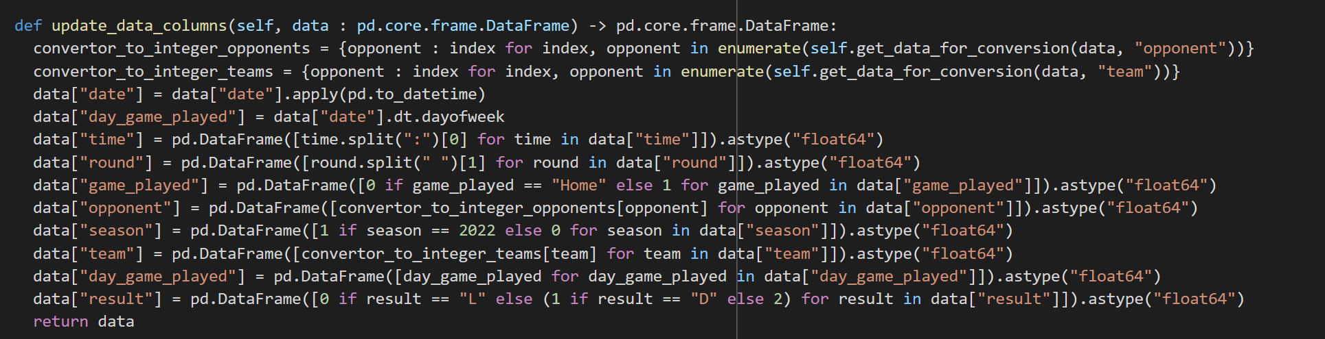
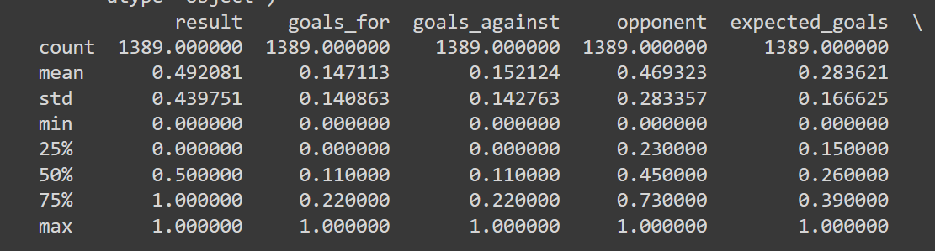
Feature engineering
Convert data to numerical

Slide 4
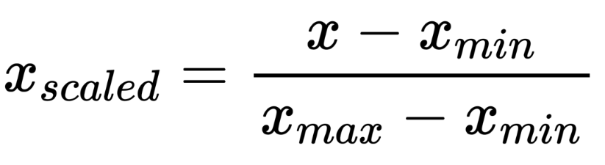
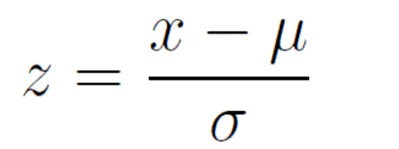
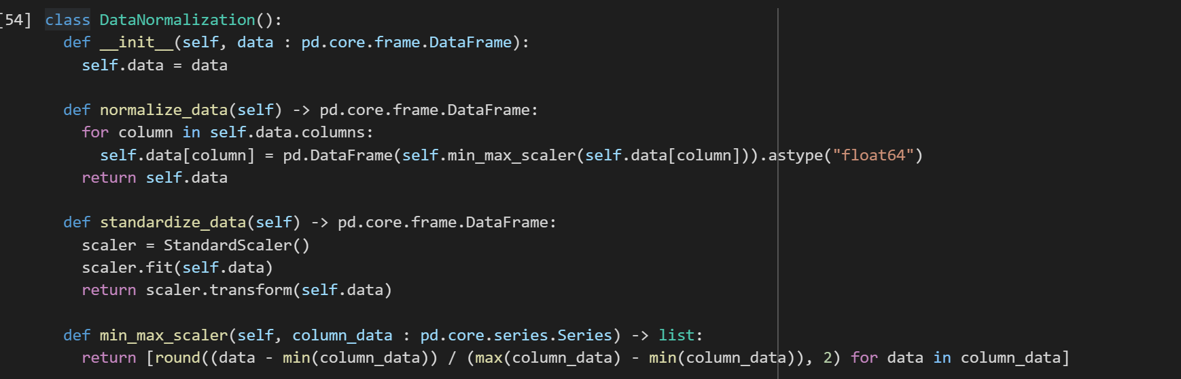
Data normalization
or

Slide 5

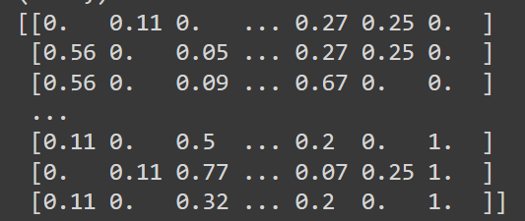





Separate and split data
Separate
features
label
X_train
training
80%
Y_train
Split
X_test
20%
testing
Y_test

Slide 6
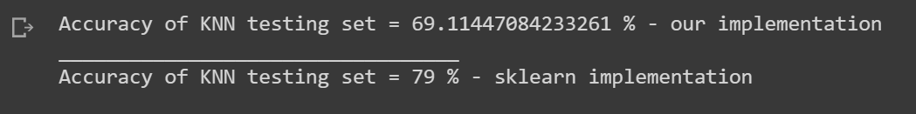
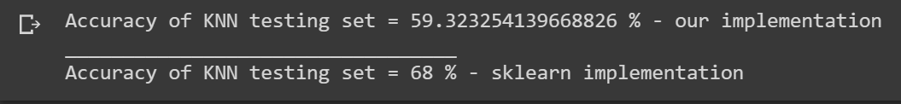
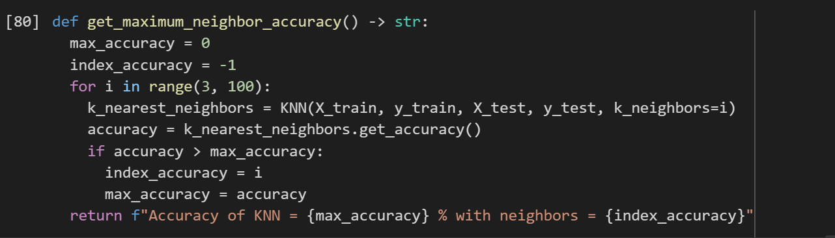
K nearest neighbors
With 10 number of features
With 16 number of features
Get the best k number of neighbors

Slide 7
Naive Bayes
With 10 number of features
With 16 number of features

Slide 8
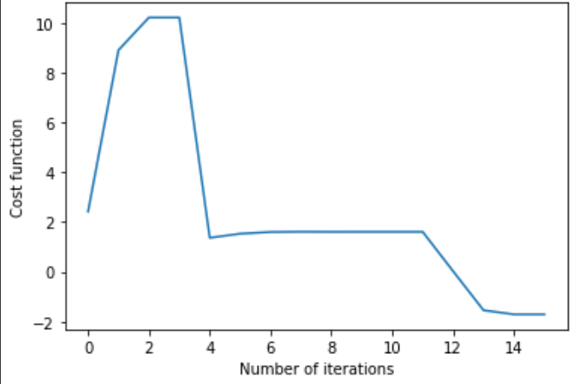
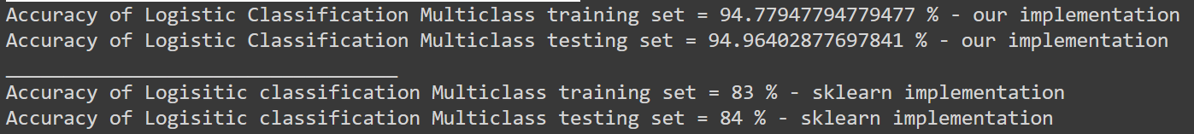
Logistic Classifier (one vs all)
With 10 number of features using minimize inbuild function

Slide 9
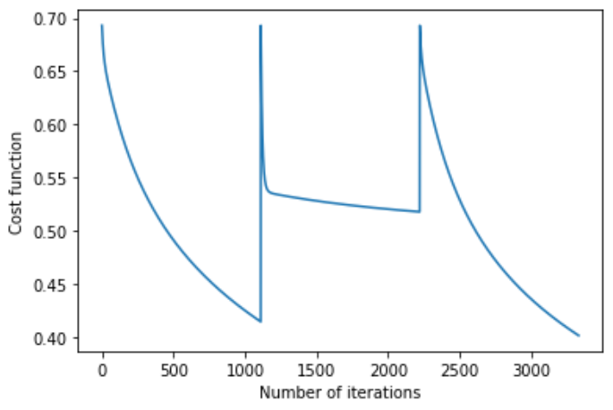
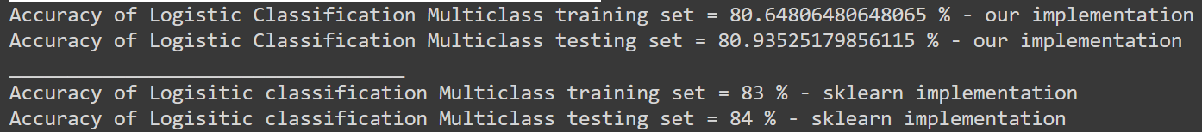
Logistic Classifier (one vs all)
With 10 number of features using our own training loop implementation

Slide 10
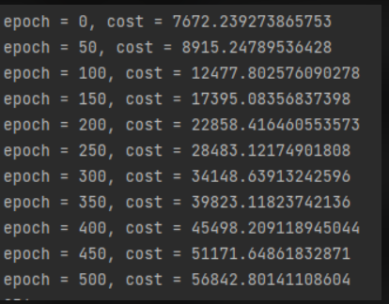

Cost function is to big and it increases instead of decreasing
Logistic Classifier (one vs all)
Problem

Slide 11
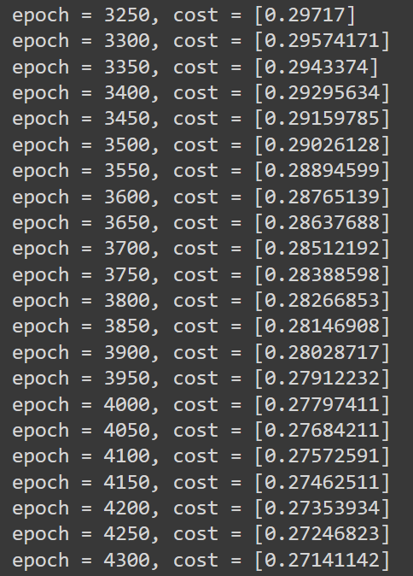
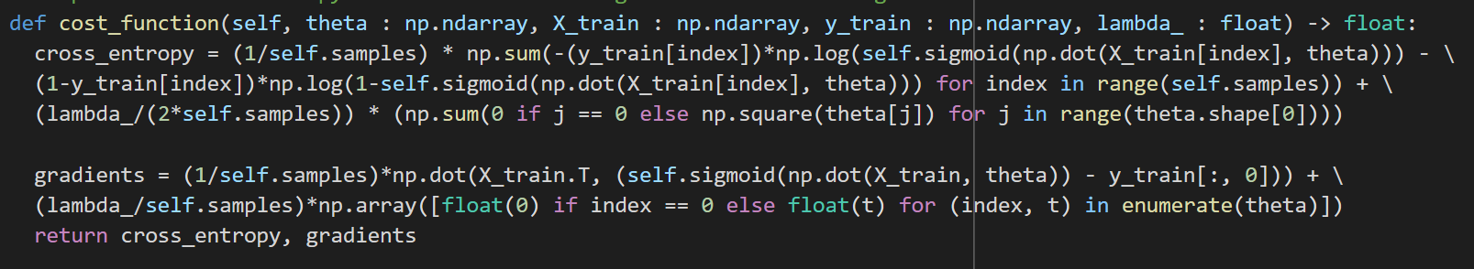
Logistic Classifier (one vs all)
Solution? Re-wrote the cost and the gradients again and trained each individual class at a time (win/draw/lose).

Slide 12


