Slide 1
Barbarian Prince
April 30, 2024

Slide 2
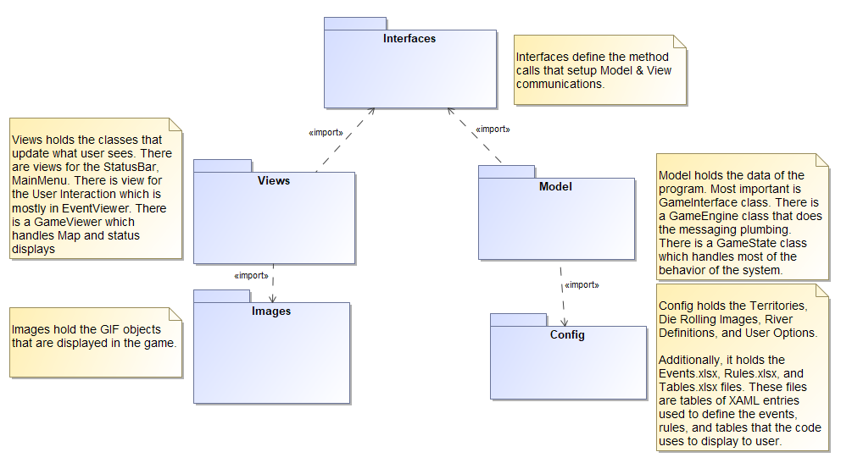
Architecture
Implement a Model-View-Controller (MVC) architectural pattern. Per “Pattern-Oriented Software Architecture” by Bushmann, Meunier, Rohnert, Sommerland, Stal, dated 1996
The MVC divides an interactive application into three components. The model contains the core functionality and data. Views display information to user. Controllers handle user input. Views and controllers together comprise the user interface. A change propagation mechanism ensures consistency between user interface and the mode.
Due to Windows Presentation Foundation (WPF) frameworks, the controller functionality resides in same class as the corresponding view.

Slide 3
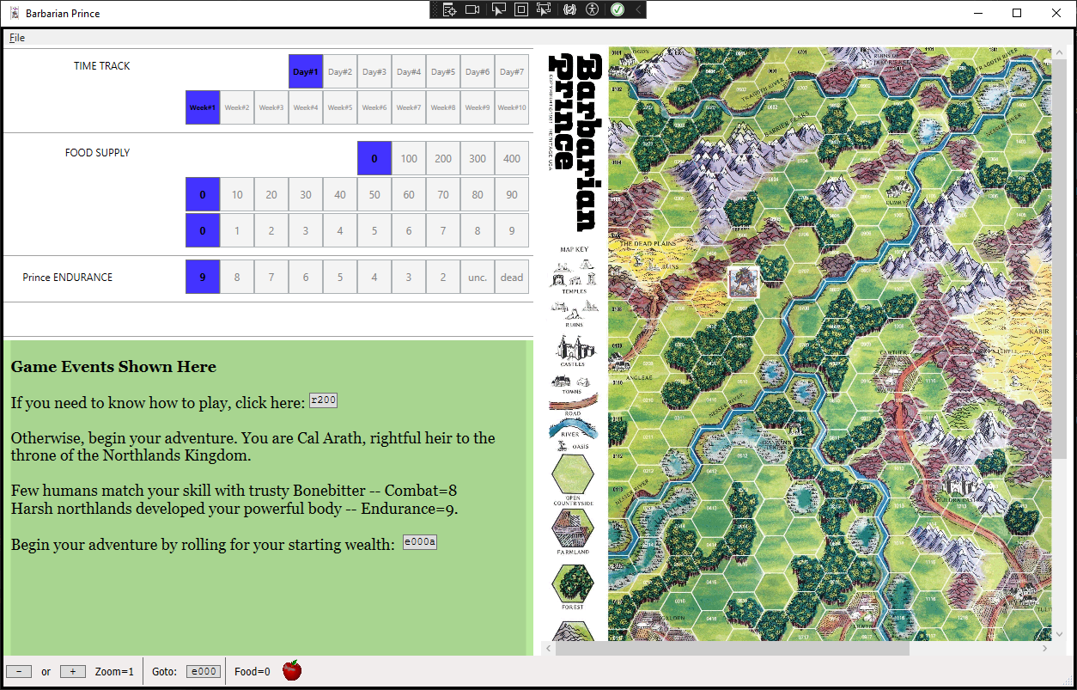
Screen Layout
MainMenuViewer
myStackPanelTimeTrackDay
GameViewerWindow handles myCanvas and status StackPanel’s
myStackPanelTimeTrackXXX
myStackPanelEndurance
myStackPanelDailyActions
myCanvas
EventViewer (and helper classes) populate GameViewerWindow->myTextBlock for game events
StatusBarViewer

Slide 4
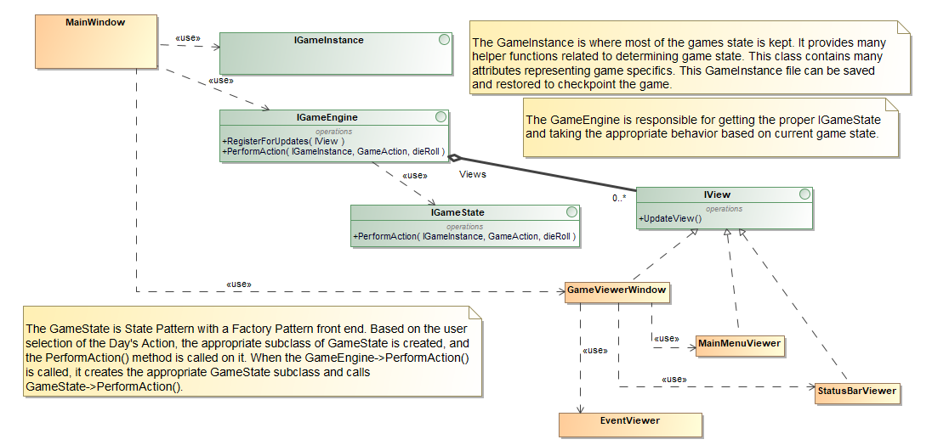
Model
MainWindow creates:
IGameInstance
IGameEngine
GameViewerWindow
GameEngine creates:
GameState
GameViewerWindow creates:
MainMenuViewer
StatusBarViewer
EventViewer

Slide 5
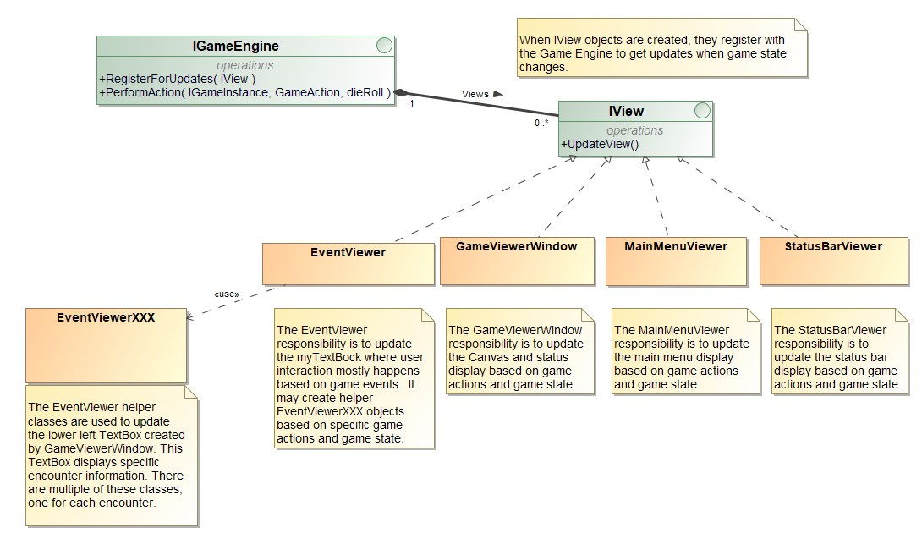
Views

Slide 6
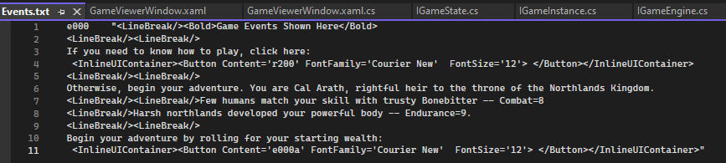
GameViewerWindow myTextBox
myTextBox is the main user interaction displaying information to the user shown in bottom left corner
The appropriate content to display in myTextBox is set by EventViewer or one of the EventViewerXXX helper classes
The source data for the myTextBox content is obtained from this file: Events.txt.
Events.txt generated from corresponding Events.xlsx spreadsheet
Text file representing rows in a spreadsheet
The text file must adhere to specific format
Two columns per row: 1.) event number (e.g., e000) 2.) XMAL representing what should be shown in myTextBox
Second column must not have double quotes embedded within the quotes
XAML is a markup language that supports WPF display of data in controls

