Slide 1


Visualization Project Idea
Kyung Hee Lee, Krzysztof Dabrowski, Franziska Schmidt

Slide 2
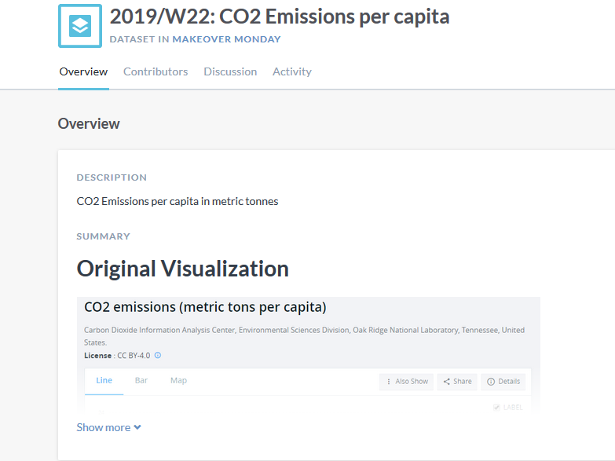
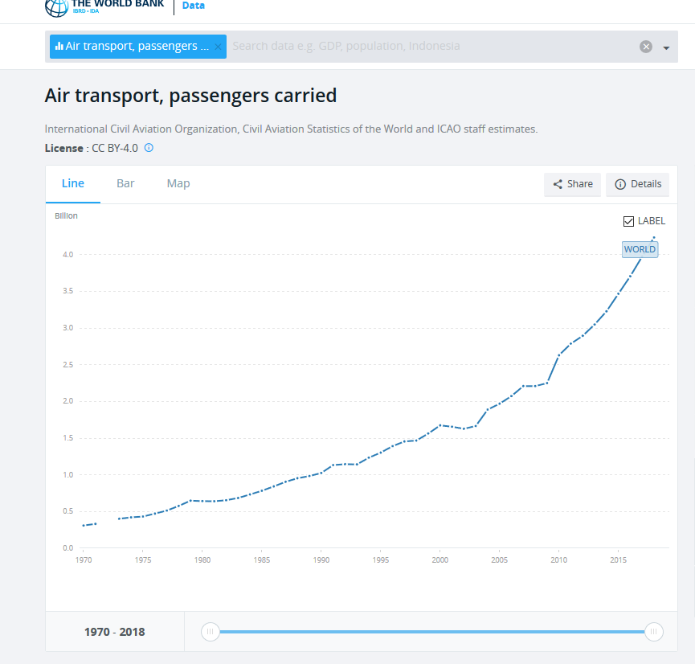
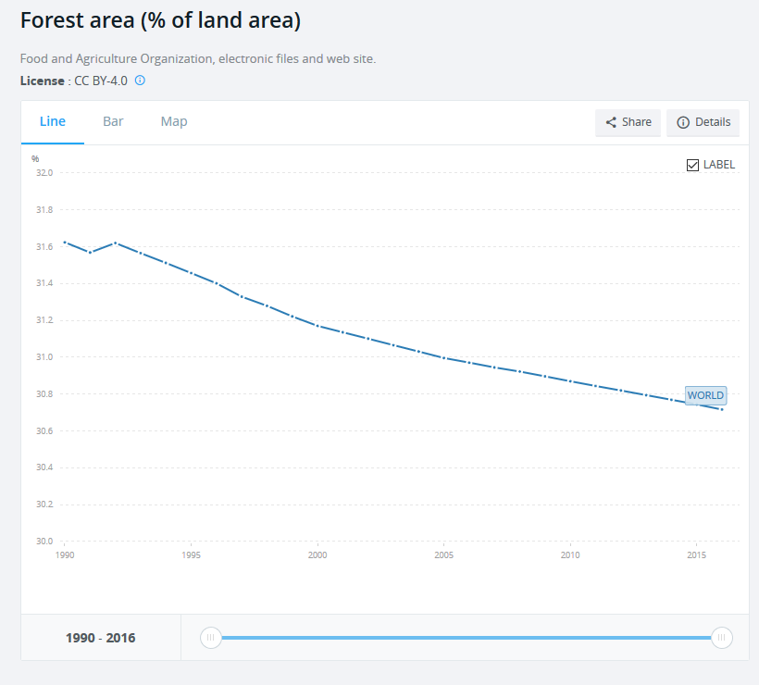
Idea & Motivation
The Motivation: Current discussion about global warming
The Aim: Understand the reasons for climate change
Data Source:
2019/W22: CO2 Emissions per capita: https://data.world/makeovermonday/2019w22
Population: https://data.world/oecd/population/workspace/file?filename=population.csv
Countries area: https://data.worldbank.org/indicator/AG.SRF.TOTL.K2
Forest area per country: https://data.worldbank.org/indicator/AG.LND.FRST.ZS
Air passengers per year: https://data.worldbank.org/indicator/IS.AIR.PSGR

Slide 3
Data
Main Data:
Area of the country in this year
Number of citizens in this year and country
Generated CO2 amount in this year and country
Transportation:
Amount of passengers in this year and country
Amount of air travel per citizen
Forestation:
Area of forests in this year and country
Display the CO₂ Data and give more insights about the reasons with e.g. data about transportation
Find reliable and complete data sources

Slide 4
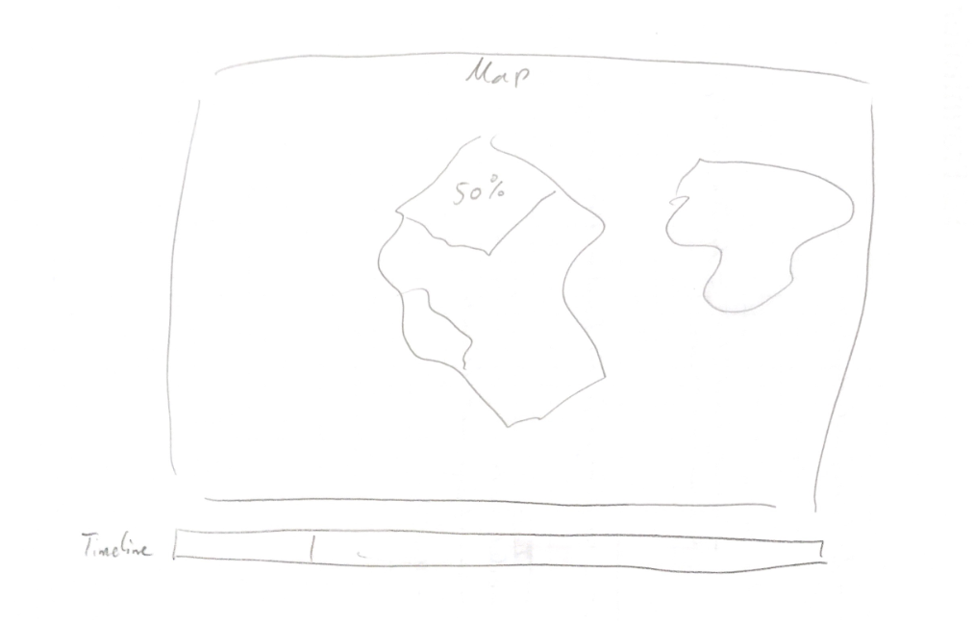
First Pen & Paper
Question: How high is the CO₂ emission in the different countries and how it has been evolving over the years?

Slide 5
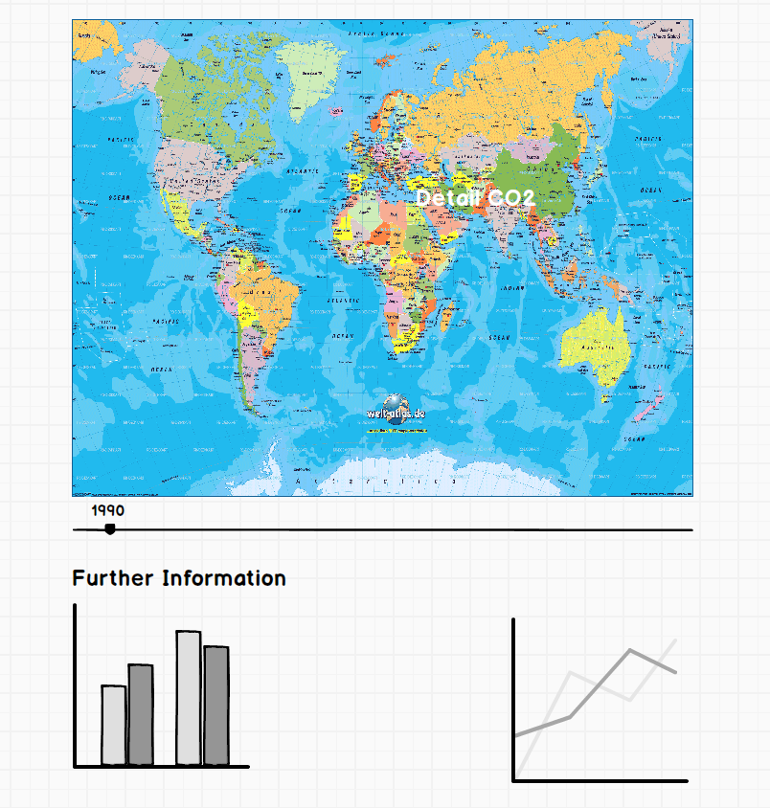
Mock-up
Questions: What are the reasons for CO₂ emissions?

Slide 6
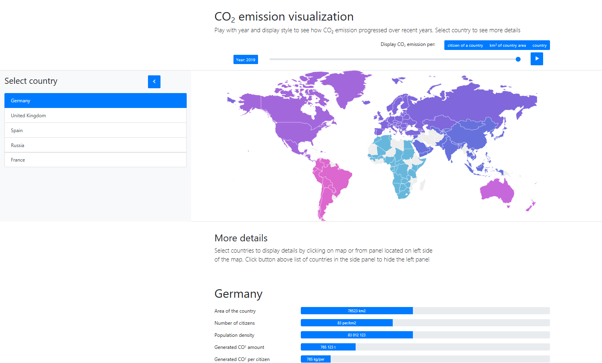
GitHub
Prototype
Preview

Slide 7
Things to consider for the next step
How express if data is not available?
How do we effectively show subcateogry comparisons between countries?

