Slide 1

THE NATIONAL CYBERCHAMP COMPETITION 2023
(NCCC23)
FINAL CHALLENGE
DIGITAL FORENSICS
DATE: 1st , APRIL 2023.

Slide 2
THE NATIONAL CYBERCHAMP COMPETITION 2023
(NCCC23)
FINAL CHALLENGE
FORENSICS
GLAGO GIDEON ELORM
29 APRIL 2023.

Slide 3
FORENSIC CASE SCENARIO
CYBERGHANA has been contracted as a consultant to conduct an independent investigation into a computer related crime. The case involves a suspect, Kofi Koomson, an employee for Global Technology Ltd suspected of child pornography and drug related crimes and his employer. CYBERGHANA has designated you as the lead investigator to handle this case. You have appropriately secured images of Kofi’s computer on which the suspected activity happened together with a seized USB drive found to be empty.

Slide 4
TASK REQUIREMENT
PART 1
Determination of the filetypes of the 3 attachments in the 3 different messages the suspect sent.
Autopsy report for your investigation
Retrieval of hidden information in the attached files
Computation of hash values for all 3 attachments
PART 2
Recovery of deleted files on the USB drive (if any)
Generation of autopsy report for your investigation
Retrieval of hidden information in the files found on the USB drive
Computation of hash values of files found on the USB drive
Comparison and contrasting of hash values and hidden information found in files from the suspect’s computer and the ones found on the seized USB drive.

Slide 5
OUTLINE OF TASK
Step 1: Recovering the actual file type of attachments from the SYSTEM.
Step 2: Generating autopsy reports from analysis made from the SYSTEM.
Step 3: Retrieving information from the attachments recovered from the SYSTEM.
Step 4: Computation of hash values from the attachments.
Step 5: Recovering deleted files from the USB disk image.
Step 6: Uncovering information from behind the recovered deleted files from the USB disk.
Step 7: Generating autopsy reports from analysis made from the USB disk.
Step 8:Observation, comparisons and conclusions from analysis and investigations carried out.

Slide 6
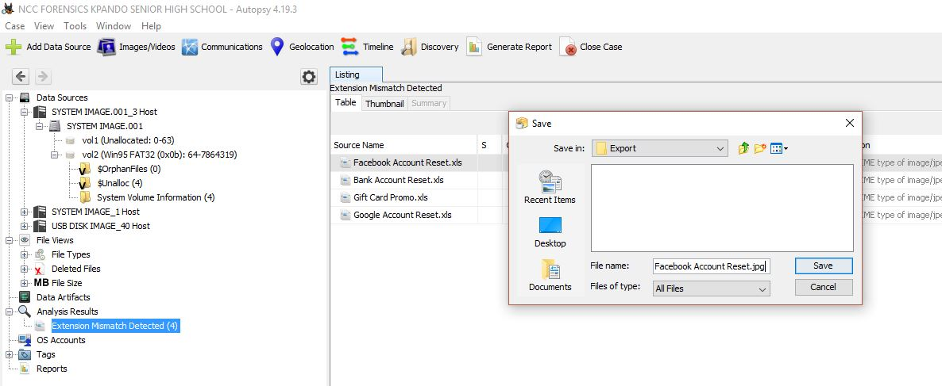
Screenshot showing how Actual and
Perceived Files were Retrieved

Slide 7
Actual Filetypes & Extensions
Perceived File Type | Actual File Type
Bank Account Reset.xls | Bank Account Reset.jpg
Facebook Account Reset.xls | Facebook Account Reset.jpg
Google Account Reset.xls | Google Account Reset.jpg

Slide 8
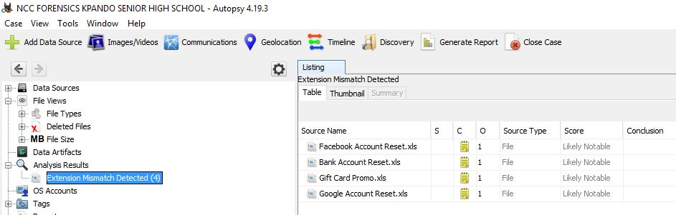
Screenshot of Actual Files and extensions on System Image in Autopsy (Extension Mismatch)

Slide 9
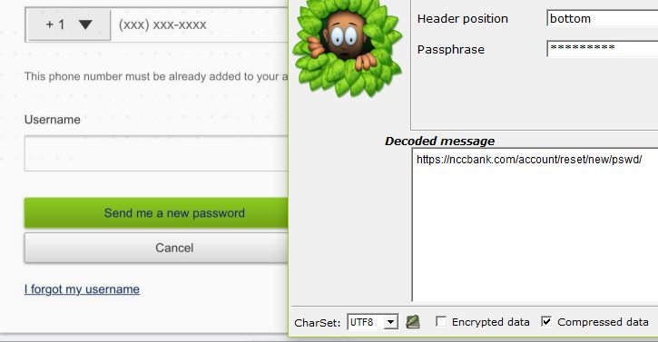
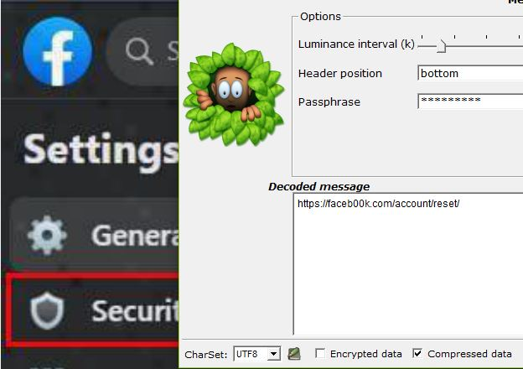
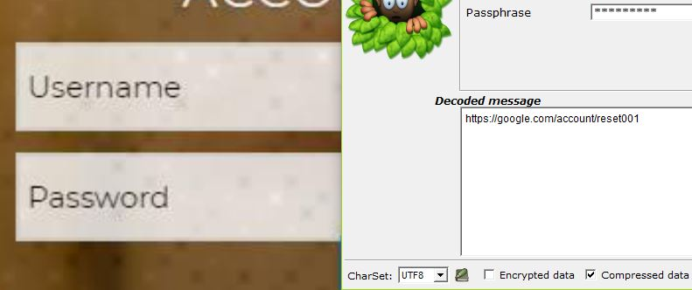
Screenshot Showing how Hidden Information in Files on System Image were Retrieved

Slide 10
Hidden Information in Files on System Image
File | Hidden Information
Bank Account Reset.jpg | https://nccbank.com/account/reset/new/pswd/
Facebook Account Reset.jpg | https://faceb00k.com/account/reset/
Google Account Reset.jpg | https://google.com/account/reset001

Slide 11
Sample Screenshot of How Hidden Information was Retrieved using Silent Eye

Slide 12
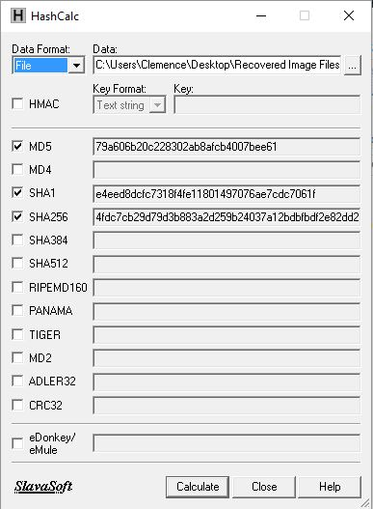
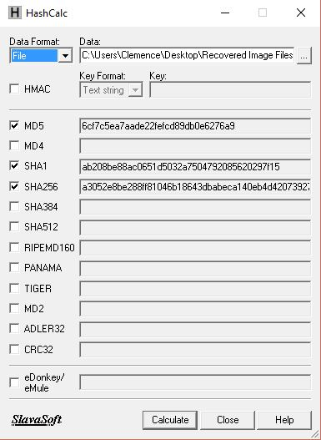
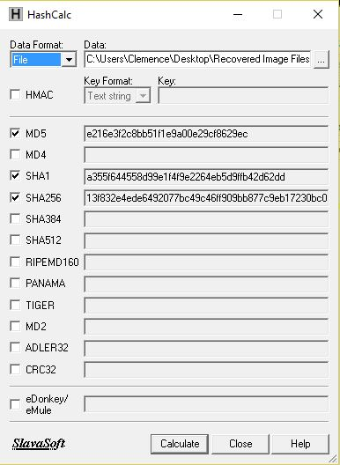
Sample Screenshot of Computing Hash values using HashCalc
Bank Account Reset.jpg
hash values
Facebook Account Reset.jpg
hash values
Google Account Reset.jpg
hash values

Slide 13
Hash Values of Files on System Image
File | Hash Value
Bank Account Reset.jpg | SHA 256: 4fdc7cb29d79d3b883a2d259b24037a12bdbfbdf2e82dd2
Facebook Account Reset.jpg | SHA 256: a3052e8be288ff81046b18643dbabeca140eb4d42073927f5ec2fa189fe68aaa
Google Account Reset.jpg | SHA256: 13f832e4ede6492077bc49c46ff909bb877c9eb17230bc09e0dcac3fec1e5fa4

Slide 14
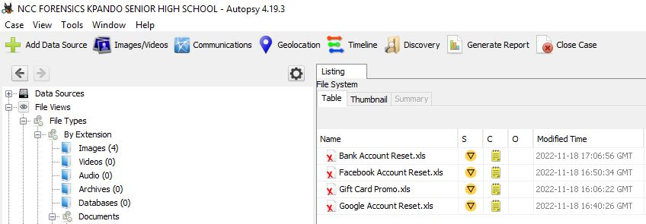
Screenshot of Recovered Deleted Files on USB Image using Autopsy

Slide 15
RECOVERED DELETED FILES AND HIDDEN INFORMATION
File | Hidden Information
Bank Account Reset | https://nccbank.com/account/reset/new/pswd/
Facebook Account Reset | https://faceb00k.com/account/reset/
Google Account Reset | https://google.com/account/reset001

Slide 16
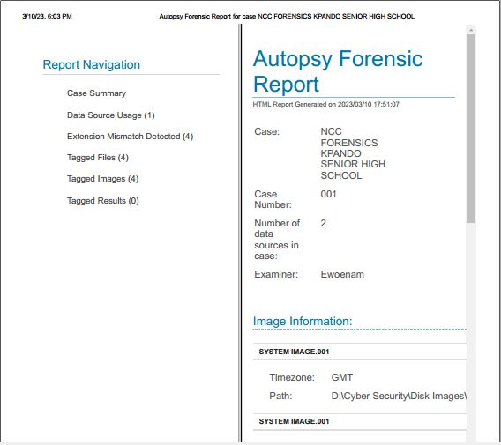
Screenshot of Autopsy Generated Report for both System and USB Images

Slide 17
RECOVERED DELETED FILES AND HASH VALUES
File | Hash Values
Bank Account Reset.jpg | SHA 256: 4fdc7cb29d79d3b883a2d259b24037a12bdbfbdf2e82dd2
Facebook Account Reset.jpg | SHA 256: a3052e8be288ff81046b18643dbabeca140eb4d42073927f5ec2fa189fe68aaa
Google Account Reset.jpg | SHA256: 13f832e4ede6492077bc49c46ff909bb877c9eb17230bc09e0dcac3fec1e5fa4

Slide 18
COMPARISON OF HIDDEN INFORMATION
Hidden Information Found on System Image | Hidden Information on the USB Image used for Analysis
Bank Account Reset.jpg https://nccbank.com/account/reset/new/pswd/ | Bank Account Reset.jpg https://nccbank.com/account/reset/new/pswd/
Facebook Account Reset.jpg https://faceb00k.com/account/reset/ | Facebook Account Reset.jpg https://faceb00k.com/account/reset/
Google Account Reset.jpg https://google.com/account/reset001 | Google Account Reset.jpg https://google.com/account/reset001

Slide 19
COMPARISON OF HASH VALUES
HASH VALUES OF FILES ON SYSTEM IMAGE | HASH VALUES OF FILES ON USB IMAGE
Bank Account Reset.jpg SHA 256: 4fdc7cb29d79d3b883a2d259b24037a12bdbfbdf2e82dd2 | Bank Account Reset.jpg SHA 256: 4fdc7cb29d79d3b883a2d259b24037a12bdbfbdf2e82dd2
Facebook Account Reset.jpg SHA256: a3052e8be288ff81046b18643dbabeca140eb4d42073927f5ec2fa189fe68aaa | Facebook Account Reset.jpg SHA 256: a3052e8be288ff81046b18643dbabeca140eb4d42073927f5ec2fa189fe68aaa
Google Account Reset.jpg SHA256: 13f832e4ede6492077bc49c46ff909bb877c9eb17230bc09e0dcac3fec1e5fa4 | Google Account Reset.jpg SHA256: 13f832e4ede6492077bc49c46ff909bb877c9eb17230bc09e0dcac3fec1e5fa4

Slide 20
ANY OTHER RELEVANT INFORMATION ON THE USB IMAGE (IF ANY)
The suspected employee used phishing to make the victim think he had a legitimate email from an organization. From that technique, the suspect was able to get access to the client’s bank account, the client’s Facebook account and the client’s google account. All the information that were retrieved from the attachments were links to websites. The main aim was bent towards getting clients to reset their passwords.
From the image; “Facebook Account Reset.jpg”, it indicates that the file was created at 8:57 but the metadata that was generated from the autopsy report indicates that it was created on the 11th of November, 2022 at 5:20PM GMT.

Slide 21
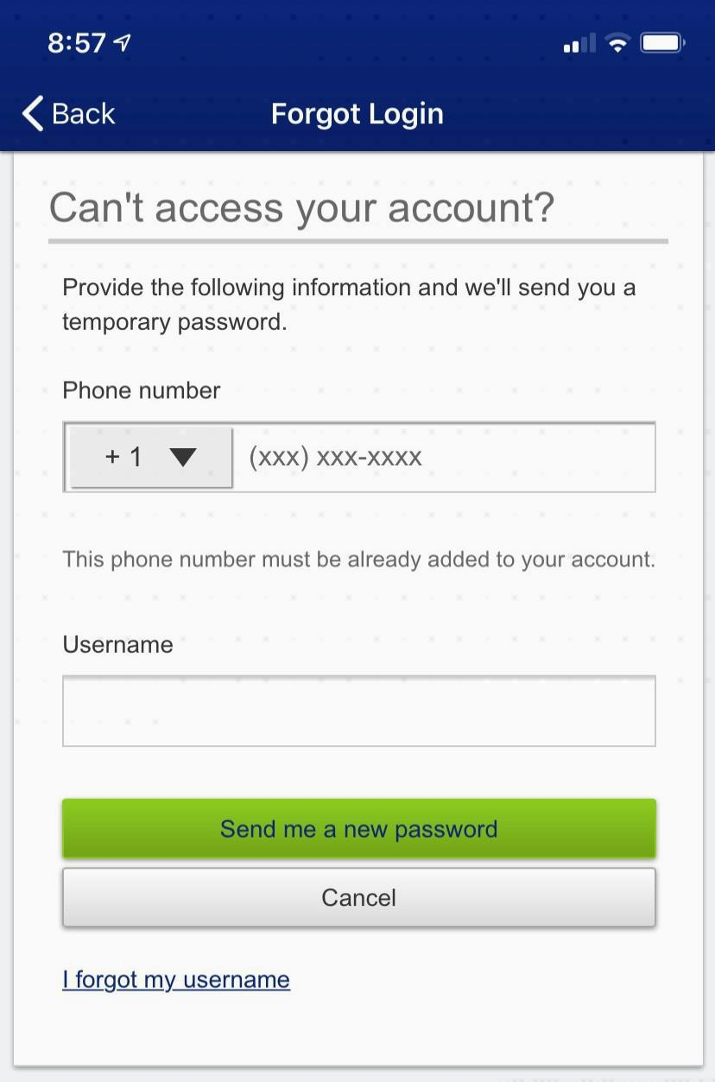
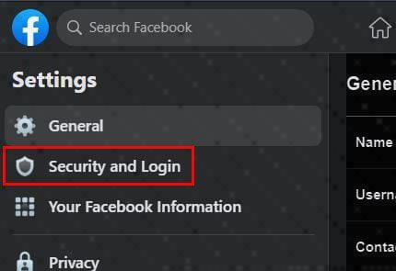
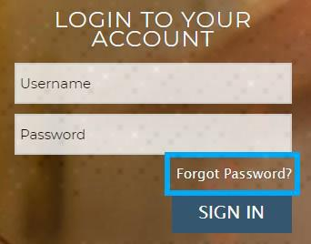
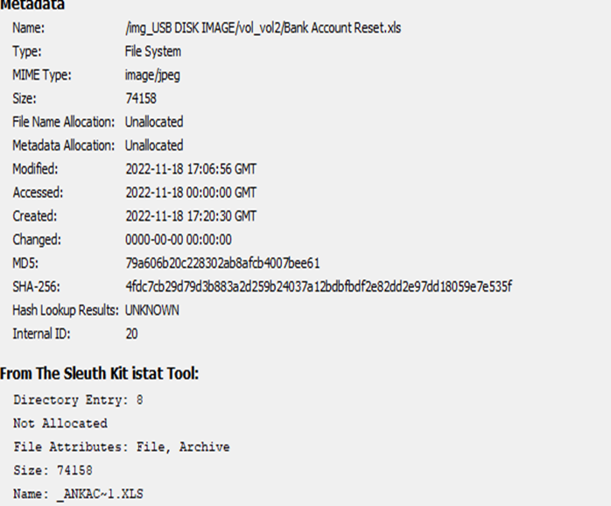
Screenshot of Any other Relevant Data Found on USB Image
1.
2.

Slide 22
SUMMARY OF OBSERVATION1/2
The System image and USB image contain a total of 6 images, all with mismatched extensions.(.xls).
An anti-forensics step had been taken to cover up the actual file types of images on the system image.
All the images contained links to sites where the reset of password was required.
The deleted files were images but had been changed to Microsoft excel spreadsheet files with extension “.xls”.
The image files on the SYSTEM IMAGE corresponds to the recovered deleted image files on the USB IMAGE.
The retrieved links from the system image were the same as the retrieved links from the USB drive image.
The hash values (or the finger prints) of extracted images from the system were same as the recovered images from the USB drive image.

Slide 23
SUMMARY OF OBSERVATION 2/2
From all investigations that were carried out, we observed that the suspect changed the extensions for all the attachments because if he did not do that, then the files he was working with could have just been read by anyone. For this reason, he changed them into a format that was unreadable for the actual file type.
Before changing the extensions of the files, the suspect hid phishing links behind the images so that a third party would just see the file without knowing what it actually contained.
Further investigations indicated that, the suspect worked the files on his computer system then later transferred them to his USB drive. After which, he deleted them because he realized he could soon be caught.

Slide 24
CONCLUSIONS
There can be only two reasons for changing the file extension of all the attachments recovered from the suspect’s computer and deleting the attachments on the USB drive;
i. either the suspect wants to cover up a crime
ii. Or the suspect does not want anybody to know what he has been up to.
With the evidences that were procured, we suggest that the suspect did send phishing messages with links to malicious sites because, all the hidden links which were uncovered from all the attachments seemed to aim at one thing, that is, to get clients’ personal information.
Whoever the suspect sent the phishing message to must be aware some information has been encoded into the attachments therefore receiver is not a victim but an accomplice.

Slide 25
End of Presentation
THANK YOU

