Slide 1
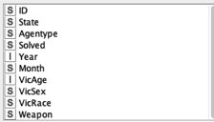
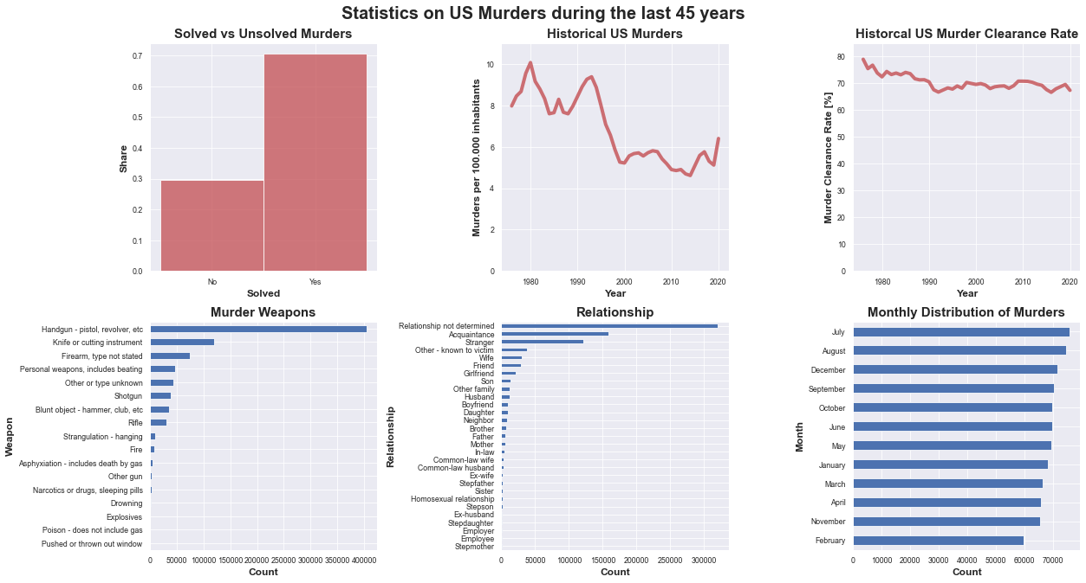
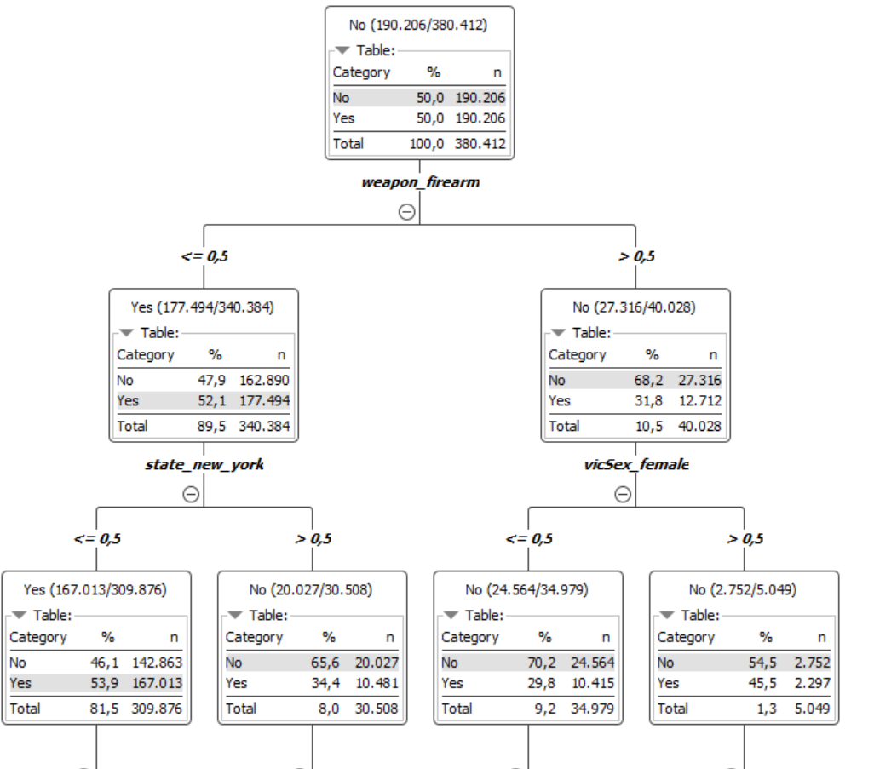
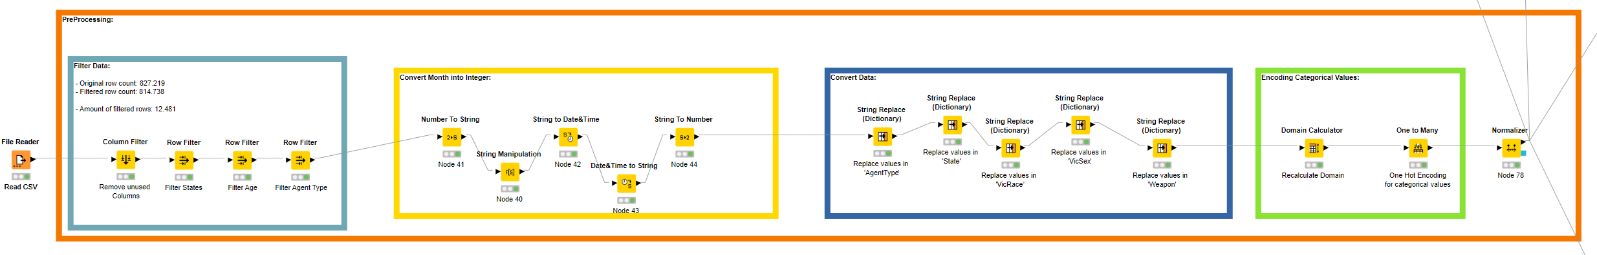
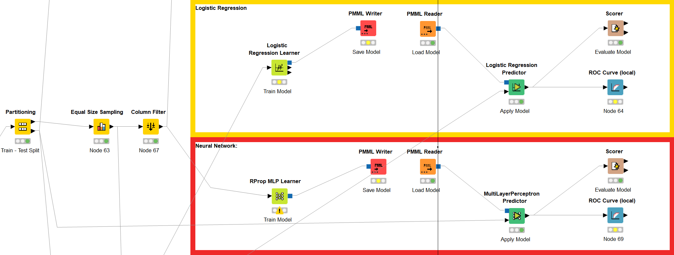
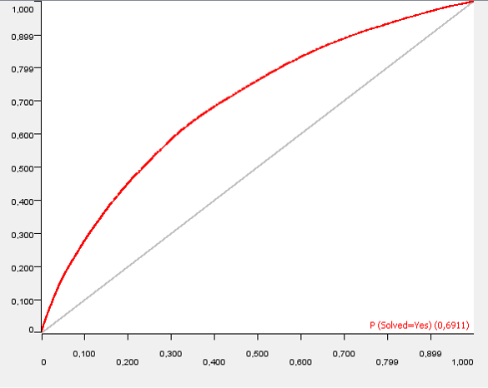
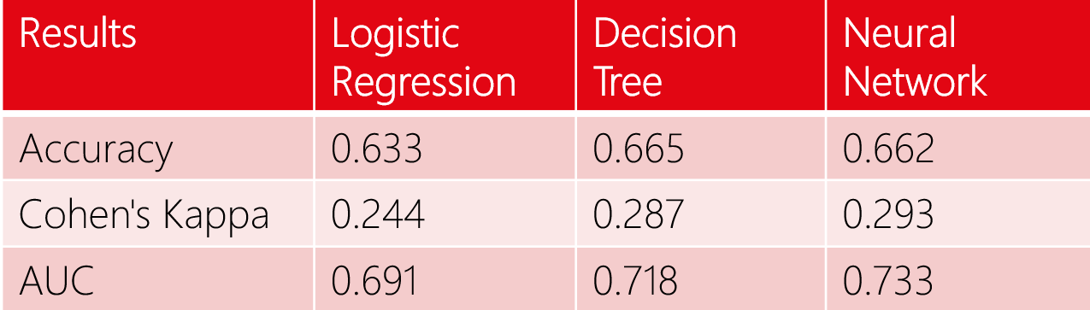
Group 7: Homicide
Lint Tobias, Wiskott Christian, Sumesgutner Ava, Wohlleben Kilian
Challenge
Dataset
Challenges
Going through the various stages of the CRISP-DM process to revise and refine our objective as well as our methods. Formulating a core question that fit the data that we have. Filtering out the relevant information due to the high number of features and the way the data was generated by the agencies.
Core Question
Can we, based on various features of previous murders, like the state, the year or the murder weapon, predict if a new murder case will be solved?
Why?
In 2020, law enforcement agencies cleared only 54 percent of homicides. At the same time, the budget available to investigators is limited. We want to give an indication whether a case may be unnecessarily draining resources or additional resources should be allocated.
827,219 victims (instances) related to 789,664 incidents (IDs)
Data collected by the murder accountability project (MAP) from the Supplementary Homicide Reports (SHR) from the FBI and Florida's separately reported tally
31 features
Data quality issues in some features, e.g. due to definitions changing over time and incomplete data sets
Multiple features reporting the same or similar values, e.g. 'state' reporting the state, 'cntyfips' reporting the state and county
Data Understanding & Preparation
Modelling
Data Understanding
Unbalanced dataset with 70% solved and 30% unsolved murder cases
Overall decline in murders per capita over the last 45 years but rising again since 2014
Steady murder clearance rate of around 70% since 1990
Around 78% of victims where male and 22% were female
The share of black vs. white victims was almost 50/50 over the last 45 years although black citizens make up only about 13% of the population
Alarming rise in murders overall in 2020 with black citizens being affected disproportionally often
Data Preparation
The unused features were filtered out
Erroneous data was removed
Data was converted to usable formats
One Hot encoding was applied to the categorical features
Data was normalized to make computation more stable
We're splitting the data into a train and a validation set, where we use 80% of the data for training and 20% for testing. We choose the training data that large, because we use equal size sampling to get a balanced dataset.
In the end we're left with 380412 training samples and 162948 test samples. We've tried three different models; A logistic regression, a neural network and a decision tree.
KNIME-Workflow
Results
Conclusion
Very similar results for all three models
The best performing model for all metrics was the multi-layer perceptron
Since the difference in accuracy between the MLP and the decision tree is so marginal we decided to use the Decision Tree as our main candidate
Reasonable results given the vast amount of categorical values to be considered and the resulting imbalance for every such category
Performance of these models could be vastly improved by:
augmenting the data set with external data like socio economic features of a given state
balancing the data by over- and respectively under sampling categories like Victim sex, Weapon Type, Agency Type etc.
University of Vienna, Department of Business Analytics

