Slide 1

Introduction to Device Drivers
Advanced Embedded Linux
Development
with Dan Walkes

Slide 2
Learning objectives:
Understand role of Device Drivers
Device Driver Design
Introduce Modules
Notes:
Slide 2

Slide 3
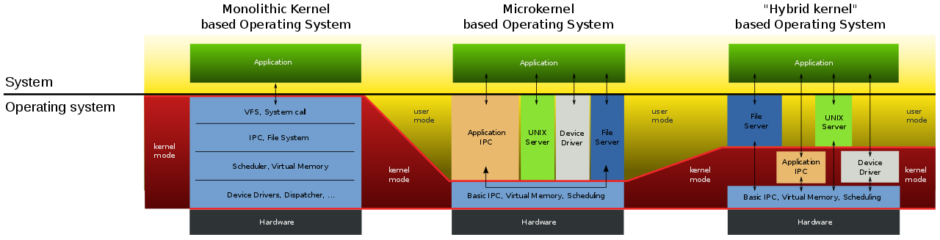
Example Operating Systems Structures
Monolithic - Linux (Monolithic Modular)
Microkernel - FreeRTOS
Hybrid Kernel - Windows, MacOSx
*
https://commons.wikimedia.org/wiki/File:OS-structure2.svg

Slide 4
Introduction to Device Drivers
Make hardware respond to well defined abstraction interface
read(), write(), ioctl()
Built separately from the kernel and plugged in when needed.
Linux Device Drivers 3rd Edition Chapter 1

Slide 5
Mechanism vs Policy
Driver should provide mechanism, not policy
What capabilities are provided? - mechanism
How can these capabilities be used? - policy
TCP/IP sockets -> servers/services
HDD driver blocks -> filesystem
Linux Device Drivers 3rd Edition Chapter 1

Slide 6
Policy-Free Driver Characteristics
Support for asynchronous and synchronous operation
Ability to be opened multiple times at once
Lack of software layers to “simplify things”
Often released with user programs which provide policy, configuration, access to the device.
Linux Device Drivers 3rd Edition Chapter 1

Slide 7
Kernel Roles
Process Management
Create/destroy processes
Handle process I/O
Schedule processes
Memory Management
build the virtual address space for processes
malloc() and free()
Linux Device Drivers 3rd Edition Chapter 1

Slide 8
Kernel Roles
Filesystems
“Everything is a file”
Several types of filesystems - ext4, fat, NTFS
Device Control
Endpoint of system operations
The kernel must have a device driver for every device in the system
Linux Device Drivers 3rd Edition Chapter 1

Slide 9
Kernel Roles
Networking
Collect, identify, dispatch network packets
Routing and address resolution
Linux Device Drivers 3rd Edition Chapter 1

Slide 10
User Space Roles
Applications
FTP server
Graphics Session Manager
Utilities that interact with drivers
Linux Device Drivers 3rd Edition Chapter 1

Slide 11
Modules
Driver: Kernel code that controls hardware
May or may not be added at runtime
Module: Kernel code added at runtime
User space utilities used to add to the running kernel:
insmod - links to the running kernel
rmmod - removes from the running kernel
modprobe - links to a running kernel, also includes dependencies
Linux Device Drivers 3rd Edition Chapter 1

Slide 12
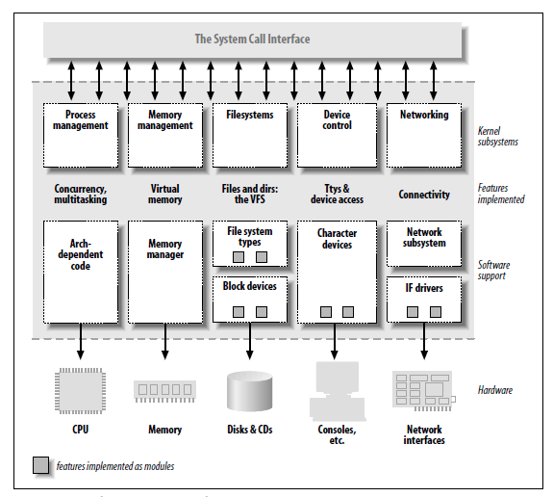
Split View of the Kernel
Linux Device Drivers 3rd Edition Chapter 1

