Slide 1

Does TCP New Congestion Window Validation Improve HTTP Adaptive Streaming Performance?
Mihail Yanev, Stephen McQuistin, and Colin Perkins

Slide 2
Does TCP New Congestion Window Validation Improve HTTP Adaptive Streaming Performance?
Yes. And now I will tell you why…

Slide 3
Does TCP New Congestion Window Validation Improve HTTP Adaptive Streaming Performance?
Yes. And now I will tell you why…

Slide 4




HTTP Adaptive Streaming
T_{Play} = 3s
..3
..6
..9
..6
..9
..12
Get ..12
T_{Download}
..12
..6
..9
..12
T_{Play} > T_{Download}

Slide 5
HTTP Adaptive Streaming
During T_{Play} - T_{Download} the link remains idle
T_{Play} = 3s
..3
..6
..9
..6
..9
..12
Get ..12
T_{Download}
..12
..6
..9
..12
T_{Play} > T_{Download}

Slide 6
Video Transfer
Congestion Window
Link Capacity
Chunk n
Chunk n+1
T_{Download}
Time
Slow Start
Congestion Avoidance
T_{Play}

Slide 7
Video Transfer
Congestion Window
X
Link Capacity
Chunk n
Chunk n+1
T_{Download}
Time
Slow Start
Congestion Avoidance
T_{Play}

Slide 8
Video Transfer
What happens during the idle periods?
Congestion Window
X
Link Capacity
Chunk n
Chunk n+1
T_{Download}
Time
Slow Start
Congestion Avoidance
T_{Play}

Slide 9
Congestion Window Validation
What happens during the idle periods?
Congestion Window
X
X
Link Capacity
Chunk n
Chunk n+1
T_{Download}
Time
Slow Start
Congestion Avoidance
T_{Play}

Slide 10
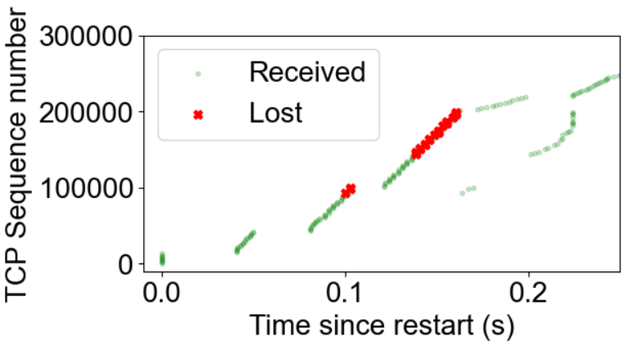
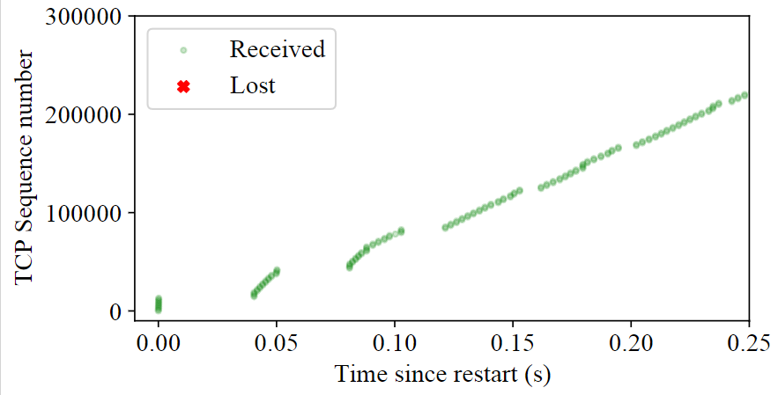
Transfer After Idle
New CWV
CWV

Slide 11
Approach #2
What happens during the idle periods?
Congestion Window
We already have prior CWND knowledge
X
Link Capacity
Chunk n
Chunk n+1
T_{Download}
Time
Slow Start
Congestion Avoidance
T_{Play}

Slide 12
Approach #2
What happens during the idle periods?
Congestion Window
We know the value of the CWND before it was invalidated
X
Link Capacity
Chunk n
Chunk n+1
T_{Download}
Time
Slow Start
Congestion Avoidance
T_{Play}

Slide 13
New Congestion Window Validation
What happens during the idle periods?
Congestion Window
We already have prior CWND knowledge
X
Link Capacity
Chunk n
Chunk n+1
T_{Download}
Time
Slow Start
Congestion Avoidance
T_{Play}

Slide 14
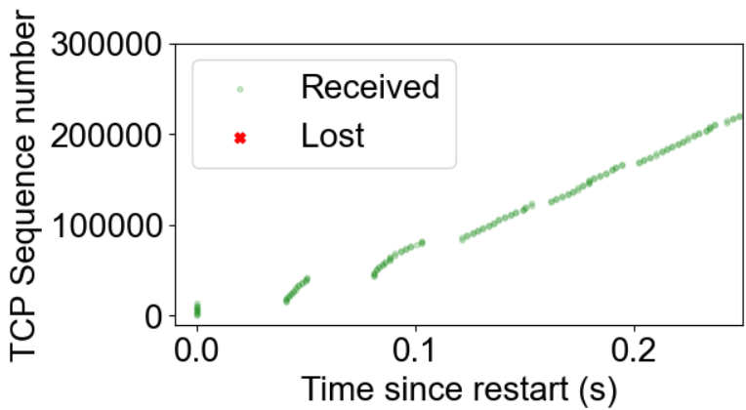
Transfer After Idle
Fewer lost packets:
Bounded CWND growth
Increased network goodput
CWV
New CWV

Slide 15
Effect of New CWV on Video
Transport layer benefits from:
Limiting CWND growth after idle.
Reducing the burst packet loss.
Video (application) effect has not been studied.

Slide 16
Effect of New CWV on Video
Transport layer benefits from:
Limiting CWND growth after idle.
Reducing the burst packet loss.
Video (application) effect has not been studied. Yet…

Slide 17


Experimental Setup
Server
Client(s)
40 ms
DSL
FTTC
FTTP

Slide 18
Experimental Setup
Server
Client(s)
40 ms
DSL
FTTC
FTTP

Slide 19


Application Impact
Rebuffer Ratio

Slide 20
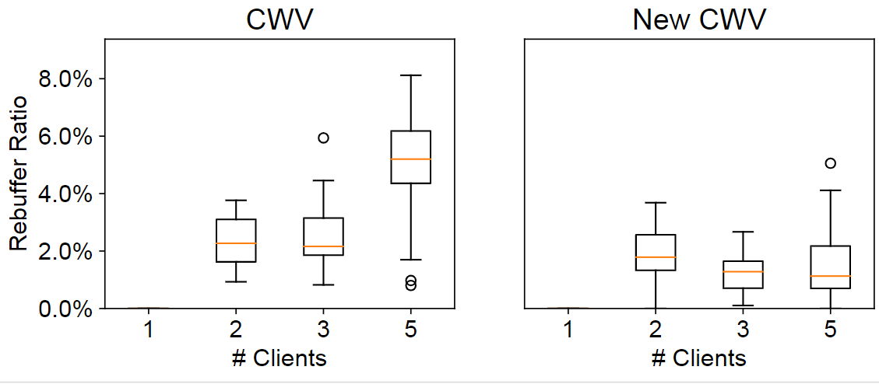
Rebuffer Ratio

Slide 21
Rebuffer Ratio
A mean difference of 4% points.
Rebuffering reduced by over 25 seconds.

Slide 22

Application Impact
Bit-rate Switch Frequency

Slide 23
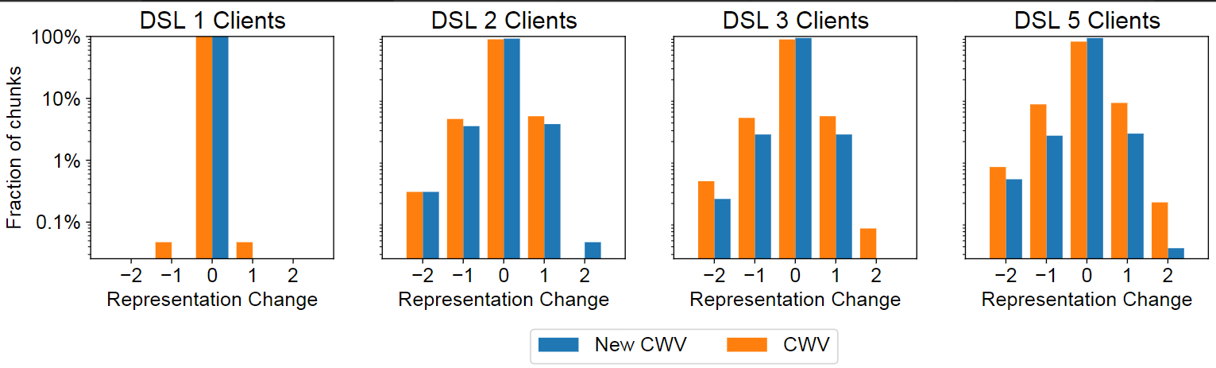
Bit-rate Switch Frequency
LOG SCALE Y-AXIS

Slide 24
Bit-rate Switch Frequency
12.4% points fewer representation switches.
LOG SCALE Y-AXIS

Slide 25
Does TCP New Congestion Window Validation Improve HTTP Adaptive Streaming Performance?
Yes.

Slide 26
Does TCP New Congestion Window Validation Improve HTTP Adaptive Streaming Performance?
Yes. In our simulations we observed that compared to current CWND validation, New CWV:
Reduced rebuffering events by 4% points.
Limited representation switches by 12.4% points.
https://doi.org/10.1145/3534088.3534347
m.yanev.1@research.gla.ac.uk
https://yanev.uk

