Slide 1

Notes:
We were employed by Children with Cancer UK, a charity that aims to ease the burden on families affected by childhood cancer. We were to create a software that allows families going through similar situations to connect and share advice and support each other through the challenges they face. This software is to make the situation easier for the children and the parents by offering this connectivity as well as professional advice and explanations.

Slide 2
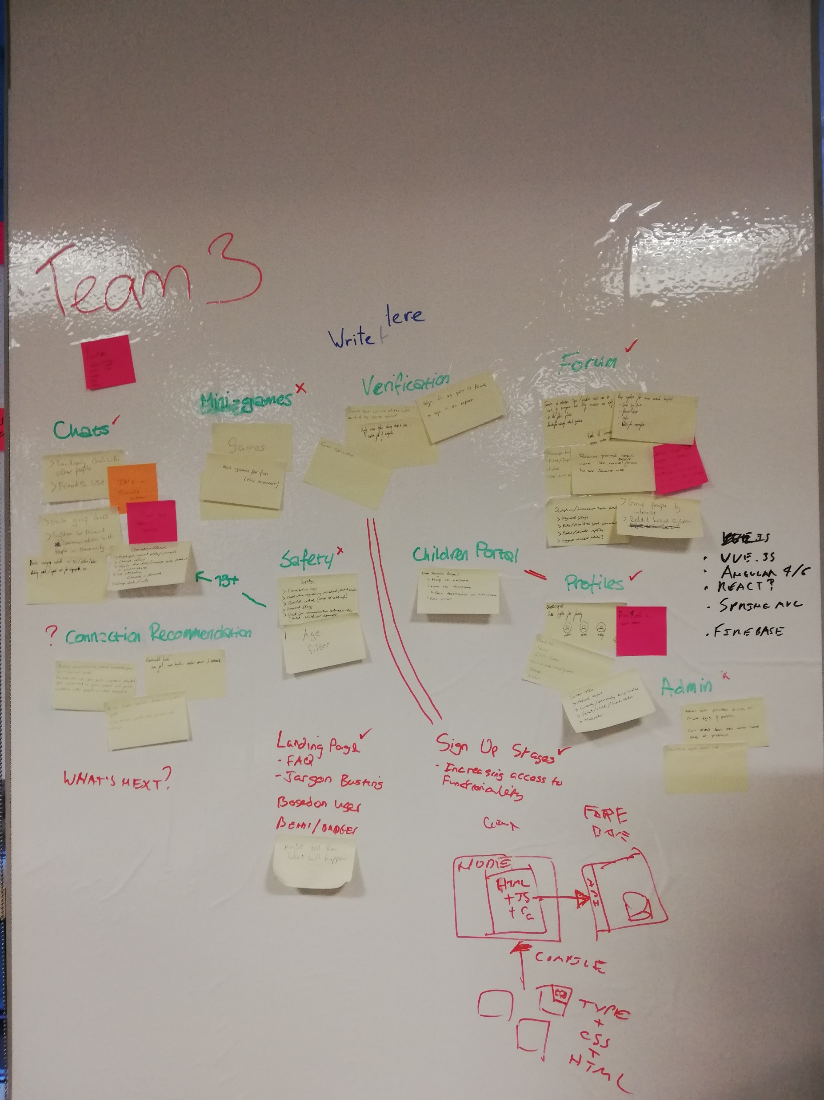
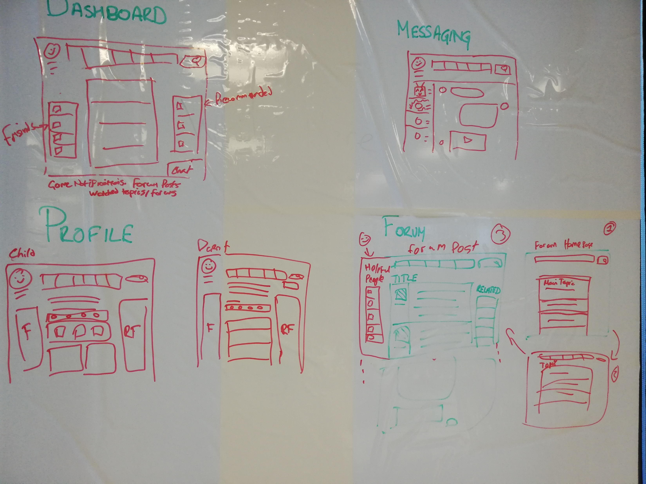
Notes:
Briefly overview all the idea titles
Focus on the ideas that we actually implemented
Intention to have four primary functional displays to allow the user to do different things, their opening dashboard, private messaging, the user’s profile and the discussion forums

Slide 3
Demo

Slide 4
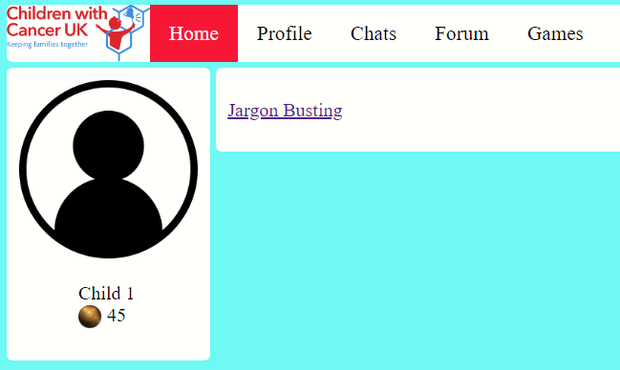
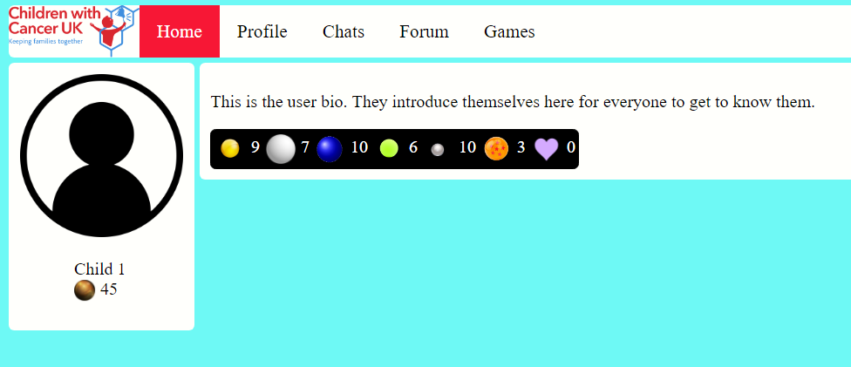
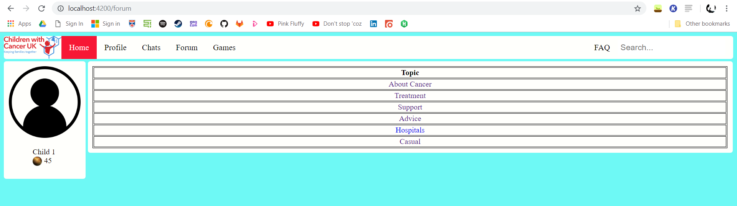

Slide 5
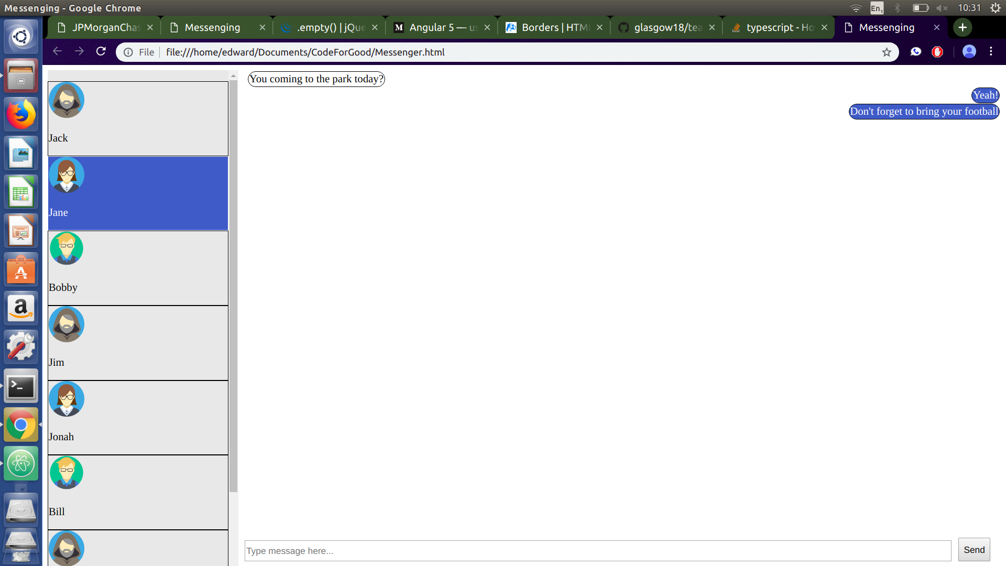

Slide 6
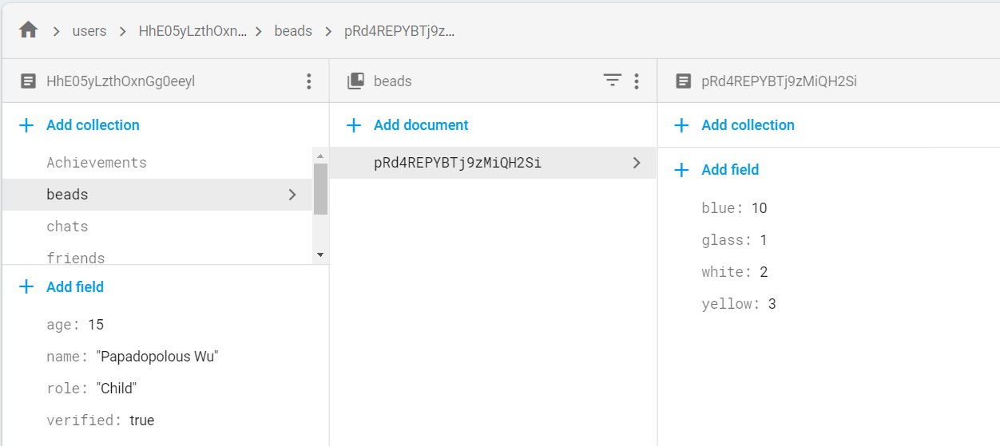
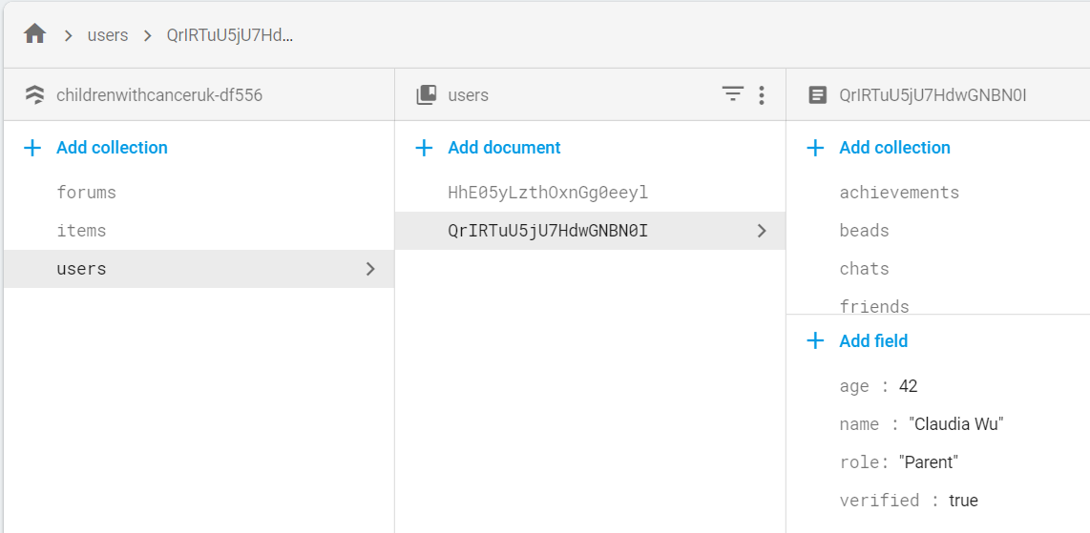
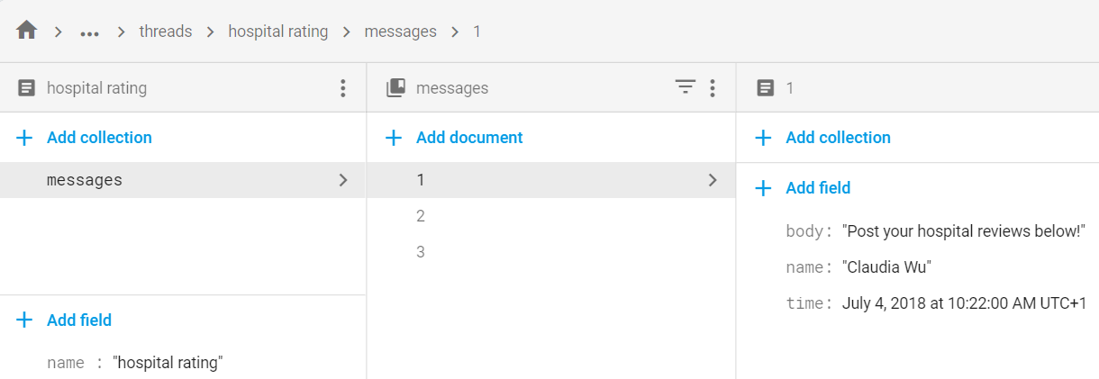

Slide 7
Questions

