Slide 1

Team-16 Maggie’s Project

Slide 2
Aims
Fingerprint Verification
Time-saving Application
Accurate information
Provide Quick Tips to User
Insert multiple records in 1 click

Slide 3
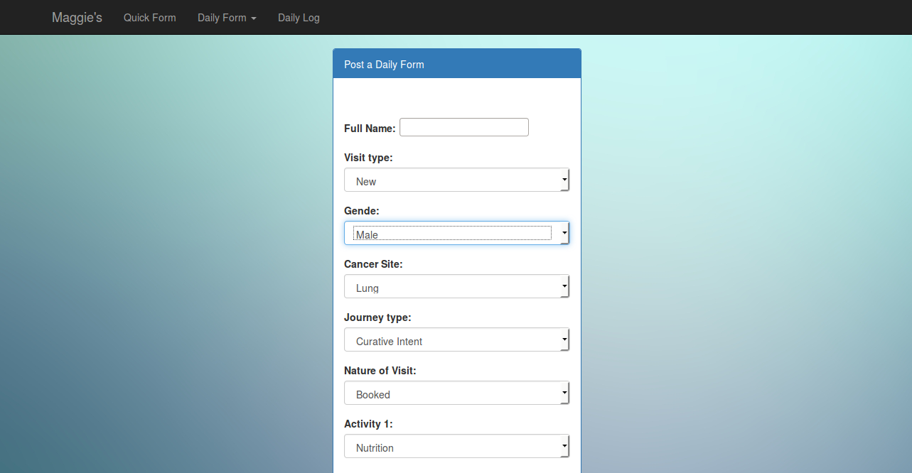
Provide Quick Tips to User
Please specify the type of person who visited this facility
Select type of visit. E.x Has the user booked an appointment in advance?

Slide 4
Multiple Records Functionality
Insert single record or multiple
Group
Single

Slide 5
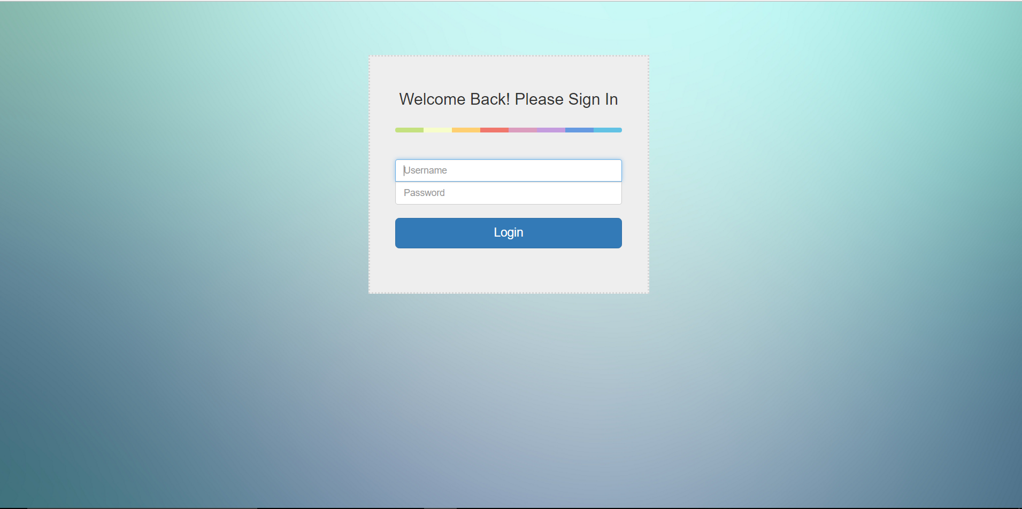
Main page- Login page

Slide 6
Quick Form

Slide 7
Input Form
User is able to select and edit an entry from the database that have been logged the same day
Once edited the user submits and the entry is replaced with the current one
If a user identifies a duplication of a person can merge the data into one entry

Slide 8
Daily Log
At the end of the day a user can see everything that has been logged as a final form
A user can also see who was the one to last to modify an entry
Visit Type | Gender | Cancer Site | Journey Stage | Nature of Visit | Activity(1,2,3)
Returning | Female | Breast | Post Treatment | Booked | 1.Nutrition 2.Manage Stress

Slide 9
Thank you!

