Slide 1
Falkirk Community Trust
Team 5-Code For Good 2016

Slide 2
The Idea
A QR-Code based treasure hunt.
Pre-planned routes joinable at any point directing Visitors to various different attractions within the Helix.
Interactive ‘posts’ that provide information and enable interactivity.

Slide 3
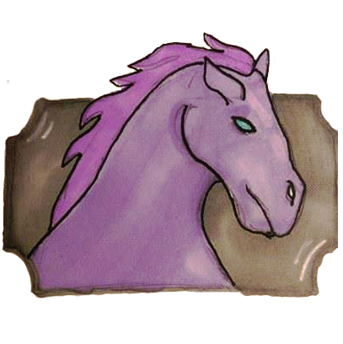
The Requirements
The Posts
Must be able to display unique dynamic QR codes when a user is nearby.
These QR codes must link to the appropriate page on the app.
The App
Must be able to Scan the QR Codes.
Manage and share Achievements.
Create and Track Routes.

Slide 4
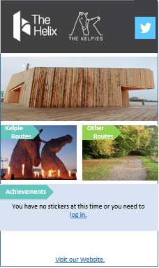
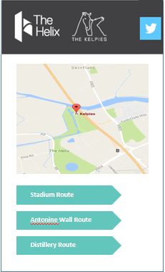
App Design
Simple Intuitive Design.
Consistent with The Helix’s official website.
Implements Google Maps.

Slide 5
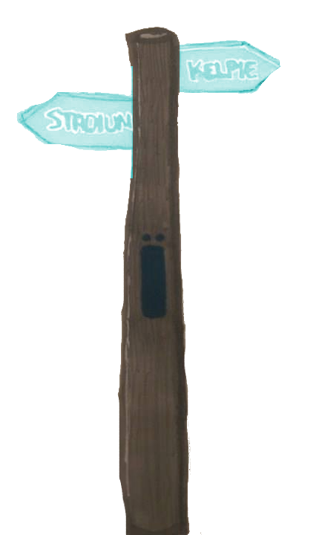
Post Design
Modern materials such as brushed steel and Perspex to fit with the aesthetic of the Kelpies.
Traditional style with dual purpose.
Motion sensor positioned above screen to prevent being set off by local wildlife.

Slide 6
Improvements/Extensions
Constructing a database to store User details would be a functional requirement because of the large numbers of possible users.
GPS could be used to track your position on the route when you are outwith the vicinity of the posts.
Posts could gather weather information and send alerts to Visitor’s apps advising them on courses of action.
E.g. “It’s going to Rain! How about heading to the café?” or “It’s sunny today, perfect for kayaking at the Helix Lagoon.”
Ideally the QR Scanner would be self contained within the app, which due to time constraints, we used a 3rd party app.

