Slide 1
Falkirk Community Trust
Team 5-Code For Good 2016

Slide 2
Brief

Slide 3
The Idea

Slide 4
The Requirements

Slide 5
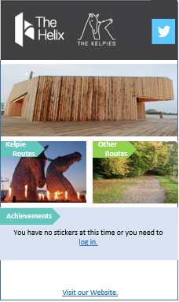
App Design

Slide 6
Post Design

Slide 7
Possible Improvements/Extensions

