Slide 1
Falkirk Community Trust
Team 5-Code For Good 2016

Slide 2
Brief
To create a smart park experience by making use of interactive “posts”. Visitors will be able communicate with these posts directly or indirectly. The posts can gather their own data from their attached equipment, the internet or visitors smart phones, and do something interesting with it.

Slide 3
The Idea
A QR-Code based treasure hunt.
Pre-planned routes joinable at any point directing Visitors to various different attractions within the Helix.
Interactive ‘posts’ that provide information and enable interactivity.

Slide 4
The Requirements
The Posts
Must be able to display unique dynamic QR codes.
Must be able to tell when a Visitor is nearby so it can generate a valid QR Code.
These QR codes must link to the appropriate page on the app.
The App
Must be able to store and retrieve relevant user information.
Must be able to Scan the QR Codes.
Manage Achievements.
Create and Track Routes.
Share achievements on Social Media.

Slide 5
What We Used
We utilised:
A Raspberry Pi 3 along with a motion sensor.
Python, for basic functions.
HTML5, to design the layout of the web app.
Amazon EC2 to host the web app.
Flask to support the dynamic features of the web pages.

Slide 6
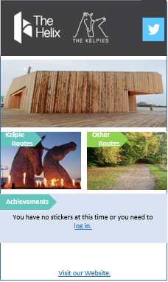
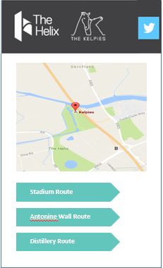
App Design
Simple Intuitive Design.
Consistent with The Helix’s official website.
Implements Google Maps.

Slide 7
Post Design
Modern materials such as brushed steel and Perspex to fit with the aesthetic of the Kelpies.
Small screen run by a raspberry pie to allow the post to be kept as small as possible.
Motion sensor positioned above screen to prevent being set off by local wildlife

Slide 8
Improvements/Extensions
Constructing a database to store User details would be a functional requirement because of the large numbers of possible users.
GPS could be used to track your position on the route when you are outwith the vicinity of the posts.
Posts could gather weather information and send alerts to Visitor’s apps advising them on courses of action.
E.g. “It’s going to Rain! How about heading to the café?” or “It’s sunny today, perfect for kayaking at the Helix Lagoon.”
Ideally the QR Scanner would be self contained within the app, which due to time constraints, we used a 3rd party app.

