Slide 1
BUSINESS REPORT
The Helix
Team-8
Xu Zhu
Xue Guo
Yunjia Wang
Lan Liu
Mingjian Luo

Slide 2
CONTENTS
Introduction
Overall
.
Process
Interface
Conclusion

Slide 3
1
Introduction

Slide 4
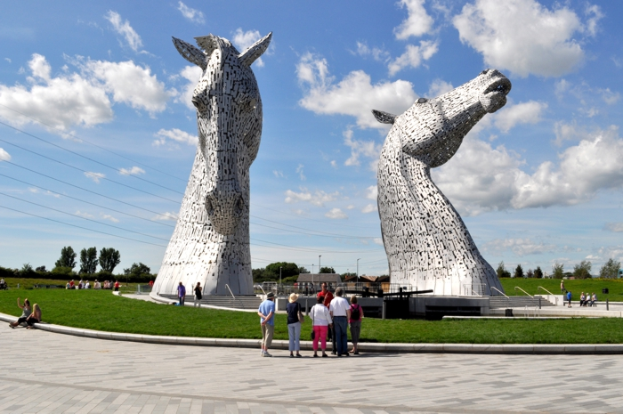
The Helix
A smart park
The helix is a park in Falkirk.
We make it interact with visitors and attract more people to feel each point in the Falkirk 。

Slide 5
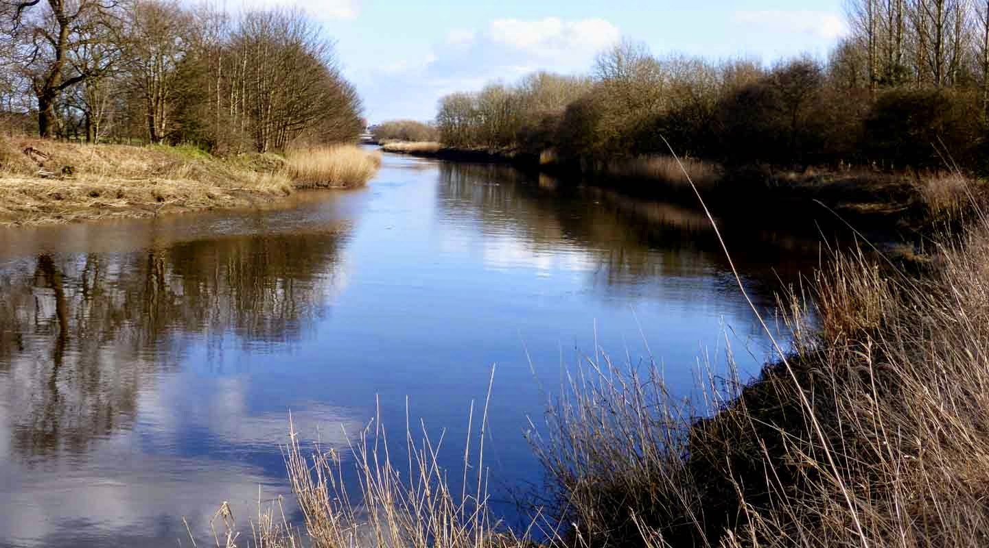



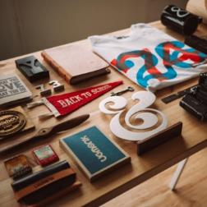
1
What we do
Rasberry pi sensor
Link back-end with
Font-end
Map compute
Web front-end

Slide 6
2
How it work

Slide 7





2
Different visitors
Meet different people’s needs
Family
Couple
Fitness
Walk dog

Slide 8


2
Different weather
Rainy
sunny
Route include more place
Map

Slide 9






2
Interaction process
Choose what you want
Arrive next node
Arrive destination
Get a route
Input code to get next node information
Share or get reward

Slide 10
3
Interface

Slide 11
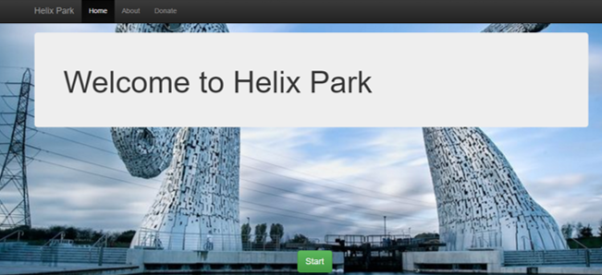
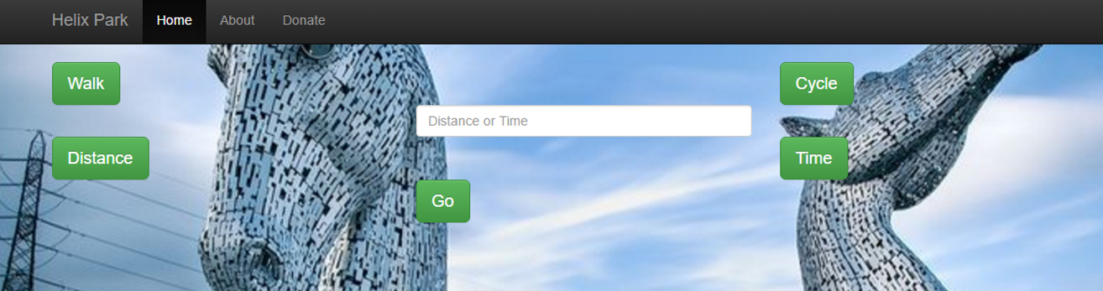
3
User interface

Slide 12
4
Conclusion

Slide 13
THANK YOU!
Team-8
Xu Zhu
Xue Guo
Yunjia Wang
Lan Liu
Mingjian Luo

