Slide 1


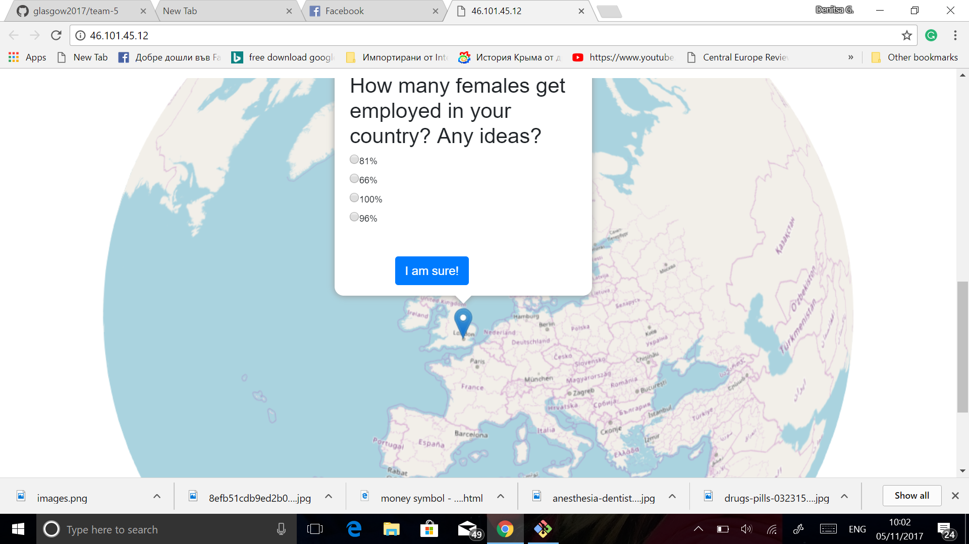
In their Shoes
It’s time you ? Equality

Slide 2


Project description
Gender equality levels vary in different countries. Comparing the data sets extracted from various countries would not be enough to raise the awareness of people
The project is looking at the issues in different angle, representing the data in more attractive way
The project is divided into two main components, which are intertwined and they work together:
1.Quiz
2.Game

Slide 3
OUR AIM
Contribute to better community and pass it to the next generation
Bigger percentage of people participating
Raise awareness
about gender equality

Slide 4

OUR APPROACH
We built a user friendly web app and then we started building mobile friendly
We implemented a quiz there
The quiz is using open source data with 5 attributes for four countries-United Kingdom, Rwanda ,India, Indonesia.
We made our project more interactive by utilising a game/ entertainment

Slide 5
Countries’ attributes
literacy
law prohibits child marriage
maternal mortality
employment to population ratio (ages 15-24 female)
underage pregnancy

Slide 6
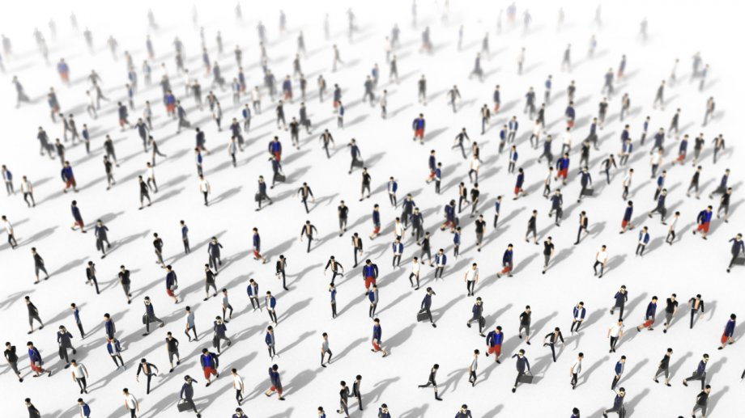


Future Goals
Making 3D models using JSON to represent the main obstacles in the game
In the future we aim at making mobile friendly design
People’s unawareness in
general about the issues in
society.
Drugs
Money

Slide 7

Wait for the last slide

Slide 8

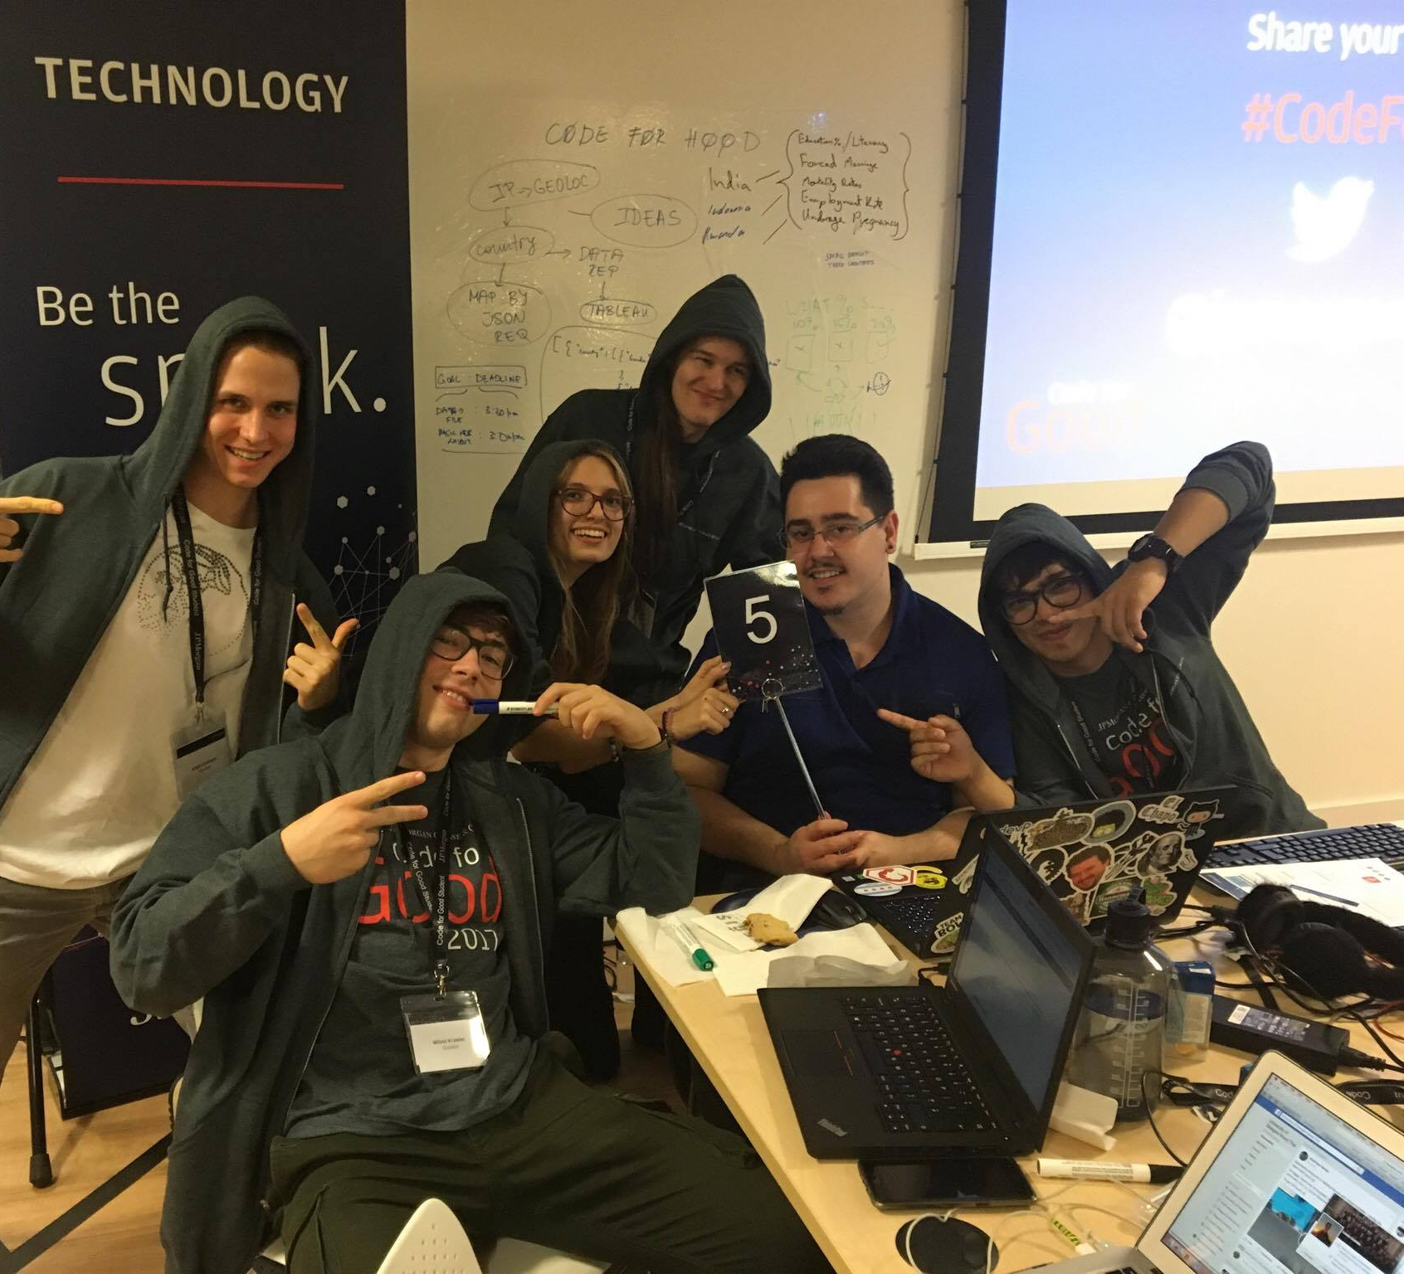
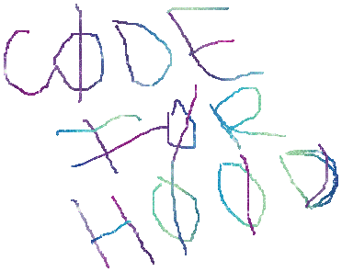
ASK OUR TEAM

