Slide 1


The TECHNICAL SIDE

Slide 2
BackEnd
Ubuntu server with Nginx
PHP7.0-Laravel
MySQL Database on AWS
Python to access the World Bank’s API

Slide 3

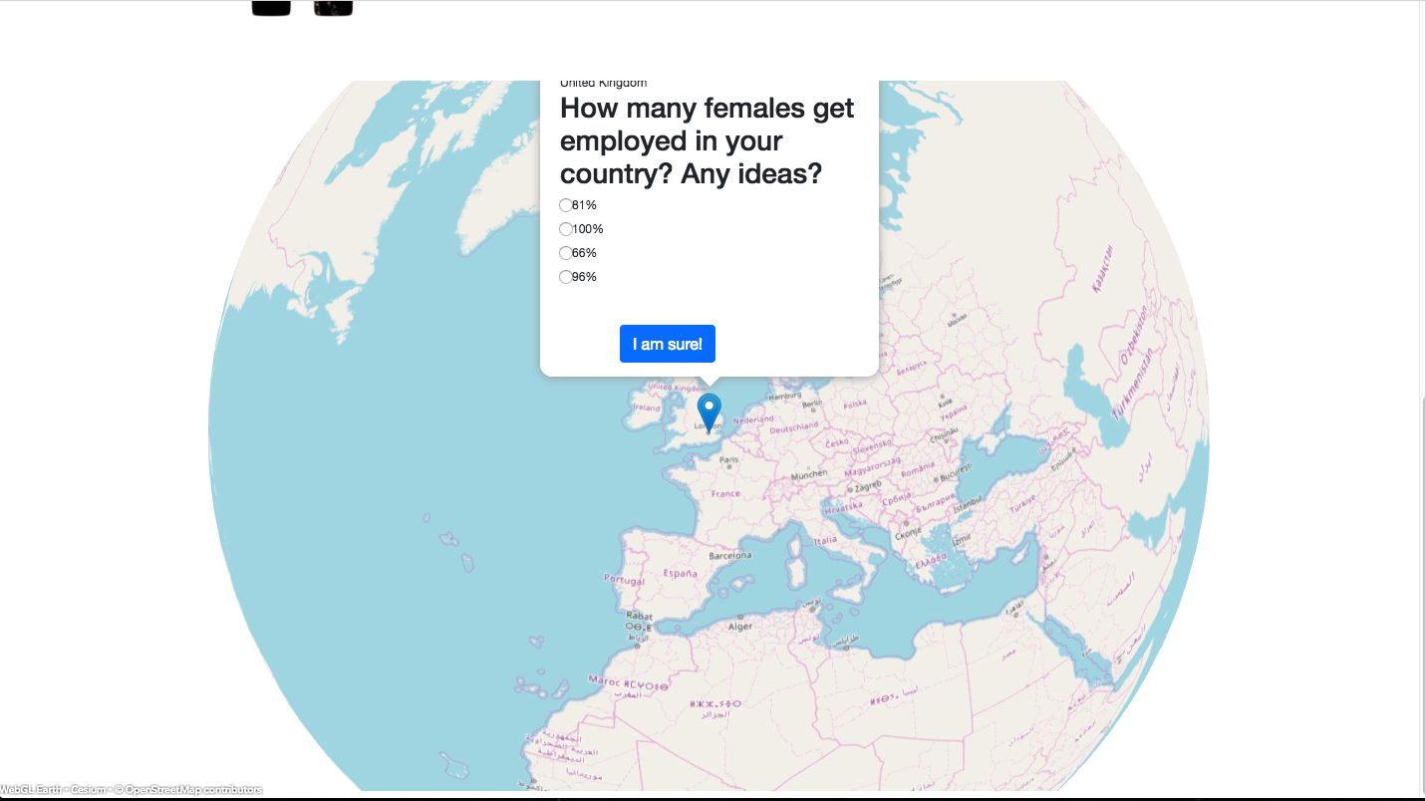
Backend is visualised in Web App

Slide 4
FrontEnd
JavaScript
HTML
CSS

Slide 5
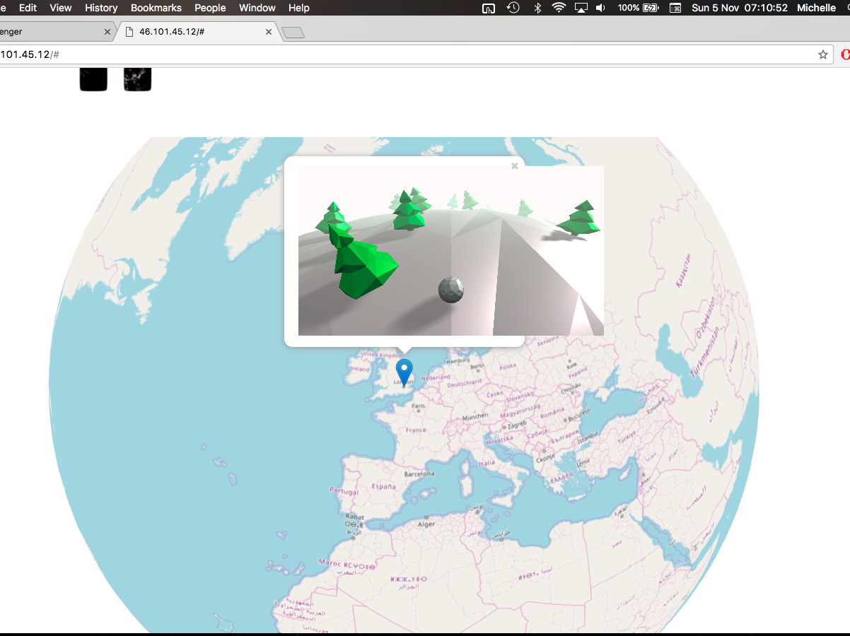
OUR GAME IN ACTION

Slide 6
Room for Improvement
More data sources
New features in the game
Improve the design of the Web App

Slide 7
Future areas for improvement
Making 3D models using JSON to represent the main obstacles in the game
Unawareness
Drugs
MONEY

Slide 8
