Slide 1

Cyclops
Accessibility tool for
Chrome.

Slide 2
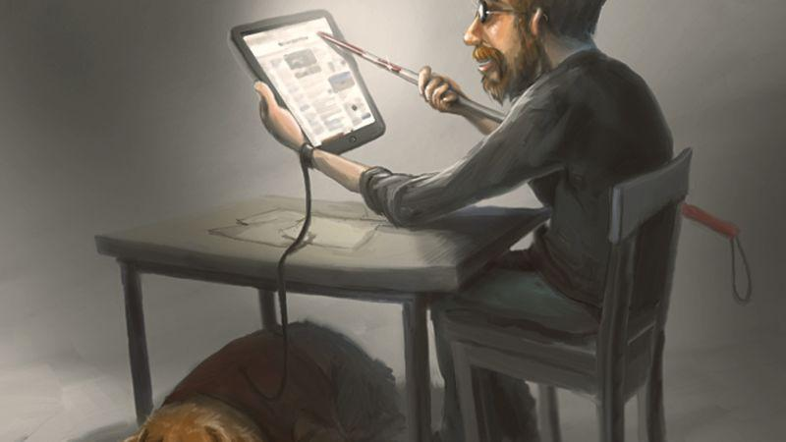
The problem
Internet has shifted more towards visual implementation and information
However not everyone can benefit from the modern customs
Some are actually put into more of a disadvantage

Slide 3

The solution
Plugin for Chrome
Web pages easier to navigate for the visually impaired.
Making the live chat accessible

Slide 4
Demo

Slide 5
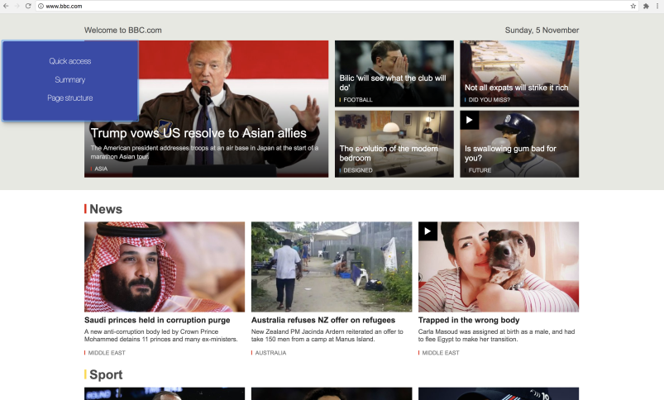
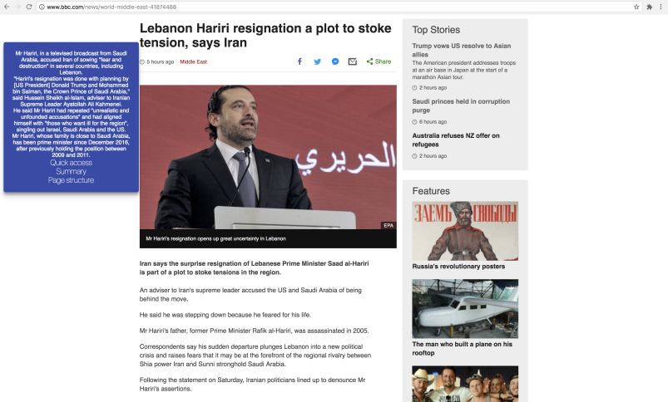
Easier web page navigation
Parsing the content of the web page and then through an API returns a summarized version
Describes an image on the page to the user
=>

Slide 6
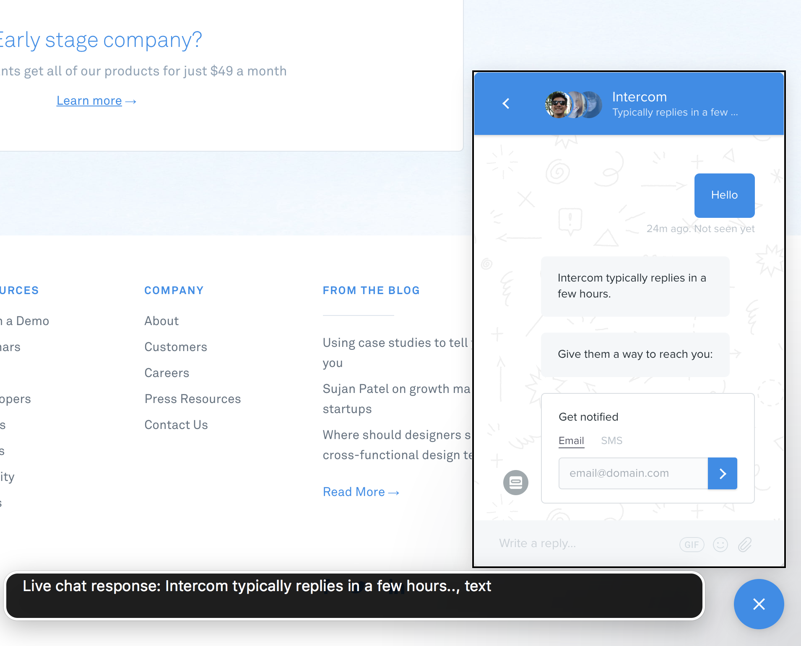
Accessible live chats

Slide 7
Future developments
Cross-browser support
Making a consistent solution across all live chats
A client based solution that is swift and make end user convenient

Slide 8
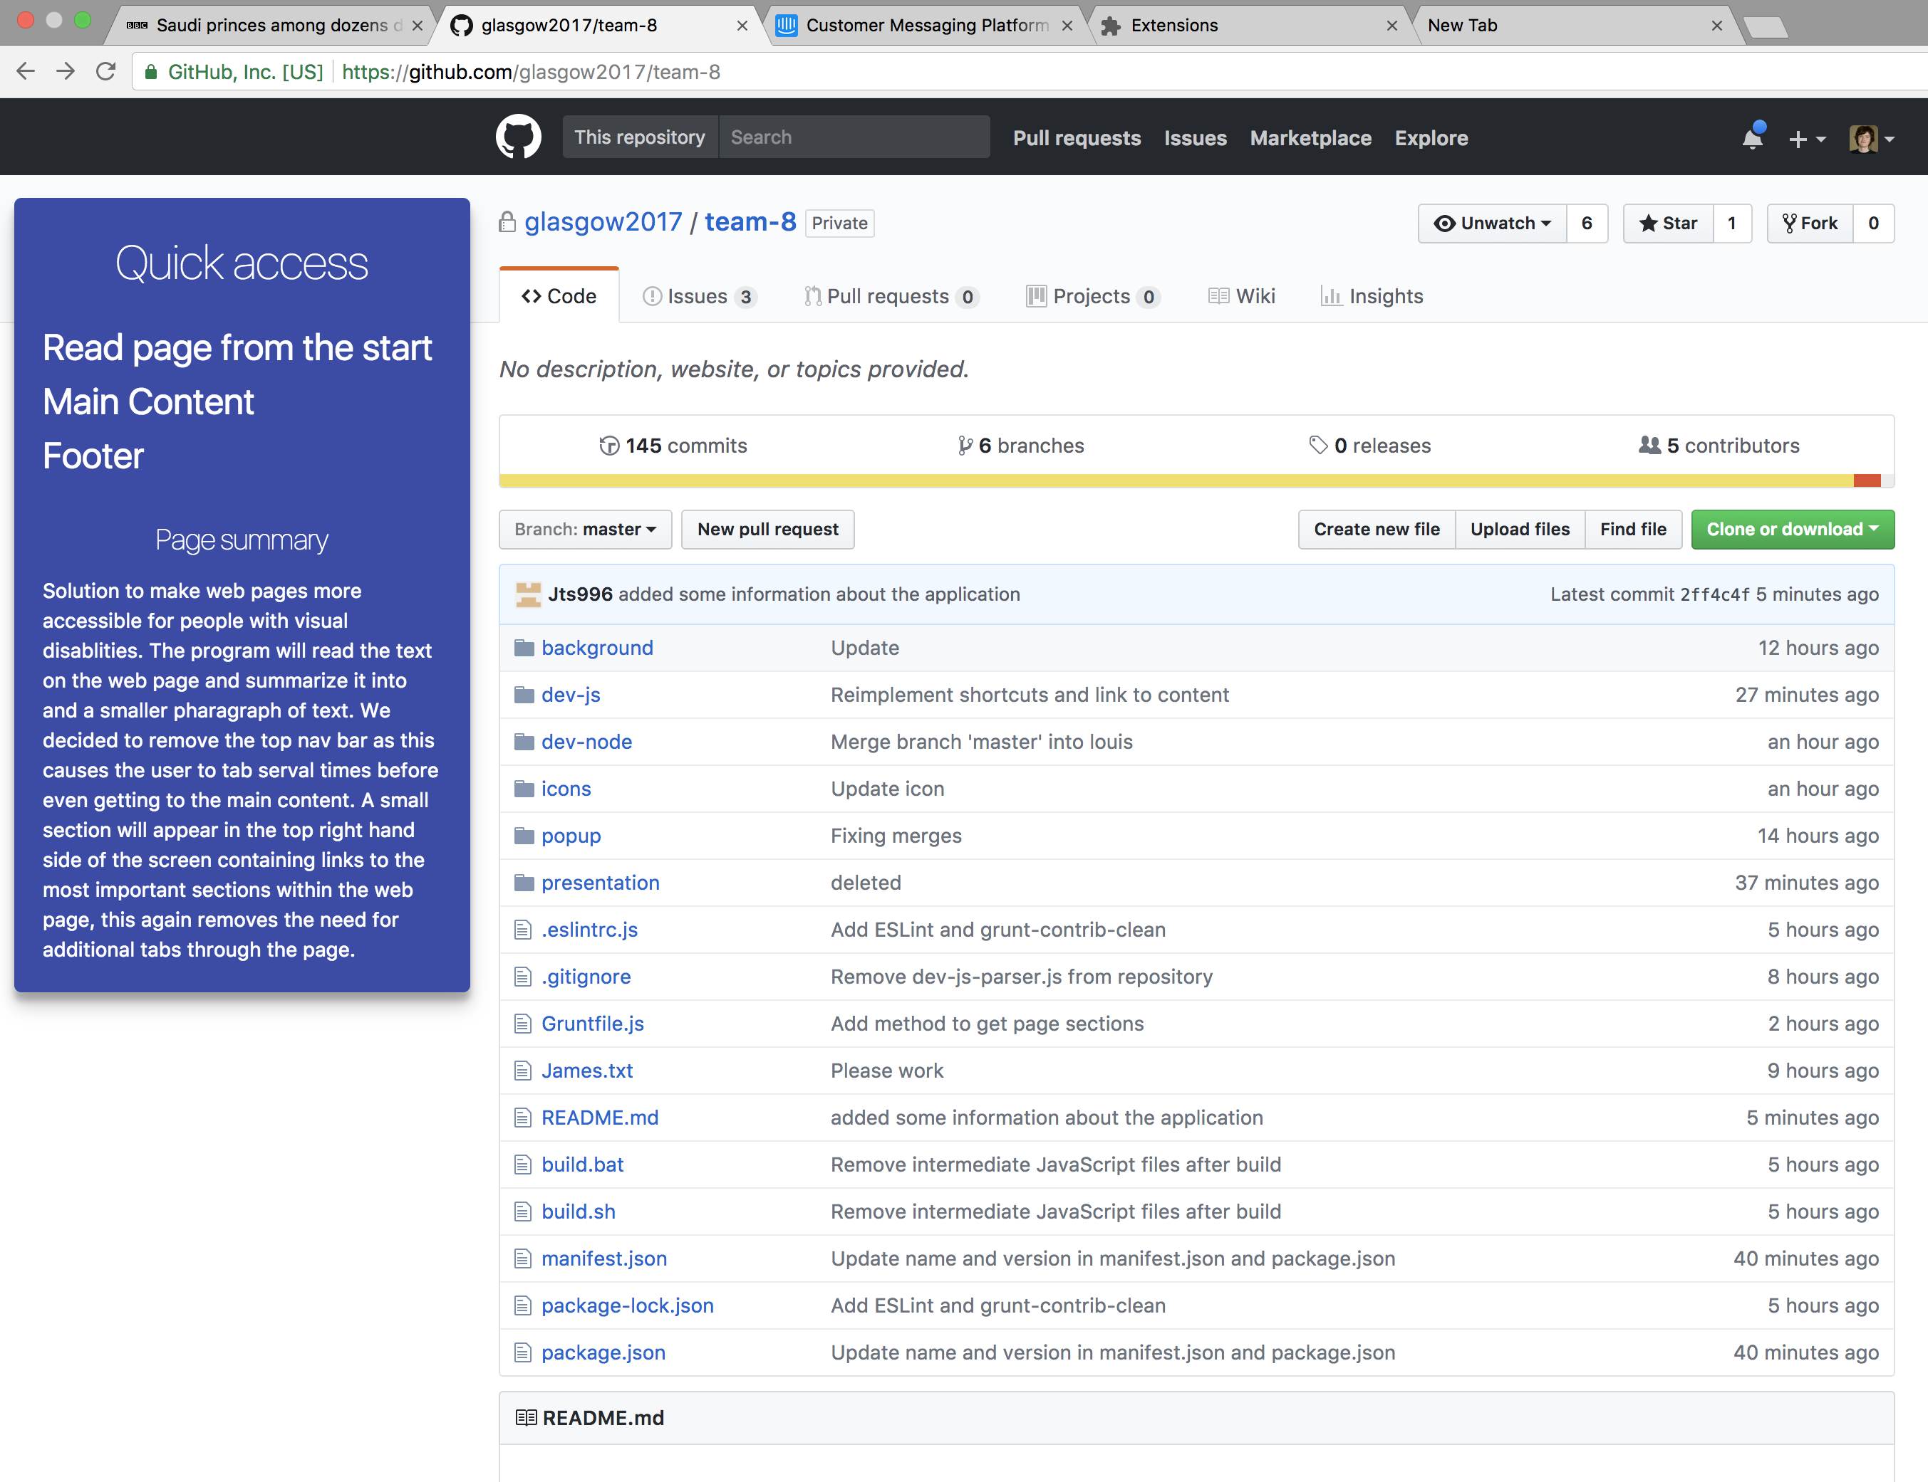

Slide 9
Thank you

