Slide 1
The RapidFire Project
https://github.com/glassdfir/RapidFire

Slide 2
What is RapidFire?
Remote APplication for Investigating Digital Forensics Incident Response Events
RapidFire is a collection of python tools designed to collect files of interest and other artifacts from live Windows systems and disk images and produce actionable information for responders.

Slide 3
What is RapidFire?
RapidFire's intentions:
Quickly collect DFIR information and return actionable information to responders.
Demystify incident response and forensics by explaining every step it takes and why.
Teach DFIR folk how python can be leveraged to accomplish forensic objectives.

Slide 4
What is RapidFire?
Rapid - Used for collecting files of interest, memory, WMI data, and other volatile data from a target system.
Fire - Used to parse collected artifacts and return actionable intelligence.

Slide 5
Why RapidFire?
Many practitioners in information security do not have strong computer science backgrounds and may not be familiar with how things work "under the hood”.
An attempt to bridge the knowledge gap between incident responders and forensic analysts

Slide 6
DEMO of the Rapid.py Collection script

Slide 7
The rest of tonight’s presentation will explain, in depth, what just happened and why.

Slide 8
Summary of the Rapid Collection Script
Opens the system drive and reads the Volume Boot Record ($Boot).
From $Boot, it parses out the necessary information to analyse the volume and find the Master File Table ($MFT)
Copies the $MFT to the collection folder and then parses for file paths and data/data runs.
Compares a list of regex pattern against each file name to determine whether or not to collect it.
If the path matches a pattern, it will use the physical offset and length to carve the file from the volume.
Collected files are stored in the RapidFire_Collection\C folder

Slide 9
Opens System Drive
Reads in $Boot
From the Volume Boot Record we need the following information:
Bytes per Sector
Sectors Per Cluster
Starting Sector of the the Master File Table ($MFT)
Size of the $MFT records

Slide 10

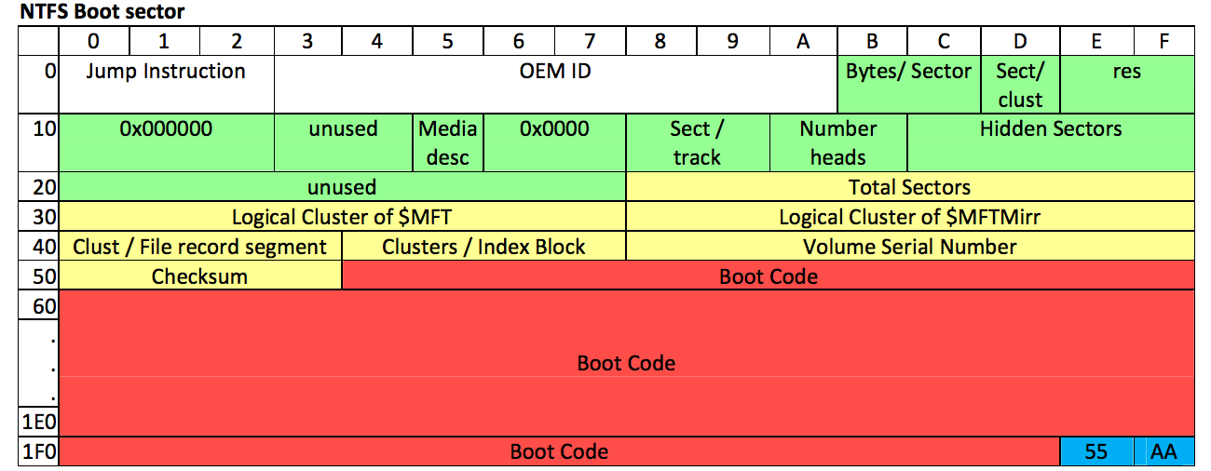
Opens System Drive
Reads in $Boot

Slide 11
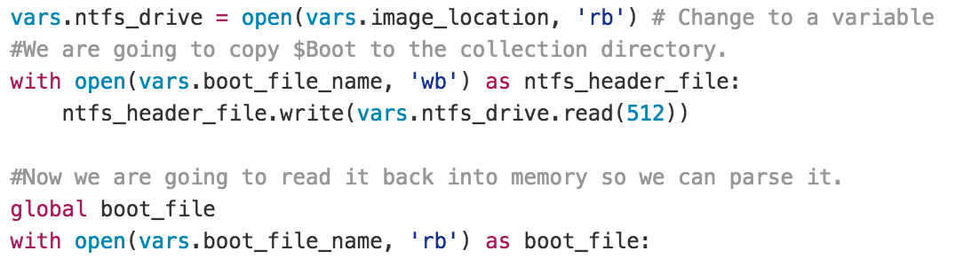
Read in VBR

Slide 12
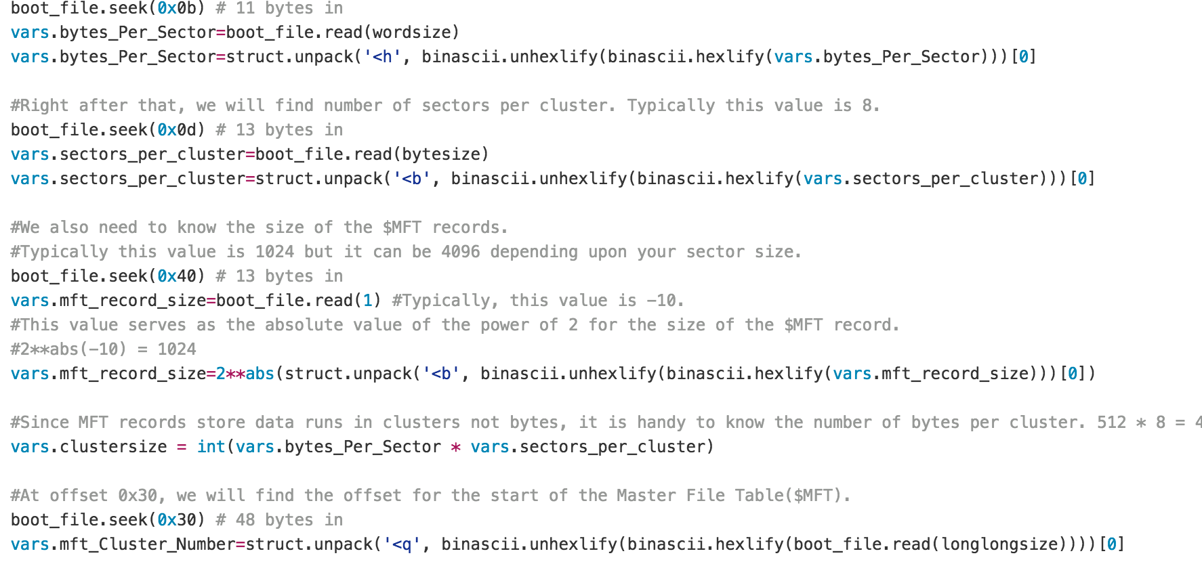
Read in VBR

Slide 13
Now what?
Bytes per Sector * Sectors per Cluster * Starting Sector of the $MFT = The offset from the start of the volume where the $MFT starts.
Now we need to carve the $MFT from the volume so we can parse it.

Slide 14
Carving the $MFT
The first record of the $MFT is for the $MFT itself
So we seek to the $MFT’s offset and read the record size we parsed from the $Boot

Slide 15
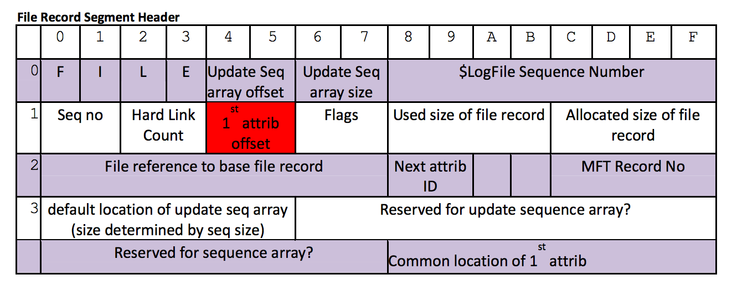
Carving the $MFT
Each $MFT record contains a header, and a series of
attributes.

Slide 16
Carving the $MFT
$MFT records are usually 1024 (1K) bytes in size but can be 4096 (4K) bytes depending upon the sector size the drive is formatted for.
4K records are not the wave of the future. They are just a necessity if you have 4K sectors.
Windows 10 Tech Preview uses the same NTFS that XP does with 1024 records.

Slide 17
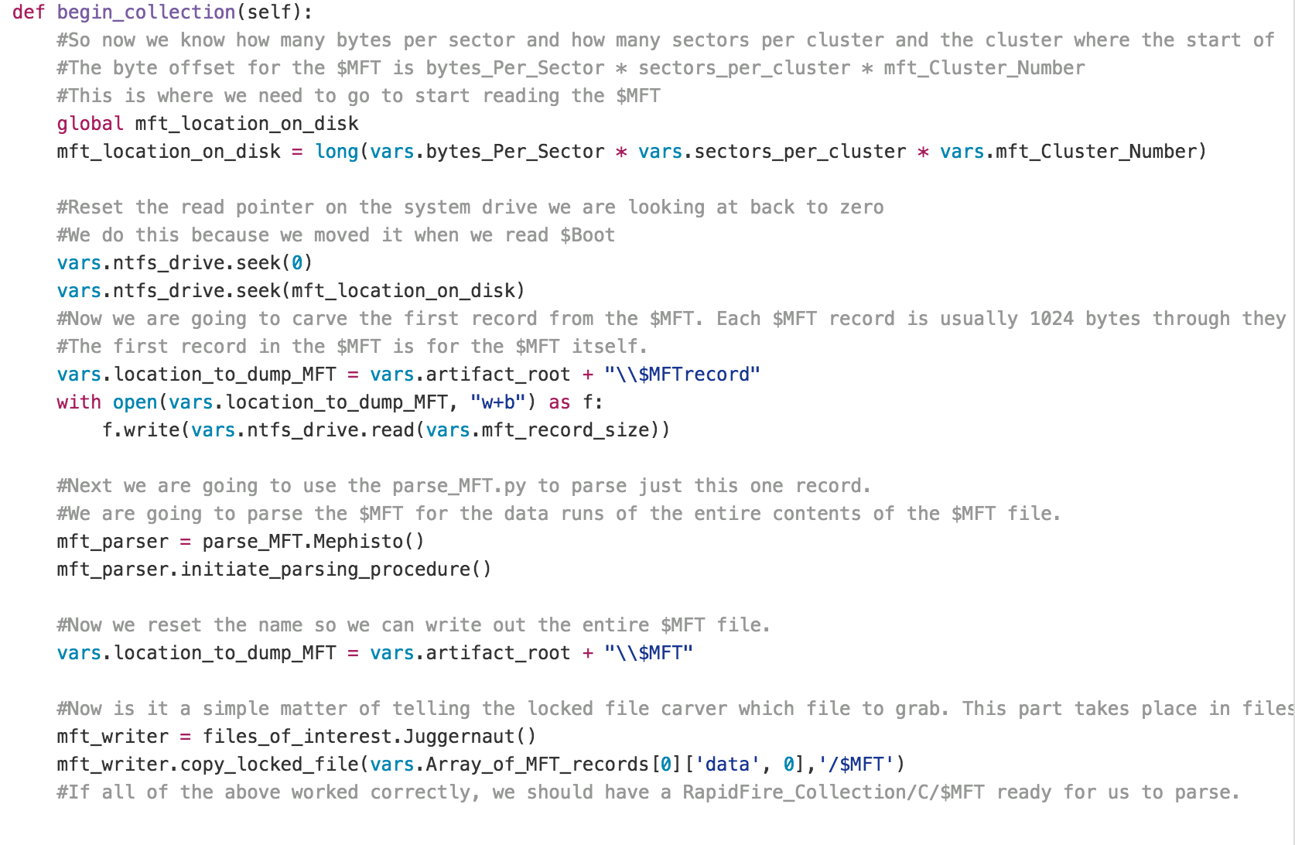
Carving the $MFT

Slide 18
Parsing the $MFT records
$MFT records are basically flat, stacked on top of each other in 1K or 4K sections. This is usually 1K. The rest of the presentation will continue with that understanding.

Slide 19
Parsing the $MFT
To carve a file from disk we need the following information from each record:
$MFT record number
Parent record number
If the File is resident we just need the data attribute.
If it is non-resident, we need the data runs.
The filename and the name of any named attributes
We take ALL of the information and cram it into an array in memory.

Slide 20
Parsing the $MFT
{('name', 0): '$MFT', 'data_count': 1, 'filename_count': 1, 'parent_reference': 5, ('data', 0): {'resident': 1, 'number_of_dataruns': 2, 'name': '', 'dataruns': [[24512, 786432], [8576, 4841828]]}, 'file_path': '/$MFT', 'MFT_record_number': 0}
A data run is the length of the file(in clusters) and the starting cluster offset within the volume. File may have many data runs.

Slide 21
Parsing the $MFT
[Length, Offset] [24512, 786432] = @786432 clusters from the start of the volume the first portion of the file is 24512 clusters in size. [8576, 4841828] = @4841828 clusters from the start of the volume the second portion of the file is 8576 clusters in size.
Clusters are usually 8 sectors or 4K.

Slide 22
Resident Evil
{('name', 0): '$ILZBCT4.py', 'data_count': 1, 'filename_count': 1, 'parent_reference': 84355, ('data', 0): {'resident': 0, 'data': '\x01\x00\x00\x00\x00\x00\x00\x00\xc0\x07\x00\x00\x00\x00\x00\x000c\x08>\x15\x80\xd0\x01C\x00:\x00\\\x00G\x00i\x00t\x00H\x00u\x00b\x00\\\x00R\x00a\x00p\x00i\x00d\x00F\x00i\x00r\x00e\x00\\\x00m\x00f\x00t\x00u\x00t\x00i\x00l\x00s\x00.\x00p\x00y\x00\x00\x00\x00\x00\x00\x00\x00\x00\x00\x00\x00\x00\x00\x00\x00\x00\x00\x00\x00\x00\x00\x00\x00\x00\x00\x00\x00\x00\x00\x00\x00\x00\x00\x00\x00\x00\x00\x00\x00\x00\x00\x00\x00\x00\x00\x00\x00\x00\x00\x00\x00\x00\x00\x00\x00\x00\x00\x00\x00\x00\x00\x00\x00\x00\x00\x00\x00\x00\x00\x00\x00\x00\x00\x00\x00\x00\x00\x00\x00\x00\x00\x00\x00\x00\x00\x00\x00\x00\x00\x00\x00\x00\x00\x00\x00\x00\x00\x00\x00\x00\x00\x00\x00\x00\x00\x00\x00\x00\x00\x00\x00\x00\x00\x00\x00\x00\x00\x00\x00\x00\x00\x00\x00\x00\x00\x00\x00\x00\x00\x00\x00\x00\x00\x00\x00\x00\x00\x00\x00\x00\x00\x00\x00\x00\x00\x00\x00\x00\x00\x00\x00\x00\x00\x00\x00\x00\x00\x00\x00\x00\x00\x00\x00\x00\x00\x00\x00\x00\x00\x00\x00\x00\x00\x00\x00\x00\x00\x00\x00\x00\x00\x00\x00\x00\x00\x00\x00\x00\x00\x00\x00\x00\x00\x00\x00\x00\x00\x00\x00\x00\x00\x00\x00\x00\x00\x00\x00\x00\x00\x00\x00\x00\x00\x00\x00\x00\x00\x00\x00\x00\x00\x00\x00\x00\x00\x00\x00\x00\x00\x00\x00\x00\x00\x00\x00\x00\x00\x00\x00\x00\x00\x00\x00\x00\x00\x00\x00\x00\x00\x00\x00\x00\x00\x00\x00\x00\x00\x00\x00\x00\x00\x00\x00\x00\x00\x00\x00\x00\x00\x00\x00\x00\x00\x00\x00\x00\x00\x00\x00\x00\x00\x00\x00\x00\x00\x00\x00\x00\x00\x00\x00\x00\x00\x00\x00\x00\x00\x00\x00\x00\x00\x00\x00\x00\x00\x00\x00\x00\x00\x00\x00\x00\x00\x00\x00\x00\x00\x00\x00\x00\x00\x00\x00\x00\x00\x00\x00\x00\x00\x00\x00\x00\x00\x00\x00\x00\x00\x00\x00\x00\x00\x00\x00\x00\x00\x00\x00\x00\x00\x00\x00\x00\x00\x00\x00\x00\x00\x00\x00\x00\x00\x00\x00\x00\x00\x00\x00\x00\x00\x00\x00\x00\x00\x00\x00\x00\x00\x00\x00\x00\x00\x00\x00\x00\x00\x00\x00\x00\x00\x00\x00\x00\x00\x00\x00\x00\x00\x00\x00\x00\x00\x00\x00\x00\x00\x00\x00\x00\x00\x00\x00\x00\x00\x00\x00\x00\x00\x00\x00\x00\x00\x00\x00\x00\x00\x00\x00\x00\x00\x00\x00\x00\x00\x00\x00\x00\x00\x00\x00\x00\x00\x00\x00\x00\x00\x00\x00\x00\x00\x00\x00\x00\x00\x00\x00\x00\x00\x00', 'name': ''}, 'file_path': '/$Recycle.Bin/S-1-5-21-4059791055-2987271044-1182966452-1001/$ILZBCT4.py', 'MFT_record_number': 25096}

Slide 23
Non-Resident Evil
{('name', 0): '$MFT', 'data_count': 1, 'filename_count': 1, 'parent_reference': 5, ('data', 0): {'resident': 1, 'number_of_dataruns': 2, 'name': '', 'dataruns': [[24512, 786432], [8576, 4841828]]}, 'file_path': '/$MFT', 'MFT_record_number': 0}

Slide 24
Rapid uses the info from the $MFT to…
Generate the full path of each file on the system.
Then we compare those paths against a list of RegEx signatures to see whether or not we want to copy them

Slide 25
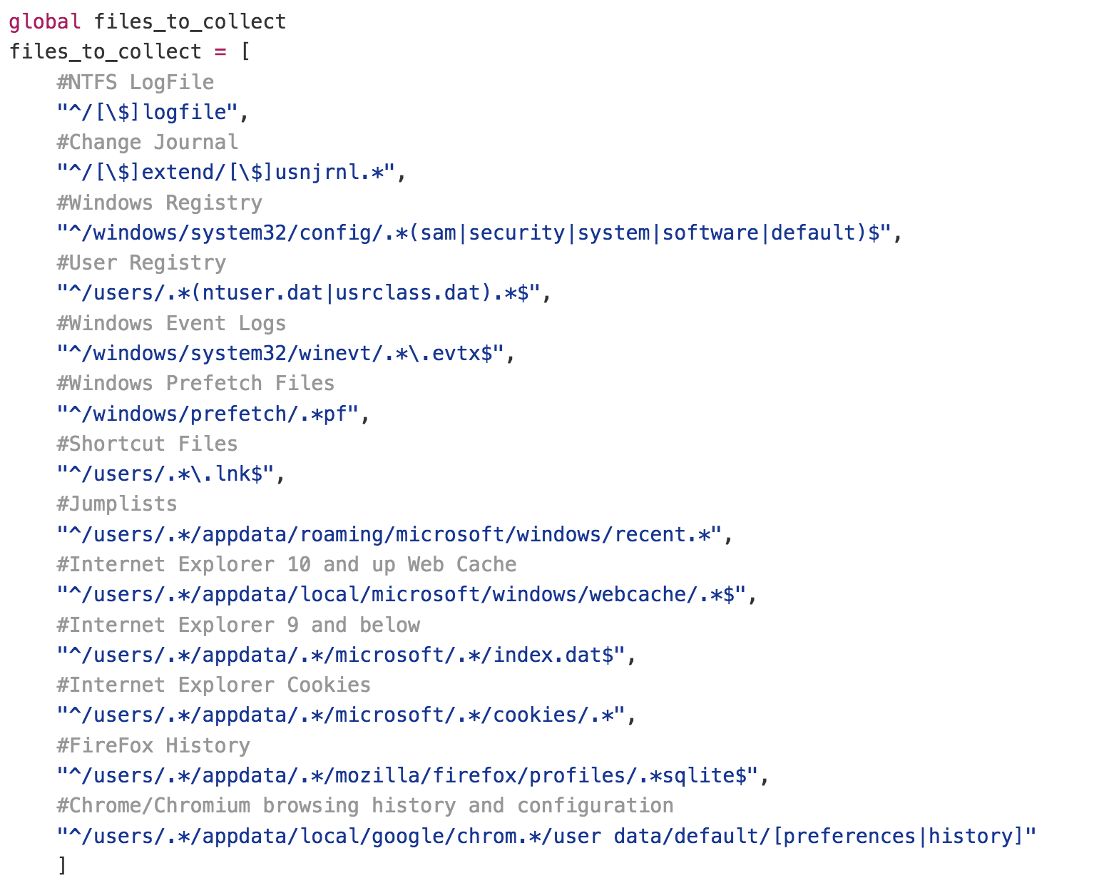
Regex in vars.py

Slide 26
If we get a match, we seek, read, repeat
If the complete path matches the signature, we look at the parsed data attribute we collected
seek to the offset, read the length, rinse, repeat until we have the entire file in memory
then we write it to the Collection Folder representing where it was in the volume!
At no time does Rapid ask Windows where the file is or if it is locked/protected. We are reading “underneath” the OS.

Slide 27
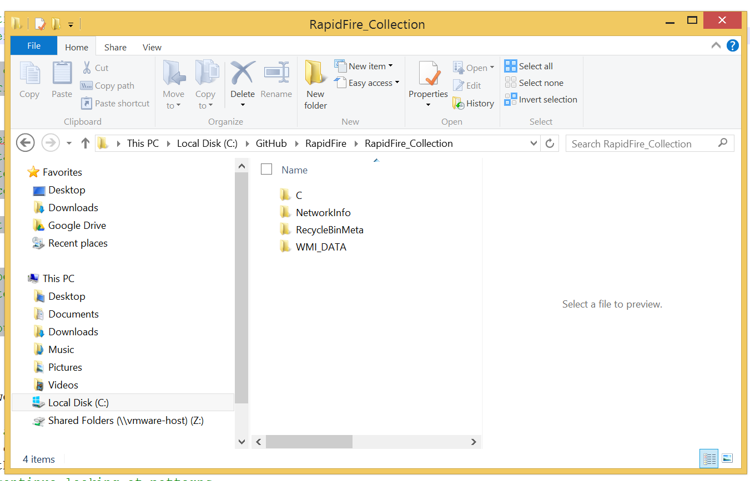
Collection Directory

Slide 28
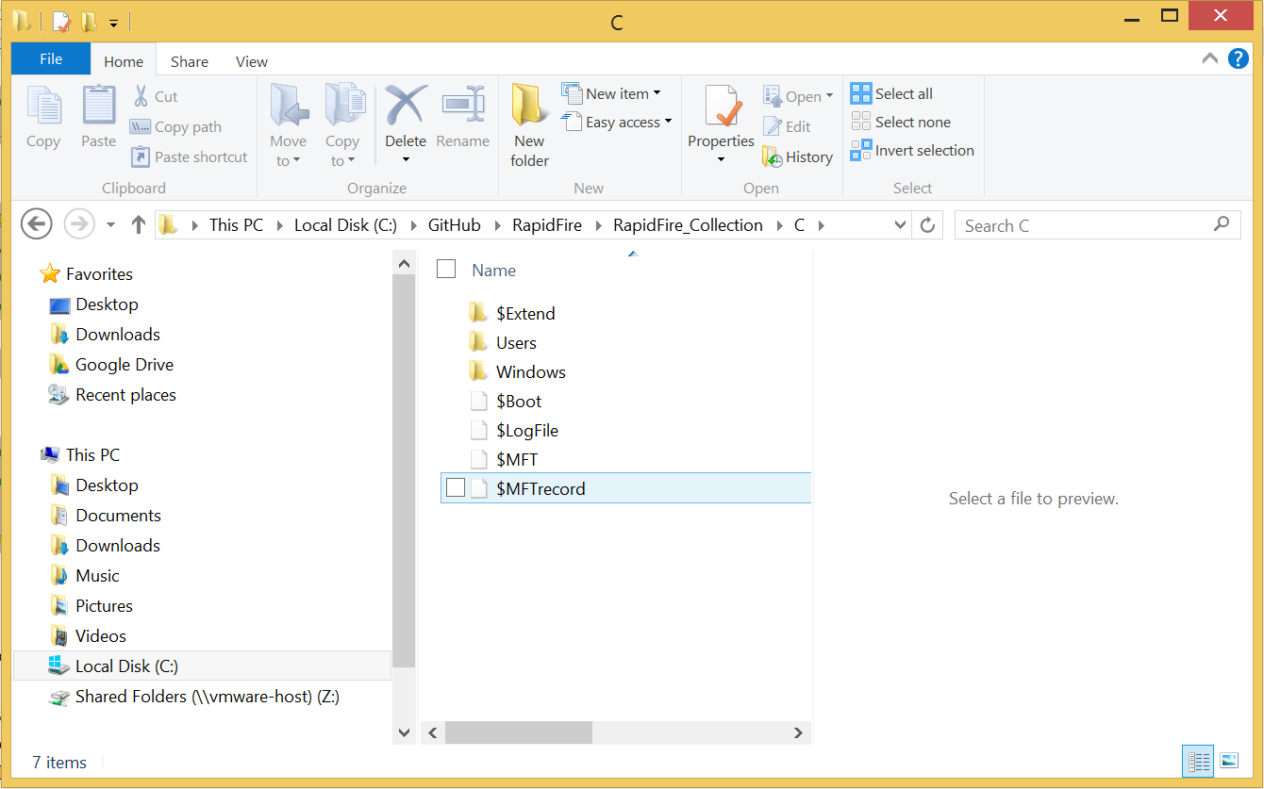
Collection Directory

Slide 29
Rapid also collects
Dumps memory *not yet. Pursuing live memory analysis
Runs a list of Window Management Instrumentation (WMI) queries for:
Running processes
Service information
Network configuration
Other contextual information that might prove useful
Parses Recycle Bin $I files for meta.
Grabs the status of Network Connections (netstat)

Slide 30
Rapid also collects
The allusive $UsnJrnl:$J sparse file
A sparse file has an attribute that causes the I/O subsystem to allocate only meaningful (nonzero) data. Nonzero data is allocated on disk, and non-meaningful data (large strings of data composed of zeros) is not. When a sparse file is read, allocated data is returned as it was stored; non-allocated data is returned, by default, as zeros.
Blah Blah Blah…RapidFire has been configured to grab that too.

Slide 31
What makes Rapid so useful?
Compile it to run it on a live system.
Mount a disk image and run it against the “D:\”
It’s python, run it on linux/OSX to carve files from a unmounted disk image. The exact same code will work either way.
This tool can be used for IR and Forensics thus brigding the knowledge gap between the two.

Slide 32
What makes Rapid so useful?
Don’t want to use the Fire script to parse the collected artifacts? Don’t! Use your favorite forensic software, hex editor, text editor, or whatever.
Most should work by pointing them at the RapidFire_Collection\C folder**
**I have no actual evidence at this point to back that up but it seems reasonable, right?

Slide 33
Questions?

Slide 34
Dataruns - http://inform.pucp.edu.pe/~inf232/Ntfs/ntfs_doc_v0.5/concepts/data_runs.html
http://www.writeblocked.org/resources/ntfs_cheat_sheets.pdf
http://ntfs.com/ntfs-sparse.htm
https://github.com/dkovar

