Slide 1
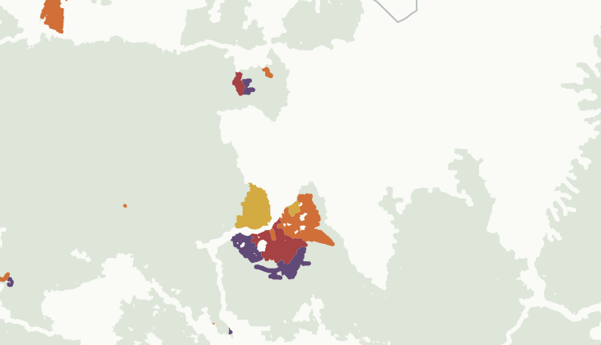
Annual loss of intact forest landscapes
Iddo Glass (2025)
Estimate annual intact forest
landscape (IFL) loss between
existing map snapshots, 2001-2024.
Developed for Houngbedji et al. (2026) using Google Earth Engine. Meant to examine when IFL loss occurred relative to forest certification.
IFL extent in 2020
Estimated loss:
2021
2022
2023
2024
Northwestern Congo Basin
Houngbedji, K., Isman, J. J., Plakhtieva, M., & Wren-Lewis, L. (2026). What are the Limits to Voluntary Certification? Evidence from an Attempt to Protect Biodiversity. Working paper.
01

Slide 2
What qualifies as an intact forest landscape?
Large, connected natural ecosystems without substantial human disturbance.
Existing snapshots: 2000, 2013, 2016, 2020 and 2025
(Potapov et al., 2017; IFL Mapping Team, 2025)
2km
500km²
10km
Minimum width of
corridors and appendages
Minimum
patch area
Minimum width at
the broadest point
Potapov et al. (2017). The last frontiers of wilderness: Tracking loss of intact forest landscapes from 2000 to 2013. Science Advances, 3, e1600821.
IFL Mapping Team (2025). Intact Forest Landscapes Extent and Change, 2000-2025.
02a

Slide 3
From disturbance to IFL loss
Detect disturbance
→
Buffer by 1km
Apply spatial rules
2km
500km²
10km
Minimum width of
corridors and appendages
Minimum
patch area
Minimum width at
the broadest point
Remove narrow parts.
Remove smaller remnants.
Not applied: little added
value, high computing cost.
02b

Slide 4
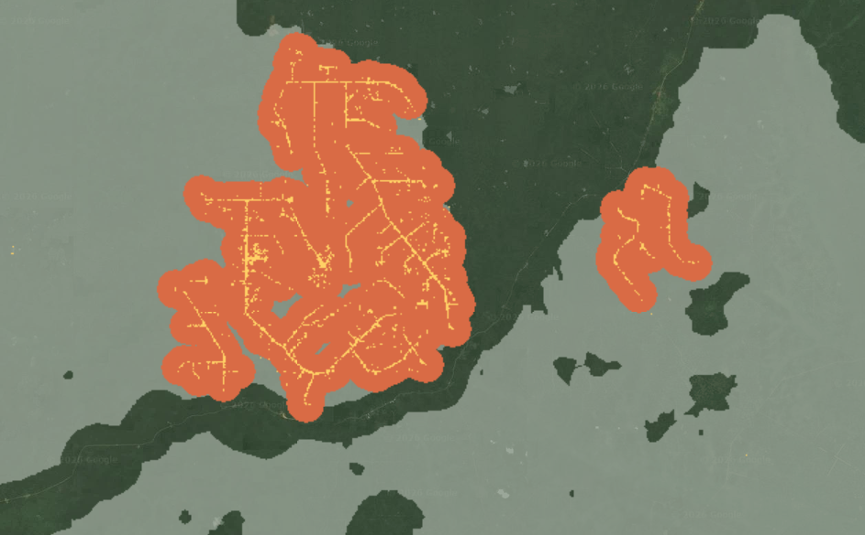
Estimating loss one year at a time
1. Find tree loss
Select the year’s forest loss
and exclude mapped fires.
2. Group disturbance
Buffer connected pixels by 1km.
Keep groups with enough loss.
3. Apply IFL rules
Remove narrow parts and
small remaining patches.
Western Congo, 2021 loss over current satellite imagery
Tree-loss pixels
1km candidate buffers
Previous IFL
Hansen et al. (2013). High-resolution global maps of 21st-century forest cover change. Science, 342, 850-853.
Tyukavina et al. (2022). Global trends of forest loss due to fire from 2001 to 2019. Frontiers in Remote Sensing, 3, 825190.
03

Slide 5
Updating the remaining IFL each year
Each update starts from the area remaining after the previous year.
Apply year t + 1
disturbance and
spatial rules
Apply year t + 2
disturbance and
spatial rules
Baseline IFL
year t
→
→
Remaining IFL
year t + 1
→
→
Remaining IFL
year t + 2
↓
↓
Estimated loss
in year t + 1
Estimated loss
in year t + 2
04

Slide 6
Implementation at 30m resolution
Spatial operations and area calculations at 30m were expensive.
Runs remained costly even after the changes below.
Execution
Developed in the GEE JavaScript editor. Python automated annual runs.
Regions
Split processing into regions, drawing boundaries to avoid cutting IFL patches.
Spatial filtering
Used raster erosion and regrowth.
Area checks
Screened patches at 200m, then removed small areas from the detailed map.
05

Slide 7
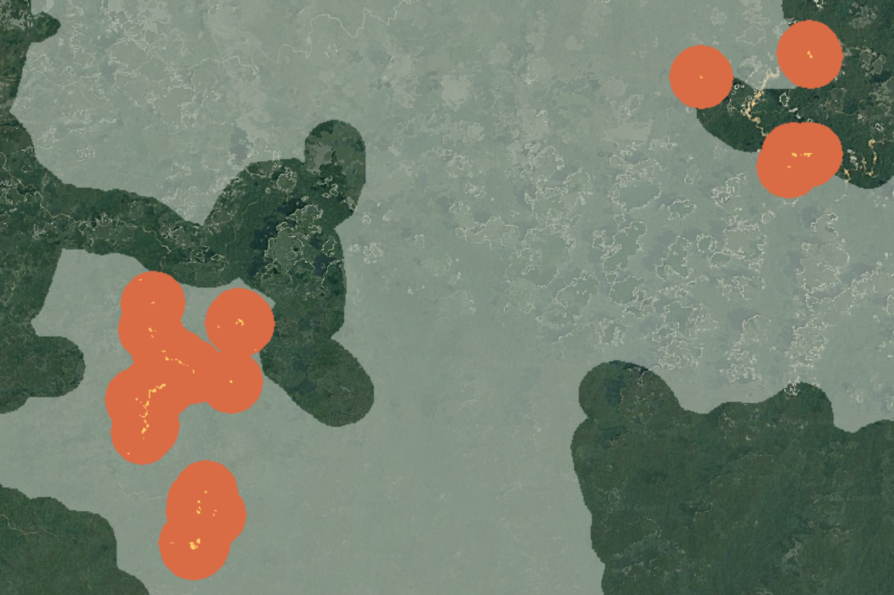
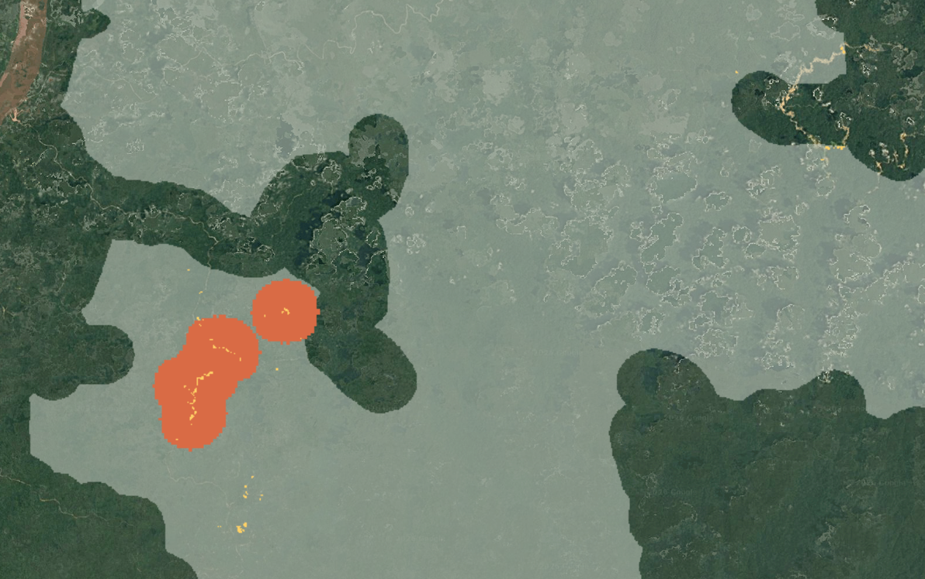
Improving detection: filtering isolated groups
Before:
all candidate buffers
After:
groups with enough loss pixels
Tree-loss pixels
Buffered candidates
Previous IFL
Western Congo, 2021 loss over current satellite imagery
06

Slide 8
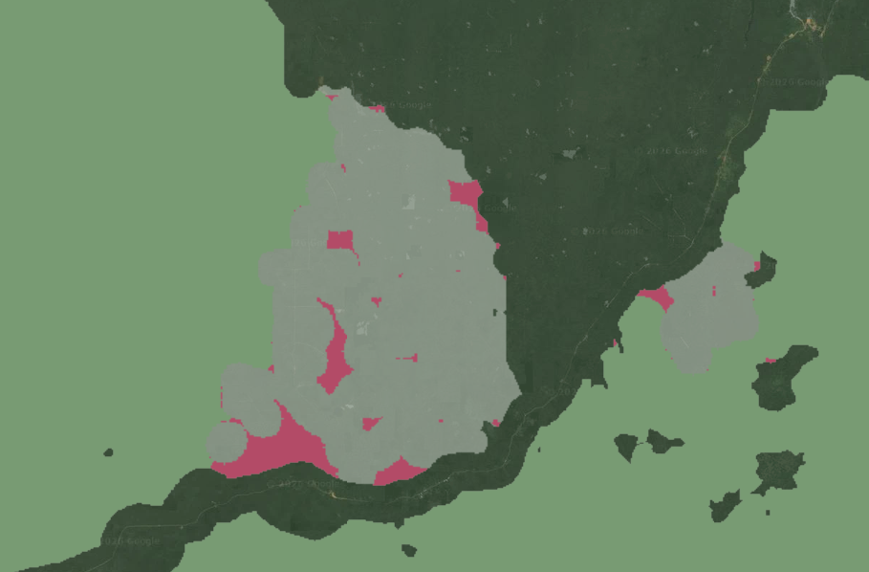
Corridor and appendage filtering
1. Shrink by 1km
Narrow parts disappear.
2. Regrow by 1.5km
Restore the wider areas.
3. Keep the overlap
Limit regrowth to the original IFL.
Remaining IFL
Removed: disturbance
Removed: spatial rule
Western Congo, 2021 loss over current satellite imagery
07

Slide 9
Share of snapshot loss assigned to a year
2021-2024 estimates, compared with loss between the 2020 and 2025 IFL maps
Recall
The share of loss shown in the IFL snapshots that the method detects and assigns to a year.
Precision: 98.9-99.6%, nearly 100% by design as estimates are restricted to loss in the IFL snapshots.
08

Slide 10
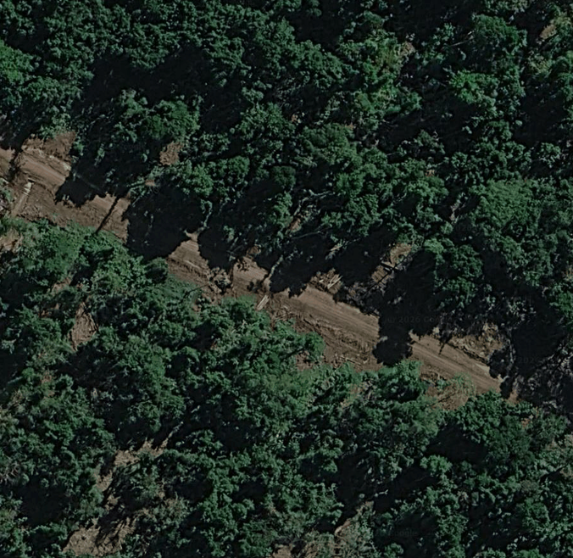
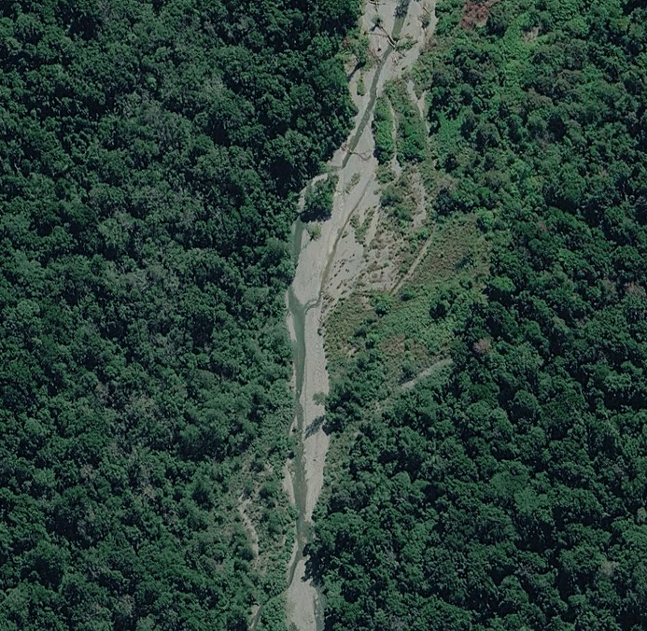
Limitations: not just human disturbance
Road
Riverbed
Both count as IFL loss here: both appear as tree-cover loss in Hansen et al. (2013).
Papua New Guinea. Satellite imagery: 2026.
09

Slide 11
Limitations
•
Some loss shown in the IFL snapshots remains unassigned to a year.
•
No annual reference maps are available to check the estimated year of loss.
•
The fire-loss data ends in 2023, leaving 2024 without this filter.
•
Coarser area checks can miss small remnants.
•
GEE quotas limited further runs and testing.
10

