Slide 1
CDC Growth Charts 2000
Centers for Disease Control and Prevention
National Center for Chronic Disease Prevention and Health Promotion
Division of Nutrition and Physical Activity
Maternal and Child Nutrition Branch
Revised June 2002
Notes:
The CDC Growth Charts, released in May 2000, consist of revised versions of the growth charts developed by the National Center for Health Statistics (NCHS) in 1977 and the addition of the Body Mass Index (BMI)-for-age charts.
The development of the growth charts was a collaborative effort between the Division of Health Examination Statistics in the National Center for Health Statistics (NCHS) and the Division of Nutrition and Physical Activity (DNPA) in the National Center for Chronic Disease Prevention and Health Promotion (NCCDPHP) at the Centers for Disease Control and Prevention (CDC).

Slide 2
Training Objectives
Science behind development of growth charts
Rationale for including BMI-for-age
Using BMI-for-age as a screening tool
Notes:
The objectives of this training are to present general information about the new growth charts, the science behind the development of the growth charts, the rationale for using BMI-for-age and the advantages of using the BMI-for-age charts as a screening tool.

Slide 3
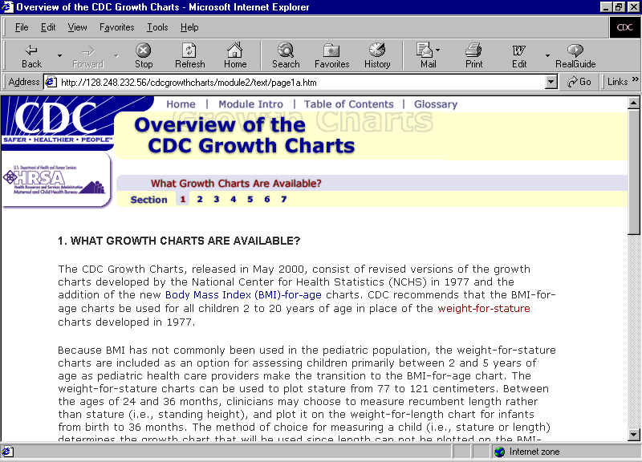
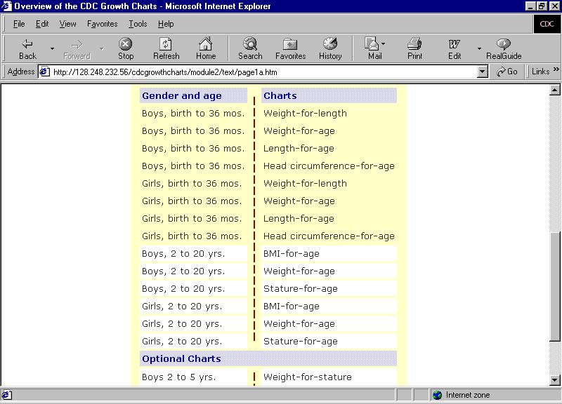
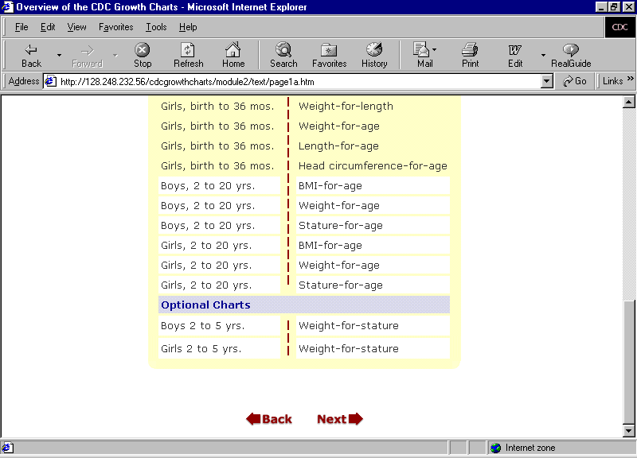
What growth charts are available?
Notes:
New growth charts are shown on this list. They are revised versions of the NCHS growth charts with the addition of the new Body Mass Index-for-age charts. CDC recommends that the BMI-for-age charts be used for all children 2 to 20 years of age in place of the weight-for-stature charts developed in 1977. There are 14 gender and age specific charts and 2 optional charts.
Because BMI has not been used commonly in the pediatric population, the weight-for-stature charts are included as an option for assessing children primarily between 2 and 5 years of age as pediatric health care providers make the transition to the BMI-for-age chart. The weight-for-stature charts can be used to plot stature from 77 to 121 centimeters.
Between the ages of 24 and 36 months, clinicians may choose to measure recumbent length rather than stature (i.e., standing height), and plot it on the weight-for-length chart for infants from birth to 36 months. The method of choice for measuring a child (i.e., stature or length) determines the growth chart that will be used since length can not be plotted on the BMI-for-age chart and stature can not be plotted on the weight-for-length chart for infants birth to 36 months.

Slide 4
New Features of the Growth Charts
BMI-for-age charts (2-20 years)
85th percentile (at risk of overweight)
3rd and 97th percentiles available
Lower limits of length (45 vs. 49 cm) and height (77 vs. 90 cm) extended
Smoothed percentile curves and z-scores agree
Correction in the disjunction
Notes:
There are several new features of the growth charts. These include
The addition of the BMI-for-age chart for children and adolescents 2 to 20 years;
The addition of the 85th percentile to identify at risk of overweight on the BMI-for-age chart and weight-for-stature chart;
The addition of the 3rd and 97th percentiles. Pediatric endocrinologists and others providing services to special populations may choose to use these charts when caring for children growing at the outer percentiles;
The limits for length and height were extended: On the weight-for-length chart for children from birth to 36 months old, length was extended from 49 to 45 cm. On the optional weight-for-stature chart, the extension from 90 to 77 cm allows almost all 2-year-old children to be plotted on the chart;
The agreement of smoothed percentile curves and z-scores;
Correction in the disjunction that occurred between 24 and 36 months of age when switching from length to stature using the 1977 NCHS growth charts;

Slide 5
Disjunction: Smoothed in New Charts
120
120
110
1977
110
2000
100
100
90
90
Length/height in cm
80
Length/height in cm
80
70
70
60
60
50
50
40
40
0
6
12
18
24
30
36
42
48
54
60
0
6
12
18
24
30
36
42
48
54
60
Age in month
Age in month
Notes:
In the 1977 charts, the infant and child curves for length-for-age and stature-for-age did not exactly join at the usual junction of 24 to 36 months. This disjunction occurred in part because recumbent length was obtained from the 1977 Fels data set consisting of upper middle-class infants in Ohio. Stature was from the 1977 NCHS data sets. When changing from recumbent length to stature in a clinical setting, usually between 24 and 36 months, there appeared to be a downward shift in the child's placement on the charts.
In the new CDC growth charts, there is no longer a disjunction between length and stature because the same reference population of children 2 to 3 years of age was measured for both length and height. (Note that the average difference between recumbent length and stature in national survey data is approximately 0.8 cm.)

Slide 6
Reference Population for CDC Growth Charts
Racially and ethnically diverse
Infants: Birth to 36 months
Children and Adolescents: 2 to 20 years
Breast- and formula-fed infants
Notes:
The reference population used to construct the CDC Growth Charts is a nationally representative sample. Data were obtained from a series of national health examinations and surveys conducted by NCHS from 1963-1994 and from supplemental data.
The racial and ethnic distribution in the reference population represents that of the U.S. population at the time each of the National Health Examination Survey (NHES) and National Health and Nutrition Examination Survey (NHANES) surveys were conducted.
For the first time, nationally representative data were used to construct the growth charts for infants — birth to 36 months of age.
Nationally representative data were used to create the growth charts for children and adolescents 2 to 20 years of age and were obtained from 5 national survey data sets.
The new reference represents the combined growth pattern of breast- and formula-fed infants in the U.S. Approximately 50 percent of the infants were reported to breastfeed with about 33 percent breastfeeding for 3 months or longer.

Slide 7
Reference Data Sets: Birth to 36 Months
Notes:
For the first time, data used to construct growth charts for infants from birth to 36 months of age is nationally representative.
The new infant growth charts were developed using data from several sources. NHANES III provided weight, length, and head circumference data beginning at 2 months of age. NHANES II provided data beginning at 6 months of age and NHANES I provided data beginning at 12 months of age. Because national surveys did not collect data between birth and 2 months of age, supplemental data was used. These data included 1) birth data from U. S. vital statistics; 2) length and weight-for-length data from Missouri and Wisconsin birth certificates; 3) length data from infants between 0.5 and 4.5 months of age in the Pediatric Nutrition Surveillance System; and 4) head circumference measurements at birth from the Fels Longitudinal Study.

Slide 8
Reference Data Sets: 2 to 20 Years
Notes:
Data used to create the growth charts for children and adolescents 2 to 20 years of age were nationally representative and obtained from 5 national survey data sets.
The new growth charts for children and adolescents aged 2 to 20 were developed using data from various sources. NHES - Cycle II, included weight and stature data from children and adolescents from 6 through 11 years of age. Data from Cycle III of NHES represented children and adolescents from 12 through 17 years of age. NHANES I, II, and III provided weight and stature data for children from 2 to 20 years of age. However, the NHANES III weight measures were excluded for children 6 years of age and older

Slide 9
Exclusions from the Reference Data
Very low birth weight (VLBW) infants (<1500 g) were excluded because they have different growth patterns
NHANES III weight data for 6+ year olds were excluded to avoid an upward shift in weight-for-age and BMI-for-age curves
Notes:
Two groups were excluded from the reference population:
Very low birth weight (VLBW) infants were excluded from the reference data because the growth pattern of VLBW infants, who are almost always born premature, is markedly different from that of term infants weighing 2500 g or more. The number of VLBW infants in the reference data was small resulting in the exclusion of less than 1 percent of the data from birth through 35 months old.
NHANES III weight data for children 6 years and older were excluded to avoid the influence of an increase in body weight that occurred between the previous national surveys and the NHANES III survey. If these data would have been included an upward shift in the weight-for-age and BMI-for-age curves would have resulted.

Slide 10
Age-Adjusted Prevalence of Overweight¹ From NHANES I to III ²
Percent
Sex and Age Group
¹>95th percentile BMI-for-age
² http://www.cdc.gov/nchs/products/pubs/pubd/hestats/overwght99.htm
Notes:
This graph shows the considerable increase in the prevalence of overweight in NHANES III (green bar) for boys and girls ages 6 to 11 and 12 to 19 when compared to NHANES I (purple bar) and II (white bar). If data from NHANES III had been included, the resulting 95th percentile curve would have been higher. Consequently, weight data for children 6 years and older were excluded.

Slide 11
CDC Growth Charts Are for All Racial and Ethnic Groups Combined
Environmental influences appear to contribute to variations in growth more than genetic influences
Inadequate sample data for racial- and ethnic- specific charts
The effect of race and ethnicity on BMI-for- age is unclear
Notes:
CDC promotes one set of growth charts for all racial and ethnic groups. Racial- and ethnic-specific charts are not recommended because studies support the premise that differences in growth among various racial and ethnic groups are the result of environmental rather than genetic influences.
Also, the reference population lacked sufficient numbers of specific racial/ethnic groups to consider separate charts.
Although some studies using BMI-for-age to evaluate at risk of overweight and overweight have found differences by ethnic and racial groups, factors that affect differences in growth among racial and ethnic groups, if they truly exist, remain unclear and more research is needed to clarify the issue.

Slide 12
Age Adjusted Prevalence of Low Height-for-Age by Ethnic Groups, Children Aged 0 to 5 Years¹
Percentage
Year of Visit
¹ Mei, Yip and Trowbridge, Asia Pacific J Clin Nutr 1998; 7(2): 111-116
Notes:
A study by Mei et al., illustrates the effect of environmental factors on growth. This graph shows the trend of the prevalence of low height-for-age or stunting of recently immigrated refugee children from Southeast Asia to the United States in the early 1980s (yellow line) compared to white children (red line) living in the United States. By the 1990s, the prevalence of low height-for-age had declined among Asian children and height-for-age was almost identical to that of white children in the United States. Changing socioeconomic status often is associated with improved growth.

Slide 13
Breast-Fed vs. Formula-Fed Infants
Mode of infant feeding can influence growth
New charts represent the combined growth patterns of breast-fed and formula-fed infants
Working group of the World Health Organization (WHO) is developing growth charts for infants and children through age 5 using data collected on infants following WHO feeding recommendations
Notes:
Another characteristics of the reference population that needs to be considered is that the growth patterns of breast-fed infants differ from those of formula-fed infants. Generally, breast-fed infants grow more rapidly in the first 2 months of life and not as rapidly at 3 to 4 months. Breast-fed infants continue to grow less rapidly up to 12 months compared with the 1977 reference data, which were based on mainly formula-fed infants.
The new reference represents the combined growth patterns of both breast- and formula- fed infants in the United States. About 50 percent of the infants born were reported to have been breast-fed and about 33 percent of those were breast-fed 3 months or longer. Because the patterns of growth for exclusively breast-fed and formula-fed infants differ, caution must be used when interpreting growth of exclusively breast-fed infants. The American Academy of Pediatrics (AAP) recommends exclusively breastfeeding for the first 6 months and continuing for at least 12 months. Currently, a reference for exclusively breast-fed infants is not available.
However, CDC is collaborating with the World Health Organization (WHO) to develop a set of international growth charts for infants and children through 5 years of age based on the growth of infants and children fed according to WHO recommendations (breast-fed at least 12 months and complementary food introduced sometime between 4 and 6 months).

Slide 14
Indicators of Nutritional Status
Head circumference-for-age
<5th percentile
>95th percentile
Stunting/shortness
length or stature-for-age
<5th percentile
Underweight
weight-for-length
BMI-for-age
<5th percentile
Notes:
There are several common measures for monitoring a child’s growth. These include head circumference, length or height, and body weight.
The most common indices to compare weight and stature measurements with reference curves are length or stature-for-age, weight-for-age, weight-for-length for children < 2 years of age, and BMI-for-age for children 2 to 20 years of age.
Head circumference reflects brain size and is often used to screen for potential developmental problems among infants at birth to 24 months old. Children with a head circumference less than the 5th percentile or above the 95th percentile have health or developmental risks that need further medical assessment.
Infants and children whose length- or stature-for-age is less than the 5th percentile may be short because their parents are short or they may be stunted because of long-term malnutrition, delayed maturation, chronic illness, or genetic disorder.
Underweight defined as weight-for-length or BMI-for-age less than the 5th percentile may be indicative of recent malnutrition, dehydration, or a genetic disorder.
The cutoff values of less than the 5th percentile and above the 95th percentile are used to screen for potential health or nutrition problems and identify children who may need further medical assessment.

Slide 15
Indicators of Nutritional Status
Overweight
Weight-for-length
BMI-for-age
>95th percentile
Risk of overweight
BMI-for-age
85th to 95th percentile
Notes:
“Overweight” rather than obesity is the term preferred for describing infants or children greater than or equal to the 95th percentile of weight-for-length or BMI-for-age. The 85th percentile is included on the BMI-for-age and the weight-for-stature charts. Expert committees have indicated that children and adolescents aged 2 to 20 years between the 85th and 95th percentiles are at risk of overweight.
Evaluating a child’s pattern of growth over time is more important than a single measure of size. The pattern of growth is based on periodic measurements which are tracked on a percentile line as a child grows.

Slide 16
Prevalence of Nutritional Status Indicators New Reference Curves Compared with Old Curves*
< 2 Years Old
Nutrition Indicator
Change in Prevalence
Stunting/shortness
length-for-age <5th
1% to 2% lower
Underweight
weight-for-length <5th
1% to 2% higher
Overweight
weight-for-length >95th
2% lower for females
2% higher for males
* NHANES III
Notes:
Practitioners have asked about the impact of the new reference population on the prevalence of nutrition indicators including stunting or shortness, underweight, and overweight. To answer this question, data from NHANES III were used to compare the 2000 (new) reference with the 1977(old) reference. There are only slight differences in the prevalence rates of shortness, underweight, and overweight when using the new reference. Fewer children will be classified as short or stunted, but a few more will be classified as underweight.
Specifically, among children < 2 years old:
● the prevalence of stunting or shortness, defined as length-for-age less than the 5th percentile, is 1% to 2% lower;
● Underweight, defined as weight-for-length less than the 5th percentile, is 1% to 2% higher; and
● Overweight, defined as equal to or greater than the 95th percentile, is 2% lower for females and 2% lower for males.

Slide 17
Prevalence of Nutritional Status Indicators New Reference Curves Compared with Old Curves*
Children 2 to 5 years of age
Nutrition Indicator
Change in Prevalence
Stunting/shortness
stature-for-age <5th
1% lower
Underweight** <5th
3% to 4% higher
Overweight** 95th
No change for females
1% higher for males
* NHANES III
**BMI-for-age, weight-for-stature
Notes:
Among children 2 to 5 years, the greatest difference is found in an increase in the prevalence of underweight by 3 – 4 percent in 2 to 5 year-old girls and boys.
In older children, little change in the prevalence of nutrition indicators was found.

Slide 18
What Is BMI?
Body mass index (BMI) =
weight (kg)/height (m)²
BMI is an effective screening tool; it is not a diagnostic tool
For children, BMI is age and gender specific, so BMI-for-age is the measure used
Notes:
Body Mass Index (BMI) is an anthropometric index of weight and height (stature) that is defined as body weight in kilograms divided by height in meters squared. BMI is the commonly accepted index for classifying adiposity in adults and it is recommended for use with children and adolescents.
Like weight-for-height, BMI is a screening tool used to identify individuals who are underweight or overweight. BMI is not a diagnostic tool. For example, a child who is relatively heavy may have a high BMI for his or her age or high weight-for-stature. To determine whether the child has excess fat, further assessment needed might include triceps skinfold measurements. To determine a counseling strategy, assessments of diet, health, and physical activity are needed.
BMI is gender specific and age specific for children. BMI-for-age is the measure used for ages 2 to 20 years since BMI changes substantially as children get older. Whereas for adults, BMI is neither age nor gender specific and nutritional status is defined by fixed cut points.

Slide 19
Advantages of BMI-for-Age
Provides a reference for adolescents that was not previously available
Consistent with adult index so it can be used continuously from 2 years of age to adulthood
Tracks childhood overweight into adulthood
Notes:
There are several advantages to using BMI-for-age as a screening tool for overweight and underweight. BMI-for-age provides a reference for adolescents that was not previously available. When the 1977 NCHS growth charts were developed, weight-for-height percentiles were provided only for prepubescent girls up to 10 years and for boys up to 11.5 years. BMI-for-age is the only indicator that allows us to plot a measure of weight and height with age on the same chart. Age and stage of sexual maturation are highly related to body fatness. BMI-for-age was not available in the 1977 charts.
Another advantage is that BMI-for-age is the measure that is consistent with the adult index so BMI can be used continuously from 2 years of age to adulthood.
BMI can be used to track body size beginning at 2 years of age and continue throughout the life cycle. This is important since BMI in childhood is a determinant of adult BMI.

Slide 20
Tracking BMI-for-Age from Birth to 18 Years with Percent of Overweight Children who Are Obese at Age 25¹
Whitaker et al. NEJM: 1997;337:869-873
Notes:
The tracking of BMI that occurs from childhood to adulthood is clearly shown in data from a study by Robert Whitaker (Children’s Hospital Medical Center in Cincinnati) and colleagues. They examined the probability of obesity in young adults in relation to the presence or absence of overweight at various times during childhood. For example, in children 10 to 15 years old, 10% of those with BMI-for-age < 85th percentile were obese at age 25 whereas 75% of those with a BMI-for-age > 85th percentile were obese as adults and 80% of those with a BMI-for-age > 95th percentile were obese at age 25. (The sample size for the study was 854.) This study clearly shows that an overweight child is more likely than a child of normal weight to be obese as an adult.
Other studies have shown this same trend of tracking occurring from childhood to adulthood.

Slide 21
Advantages of BMI-for-Age
BMI-for-age relates to health risks
Correlates with clinical risk factors for cardiovascular disease including hyperlipidemia, elevated insulin, and high blood pressure
BMI-for-age during pubescence is related to lipid levels and high blood pressure in middle age
Notes:
Another advantage of using BMI-for-age to screen for overweight or at risk of overweight in children is that it correlates with clinical risk factors for cardiovascular disease including hyperlipidemia, elevated insulin, and high blood pressure. Freedman and colleagues* used data from the Bogalusa Heart Study and found that approximately 60% of 5- to 10 year-old children who were overweight had at least one biochemical or clinical risk factor for cardiovascular disease such as those just mentioned, and 20% had two or more risk factors.*
We know that risk factors in children become chronic diseases in adults. BMI-for-age during pubescence is related to lipid and lipoprotein levels and blood pressure in middle age.
*Freedman et al., The relation of overweight to cardiovascular risk factors among children and adolescents: the Bogalusa Heart Study. Pediatrics 1999;103:1175-1182.

Slide 22
BMI-for-Age Compares Well with
Weight-for-stature measurements ¹
Measures of body fat
Mei et al., Am J Clin Nutr 2002;75:978-85.
Notes:
BMI-for-age compares well with both weight-for-stature measurements and measures of body fat.
A study completed by researchers at CDC compared the performance of BMI-for-age and weight-for-stature with fatness measured by dual energy x-ray absorptometry (DXA), a direct measure of adiposity.
NHANES III data were used to test how well BMI-for-age predicts underweight (below 15th percentile) and overweight (>85th percentile) relative to the traditional weight-for-stature in children 2 to 19 years old.
Both BMI-for-age and weight-for-stature performed equally well in screening for underweight and overweight among children 3 to 5 years of age.
For school-aged children (6 to 11 and 12 to 19 age groups), BMI-for-age was slightly better than weight-for-stature in predicting underweight and overweight.
Ratios of weight relative to stature such as BMI-for-age and weight-for-stature may be used as indirect measures of overweight that correlate with more direct measures.
BMI-for-age is significantly correlated with subcutaneous and total body fatness in adolescents. It is not a measure of body fatness but rather a proxy for body fat.

Slide 23
Why Use BMI-for-Age?
Recommended by expert committees to evaluate overweight
Guidelines for Overweight in Adolescent Preventive
Services (Am J Clin Nutr 1994;59:307-316)
Obesity Evaluation and Treatment: Expert Committee
Recommendations (Pediatrics 1998 Sept;(102)3:e 29)
Assessment of Childhood and Adolescent Obesity:
International Obesity Task Force (Am J Clin Nutr 1999, 70,suppl)
Notes:
Because of the numerous advantages of using BMI-for-age for assessing overweight in children and adolescents, expert committees and advisory groups have recommended BMI-for-age as the accepted measure. Published references are listed on the slide. Briefly, the background on recommendations to use BMI-for-age follow:
In 1994, an expert committee on Clinical Guidelines for Overweight in Adolescent Preventive Services was convened to provide advice on the development of Bright Futures: National Guidelines for Health Supervision of Infants, Children and Adolescents and Guidelines for Adolescent Preventive Services (GAPS). The committee recommended that BMI-for-age be used to routinely screen for overweight in adolescents.
In 1997, a consensus panel recommended that BMI for age be used routinely to screen children for overweight. They also recommended cutpoints of between the 85th and 95th percentiles to identify children and adolescents as at risk of overweight and at or above the 95th percentile to identify children and adolescents as overweight. (Barlow and Dietz, 1998).
Also, in 1997, an international conference convened by the International Obesity Task Force concluded that BMI is a reasonable measure for assessing overweight in children and adolescents worldwide. (Dietz and Bellizzi, 1999; Bellizzi and Dietz, 1999).

Slide 24
Shape of Weight-for-Stature Curve versus BMI-for-Age Curve
35
35
95th
95th
30
30
50th
25
5th
25
20
BMI
50th
Weight (kg)
15
20
5th
10
15
5
0
10
80
90
100
110
120
130
24
72
120
168
216
Stature (cm)
Age (months)
Notes:
The shapes of the weight-for-stature and the BMI-for-age growth curves differ, as you can see. The weight-for-stature curve shows how weight increases in relation to stature. The BMI-for-age chart shows age-related changes in growth and can be used up to age 20. With the BMI-for-age chart weight, stature and age of a child are considered whereas with the weight-for-stature chart, only weight and stature are used.

Slide 25
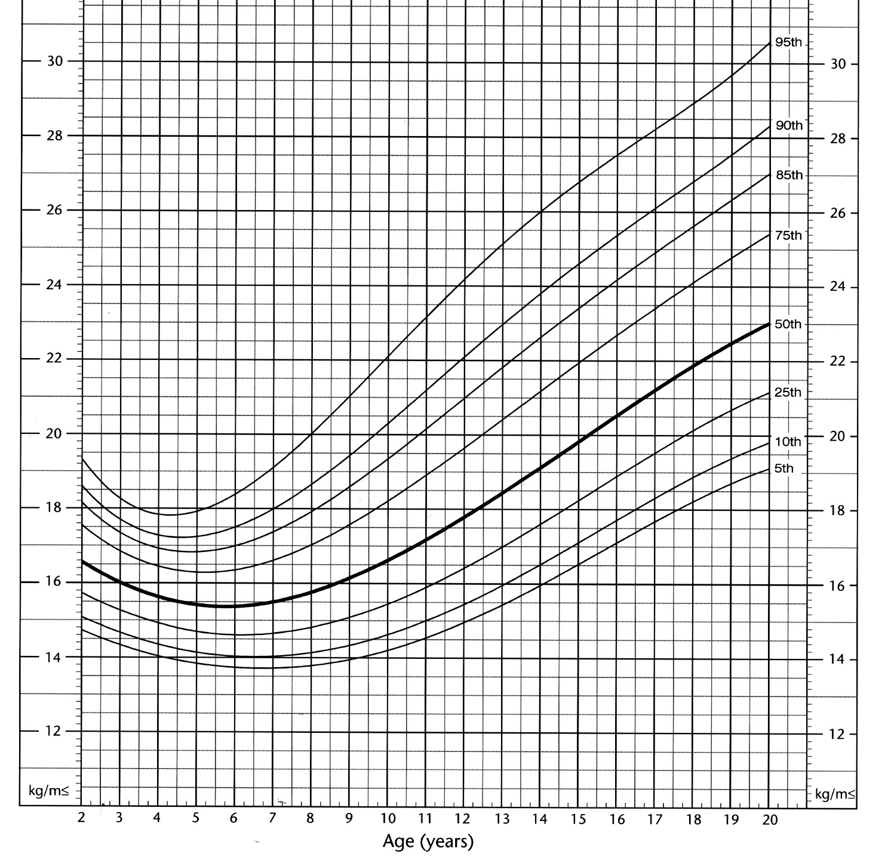
For Children, BMI Changes with Age
BMI
BMI
Example: 95th Percentile Tracking
Age BMI
2 yrs 19.3
4 yrs 17.8
9 yrs 21.0
13 yrs 25.1
Boys: 2 to 20 years
BMI
BMI
Notes:
BMI changes substantially with age. After about 1 year of age, BMI-for-age begins to decline and it continues falling during the preschool years until it reaches a minimum around 4 to 6 years of age. Here you see BMI-for-age tracking on the 95th percentile.

Slide 26
Shape of BMI-for-Age Growth Curve: “Adiposity” Rebound (AR)
Example: Early AR
Age (mos) BMI
26 18.2
32 17.4
38 18.5
41 18.7
BMI
BMI
Boys: 2 to 20 years
BMI
BMI
BMI
Notes:
Here you see a section of the BMI-for-age chart for boys enlarged to show the shape of the curve in more detail. After 4 to 6 years of age, BMI-for-age begins a gradual increase through adolescence and most of adulthood. The rebound or increase in BMI that occurs after it reaches its lowest point is referred to as "adiposity" rebound. This is a normal pattern of growth that occurs in all children.
Recent research has shown that the age when the "adiposity" rebound occurs may be a critical period in childhood for the development of obesity as an adult. An early "adiposity" rebound, occurring before ages 4 to 6, is associated with obesity in adulthood. In the example shown here, adiposity rebound occurred at around age 3. BMI reached the lowest point at 32 months (2 years 8 months) and then began to increase.
However, studies have yet to determine whether the higher BMI in childhood is truly adipose tissue versus lean body mass or bone. Additional research is needed to further understand the impact of early adiposity rebound on adult obesity. (Note that we put the word adiposity in quotations when using it in this context since we do not know if it is truly adipose tissue.)

Slide 27
BMI-for-Age Cutoffs
> 95th percentile Overweight
85th to < 95th Risk of overweight
percentile
< 5th percentile Underweight
Notes:
The expert committees’ recommendations are to classify BMI-for-age at or above the 95th percentile as overweight and between the 85th and 95th percentile as at risk of overweight.
The 85th percentile is included on the BMI-for-age and the weight-for-stature charts to identify those at risk of overweight.
The cutoff for underweight of less than the 5th percentile is based on recommendations by the World Health Organization Expert Committee on Physical Status.¹
¹ The World Health Organization Expert Committee on Physical Status. The Use and Interpretation of Anthropometry. Physical Status: Report of a WHO Expert Committee: WHO Technical Report Series 854, WHO, Geneva, 1996.

Slide 28
Performance of BMI-for-Age as a Screening Tool
Using the 85th and 95th percentiles as cut points, few children are incorrectly identified as over-fat but some over-fat children will be missed.
It is desirable to correctly identify those children not at risk of overweight or overweight.
Notes:
“The validity of selected cutoff points to identify adolescents with the highest percentage of body fat has been investigated. In general, common cutoff points for BMI and relative weight have low sensitivities but high specificities. For example, BMIs > 85th percentile has a sensitivity of 29% and 23% for identifying adolescent males and females, respectively, who are above the 90th percentile for percentage body fat; corresponding specificities are 99% and 100%. In screening for adolescent overweight, specificity may be more important than sensitivity. Maximizing specificity minimizes the proportion of adolescents who will be incorrectly considered overweight by the screen.” ¹
Recently it has been shown that cardiovascular risk factors are associated with the established BMI-for-age cutoffs. Freedman et al., (1999) found that approximately 60% of 5- to 10 year-old children with BMI-for-age values > the 95th percentile had at least one biochemical or clinical risk factor for cardiovascular disease such as hypertension, elevated insulin levels, and hyperlipidemia. Twenty percent of children had two or more risk factors.
¹ Himes and Dietz, Guidelines for overweight in adolescent preventive services: Recommendations from an expert committee. Am J Clin Nutr 1994;59:307-316.

Slide 29
Calculating BMI with the Metric System
Formula: weight (kg)/[height (m)]²
Calculation: [weight (kg)/ height (cm)/
height (cm)] x 10,000
Example: A child’s weight=16.9 kg and height=105.4 cm
BMI = [16.9 kg / 105.4 cm / 105.4 cm] x 10,000 = 15.2
Notes:
BMI can be calculated using either the metric system or the English system. A hand-held calculator or the CDC Table for Calculated Body Mass Index Values for Selected Heights and Weights for Ages 2 to 20 can be used. With the metric system, the formula for BMI is weight in kilograms divided by height in meters squared. Because height is commonly measured in centimeters, an alternate calculation formula is to divide weight in kilograms by height in centimeters squared, and then multiply the result by 10,000. When using a hand-held calculator: if your calculator has a square function, divide weight (kg) by height (cm) squared, multiply by 10,000 and round to one decimal place; if your calculator does not have a square function, divide weight by height twice as shown in the calculation formula above, multiply by 10,000 and round to one decimal place. Calculations for BMI can be completed as a continuous equation.
Example: a child has a weight of 16.9 kg and height of 105.4 cm. When the calculations are completed we find his BMI to be 15.2.

Slide 30
Calculating BMI with the English System
Formula: weight (lb)/[height (in)]² x 703
Calculation: [weight (lb)/height (in)/height (in)] x 703
Example: A child’s weight = 37 pounds, 4 ounces and height = 41 1/2 inches
(convert fractions to decimal value)
BMI = [37.25 lb / 41.5 in / 41.5 in] x 703 = 15.2
Notes:
When using English measurements, ounces (oz) and fractions must be changed to decimal values. Then, calculate BMI by dividing weight in pounds (lbs) by height in inches (in) squared and multiplying by a conversion factor of 703.
When using a hand-held calculator, if your calculator has a square function, divide weight (lbs) by height (in) squared, multiply by 703 and round to one decimal place. If your calculator does not have a square function, divide weight by height twice as shown in the calculation above, multiply by 703 and round to one decimal place. Calculations for BMI can be completed as a continuous equation. Note that the formula for the latter calculation is on the CDC Clinical Growth Charts and will be the calculation used in this module.
Example: A child’s weight is 37 pounds and 4 ounces and his height is 41 1/2 inches. First, convert ounces and fractions to decimals: Weight of 37 lbs and 4 oz = 37.25 lbs (16 ounces = 1 pound so 4 oz/16 oz = 0.25). Height = 41.5 in. Then divide (37.25 lbs by 41.5 in twice) x 703 = 15.2

Slide 31


Notes:
An alternate method to obtain BMI is to use the CDC Table for Calculated Body Mass Index Values for Selected Heights and Weights for Ages 2 to 20. This is available in an 8.5 x 11 inch format or a checkbook size format that you see here. These can be printed from the growth chart Web site. (http://www.cdc.gov/growthcharts)
Selected BMIs are calculated from heights that range 29 to 78 in. and the corresponding centimeters; and from weights ranging from 18 to 250 pounds and the corresponding kilograms.

Slide 32
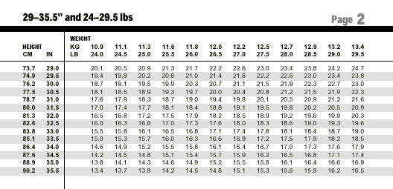
Notes:
Here you see a page from the checkbook size CDC Table for Calculated Body Mass Index Values for Selected Heights and Weights for Ages 2 to 20. To find the BMI of a child who is 33.5 inches tall with a weight of 28.0 pounds, find the height of 33.5 inches in the left column (circled in red) and the weight of 28 pounds on the top row (circled in red). The intersection of these two is the BMI (circled in red). In this example, the BMI is 17.5.

Slide 33
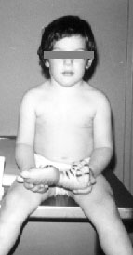
Can you see risk?
This boy is 3 years, 3 weeks old.
Is his BMI-for-age
- >85th to <95th percentile: at risk for overweight?
Photo from UC Berkeley Longitudinal Study, 1973
Notes:
In the next three slides, we want you to do a self-test to see how well you can screen for risk of overweight in children by looking. We want you to try to identify children with a BMI-for-age equal to or greater than the 85th percentile and less than the 95th percentile.
It has been said that “few medical conditions can be diagnosed as confidently by untrained individuals as gross obesity.” Yet it is very difficult to distinguish children who are at risk of overweight from normal children. In childhood, the distinction is made more difficult by age-related physiological variations.
So, see how you do with the three photos. This first one is a boy who is 3 years old. Does he appear at risk of overweight?

Slide 34
Plotted BMI-for-Age
BMI
BMI
Measurements:
Age=3 y 3 wks
Height=100.8 cm (39.7 in)
Weight=18.6 kg (41 lb)
BMI=18.3
BMI-for-age= >95th percentile overweight
Boys: 2 to 20 years
BMI
BMI
Notes:
This boy’s height is 39.7 inches and his weight is 41 pounds. Using his height and weight, his calculated BMI is 18.3.
Plotted on the BMI-for-age chart for boys, his BMI-for-age falls above the 95th percentile. Likewise, when plotted on the weight-for stature grid, it falls above the 95th percentile.

Slide 35
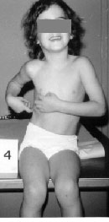
Can you see risk?
This girl is 4 years, 4 weeks old.
Is her BMI-for-age
- >85th to <95th percentile: at risk for overweight?
Photo from UC Berkeley Longitudinal Study, 1974
Notes:
Here is 4-year-old girl. Is she at risk for overweight?

Slide 36
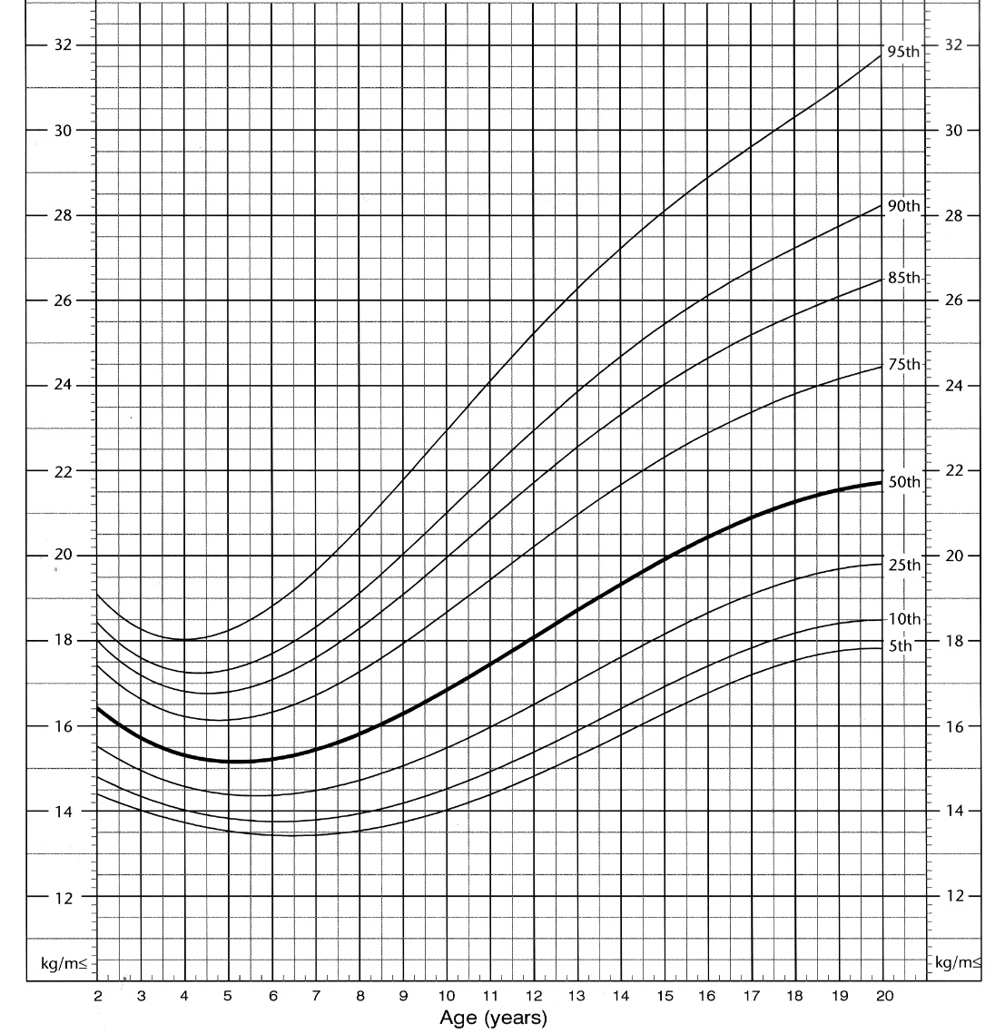
Plotted BMI-for-Age
Measurements:
BMI
Girls: 2 to 20 years
BMI
Age= 4 y 4 wks
Height=106.4 cm (41.9 in)
Weight=15.7 kg (34.5 lb)
BMI=13.9
BMI-for-age= 10th percentile Normal
BMI
BMI
Notes:
This girl’s height is 41.9 inches and her weight is 34.5 pounds. Using her height and weight we calculated BMI to be 13.9.
Plotted on the BMI-for-age chart for girls, her BMI-for-age falls on the 10th percentile. Likewise, when plotted on the weight-for stature chart, it falls on the 10th percentile.

Slide 37
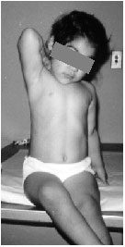
Can you see risk?
This girl is 4 years old.
Is her BMI-for-age
- >85th to <95th percentile: at risk for overweight?
Photo from UC Berkeley Longitudinal Study, 1973
Notes:
This is another 4-year-old girl.
Does she appear at risk of overweight?

Slide 38
Plotted BMI-for-Age
Measurements: Age=4 y
Height=99.2 cm (39.2 in)
Weight=17.55 kg (38.6 lb)
BMI=17.8
BMI-for-age= between 90th –95th percentile At risk for overweight
BMI
BMI
Girls: 2 to 20 years
BMI
BMI
Notes:
This girl’s height is 39.2 inches and her weight is 38.6 pounds. Using her height and weight we calculated BMI to be 17.8.
Plotted on the BMI-for-age chart for girls, her BMI-for-age falls between the 90th and 95th percentiles. She is classified as at risk of overweight.
The point of this exercise is to demonstrate the difficulty of making a consistently accurate visual assessment of at risk of overweight. BMI-for-age needs to be obtained and plotted on the appropriate growth chart to determine risk of overweight.

Slide 39
Accurate Measurements are Critical
BMI
BMI
5 1/2 year old boy
Weight: 41.5 lb
Height: 43 in
BMI= 15.8
BMI-for-age=50th %tile
Inaccurate height measurement: 42.25
BMI=16.3
BMI-for-age=75th %tile
Boys: 2 to 20 years
BMI
BMI
Notes:
Measurements must be obtained and recorded accurately if they are to be used as an effective screening tool. Stature and weight should be measured following recommended protocols.
To illustrate the importance of accurate data, we used the case of a 5.5-year-old boy, weighing 41.5 lb with a height of 43 inches. His calculated BMI-for-age is 15.8. When plotted on the BMI-for-age chart for boys, his BMI is on the 50th percentile. If his height were measured or recorded inaccurately at 42.25 (3/4-inch below his actual height of 43 inches), his BMI-for-age would be 16.3 and would fall on the 75th percentile (orange dot). A measurement error of 3/4-inch in height resulted in a change of 25 percentiles. In this example, the measurement error did not cause a change in classification because growth remained within the normal range but you see what could happen.

Slide 40
Interpreting the BMI-for-Age Cutoffs
> 95th percentile Overweight
85th to < 95th Risk of overweight
percentile
< 5th percentile Underweight
Notes:
Interpretation of BMI plotted on a BMI-for-age chart is based on the established cutoff values.
These percentiles indicate the rank of BMI in a group of 100 children of the same gender and age. For example, in a group of 100 children, you would expect:
5 children to have a BMI-for-age that is at or above the 95th percentile
10 to have a BMI-for-age that is between the 85th and 95th percentiles
5 to have a BMI-for-age less than the 5 percentile,
80 children will have a BMI-for-age that is within the normal range.
Note that there are no recognized standards to satisfactorily define the lower limits of BMI-for-age for children and adolescents; however, it is reasonable to use BMI-for-age to identify children and adolescents as underweight. Research is needed to determine the validity of using BMI-for-age to screen for underweight.

Slide 41
Interpreting the BMI-for-Age Chart
BMI-for-age indicates a child’s weight in relation to his/her height for a specific age and gender
Need a series of BMI plots to determine the growth trend
If indices deviate from normal growth patterns, further assessment may be needed
Notes:
For children, BMI is age and gender specific
When assessing physical growth, it is desirable to have a series of accurate measurements to establish an observed growth pattern. Having a series of measurements takes into consideration short- and longer-term conditions and provides a context for individual measurements in interpretation. To obtain a clear understanding of the growth pattern observed on the BMI-for-age chart, plot the weight-for-age and stature-for-age charts to determine the pattern of weight and stature separately.
Growth patterns that fall outside the established parameters, the 5th and 95th percentile for any given anthropometric indices, suggest the need to recheck measurements, plots, and calculations and make any necessary corrections or adjustments. If measurements are correct, further evaluation may be needed to determine the cause.

Slide 42
Example: “Sam”
Name: Sam
Weight: 37 lb 4 oz (16.9 kg)
Height: 41.5 inches (105 cm)
Age: 3.5 years
BMI: 15.2
Notes:
Here is an example of interpretation of BMI-for-age:
Sam weighs 37 pounds and 4 ounces and is 41.5 inches tall. He is 3 1/2 years old and his calculated BMI is 15.2.

Slide 43
Sam’s BMI Plotted on Boy’s BMI-for-Age Chart
BMI
BMI
Interpretation:
Sam’s BMI-for-age is slightly below the 25th %tile so it falls within the normal range.
Of 100 boys who are the same age, fewer than 25 have a BMI-for-age lower than Sam’s.
Boys: 2 to 20 years
BMI
BMI
Notes:
On the BMI-for-age chart, find Sam’s age on the horizontal axis and visually draw a vertical line up from that point, then find his BMI on the vertical axis and visually draw a horizontal line across from that point. The point where the two intersect represents Sam’s BMI-for-age.
When plotted on the growth chart, Sam’s BMI-for-age falls just below the 25th percentile curve. Percentile indicates the rank of a measure in a group of 100. This means that of 100 children the same sex and age as Sam, fewer than 25 children will have a BMI lower than his.
Sam is neither overweight, underweight nor at risk of overweight. When a child’s plotted measurement falls between the 5th and 95th percentiles it is considered to be in the normal range. Sam’s BMI-for-age is in the normal range. When a child’s percentile rank falls outside the normal range (i.e., outside the 5th or 95th percentiles), further evaluation is needed.

Slide 44
Summary of Using BMI-for-Age
BMI-for-age is the recommended method for screening overweight and underweight
For children, BMI is age and gender specific; for adults there are fixed cut points
Accurate and periodic measurements are important elements of any anthropometric screening
Notes:
BMI-for-age is the method recommended for screening overweight and underweight in children and adolescents from 2 to 20 years of age. BMI-for-age is a screening tool that may lead to further assessment to diagnose a specific health condition. For children, BMI is age and gender specific and nutritional status is determined based on percentiles. This is different for adults as BMI is neither age nor gender specific and nutritional status is defined by fixed cut points for adults. Periodic, accurate measurements and growth records are important elements of growth screening. An accurate interpretation of growth depends on the accuracy of weighing and measuring.

Slide 45
Steps to Plot BMI-for-Age
Obtain accurate weight and height measurements
Select the appropriate growth chart
Record the data
Calculate BMI
Plot measurements
Interpret plotted measurements
Notes:
An instruction sheet entitled Use and Interpretation the CDC Growth Charts gives detailed instructions for the steps to calculate BMI and plot BMI-for-age. This is available at www.cdc.gov/growthcharts. The six steps outlined here to plot BMI-for-age are similar to steps for general growth assessment.

Slide 46
Please visit:
http://www.cdc.gov/growthcharts/
For additional training materials related to the growth charts
For tools related to the growth charts
To download the growth charts
Notes:
Please visit the growth chart Web site at (http://www.cdc.gov/growthcharts) to access additional training materials including web-based interactive training modules and tools related to the growth charts including the BMI tables and the instruction sheet for the growth charts. The clinical growth charts can be downloaded or printed from this Web site.

Slide 47


www.cdc.gov/growthcharts
Notes:
Here is the CDC Web site. All materials related to the growth charts can be accessed at this site.

