Slide 1
Air Force Weather Agency
GOES-R Data
Exploitation Activities
Mr. Thomas E. Coe
Strategic Center Programs Division
Air Force Weather Agency

Slide 2
Overview
AFWA Mission
Current Architecture
Current METSAT Data Exploitation
Planned NPOESS Architecture
Planned Use of GOES-R Data
Notes:
Intent is to describe:
AFWA mission
What we use satellite data for
Our current architecture
NPOESS example – the kind of activities we need to accomplish to ingest any new satellite data type
A few items we plan to use on GOES-R

Slide 3
Mission
Arming our Nation’s forces with essential air and space environmental intelligence, training, and technical services to ensure battlespace awareness and decision superiority - Anytime, Anywhere.
Operational focus
Priority for resources to support operational applications
Enduring principles:
Worldwide data collection and dissemination
Precise specification of battlespace environment
Real time cloud analyses and forecasts

Slide 4
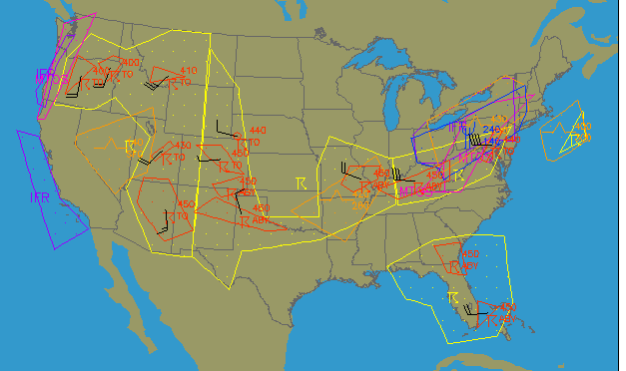
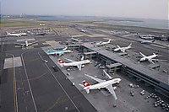

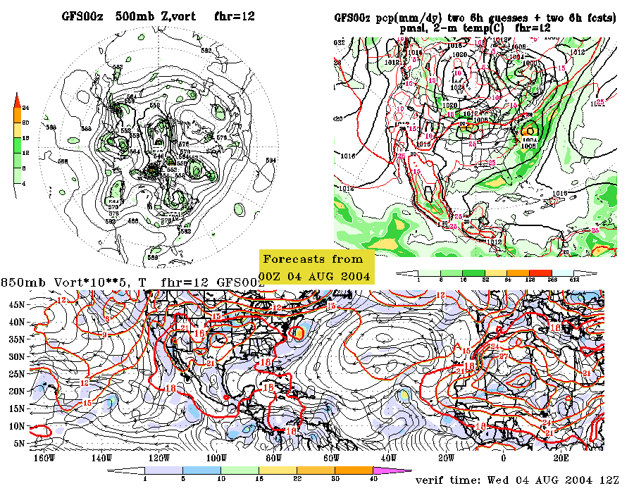
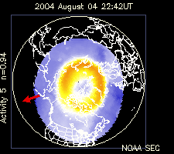
AFWA Civil Support
Back-up for NOAA Operations:
Storm Prediction Center (SPC)
Aviation Weather Center (AWC)
National Volcanic Ash Advisory Center (VAAC)
Environmental Modeling Center (EMC)
Space Environment Center (SEC)
4
Notes:
AFWA supports civilian agencies as well as military

Slide 5
Military/Civilian Differences
Focused on combat decision makers, deployed forces
Mission-specific vs. wide-area, general forecasts
Main concern: Mission impacts!
What we do:
Build the world's most comprehensive weather database
Apply and tailor data to specific military needs
Focused on battlespace awareness for worldwide ops
Command and control
Precision engagement
Mission execution

Slide 6
METSAT Data Architecture
Input from:
- DOMSAT
- CDMS-Oracle
- WPMDS
- NIDS
- NOAA
- RAPS
Output to:
- WPMDS
- JAAWIN
- RAPS
- CDFS II
- SIDAS
Meteorological
Satellite
Data
WPMDS
CDMS-O
NIDS
INPUT
Satellite Data
Collection and
Storage
Environmental
Product
Generation
Meteorological
Data Receipt
and Storage
System Operations
And Control
Environmental
Product
Distribution
Ancillary
Functions
OUTPUT
SCIF Product
Generation and
Distribution
WPMDS
JAAWIN
RAPS
CDFS II
SIDAS

Slide 7
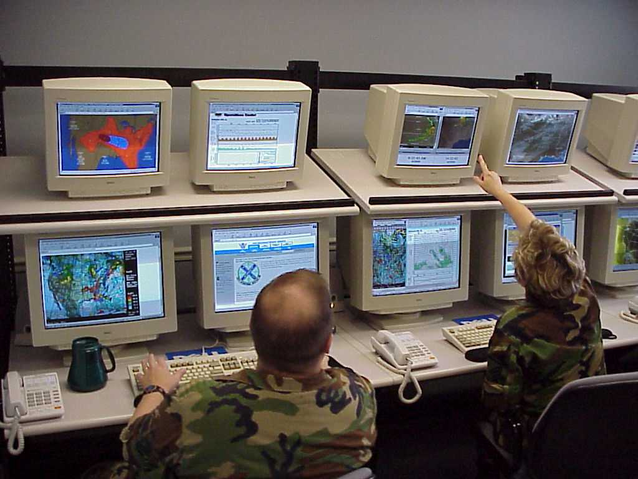
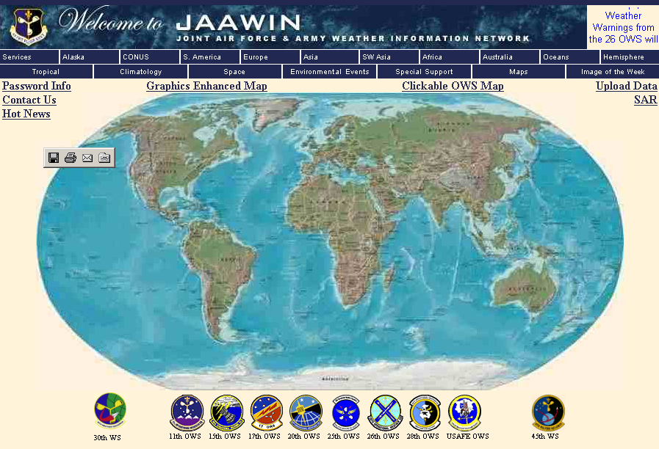
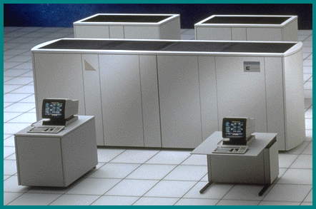
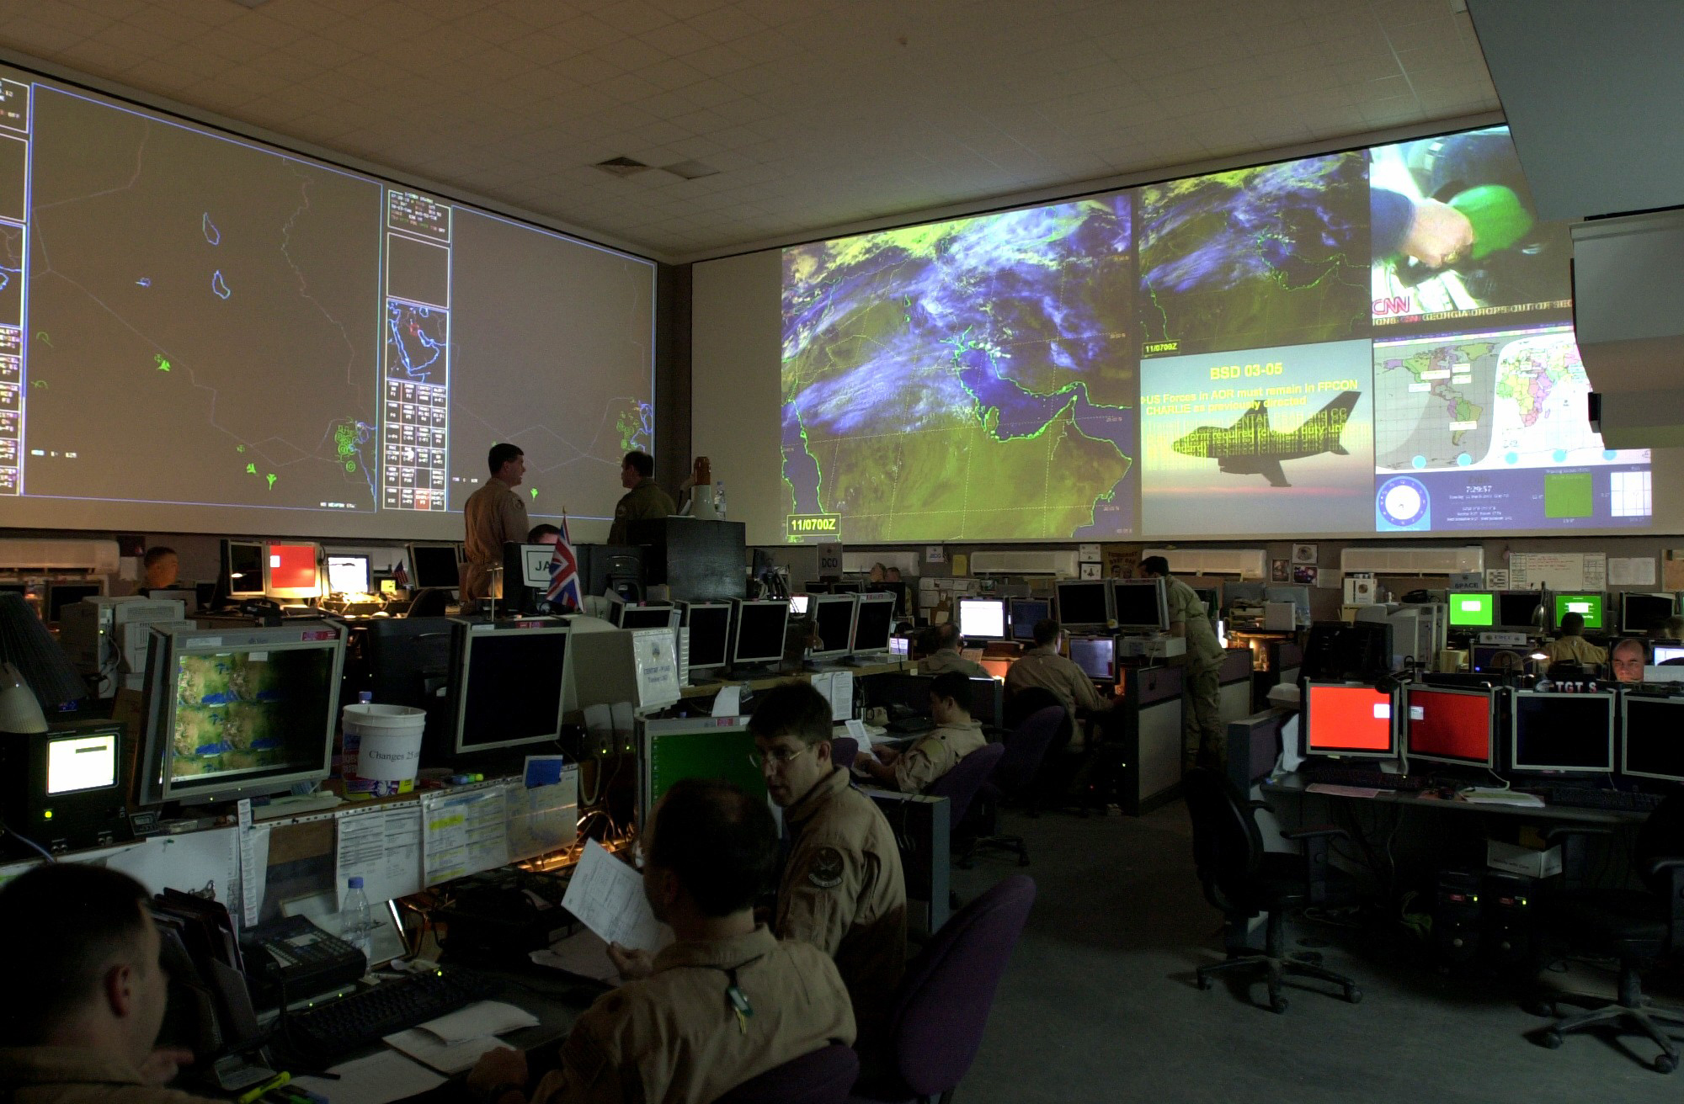
AFWA Process Overview
ANALYSIS/FORECAST/ PRODUCT TAILORING
INPUT
DISSEMINATION
METSAT Data
DMSP
POES
GOES E/W/P
METEOSAT
TRMM
QuickSCAT
EOS (AMSR-E)
Forecaster-in-the-loop
products
JAAWIN / JAAWIN-S
Observations
Surface
Upper-Air
AIREPS/PIREPS
Ship
Space
Automated
Products
Military Command and
Control Systems
Systems,
Models, and Applications
Satellite Data Handling System (SDHS)
Cloud Depiction and Forecast System (CDFS II)
Satellite Image Display/Analysis System (SIDAS)
Space WX Analysis & Forecast System (SWAFS)
Mesoscale Model (MM5)
Land/Surface Model (AGRMET)
Joint METOC Broker Language Databases
NWP Data
GFS
NOGAPS
Notes:
AFWA uses a wide variety of environmental measurements as inputs to its analysis and forecast processes
Polar METSAT data make up a significant component of the input
AFWA employs both automated and forecaster-in-the loop processes
While we have a long way to go, AFWA product dissemination is trending toward net-centric access
Primarily Web-based user-pull on unclassified and classified networks (JAAWIN) today
Moving toward increased use of data injection into C2 systems
(e.g., Common Operating Picture)

Slide 8
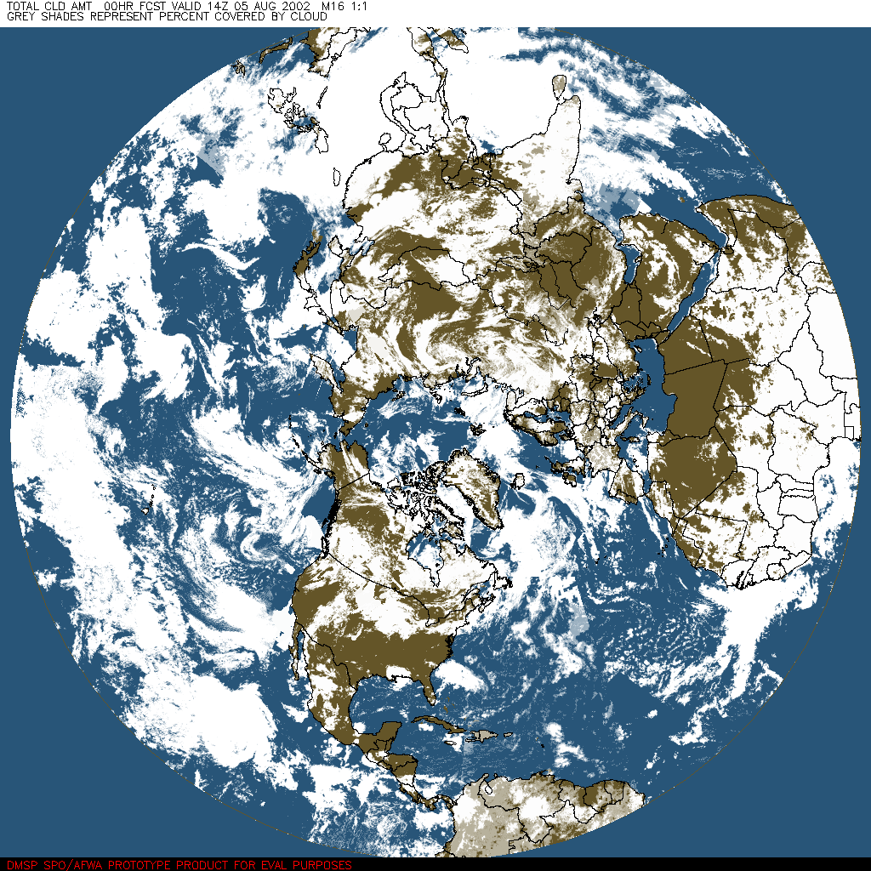
World-Wide Merged Cloud Analysis (Cloud Analysis and Forecast System – CDFS II)
Global, real-time, cloud analysis. Provides input to National Intelligence Community, cloud forecast model, and global soil temperature and moisture analysis.
Frequency | Hourly
Resolution | 12.5 nm (24 km)
Inputs | Geostationary and polar orbiting satellite data NOGAPS temperatures SFCTMP & SNODEP Surface observations
Outputs | Total cloud amount Layer cloud amount Layer cloud type Layer cloud base/top

Slide 9
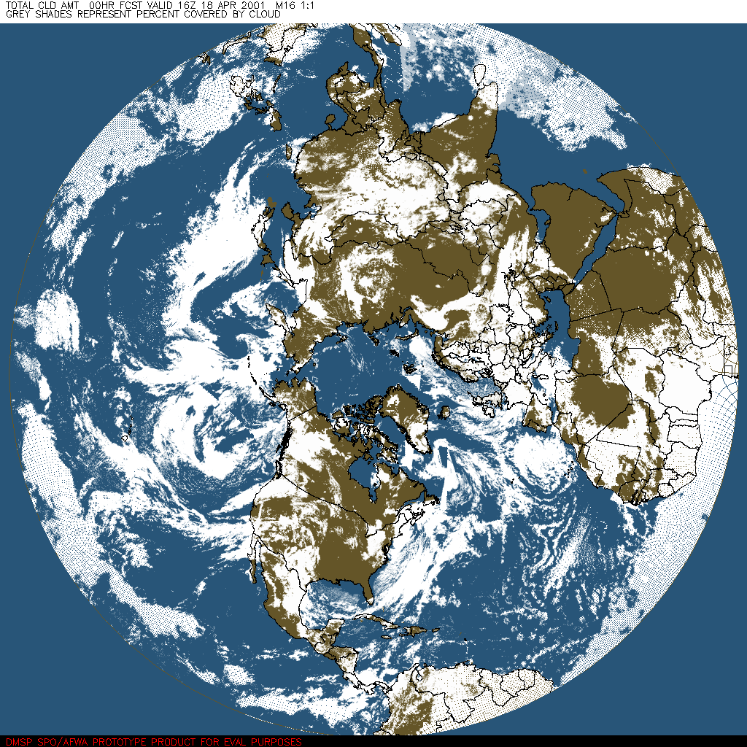
Cloud Analysis/Forecast Data Flow
Meteorological Satellite Data
• DMSP • POES
• GOES • METEOSAT
Observations
Surface
Upper Air
Specialized Gridded Analyses
Surface Temperature
Snow Depth
Cloud Analysis
WWMCA
FITL
Numerical Weather Prediction
Temperature, Pressure,
Moisture, Wind Fields
FITL
FITL = Forecaster in the Loop

Slide 10
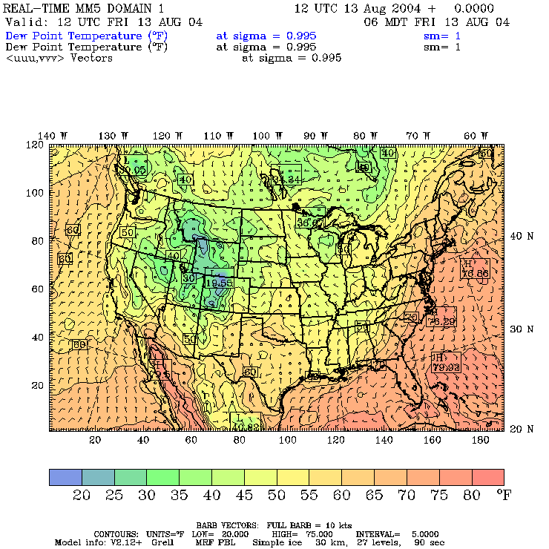
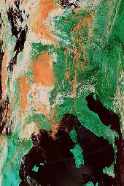
METSAT Exploitation Initiatives
Weather Research and Forecasting Model (WRF)
Initial operational capability – Jun 06
Replaces MM5 model
NPOESS, then GOES-R data planned as input
Leveraging JCSDA to support data assimilation
JCSDA Participation
On-site representation
Developing radiative transfer model for WRF 3DVar / 4DVar analysis
Direct radiance assimilation into numerical weather prediction models
Notes:
Polar METSAT will play a direct role in perhaps the two largest issues facing Air Force Weather Agency: WRF & NPOESS
JCSDA (Joint Center for Satellite data Assimilation) Participation:
Funded UCAR Visiting Scientist Assigned AFWA NCEP Liaison Officer
Dr. Jianjun Xu Maj Daniel Pawlak
5200 Auth Road daniel.pawlak@noaa.gov
Camp Springs, MD 20746
Jianjun.Xu@noaa.gov
Phone: (301) 763-8000 ext: 7733\
Current NPOESS SOW states:
Arrival of NPOESS major factor for establishing a data assimilation component of the WRF/DTC.
Focus on ensuring data from advanced instruments of the NPOESS-era are evaluated using advanced technology currently being planned for operational use at AFWA.
Designed to compliment the activities of the JCSDA, and will initially be a collaboration between NCAR, AFWA, JCSDA, and visiting scientists from CSU.
NCAR has included costs for JCSDA liaison in FY06-07
3DVAR/4DVAR Direct Radiance Assimilation
Exploit 5 imagery channels (currently using 2)

Slide 11
Notional NPOESS Architecture
Contractor Responsibility
AFWA Responsibility
AFWA Enterprise Storage Solution (ESS)
Central SAN
Enclave Boundary
Port Block
NPOESS
Landing Zone
Central Delivery Area
AFWA Systems
HDF5 Granules
HDF5 Granules
firewall
firewall
AFWA-Ready
Data Granules
Applications
Platform
(Enable JMBL)
Data Product requests / status
Data access management traffic
Fiber Channel
IP-Based
Notes:
NPOESS-era architecture. Used to discuss WAN architecture, ESS, JMBL.
Drawing should reflect Logical unit separation so that it is understood data arriving at the landing zone is not used until it is moved by the central computer to the “delivery area” where it can be used. This clarifies a clean division between data deposited directly by an outside source and the data ingested by internal AFWA systems. Rationale; Security.
The double firewall setup is retained for TCP-IP traffic
The Centrals Delivery area is made up of the Joint METOC data bases.

Slide 12
NPOESS EDRs of Interest
AFW Will Use all of the Planned NPOESS EDRs
Cloud Parameters
Atmosphere: Cloud, LIS, NWP
Land: Cloud, LIS
Space Environmental parameters: Ionospheric specification models; auroral products
All 55 NPOESS EDRs have potential uses throughout AFW
Notes:
AFWA plans to use all 55 Environmental Data Records throughout AFW.
Shown are the planned uses broken down by area (Land, Atmosphere, Space)

Slide 13
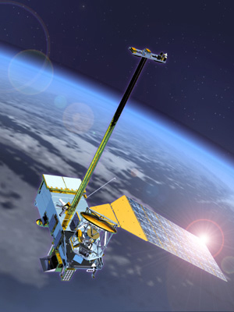
NPOESS Exploitation at AFWA
Anticipated Benefits of NPOESS Data at AFWA
Enhanced Measurement of Tropospheric Parameters
New applications
Exploitation of higher-resolution and multi-spectral data
Reduced data latency
Improved Space Environment Characterization
Input for new physics-based models (e.g., GAIM)
Specification and forecasting of the ionosphere,
magnetosphere and thermosphere
Monitoring of earth’s auroral regions
Other Exploitation Efforts
Point Analysis Reengineering (PAR)
Cloud Analysis (CDFS II)
Notes:
5
NPOESS will provide numerous improvements for observations of the troposphere and space environment
Dynamic update to snow cover/depth (Clouds, SNODEP)
Dynamic update to Vegetative Index field (LSM-A)
Soil Moisture EDR for LSM-A
Primary input to GAIM for ionospheric specification
Other Exploitation efforts include beginning work to assimilate NPOESS data into PAR and CDFS II

Slide 14
GOES-R Exploitation at AFWA
Anticipated Benefits of GOES-R Data at AFWA
AFWA will use almost all of the planned GOES-R EDRs
Planned use of new capability EDRs:
Hyperspectral Environmental Suite – Vertical temp and moisture profiles, cloud-top temps; cloud tuning
GOES Lightning Mapper
Space Weather:
Space Environment In-Situ Suite
Solar Instrument Suite
Magnetometer
Rapid Scan Winds – Improved tropical storm fixing
Expect significant improvement in NWP accuracy with dramatic increase in available vertical channel data
Notes:
5
NPOESS will provide numerous improvements for observations of the troposphere and space environment
Dynamic update to snow cover/depth (Clouds, SNODEP)
Dynamic update to Vegetative Index field (LSM-A)
Soil Moisture EDR for LSM-A
Primary input to GAIM for ionospheric specification
Other Exploitation efforts include beginning work to assimilate NPOESS data into PAR and CDFS II

Slide 15

Questions?
Notes:
Thank you for your time, do you have any questions?

