Slide 1

Using PowerPoint to Present Research Results

Slide 2
Best Used For
Slides with this format are best used
For detailing management-research question hierarchy
For detailing methodology
For detailing data limitations
For summarizing verbal findings
For detailing recommendations based on data analysis

Slide 3
Use Hyperlinks in PowerPoint
To display data charts
To display data tables
To insert video clips of respondent answers

Slide 4
To employ hyperlinks
Plan a hyperlink
Prepare charts and tables in Word, Excel, Acrobat, or other software
Determine if text or button will represent the hyperlink
Save your PowerPoint presentation before inserting hyperlinks and before testing hyperlinks in Slide Show view

Slide 5
Types of files for hyperlinks
Acrobat
Allows easy mouse control of part of page seen.
For detailed tables
For large graphic displays
Can access the entire written report, allowing you to move to any page of that report.

Slide 6
Types of files for hyperlinks
Excel
For data displays where “what if” scenarios are needed during the presentation.
Allows the presenter to create alternative graphical displays during the presentation.
For simple tables
For all graphical displays of data

Slide 7
Types of files for hyperlinks
Word
for verbal displays and simple tables.
Any other Windows based application can be linked (e.g. ArcView, MapInfo, SPSS, etc.)

Slide 8
Insert a hyperlink button
Insert a pre-designed hyperlink button
In SLIDE view, select the slide to receive the hyperlink.
From SLIDE SHOW menu choose Action Buttons.
Choose Mouse Click or Mouse Over option tab for how your link will activate.
Select a button to represent your linked file.

Slide 9
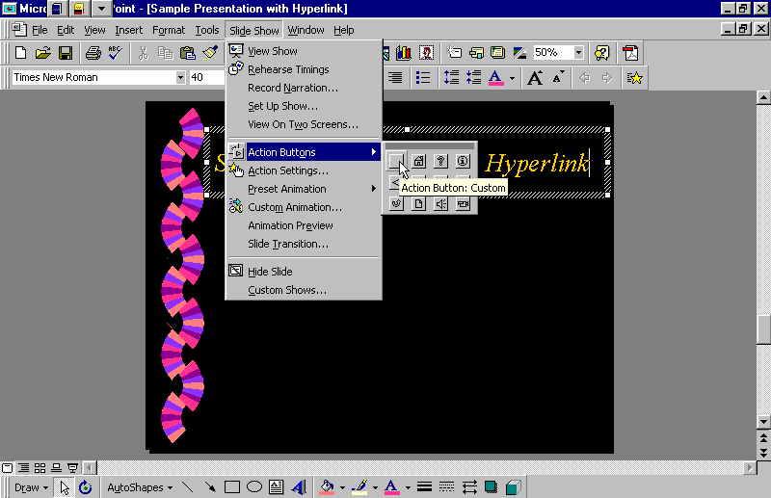
Insert a hyperlink button

Slide 10
Insert a hyperlink button
Insert a pre-designed hyperlink button
In Action Settings window
choose Mouse Click or Mouse Over option tab
Enter file location in Hyperlink to: window.
Choose ‘Other File’.
Select linked file from menu.

Slide 11
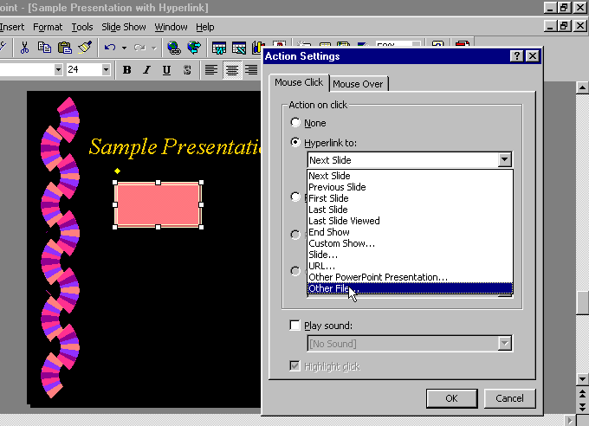
Insert a hyperlink button

Slide 12
Sample Presentation with Hyperlink
Sample Hypertext
Chart (Excel)

Slide 13
Sample Presentation with Hyperlink
Sample Hyperlink Chart (Excel)
Sample Hyperlink Chart (PDF)
These buttons are active hyperlinks, set to activate with a Mouse Click.
Position your mouse over the button until the cursor changes into a hand with pointing finger.
Click your left mouse button to activate the link.
Return to slide show by clicking the bottom of the screen, below the linked file.

Slide 14
Insert a custom hyperlink
Use AutoShapes
Choose AutoShapes from Draw Toolbar
Select a shape and draw it on the selected slide.
From SLIDE SHOW menu choose Action Settings
Choose either Mouse Click or Mouse Over to activate the link.

Slide 15
Sample Custom Hyperlink Button
This star button is an active hyperlink button.

Slide 16
Insert a text hyperlink
Type text to appear on slide.
Select text to serve as the hyperlink.
Select Action Settings from SLIDE SHOW menu.
Choose Mouse Click or Mouse Over option.
Enter file in Hypertext to: window.

Slide 17
Sample Text Hyperlink
Text hyperlink here

Slide 18
Speed access to hyperlinks during presentations
Before starting Slide Show
Open applications in which hyperlink files were created.
Minimize these applications.

Slide 19
Sample Slides with Hyperlinks
Each of these buttons is an active hyperlink.
Sample Hyperlink Chart (Excel)
Sample Hyperlink Chart (Acrobat)
Sample Hyperlink Table (Word)
Sample Hyperlink Table (Acrobat)

