Slide 1
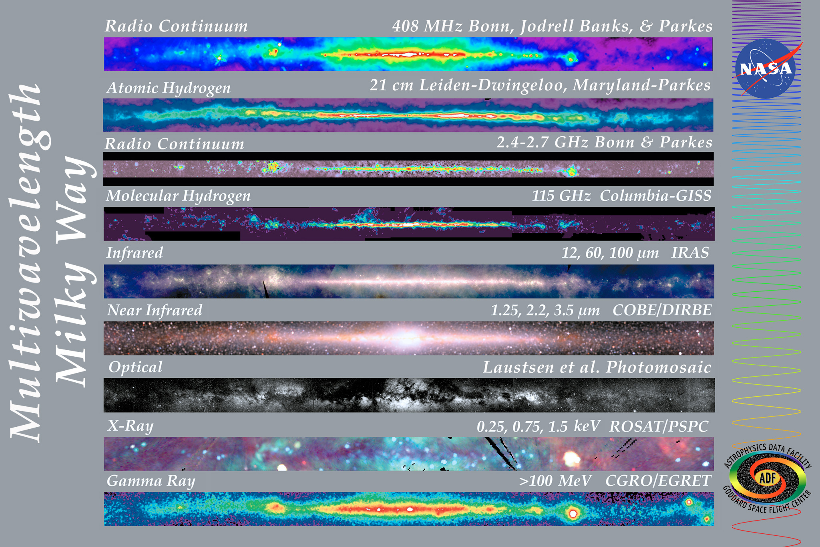
Cross-sectional view of our galaxy as seen at various wavelengths. The Infrared images particularly show the central bulge of our core and the elongate narrow structures coming off the core thought to be spiral arms.

Slide 2
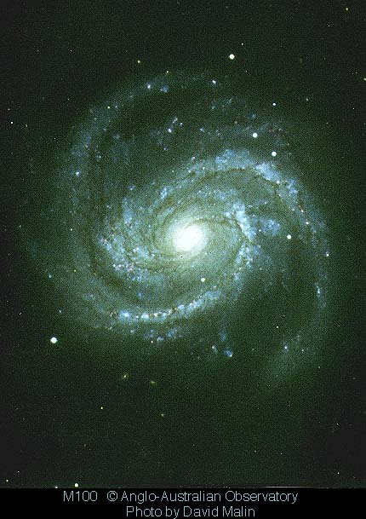
This ground-based image of a spiral galaxy (M 100) is currently what most astronomers believe our galaxy would look like if observed face-on (type Sb or Sc). However, there is evidence that suggests the central part of our galaxy may contain a bar structure. Our galaxy is made up of at least 200 billion stars and has a mass in the range of 750 billion to 1 trillion solar masses! It has an estimated diameter of 100,000 ly’s. Our galaxy is a part of what is known as the Local Group, a small cluster of galaxies made up of 3 known large galaxies and over 30 small dwarf-type galaxies (dwarf ellipticals and irregulars), within a 10 million ly volume of space. Our galaxy is the most massive of the group and has a significant influence on the orbital dynamics of our Local Group.

Slide 3
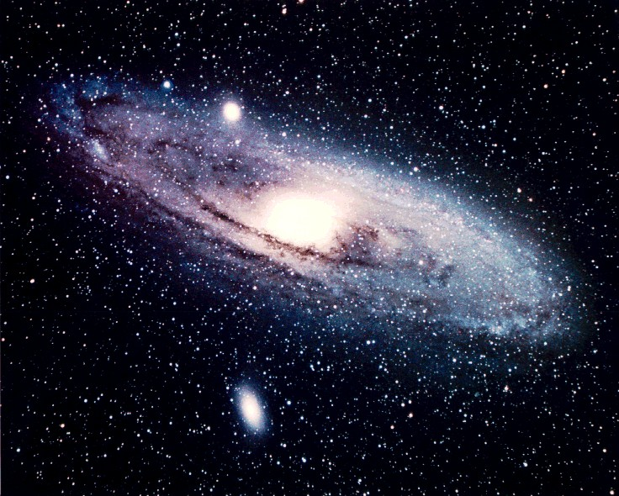
Our nearest large neighbor, the Andromeda galaxy, is located 2.9 my ly’s away, and is actually larger than our own galaxy (about 200,000 ly’s across) but is not nearly as massive (300-400 million solar masses). Each of the most massive galaxies within the Local Group have several small satellite galaxies that are gravitationally tied to the larger member. Two satellite galaxies are readily visible in this image (dwarf ellipticals) with Andromeda, and there are seven more not visible in this image.

Slide 4
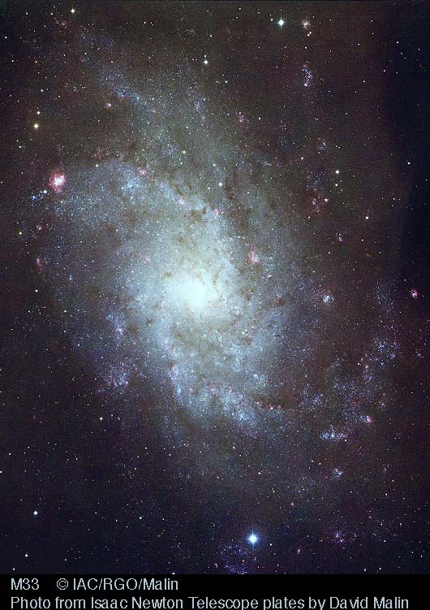
M33, “the Triangulum Galaxy”, is the third largest member of our Local Group with a size of approximately 60,000 ly’s and a mass of 10 to 40 billion suns. It is located 3 my ly’s from our galaxy and may be gravitationally tied with the Andromeda galaxy. At this time, there is only one confirmed satellite galaxy associated with this system.

Slide 5
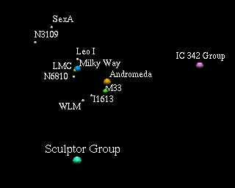
Map showing the general distribution of galaxies within our Local Group. Many members are not shown or are displayed as a single group.
3 my ly’s

Slide 6
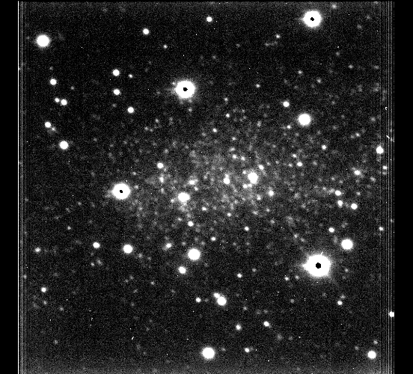
Ground-based image of the closest known galaxy to our own, known as the Sagittarius Dwarf Elliptical galaxy. The relatively poor image quality is due to its line of sight position which cuts through nearly the center of our galaxy. Until quite recently (1994), the Large Magellanic Cloud was considered our closest neighbor, this dwarf is located only 80,000 ly’s away (50,000 ly’s from the core of our galaxy) and is being disrupted by tidal gravitational interactions with our galaxy.

Slide 7
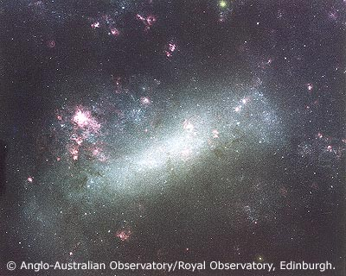
The Large Magellanic Cloud, a dwarf Irregular galaxy, is easily visible with the naked eye from the southern hemisphere as a hazy patch of “detached milky way”. It is one of our closest members (179,000 ly’s away) and contains many bright young clusters and star forming regions.

Slide 8
The Small Magellanic Cloud is very similar in appearance and characteristics to its nearby companion, the Large Magellanic Cloud, but is located at a slightly greater distance from our galaxy at 210,000 ly’s.

Slide 9
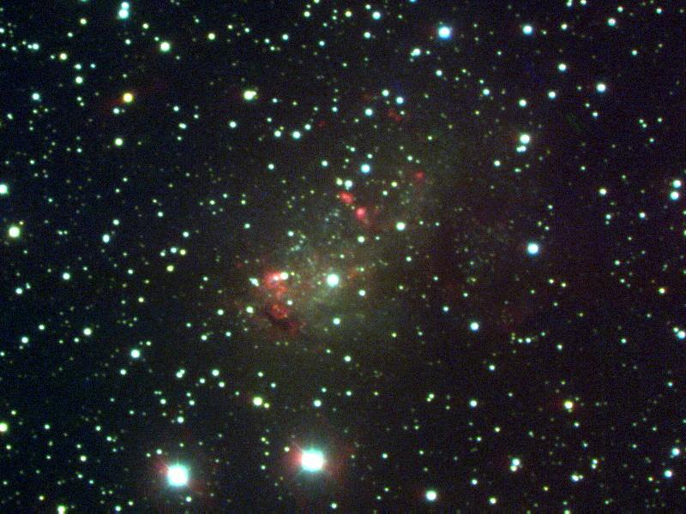
IC 10, a dwarf Irregular galaxy located 4.2 my ly’s away.

Slide 10
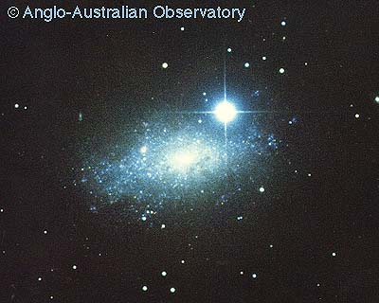
IC 5152, a dwarf Irregular galaxy located 2 my ly’s away.

Slide 11
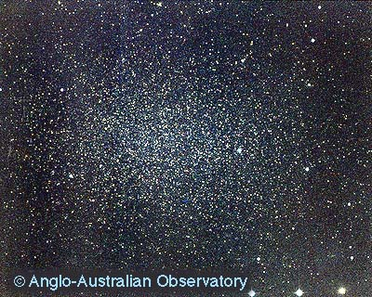
Leo I, a dwarf elliptical galaxy located 600,000 ly’s away, and one of the more remote companions to our galaxy.

Slide 12
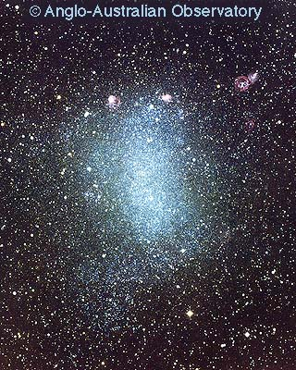
Due to its lack of symmetry this galaxy, known as NGC 6822, is classified as an Irregular galaxy. It is located approximately 1.8 my ly’s from our galaxy. At one end of the galaxy (top), a few prominent regions of active star formation are occurring; at the other, brigth bluish stars are scattered into what appears to be the the first signs of a straggling spiral arm.

Slide 13
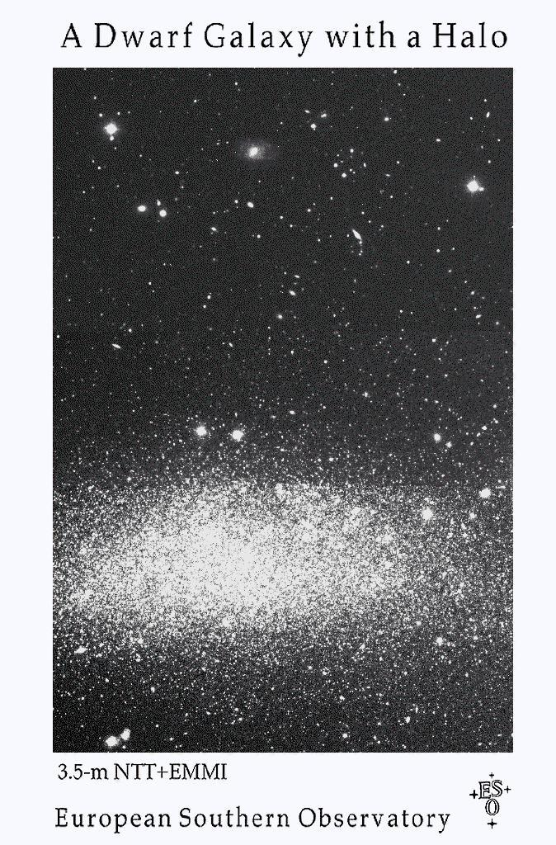
Wolf-Lundmark-Merlotte Galaxy (WLM), represents a dwarf irregular galaxy located 4.2 my ly’s away. It is an estimated 8,000 to 10,000 ly’s in length.

Slide 14
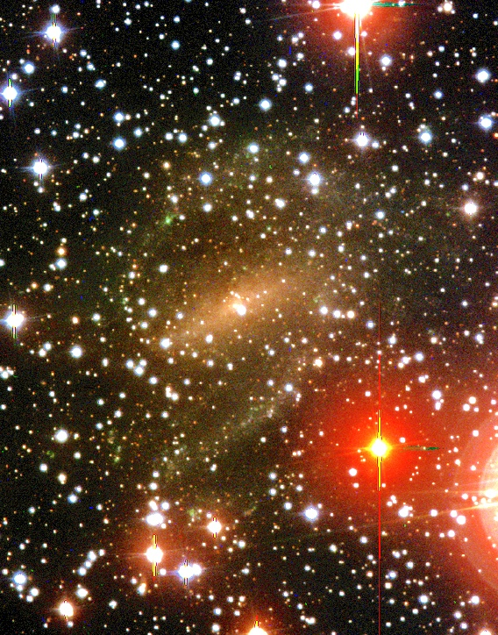

Slide 15
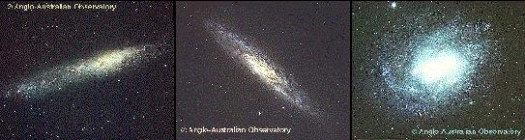
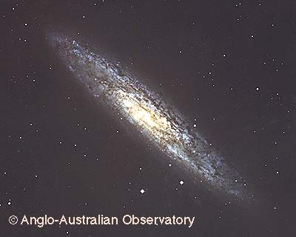
Image showing the three major members of the Sculptor Group of galaxies, probably the closest small cluster of galaxies to our own Local Group of galaxies (10 my ly’s). It is made up of 13 known galaxies only three of which are reasonably large (image above), the remainder are dwarf-types. The image at left is a closeup of the largest and brightest member of the group, NGC 253, a spiral galaxy seen nearly edge-on.

