Slide 1
Sharing and Accessing Network Resources
By Nanda Ganesan, Ph.D.
© All Rights Reserved

Slide 2
Sharing Network Resources
Windows 9x
  Resources are shared based on passwords
Windows NT/2000
  Resources are shared based on users
  Users must therefore created before a resource can be made available for sharing
  It is also possible to make the resource sharable for all the users

Slide 3
Creating Users for Sharing
Access Microsoft Management Console (MMC)
Create users using the Local Users and Groups option
  Applies to non-Active Directory implementations

Slide 4
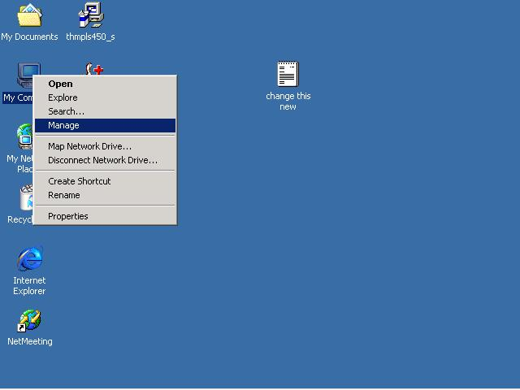

Slide 5
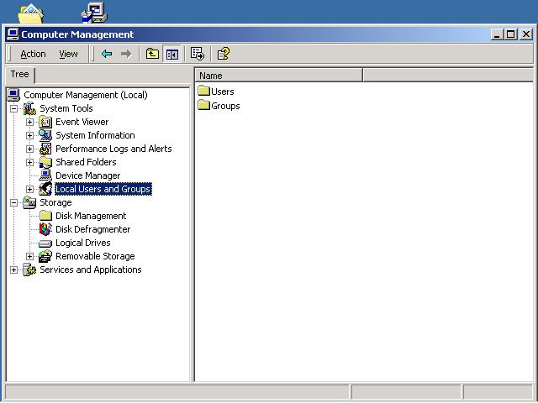
2
1

Slide 6
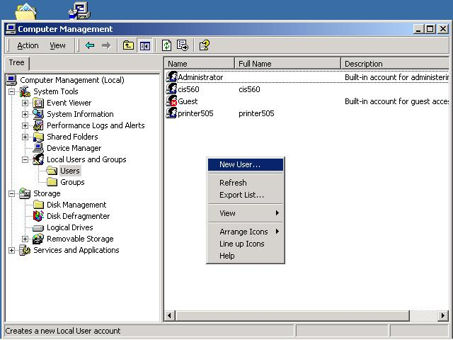
Right Click
and Select

Slide 7
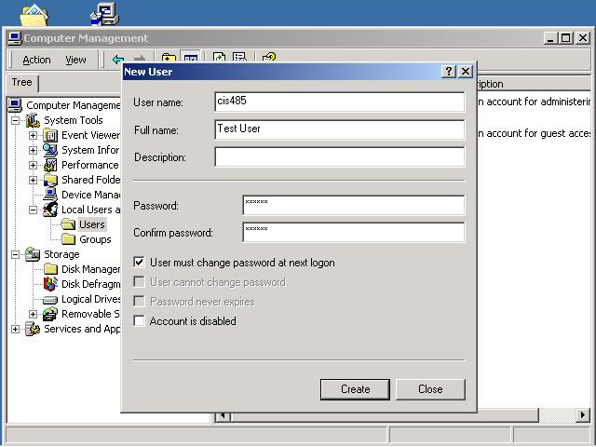

Slide 8
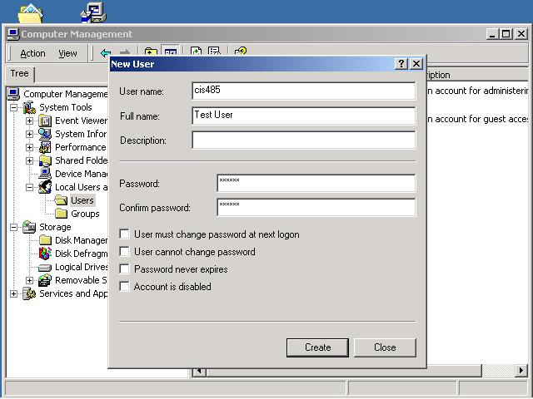

Slide 9
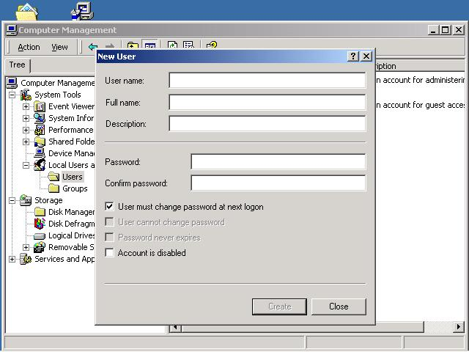
Ready to create next user.

Slide 10
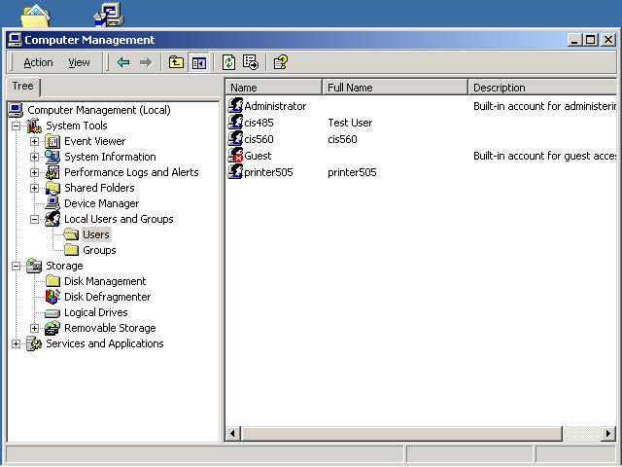
Newly created user.

Slide 11
Sharing a Folder
Select and right click a Folder
Make it available for sharing
Give permission for the selected users or everyone to access the folder

Slide 12
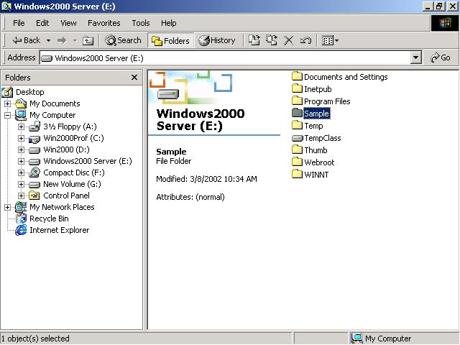
Folder to be shared: Sample

Slide 13
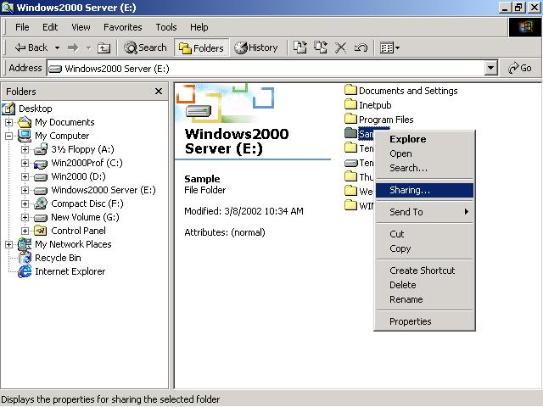

Slide 14
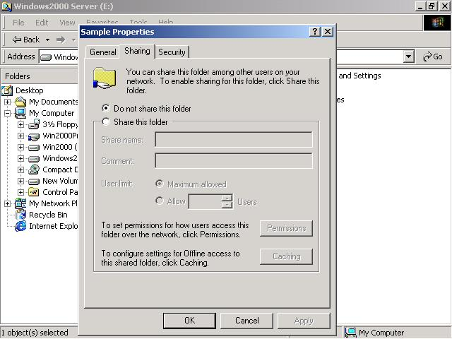

Slide 15
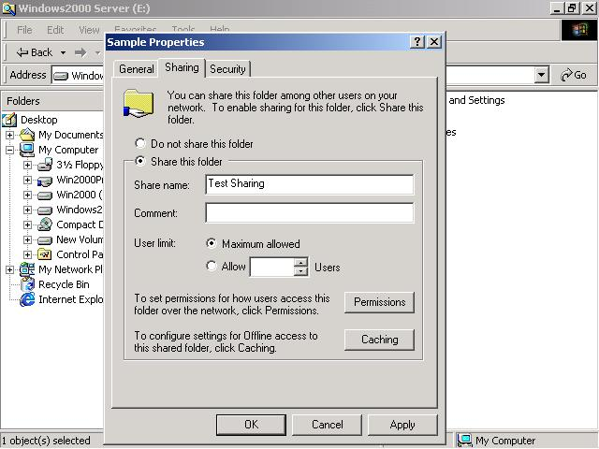
Folder is shared under a different name.

Slide 16
Permission
Sharing
  To share the folder
Security
  To gain access to the folder

Slide 18
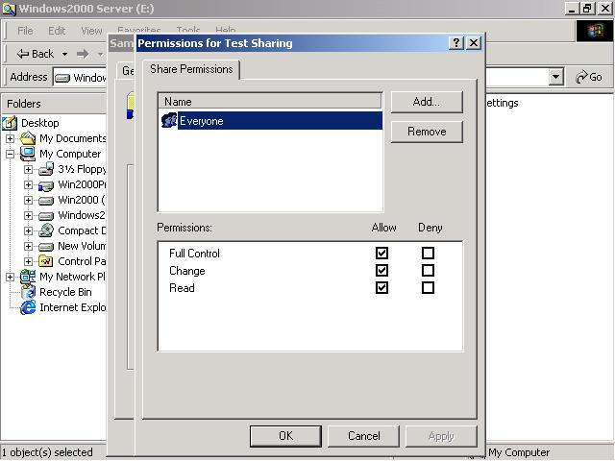
Users
Permissions

Slide 19
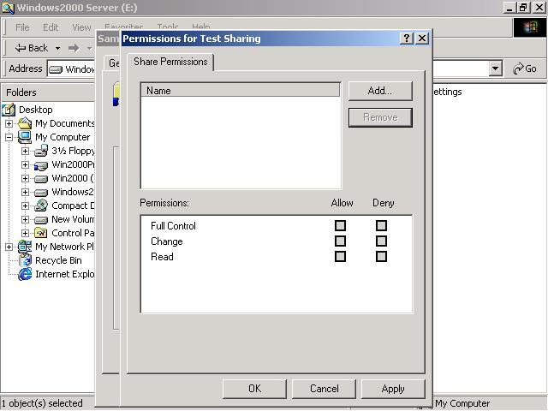
Permission removed for Everyone.

Slide 20
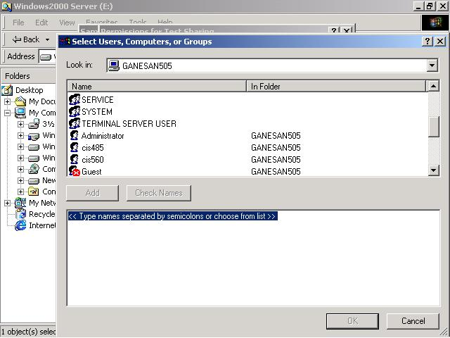
Select User(s).

Slide 21
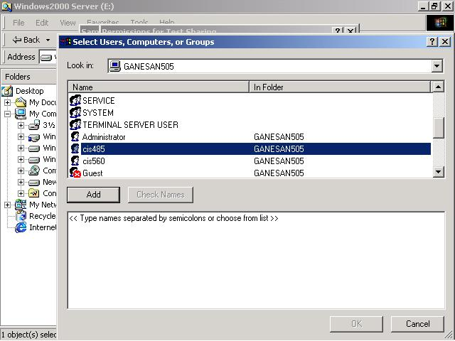

Slide 22
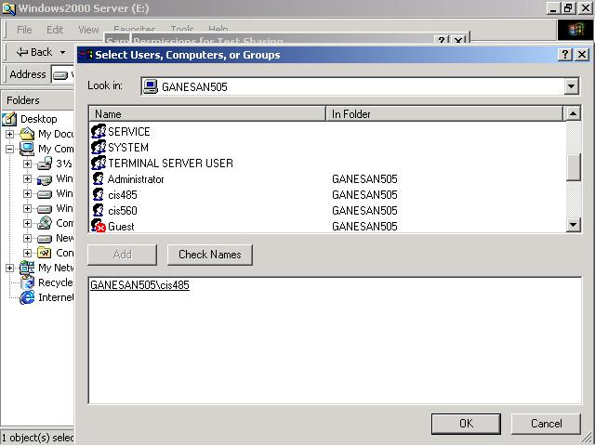

Slide 23
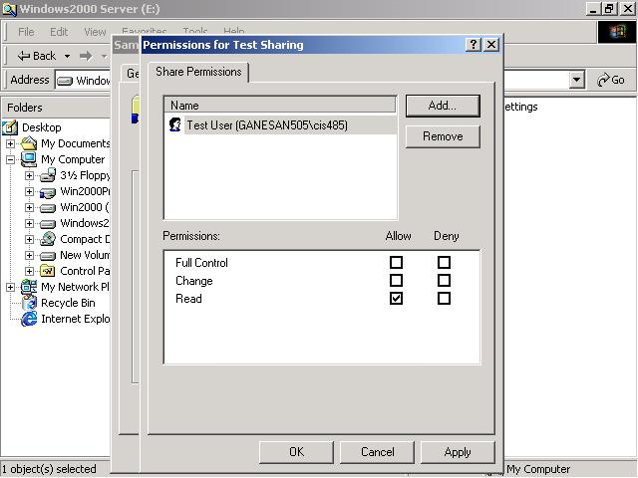
Default permission.

Slide 24
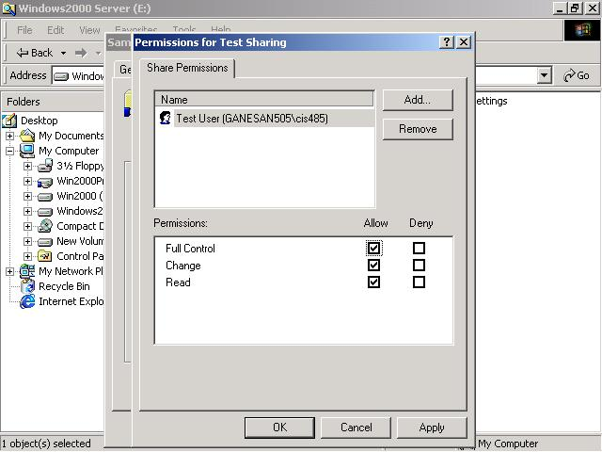
Changed permission.

Slide 25
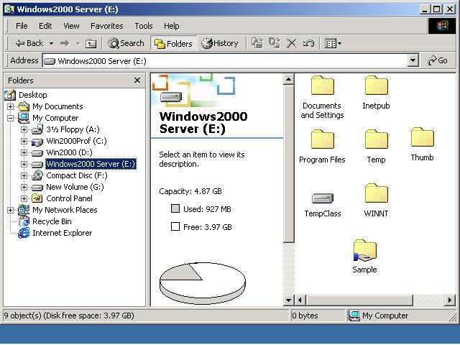
Shared Folder Indication

Slide 26
Note on Shared Folder
Shared Folder is indicated by a hand on the folder
Without security permission, the Folder could not be accessed by the users although they have been assigned the permission to share the Folder
  Experiment accessing the folder from a different client

Slide 27
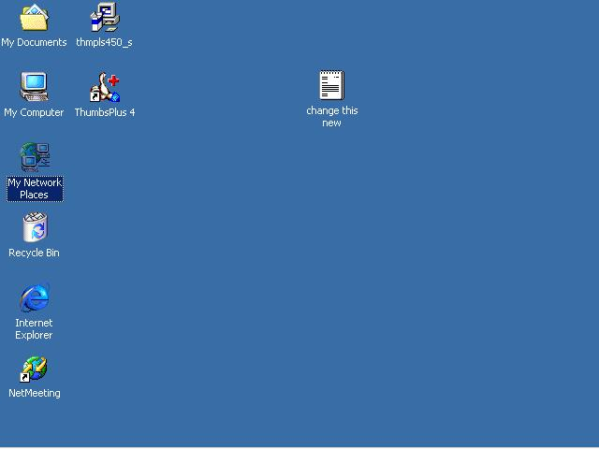

Slide 28
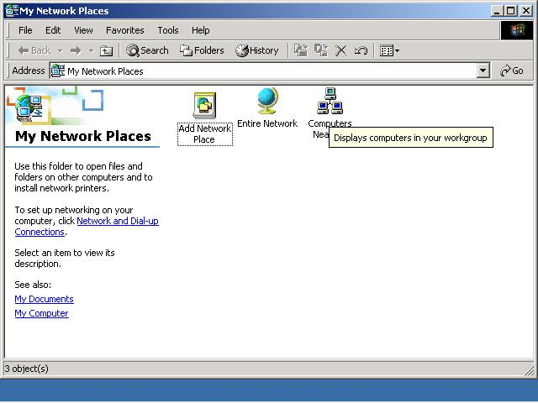

Slide 29
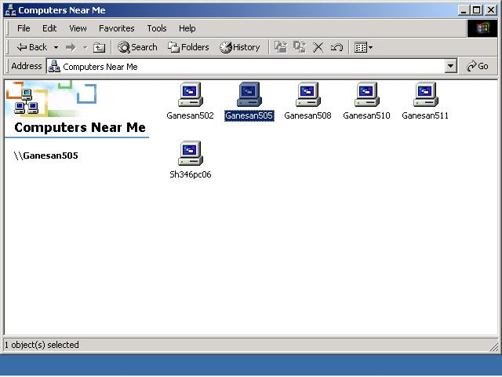

Slide 30
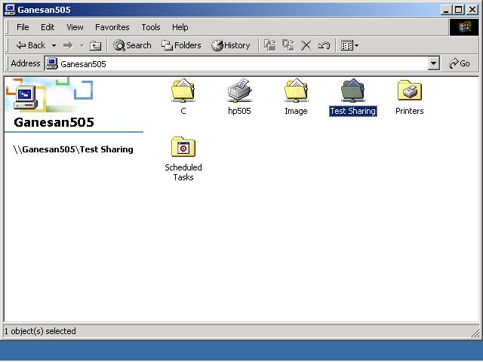
Available for sharing but it may not be accessed because the security privileges have not been assigned.

Slide 31
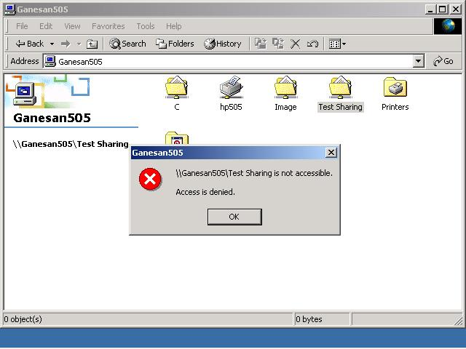

Slide 32
Security Settings
Security privileges must be assigned for the user CIS485 to access and use the folder contents

Slide 34
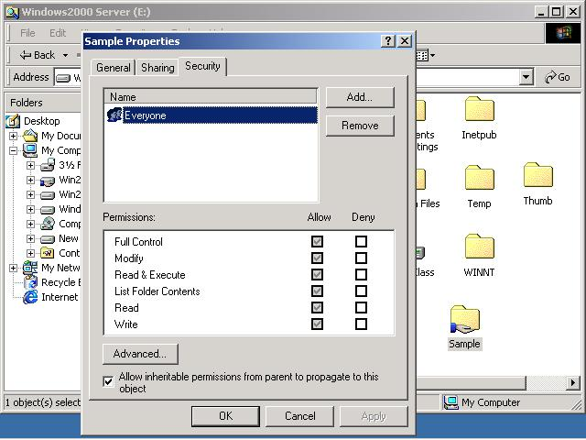
Default
1
Grayed
2
3

Slide 35
Security Observation
Everyone does not have access now because of the fact that the boxes are grayed
Removing Everyone can be done only after removing the check on the appropriate box to remove inheritance 3

Slide 36
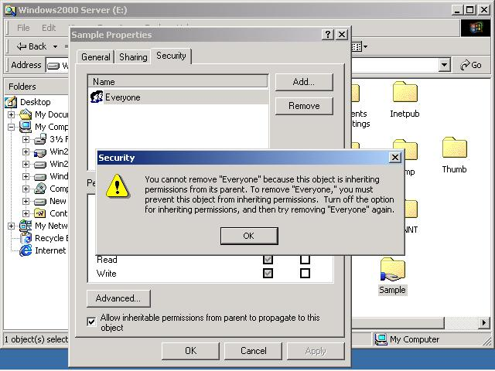

Slide 37
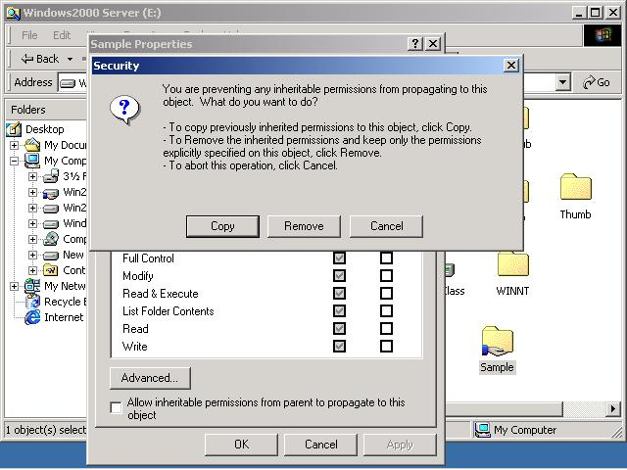
Unchecked

Slide 38
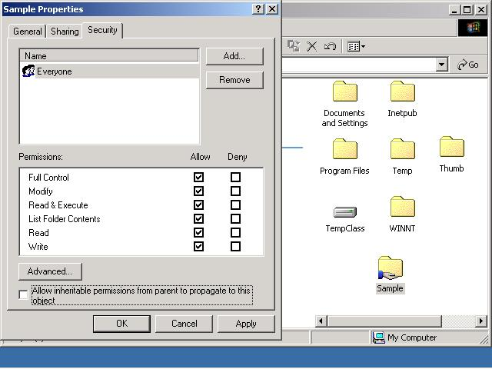
Not grayed anymore.

Slide 39
Accessing the Resource
It should now be possible for the user concerned to access and share the Folder
Note: Although Everyone has the security permission to access the Folder, only cis484 has the permission to share the Folder

Slide 40
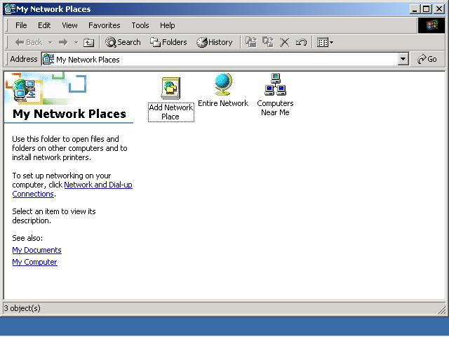

Slide 41
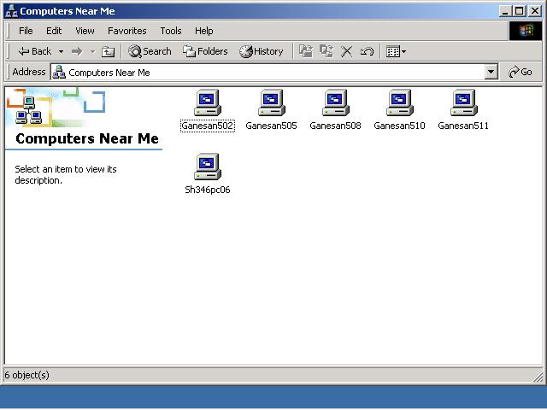

Slide 42
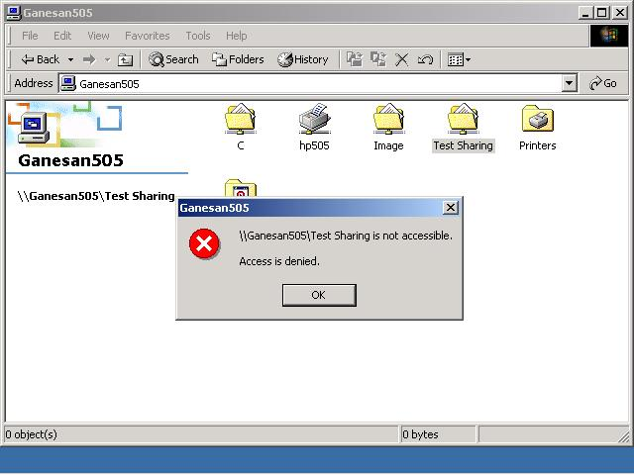
Not accessible because only user CIS 485 can share the folder.

Slide 43
Accessing the Folder
Only user cis485 can access the folder contents
Currently, the user is the local user
To access the folder contents:
  Disconnect the folder mapping
  Reconnect the folder mapping while logging-in as a different user

Slide 44
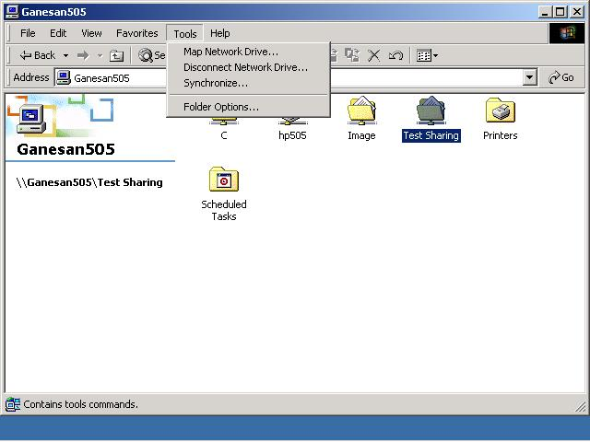

Slide 45
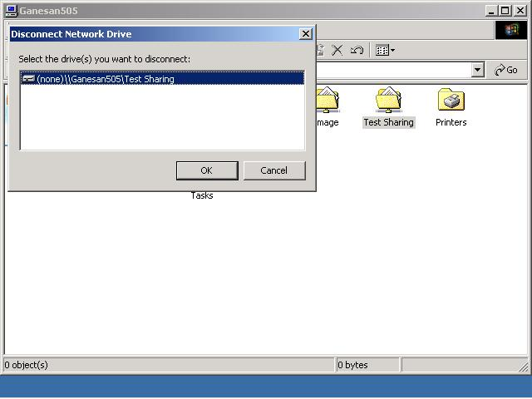

Slide 46


Slide 47
Mapping the Share
The share needs to be mapped under the user name cis485

Slide 48
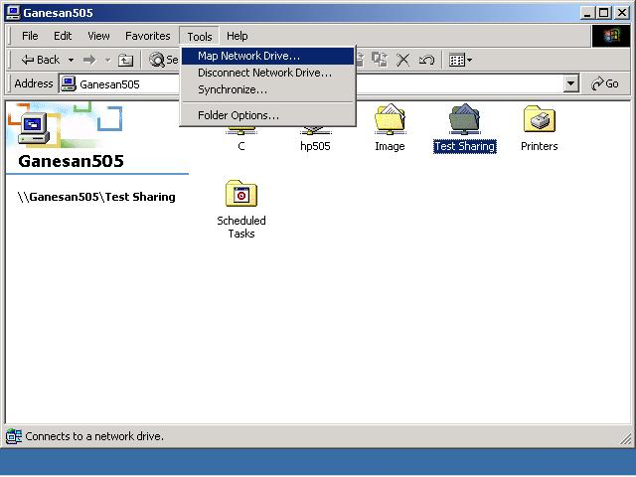

Slide 49
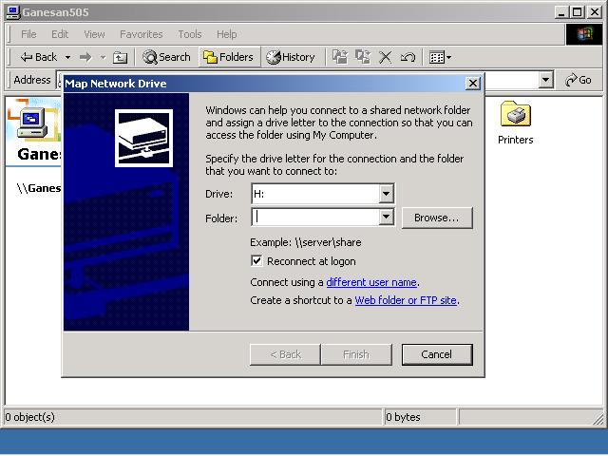

Slide 50
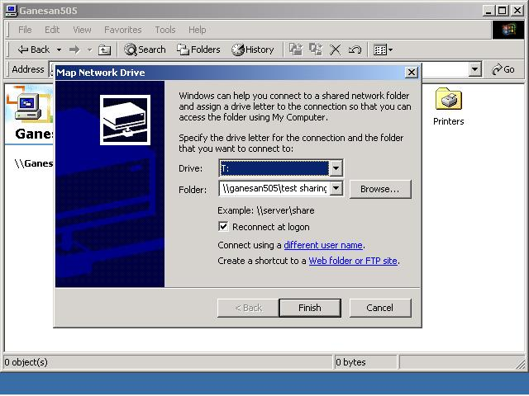

Slide 51
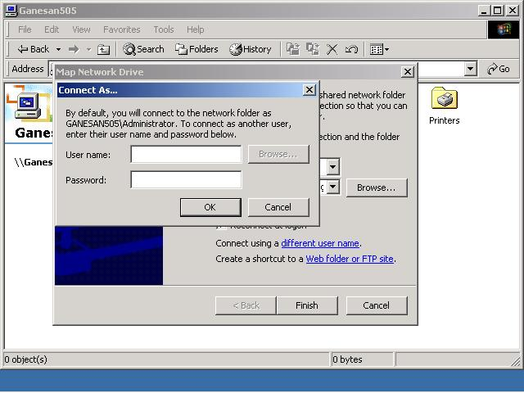

Slide 52


Slide 53
Reconnect
By choosing the appropriate option, the drive can be reconnected each time during log-on

Slide 55
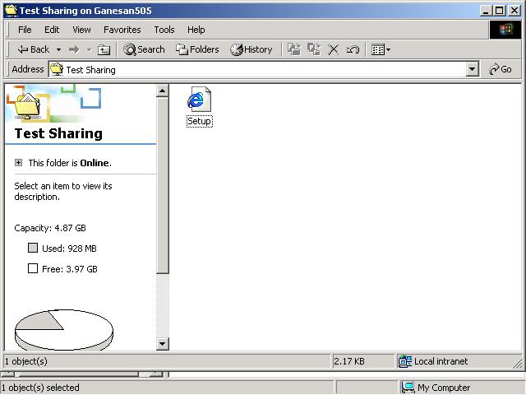
The contents of the folder are now accessible for sharing.

Slide 56
Summary
Sharing resources
  Share permission
  Security privileges
Map the share for sharing with the appropriate user name and password
Share the resource

Slide 57
End of Chapter

