Slide 1

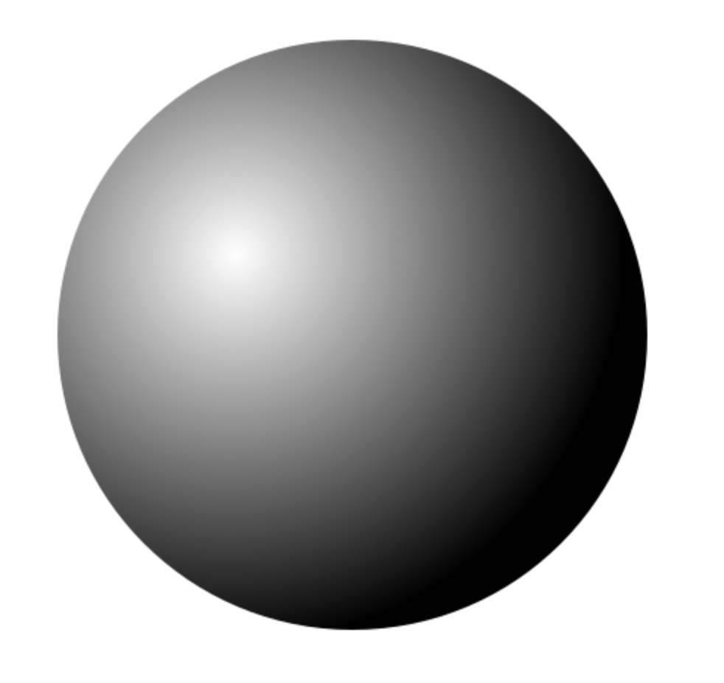

Some wavelengths are absorbed by the surface material and others are reflected
Light Ray
The « Normal » : the direction that is perpendicular to the surface
Reflection around the normal

Slide 2

The « Normal » : the direction that is perpendicular to the surface
Pixel (x,y)
Each time a ray touches an object
- We calculate the colour at the intersection point
- We calculate the direction of the ray reflected around the normal
- We re-cast a new ray in reflected direction
Ray origin
Projection image

Slide 3
Pixel (x,y)
Chaque fois que nous touchons un objet :
- nous calculons la couleur de l'objet au point d'intersection.
- nous calculons la direction du nouveau rayon réfléchi (autour de la normale à la surface)
- nous relançons le rayon réfléchi.
Origine
du rayon
Image de projection

Slide 4
Camera position

Slide 5
Camera position

Slide 6
(-1, 1, 1)
(1, 1, 1)
(-1, -1, 1)
(1, -1, 1)
If the camera is oriented facing the positive z-axis and our image is 1 unit down this axis
(0, 0, 0)
Camera position

Slide 7
2
(1,2) Interpreted as a position
1

Slide 8
2
(1,2) Interpreted as a direction (or Ray)
1

Slide 9
2
2
1
1

Slide 10
2
A position (1,2) displaced by a directional vector (1, -1) gives a new position (2,1)
1

Slide 11
r
c (x,y)
d (normalised)
o

Slide 12
r
c (x,y)
P
OC
d (normalised)
o

Slide 13
r
c (x,y)
CP
r
P
OC
P1
d (normalised)
o

Slide 14
r
c (x,y)
r
P
Angle between light and normal
n (surface normal)
d
L
o

Slide 15
r
c (x,y)
r
P
r
n (surface normal)
d
o

Slide 16
r
c (x,y)
r
P
r
PROJ = Project OP onto n
d
o

Slide 17
r
c (x,y)
r
P
r
d
o
Invert the projection :
-PROJ
Multiply by 2:
-2PROJ

Slide 18
r
c (x,y)
r
P
r
d
o
The direction from P to r is:
-2 * PROJ + OP

Slide 19
P
n (normal)
c
d (normalised)
o

