Slide 1
Restricting and Sorting Data

Slide 2
Objectives
After completing this lesson, you should be able to do the following:
  Limit the rows that are retrieved by a query
  Sort the rows that are retrieved by a query
  Use ampersand substitution to restrict and sort output at run time
Notes:
When retrieving data from the database, you may need to do the following:
Restrict the rows of data that are displayed
Specify the order in which the rows are displayed
This lesson explains the SQL statements that you use to perform the actions listed in the slide.
Oracle Database 12c: SQL Workshop I 3 - 2

Slide 3
Lesson Agenda
  Limiting rows with:
    The WHERE clause
    The comparison operators using =, <=, BETWEEN, IN, LIKE, and NULL conditions
    Logical conditions using AND, OR, and NOT operators
  Rules of precedence for operators in an expression
  Sorting rows using the ORDER BY clause
  SQL row limiting clause in a query
  Substitution variables
  DEFINE and VERIFY commands
Notes:
Oracle Database 12c: SQL Workshop I 3 - <number>

Slide 4
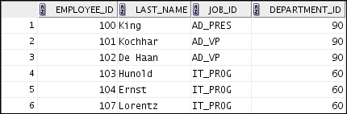

Limiting Rows by Using a Selection
EMPLOYEES
…
“retrieve all
employees in department 90”
Notes:
In the example in the slide, assume that you want to display all the employees in department 90. The rows with a value of 90 in the DEPARTMENT_ID column are the only ones that are returned. This method of restriction is the basis of the WHERE clause in SQL.
Oracle Database 12c: SQL Workshop I 3 - <number>

Slide 5
Limiting Rows That Are Selected
  Restrict the rows that are returned by using the WHERE clause:
  The WHERE clause follows the FROM clause.
      SELECT *|{[DISTINCT] column [alias],...}
FROM table
[WHERE logical expression(s)];
Notes:
You can restrict the rows that are returned from the query by using the WHERE clause. A WHERE clause contains a condition that must be met and it directly follows the FROM clause. If the condition is true, the row meeting the condition is returned.
In the syntax:
WHERE Restricts the query to rows that meet a condition
logical expression Is composed of column names, constants, and a comparison operator. It specifies a combination of one or more expressions and Boolean operators, and returns a value of TRUE, FALSE, or KNOWN.
The WHERE clause can compare values in columns, literal, arithmetic expressions, or functions. It consists of three elements:
Column name
Comparison condition
Column name, constant, or list of values
Oracle Database 12c: SQL Workshop I 3 - <number>

Slide 6
Using the WHERE Clause
SELECT employee_id, last_name, job_id, department_id
FROM employees
WHERE department_id = 90 ;
Notes:
In the example, the SELECT statement retrieves the employee ID, last name, job ID, and department number of all employees who are in department 90.
Note: You cannot use column alias in the WHERE clause.
Oracle Database 12c: SQL Workshop I 3 - <number>

Slide 7


Character Strings and Dates
  Character strings and date values are enclosed within single quotation marks.
  Character values are case-sensitive and date values are format-sensitive.
  The default date display format is DD-MON-RR.
SELECT last_name, job_id, department_id
FROM employees
WHERE last_name = 'Whalen' ;
SELECT last_name
FROM employees
WHERE hire_date = '17-OCT-03' ;
Notes:
Character strings and dates in the WHERE clause must be enclosed within single quotation marks (''). Number constants, however, need not be enclosed within single quotation marks.
All character searches are case-sensitive. In the following example, no rows are returned because the EMPLOYEES table stores all the last names in mixed case:
SELECT last_name, job_id, department_id
FROM employees
WHERE last_name = 'WHALEN';
Oracle databases store dates in an internal numeric format, representing the century, year, month, day, hours, minutes, and seconds. The default date display is in the DD-MON-RR format.
Note: For details about the RR format and about changing the default date format, see the lesson titled “Using Single-Row Functions to Customize Output.” Also, you learn about the use of single-row functions such as UPPER and LOWER to override the case sensitivity in the same lesson.
Oracle Database 12c: SQL Workshop I 3 - <number>

Slide 8
Comparison Operators
Operator
Meaning
  =
Equal to
  >
Greater than
>=
Greater than or equal to
  <
Less than
  <=
Less than or equal to
  <>
Not equal to
BETWEEN
...AND...
Between two values (inclusive)
IN(set)
Match any of a list of values
LIKE
Match a character pattern
IS NULL
Is a null value
Notes:
Comparison operators are used in conditions that compare one expression with another value or expression. They are used in the WHERE clause in the following format:
Syntax
... WHERE expr operator value
Example
... WHERE hire_date = '01-JAN-05'
... WHERE salary >= 6000
... WHERE last_name = 'Smith'
Remember, an alias cannot be used in the WHERE clause.
Note: The symbols != and ^= can also represent the not equal to condition.
Oracle Database 12c: SQL Workshop I 3 - <number>

Slide 9

Using Comparison Operators
SELECT last_name, salary
FROM employees
WHERE salary <= 3000 ;
Notes:
In the first example in the slide, the SELECT statement retrieves the last name and salary from the EMPLOYEES table for any employee whose salary is less than or equal to $3,000. Note that there is an explicit value supplied to the WHERE clause. The explicit value of 3000 is compared to the salary value in the SALARY column of the EMPLOYEES table.
In the second code example, the SELECT statement retrieves all rows where the last name is either Ernst or Abel. Because * is used in the SELECT statement, all fields from the employees table would appear in the result set.
Oracle Database 12c: SQL Workshop I 3 - <number>

Slide 10
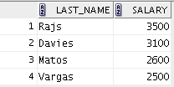
Range Conditions Using the BETWEEN Operator
Use the BETWEEN operator to display rows based on a range of values:
SELECT last_name, salary
FROM employees
WHERE salary BETWEEN 2500 AND 3500 ;
Lower limit
Upper limit
Notes:
You can display rows based on a range of values using the BETWEEN operator. The range that you specify contains a lower limit and an upper limit.
The SELECT statement in the slide returns rows from the EMPLOYEES table for any employee whose salary is between $2,500 and $3,500.
Values that are specified with the BETWEEN operator are inclusive. However, you must specify the lower limit first.
You can also use the BETWEEN operator on character values:
SELECT last_name FROM employees
WHERE last_name BETWEEN 'King' AND 'Whalen <number>
Oracle Database 12c: SQL Workshop I 3 - <number>

Slide 11
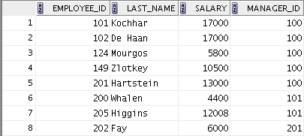
Using the IN Operator
Use the IN operator to test for values in a list:
SELECT employee_id, last_name, salary, manager_id
FROM employees
WHERE manager_id IN (100, 101, 201) ;
Notes:
To test for values in a specified set of values, use the IN operator. The condition defined using the IN operator is also known as the membership condition.
The example in the slide displays employee numbers, last names, salaries, and manager’s employee numbers for all the employees whose manager’s employee number is 100, 101, or 201.
Note: The set of values can be specified in any random order—for example, (201,100,101).
The IN operator can be used with any data type. The following example returns a row from the EMPLOYEES table, for any employee whose last name is included in the list of names in the WHERE clause:
SELECT employee_id, manager_id, department_id
FROM employees
WHERE last_name IN ('Hartstein', 'Vargas');
If characters or dates are used in a list, they must be enclosed within single quotation marks ('').
Oracle Database 12c: SQL Workshop I 3 - <number>

Slide 12

Pattern Matching Using the LIKE Operator
  Use the LIKE operator to perform wildcard searches of valid search string values.
  Search conditions can contain either literal characters or numbers:
    % denotes zero or more characters.
    _ denotes one character.
SELECT first_name
FROM employees
WHERE first_name LIKE 'S%' ;
Notes:
You may not always know the exact value to search for. You can select rows that match a character pattern by using the LIKE operator. The character pattern–matching operation is referred to as a wildcard search. Two symbols can be used to construct the search string.
The SELECT statement in the slide returns the first name from the EMPLOYEES table for any employee whose first name begins with the letter “S.” Note the uppercase “S.” Consequently, names beginning with a lowercase “s” are not returned.
The LIKE operator can be used as a shortcut for some BETWEEN comparisons. The following example displays the last names and hire dates of all employees who joined between January, 2005 and December, 2005:
SELECT last_name, hire_date
FROM employees
WHERE hire_date LIKE '%05';
Oracle Database 12c: SQL Workshop I 3 - <number>

Slide 13

Combining Wildcard Characters
  You can combine the two wildcard characters (%, _) with literal characters for pattern matching:
  You can use the ESCAPE identifier to search for the actual % and _ symbols.
SELECT last_name
FROM employees
WHERE last_name LIKE '_o%' ;
Notes:
The % and _ symbols can be used in any combination with literal characters. The example in the slide displays the names of all employees whose last names have the letter “o” as the second character.
When you need to have an exact match for the actual % and _ characters, use the ESCAPE identifier.
Oracle Database 12c: SQL Workshop I 3 - <number>

Slide 14

Using NULL Conditions
Test for nulls with the IS NULL operator.
SELECT last_name, manager_id
FROM employees
WHERE manager_id IS NULL ;
Notes:
…
The NULL conditions include the IS NULL condition and the IS NOT NULL condition.
The IS NULL condition tests for nulls. A null value means that the value is unavailable, unassigned, unknown, or inapplicable. Therefore, you cannot test with =, because a null cannot be equal or unequal to any value. The example in the slide retrieves the last_name and manager_id of all employees who do not have a manager.
Here is another example: To display the last name, job ID, and commission for all employees who are not entitled to receive a commission, use the following SQL statement:
SELECT last_name, job_id, commission_pct
FROM employees
WHERE commission_pct IS NULL;
Oracle Database 12c: SQL Workshop I 3 - <number>

Slide 15
Defining Conditions Using Logical Operators
Operator
Meaning
  AND
Returns TRUE if both component conditions are true
  OR
Returns TRUE if either component condition is true
NOT
Returns TRUE if the condition is false
Notes:
A logical condition combines the results of two or more component conditions to produce a single result based on those conditions, or it inverts the result of a single condition. A row is returned only if the overall result of the condition is true.
Three logical operators are available in SQL:
AND
OR
NOT
All the examples so far have specified only one condition in the WHERE clause. You can use several conditions in a single WHERE clause using the AND and OR operators.
Oracle Database 12c: SQL Workshop I 3 - <number>

Slide 16

Using the AND Operator
AND requires both the component conditions to be true:
SELECT employee_id, last_name, job_id, salary
FROM employees
WHERE salary >= 10000
AND job_id LIKE '%MAN%' ;
Notes:
In the example, both the component conditions must be true for any record to be selected. Therefore, only those employees who have a job title that contains the string ‘MAN’ and earn $10,000 or more are selected.
All character searches are case-sensitive, that is, no rows are returned if ‘MAN’ is not uppercase. Further, character strings must be enclosed within quotation marks.
AND Truth Table
The following table shows the results of combining two expressions with AND:
Oracle Database 12c: SQL Workshop I 3 - <number>

Slide 17
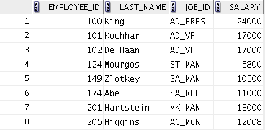
Using the OR Operator
OR requires either component condition to be true:
SELECT employee_id, last_name, job_id, salary
FROM employees
WHERE salary >= 10000
OR job_id LIKE '%MAN%' ;
Notes:
In the example, either component condition can be true for any record to be selected. Therefore, any employee who has a job ID that contains the string ‘MAN’ or earns $10,000 or both is selected.
OR Truth Table
The following table shows the results of combining two expressions with OR:
Oracle Database 12c: SQL Workshop I 3 - <number>

Slide 18
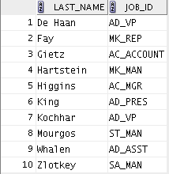
Using the NOT Operator
SELECT last_name, job_id
FROM employees
WHERE job_id
NOT IN ('IT_PROG', 'ST_CLERK', 'SA_REP') ;
Notes:
The example in the slide displays the last name and job ID of all employees whose job ID is not IT_PROG, ST_CLERK, or SA_REP.
NOT Truth Table
The following table shows the result of applying the NOT operator to a condition:
Oracle Database 12c: SQL Workshop I 3 - <number>

Slide 19
Lesson Agenda
  Limiting rows with:
    The WHERE clause
    The comparison conditions using =, <=, BETWEEN, IN, LIKE, and NULL operators
    Logical conditions using AND, OR, and NOT operators
  Rules of precedence for operators in an expression
  Sorting rows using the ORDER BY clause
  SQL row limiting clause in a query
  Substitution variables
  DEFINE and VERIFY commands
Notes:
Oracle Database 12c: SQL Workshop I 3 - <number>

Slide 20
Rules of Precedence
Operator
Meaning
  1
Arithmetic operators
  2
Concatenation operator
  3
Comparison conditions
  4
IS [NOT] NULL, LIKE, [NOT] IN
  5
[NOT] BETWEEN
  6
Not equal to
  7
NOT logical operator
  8
AND logical operator
  9
OR logical operator
You can use parentheses to override rules of precedence.
Notes:
The rules of precedence determine the order in which expressions are evaluated and calculated. The table in the slide lists the default order of precedence. However, you can override the default order by using parentheses around the expressions that you want to calculate first.
Oracle Database 12c: SQL Workshop I 3 - <number>

Slide 21
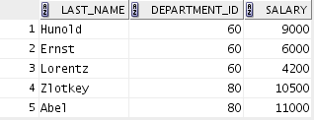

Rules of Precedence
SELECT last_name, department_id, salary
FROM employees
WHERE department_id = 60
OR department_id = 80
AND salary > 10000;
1
SELECT last_name, department_id, salary
FROM employees
WHERE (department_id = 60
OR department_id = 80)
AND salary > 10000;
2
Notes:
1. Precedence of the AND Operator: Example
In this example, there are two conditions:
The first condition is that the department ID is 80 and the salary is greater than $10,000.
The second condition is that the department ID is 60.
Therefore, the SELECT statement reads as follows:
“Select the row if an employee’s department ID is 80 and earns more than $10,000, or if the employee’s department ID is 60.”
2. Using Parentheses: Example
In this example, there are two conditions:
The first condition is that the department ID is 80 or 60.
The second condition is that the salary is greater than $10,000.
Therefore, the SELECT statement reads as follows:
“Select the row if an employee’s department ID is 80 or 60, and if the employee earns more than $10,000.”
Oracle Database 12c: SQL Workshop I 3 - <number>

Slide 22
Lesson Agenda
  Limiting rows with:
    The WHERE clause
    The comparison conditions using =, <=, BETWEEN, IN, LIKE, and NULL operators
    Logical conditions using AND, OR, and NOT operators
  Rules of precedence for operators in an expression
  Sorting rows using the ORDER BY clause
  SQL row limiting clause in a query
  Substitution variables
  DEFINE and VERIFY commands
Notes:
Oracle Database 12c: SQL Workshop I 3 - <number>

Slide 23
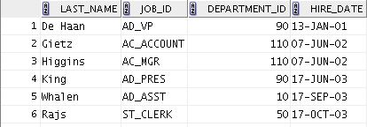
Using the ORDER BY Clause
Sort the retrieved rows with the ORDER BY clause:
  ASC: Ascending order, default
  DESC: Descending order
SELECT last_name, job_id, department_id, hire_date
FROM employees
ORDER BY hire_date ;
…
Notes:
The order of rows that are returned in a query result is undefined. The ORDER BY clause can be used to sort the rows. You can specify an expression, an alias, or a column position as the sort condition. You can specify multiple expressions in the order_by_clause. Oracle Database first sorts rows based on their values for the first expression. Rows with the same value for the first expression are then sorted based on their values for the second expression, and so on.
Syntax
SELECT expr
FROM table
[WHERE condition(s)]
[ORDER BY {column, expr, numeric_position} [ASC|DESC]];
In the syntax:
ORDER BY Specifies the order in which the retrieved rows are displayed
ASC Orders the rows in ascending order (this is the default order)
DESC Orders the rows in descending order
If the ORDER BY clause is not used, the sort order is undefined, and the Oracle server may not fetch rows in the same order for the same query twice. Use the ORDER BY clause to display the rows in a specific order.
Oracle Database 12c: SQL Workshop I 3 - <number>

Slide 24
Sorting
  Sorting in descending order:
  Sorting by column alias:
SELECT last_name, job_id, department_id, hire_date
FROM employees
ORDER BY department_id DESC ;
1
SELECT employee_id, last_name, salary*12 annsal
FROM employees
ORDER BY annsal ;
2
Notes:
The default sort order is ascending:
Numeric values are displayed with the lowest values first (for example, 1 to 999).
Date values are displayed with the earliest value first (for example, 01-JAN-92 before
01-JAN-95).
Character values are displayed in the alphabetical order (for example, “A” first and “Z” last).
Null values are displayed last for ascending sequences and first for descending sequences.
You can also sort by a column that is not in the SELECT list.
Examples
To reverse the order in which the rows are displayed, specify the DESC keyword after the column name in the ORDER BY clause. The example in the slide sorts the result by the department_id.
2. You can also use a column alias in the ORDER BY clause. The slide example sorts the data by annual salary.
Note: Use the keywords NULLS FIRST or NULLS LAST to specify whether returned rows containing null values should appear first or last in the ordering sequence.
Oracle Database 12c: SQL Workshop I 3 - <number>

Slide 25
Sorting
  Sorting by using the column’s numeric position:
  Sorting by multiple columns:
SELECT last_name, job_id, department_id, hire_date
FROM employees
ORDER BY 3;
3
SELECT last_name, department_id, salary
FROM employees
ORDER BY department_id, salary DESC;
4
Notes:
Examples
You can sort query results by specifying the numeric position of the column in the SELECT clause. The example in the slide sorts the result by the department_id as this column is at the third position in the SELECT clause.
4. You can sort query results by more than one column. You list the columns (or SELECT list column sequence numbers) in the ORDER BY clause, delimited by commas. The results are ordered by the first column, then the second, and so on for as many columns as the ORDER BY clause includes. If you want any results sorted in descending order, your ORDER BY clause must use the DESC keyword directly after the name or the number of the relevant column. The result of the query example shown in the slide is sorted by department_id in ascending order and also by salary in descending order.
Oracle Database 12c: SQL Workshop I 3 - <number>

Slide 26
Lesson Agenda
  Limiting rows with:
    The WHERE clause
    The comparison conditions using =, <=, BETWEEN, IN, LIKE, and NULL operators
    Logical conditions using AND, OR, and NOT operators
  Rules of precedence for operators in an expression
  Sorting rows using the ORDER BY clause
  SQL row limiting clause in a query
  Substitution variables
  DEFINE and VERIFY commands
Notes:
Oracle Database 12c: SQL Workshop I 3 - <number>

Slide 27

SQL Row Limiting Clause
  You can use the row_limiting_clause to limit the rows that are returned by a query.
  You can use this clause to implement Top-N reporting.
  You can specify the number of rows or percentage of rows to return with the FETCH FIRST keyword.
  You can use the OFFSET keyword to specify that the returned rows begin with a row after the first row of the full result set.
  The WITH TIES keyword includes additional rows with the same ordering keys as the last row of the row-limited result set. (You must specify ORDER BY in the query.)
Notes:
In Oracle Database 12c Release 1, SQL SELECT syntax has been enhanced to allow a row_limiting_clause, which limits the number of rows that are returned in the result set. The row_limiting_clause provides both easy-to-understand syntax and expressive power. Limiting the number or rows returned can be valuable for reporting, analysis, data browsing, and other tasks. Queries that order data and then limit row output are widely used and are often referred to as Top-N queries. Top-N queries sort their result set and then return only the first n rows.
You can specify the number of rows or percentage of rows to return with the FETCH FIRST keywords. You can use the OFFSET keyword to specify that the returned rows begin with a row after the first row of the full result set. The WITH TIES keywords includes rows with the same ordering keys as the last row of the row-limited result set (you must specify the ORDER BY clause with the WITH TIES clause in the query). FETCH FIRST and OFFSET keywords simplify syntax and comply with the ANSI SQL standard.
There are certain limitations of the SQL row limiting clause:
You cannot specify this clause with the for_update_clause.
You cannot specify this clause in the subquery of a DELETE or UPDATE statement.
If you specify this clause, then the select list cannot contain the sequence pseudocolumns CURRVAL or NEXTVAL.
Oracle Database 12c: SQL Workshop I 3 - <number>

Slide 28
Using SQL Row Limiting Clause in a Query
Using SQL Row Limiting Clause
Using the SQL Row Limiting Clause
You specify the row_limiting_clause in the SQL SELECT statement by placing it after the ORDER BY clause.
Syntax:
SELECT …
FROM …
[ WHERE … ]
[ ORDER BY … ]
[OFFSET offset { ROW | ROWS }]
[FETCH { FIRST | NEXT } [{ row_count | percent PERCENT }] { ROW | ROWS }
{ ONLY | WITH TIES }]
Notes:
You specify the row_limiting_clause in the SQL SELECT statement by placing it after the ORDER BY clause. Note that an ORDER BY clause is required if you want to sort the rows for consistency.
OFFSET: Use this clause to specify the number of rows to skip before row limiting begins. The value for offset must be a number. If you specify a negative number, offset is treated as 0. If you specify NULL or a number greater than or equal to the number of rows that are returned by the query, 0 rows are returned.
ROW | ROWS: Use these keywords interchangeably. They are provided for semantic clarity.
FETCH: Use this clause to specify the number of rows or percentage of rows to return.
FIRST | NEXT: Use these keywords interchangeably. They are provided for semantic clarity.
row_count | percent PERCENT: Use row_count to specify the number of rows to return. Use percent PERCENT to specify the percentage of the total number of selected rows to return. The value for percent must be a number.
ONLY | WITH TIES: Specify ONLY to return exactly the specified number of rows or percentage of rows. Specify WITH TIES to return additional rows with the same sort key as the last row fetched. If you specify WITH TIES, then you must specify the order_by_clause. If you do not specify the order_by_clause, then no additional rows will be returned.
Oracle Database 12c: SQL Workshop I 3 - <number>

Slide 29
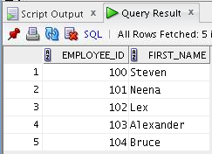
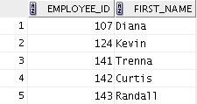
SQL Row Limiting Clause: Example
SELECT employee_id, first_name
FROM employees
ORDER BY employee_id
FETCH FIRST 5 ROWS ONLY;
SELECT employee_id, first_name
FROM employees
ORDER BY employee_id
OFFSET 5 ROWS FETCH NEXT 5 ROWS ONLY;
Notes:
The first code example returns the five employees with the lowest employee_id.
The second code example returns the five employees with the next set of lowest employee_id.
Note: If employee_id is assigned sequentially by the date when the employee joined the organization, these examples give us the top 5 employees and then employees 6-10, all in terms of seniority.
Oracle Database 12c: SQL Workshop I 3 - <number>

Slide 30
Lesson Agenda
  Limiting rows with:
    The WHERE clause
    The comparison conditions using =, <=, BETWEEN, IN, LIKE, and NULL operators
    Logical conditions using AND, OR, and NOT operators
  Rules of precedence for operators in an expression
  Sorting rows using the ORDER BY clause
  SQL row limiting clause in a query
  Substitution variables
  DEFINE and VERIFY commands
Notes:
Oracle Database 12c: SQL Workshop I 3 - <number>

Slide 31


Substitution Variables
... salary = ? …
… department_id = ? …
... last_name = ? ...
I want
to query
different
values.
Notes:
So far, all the SQL statements were executed with predetermined columns, conditions, and their values. Suppose that you want a query that lists the employees with various jobs and not just those whose job_ID is SA_REP. You can edit the WHERE clause to provide a different value each time you run the command, but there is also an easier way.
By using a substitution variable in place of the exact values in the WHERE clause, you can run the same query for different values.
You can create reports that prompt users to supply their own values to restrict the range of data returned, by using substitution variables. You can embed substitution variables in a command file or in a single SQL statement. A variable can be thought of as a container in which values are temporarily stored. When the statement is run, the stored value is substituted.
Oracle Database 12c: SQL Workshop I 3 - <number>

Slide 32
Substitution Variables
  Use substitution variables to:
    Temporarily store values with single-ampersand (&) and double-ampersand (&&) substitution
  Use substitution variables to supplement the following:
    WHERE conditions
    ORDER BY clauses
    Column expressions
    Table names
    Entire SELECT statements
Notes:
You can use single-ampersand (&) substitution variables to temporarily store values.
You can also predefine variables by using the DEFINE command. DEFINE creates and assigns a value to a variable.
Restricted Ranges of Data: Examples
Reporting figures only for the current quarter or specified date range
Reporting on data relevant only to the user requesting the report
Displaying personnel only within a given department
Other Interactive Effects
Interactive effects are not restricted to direct user interaction with the WHERE clause. The same principles can also be used to achieve other goals, such as:
Obtaining input values from a file rather than from a person
Passing values from one SQL statement to another
Note: Both SQL Developer and SQL* Plus support substitution variables and the DEFINE/UNDEFINE commands.
Oracle Database 12c: SQL Workshop I 3 - <number>

Slide 33
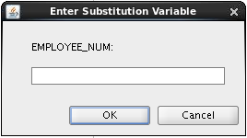
Using the Single-Ampersand
Substitution Variable
Use a variable prefixed with an ampersand (&) to prompt the user for a value:
SELECT employee_id, last_name, salary, department_id
FROM employees
WHERE employee_id = &employee_num ;
Notes:
When running a report, users often want to restrict the data that is returned dynamically. SQL*Plus or SQL Developer provides this flexibility with user variables. Use an ampersand (&) to identify each variable in your SQL statement. However, you do not need to define the value of each variable.
The example in the slide creates a SQL Developer substitution variable for an employee number. When the statement is executed, SQL Developer prompts the user for an employee number and then displays the employee number, last name, salary, and department number for that employee.
With the single ampersand, the user is prompted every time the command is executed if the variable does not exist.
Oracle Database 12c: SQL Workshop I 3 - <number>

Slide 34
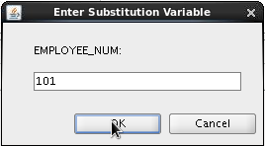
Using the Single-Ampersand
Substitution Variable
Notes:
When SQL Developer detects that the SQL statement contains an ampersand, you are prompted to enter a value for the substitution variable that is named in the SQL statement.
After you enter a value and click the OK button, the results are displayed.
Oracle Database 12c: SQL Workshop I 3 - <number>

Slide 35
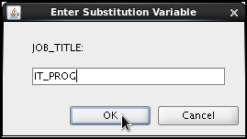

Character and Date Values with Substitution Variables
Use single quotation marks for date and character values:
SELECT last_name, department_id, salary*12
FROM employees
WHERE job_id = '&job_title' ;
Notes:
In a WHERE clause, date and character values must be enclosed within single quotation marks. The same rule applies to the substitution variables.
Enclose the variable with single quotation marks within the SQL statement itself.
The slide shows a query to retrieve the employee names, department numbers, and annual salaries of all employees based on the job title value of the SQL Developer substitution variable.
Oracle Database 12c: SQL Workshop I 3 - <number>

Slide 36
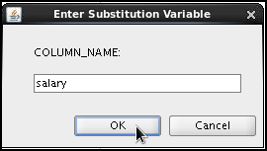
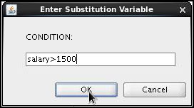
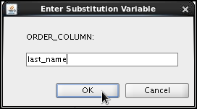
Specifying Column Names, Expressions, and Text
SELECT employee_id, last_name, job_id,&column_name
FROM employees
WHERE &condition
ORDER BY &order_column ;
Notes:
You can use the substitution variables not only in the WHERE clause of a SQL statement, but also as substitution for column names, expressions, or text.
Example
The example in the slide displays the employee number, last name, job title, and any other column that is specified by the user at run time, from the EMPLOYEES table. For each substitution variable in the SELECT statement, you are prompted to enter a value, and then click OK to proceed.
If you do not enter a value for the substitution variable, you get an error when you execute the preceding statement.
Note: A substitution variable can be used anywhere in the SELECT statement, except as the first word entered at the command prompt.
Oracle Database 12c: SQL Workshop I 3 - <number>

Slide 37
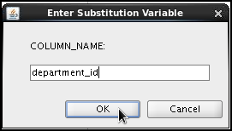

Using the Double-Ampersand
Substitution Variable
Use double ampersand (&&) if you want to reuse the variable value without prompting the user each time:
SELECT employee_id, last_name, job_id, &&column_name
FROM employees
ORDER BY &column_name ;
…
Notes:
You can use the double-ampersand (&&) substitution variable if you want to reuse the variable value without prompting the user each time. The user sees the prompt for the value only once. In the example in the slide, the user is asked to give the value for the variable, column_name, only once. The value that is supplied by the user (department_id) is used for both display and ordering of data. If you run the query again, you will not be prompted for the value of the variable.
SQL Developer stores the value that is supplied by using the DEFINE command; it uses it again whenever you reference the variable name. After a user variable is in place, you need to use the UNDEFINE command to delete it:
UNDEFINE column_name;
Oracle Database 12c: SQL Workshop I 3 - <number>

Slide 38
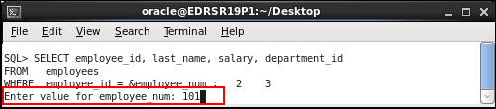
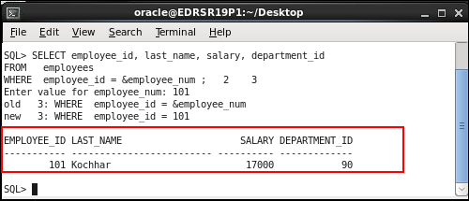
Using the Ampersand Substitution Variable in SQL*Plus
Notes:
The example in the slide creates a SQL*Plus substitution variable for an employee number. When the statement is executed, SQL*Plus prompts the user for an employee number and then displays the employee number, last name, salary, and department number for that employee.
Oracle Database 12c: SQL Workshop I 3 - <number>

Slide 39
Lesson Agenda
  Limiting rows with:
    The WHERE clause
    The comparison conditions using =, <=, BETWEEN, IN, LIKE, and NULL operators
    Logical conditions using AND, OR, and NOT operators
  SQL row limiting clause in a query
  Rules of precedence for operators in an expression
  Sorting rows using the ORDER BY clause
  Substitution variables
  DEFINE and VERIFY commands
Notes:
Oracle Database 12c: SQL Workshop I 3 - <number>

Slide 40

Using the DEFINE Command
  Use the DEFINE command to create and assign a value to a variable.
  Use the UNDEFINE command to remove a variable.
DEFINE employee_num = 200
SELECT employee_id, last_name, salary, department_id
FROM employees
WHERE employee_id = &employee_num ;
UNDEFINE employee_num
Notes:
The example shown creates a substitution variable for an employee number by using the DEFINE command. At run time, this displays the employee number, name, salary, and department number for that employee.
Because the variable is created using the SQL Developer DEFINE command, the user is not prompted to enter a value for the employee number. Instead, the defined variable value is automatically substituted in the SELECT statement.
The EMPLOYEE_NUM substitution variable is present in the session until the user undefines it or exits the SQL Developer session.
Oracle Database 12c: SQL Workshop I 3 - <number>

Slide 41
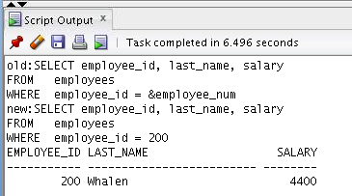
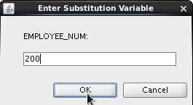
Using the VERIFY Command
Use the VERIFY command to toggle the display of the substitution variable, both before and after SQL Developer replaces substitution variables with values:
SET VERIFY ON
SELECT employee_id, last_name, salary
FROM employees
WHERE employee_id = &employee_num;
Notes:
To confirm the changes in the SQL statement, use the VERIFY command. Setting SET VERIFY ON forces SQL Developer to display the text of a command after it replaces substitution variables with values. To see the VERIFY output, you should use the Run Script (F5) icon in the SQL Worksheet. SQL Developer displays the text of a command after it replaces substitution variables with values, in the Script Output tab as shown in the slide.
The example in the slide displays the new value of the EMPLOYEE_ID column in the SQL statement followed by the output.
SQL*Plus System Variables
SQL*Plus uses various system variables that control the working environment. One of the variables is VERIFY. To obtain a complete list of all the system variables, you can issue the SHOW ALL command on the SQL*Plus command prompt.
Oracle Database 12c: SQL Workshop I 3 - <number>

Slide 42
Quiz
Which four of the following are valid operators for the WHERE clause?
  >=
  IS NULL
  !=
  IS LIKE
  IN BETWEEN
  <>
Notes:
Answer: a, b, c, f
Oracle Database 12c: SQL Workshop I 3 - <number>

Slide 43
Summary
In this lesson, you should have learned how to:
  Limit the rows that are retrieved by a query
  Sort the rows that are retrieved by a query
  Use ampersand substitution to restrict and sort output at run time
Notes:
In this lesson, you should have learned about restricting and sorting rows that are returned by the SELECT statement. You should also have learned how to implement various operators and conditions.
By using the substitution variables, you can add flexibility to your SQL statements. This enables the queries to prompt for the filter condition for the rows during run time.
Oracle Database 12c: SQL Workshop I 3 - <number>

Slide 44
Practice 3: Overview
This practice covers the following topics:
  Selecting data and changing the order of the rows
  that are displayed
  Restricting rows by using the WHERE clause
  Sorting rows by using the ORDER BY clause
  Using substitution variables to add flexibility to your
  SQL SELECT statements
Notes:
In this practice, you build more reports, including statements that use the WHERE clause and the ORDER BY clause. You make the SQL statements more reusable and generic by including the ampersand substitution.
Oracle Database 12c: SQL Workshop I 3 - <number>

