Slide 1
Displaying Data from Multiple Tables Using Joins

Slide 2
Objectives
After completing this lesson, you should be able to do the following:
  Write SELECT statements to access data from more than one table using equijoins and nonequijoins
  Join a table to itself by using a self-join
  View data that generally does not meet a join condition by using OUTER joins
  Generate a Cartesian product of all rows from two or more tables
Notes:
This lesson explains how to obtain data from more than one table. A join is used to view information from multiple tables. Therefore, you can join tables together to view information from more than one table.
Note: Information about joins is found in the “SQL Queries and Subqueries: Joins” section in
Oracle Database SQL Language Reference for 12c database.
Oracle Database 12c: SQL Workshop I 7 - <number>

Slide 3
Lesson Agenda
  Types of JOINS and their syntax
  Natural join
  Join with the USING clause
  Join with the ON clause
  Self-join
  Nonequijoins
  OUTER join:
    LEFT OUTER join
    RIGHT OUTER join
    FULL OUTER join
  Cartesian product
    Cross join
Notes:
Oracle Database 12c: SQL Workshop I 7 - <number>

Slide 4
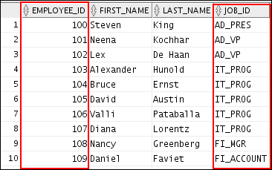
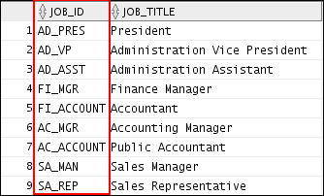
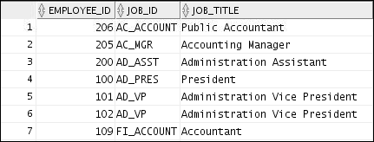
Obtaining Data from Multiple Tables
EMPLOYEES
JOBS
…
Notes:
Sometimes you need to use data from more than one table. In the example in the slide, the report displays data from two separate tables:
Employees IDs exist in the EMPLOYEES table.
Job IDs exist in both the EMPLOYEES and JOBS tables.
Job title exist in the JOBS table.
To produce the report, you need to link the EMPLOYEES and JOBS tables, and access data from both of them.
Oracle Database 12c: SQL Workshop I 7 - <number>

Slide 5
Types of Joins
Joins that are compliant with the SQL:1999 standard include the following:
  Natural join with the NATURAL JOIN clause
  Join with the USING clause
  Join with the ON clause
  OUTER joins:
    LEFT OUTER JOIN
    RIGHT OUTER JOIN
    FULL OUTER JOIN
  Cross joins
Notes:
To join tables, you can use a join syntax that is compliant with the SQL:1999 standard.
Note
Before the Oracle9i release, the Oracle join syntax was different from the American National Standards Institute (ANSI) standards. The SQL:1999–compliant join syntax does not offer any performance benefits over the Oracle-proprietary join syntax that existed in the prior releases.
The following slide discusses the SQL:1999 join syntax.
Oracle Database 12c: SQL Workshop I 7 - <number>

Slide 6
Joining Tables Using SQL:1999 Syntax
Use a join to query data from more than one table:
SELECT table1.column, table2.column
FROM table1
[NATURAL JOIN table2] |
[JOIN table2 USING (column_name)] |
[JOIN table2 ON (table1.column_name = table2.column_name)]|
[LEFT|RIGHT|FULL OUTER JOIN table2
ON (table1.column_name = table2.column_name)]|
[CROSS JOIN table2];
Notes:
In the syntax:
table1.column denotes the table and the column from which data is retrieved
NATURAL JOIN joins two tables based on the same column name
JOIN table2 USING column_name performs an equijoin based on the column name
JOIN table2 ON table1.column_name = table2.column_name performs an equijoin based on the condition in the ON clause
LEFT/RIGHT/FULL OUTER is used to perform OUTER joins
CROSS JOIN returns a Cartesian product from the two tables
For more information, see the section titled “SELECT” in Oracle Database SQL Language Reference for 12c database.
Oracle Database 12c: SQL Workshop I 7 - <number>

Slide 7
Lesson Agenda
  Types of JOINS and their syntax
  Natural join
  Join with the USING clause
  Join with the ON clause
  Self-join
  Nonequijoins
  OUTER join:
    LEFT OUTER join
    RIGHT OUTER join
    FULL OUTER join
  Cartesian product
    Cross join
Notes:
Oracle Database 12c: SQL Workshop I 7 - <number>

Slide 8
Creating Natural Joins
  The NATURAL JOIN clause is based on all the columns that have the same name in two tables.
  It selects rows from the two tables that have equal values in all matched columns.
  If the columns having the same names have different data types, an error is returned.
SELECT * FROM table1 NATURAL JOIN table2;
Notes:
You can join tables automatically based on the columns in the two tables that have matching data types and names. You do this by using the NATURAL JOIN keywords.
Note: The join can happen on only those columns that have the same names and data types in both tables. If the columns have the same name but different data types, the NATURAL JOIN syntax causes an error.
Oracle Database 12c: SQL Workshop I 7 - <number>

Slide 9
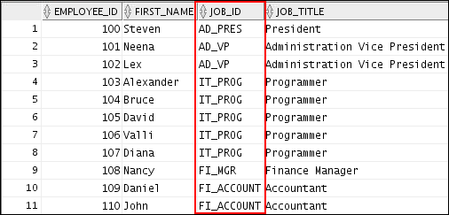
Retrieving Records with Natural Joins
SELECT employee_id, first_name, job_id, job_title
from employees NATURAL JOIN jobs;
…
Notes:
In the example in the slide, the JOBS table is joined to the EMPLOYEES table by the JOB_ID column, which is the only column of the same name in both tables. If other common columns were present, the join would have used them all.
Natural Joins with a WHERE Clause
Additional restrictions on a natural join are implemented by using a WHERE clause. The following example limits the rows of output to those with a DEPARTMENT_ID equal to 20 or 50:
SELECT department_id, department_name,
location_id, city
FROM departments
NATURAL JOIN locations
WHERE department_id IN (20, 50);
Oracle Database 12c: SQL Workshop I 7 - <number>

Slide 10
Creating Joins with the USING Clause
  If several columns have the same names but the data types do not match, use the USING clause to specify the columns for the equijoin.
  Use the USING clause to match only one column when more than one column matches.
Notes:
Natural joins use all columns with matching names and data types to join the tables. The USING clause can be used to specify only those columns that should be used for an equijoin.
Oracle Database 12c: SQL Workshop I 7 - <number>

Slide 11
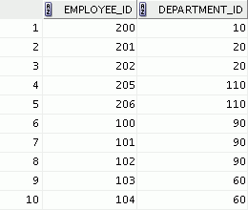
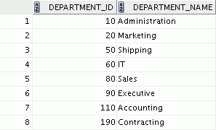
Joining Column Names
EMPLOYEES
DEPARTMENTS
…
Primary key
Foreign key
Notes:
To determine an employee’s department name, you compare the value in the DEPARTMENT_ID column in the EMPLOYEES table with the DEPARTMENT_ID values in the DEPARTMENTS table. The relationship between the EMPLOYEES and DEPARTMENTS tables is an equijoin; that is, values in the DEPARTMENT_ID column in both the tables must be equal. Frequently, this type of join involves primary and foreign key complements.
Oracle Database 12c: SQL Workshop I 7 - <number>

Slide 12
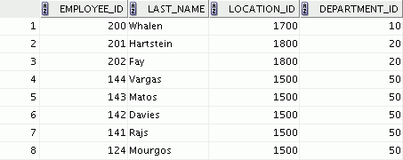
Retrieving Records with the USING Clause
SELECT employee_id, last_name,
location_id, department_id
FROM employees JOIN departments
USING (department_id) ;
…
Notes:
In the example in the slide, the DEPARTMENT_ID columns in the EMPLOYEES and DEPARTMENTS tables are joined and thus the LOCATION_ID of the department where an employee works is shown.
Oracle Database 12c: SQL Workshop I 7 - <number>

Slide 13
Qualifying Ambiguous Column Names
  Use table prefixes to qualify column names that are in multiple tables.
  Use table prefixes to increase the speed of parsing of the statement.
  Instead of full table name prefixes, use table aliases.
  Table alias gives a table a shorter name:
    Keeps SQL code smaller, uses less memory
  Use column aliases to distinguish columns that have identical names, but reside in different tables.
Notes:
When joining two or more tables, you need to qualify the names of the columns with the table name to avoid ambiguity. Without the table prefixes, the DEPARTMENT_ID column in the SELECT list could be from either the DEPARTMENTS table or the EMPLOYEES table. It is necessary to add the table prefix to execute your query. If there are no common column names between the two tables, there is no need to qualify the columns. However, using the table prefix increases the speed of parsing of the statement, because you tell the Oracle server exactly where to find the columns.
However, qualifying column names with table names can be time consuming, particularly if the table names are lengthy. Instead, you can use table aliases. Just as a column alias gives a column another name, a table alias gives a table another name. Table aliases help to keep SQL code smaller, therefore, using less memory.
The table name is specified in full, followed by a space, and then the table alias. For example, the EMPLOYEES table can be given an alias of e, and the DEPARTMENTS table an alias of d.
Guidelines
Table aliases can be up to 30 characters in length, but shorter aliases are better than longer ones.
If a table alias is used for a particular table name in the FROM clause, that table alias must be substituted for the table name throughout the SELECT statement.
Table aliases should be meaningful.
The table alias is valid for only the current SELECT statement.
Oracle Database 12c: SQL Workshop I 7 - <number>

Slide 14

Using Table Aliases with the USING Clause
  Do not qualify a column that is used in the NATURAL join or a join with a USING clause.
  If the same column is used elsewhere in the SQL statement, do not alias it.
SELECT l.city, d.department_name
FROM locations l JOIN departments d
USING (location_id)
WHERE d.location_id = 1400;
Notes:
When joining with the USING clause, you cannot qualify a column that is used in the USING clause itself. Furthermore, if that column is used anywhere in the SQL statement, you cannot alias it. For example, in the query mentioned in the slide, you should not alias the location_id column in the WHERE clause because the column is used in the USING clause.
The columns that are referenced in the USING clause should not have a qualifier (table name or alias) anywhere in the SQL statement. For example, the following statement is valid:
SELECT l.city, d.department_name
FROM locations l JOIN departments d USING (location_id)
WHERE location_id = 1400;
The columns that are common in both the tables, but not used in the USING clause, must be prefixed with a table alias; otherwise, you get the “column ambiguously defined” error.
In the following statement, manager_id is present in both the employees and departments table; if manager_id is not prefixed with a table alias, it gives a “column ambiguously defined” error.
The following statement is valid:
SELECT first_name, e.department_name, d.manager_id
FROM employees e JOIN departments d USING (department_id)
WHERE department_id = 50;
Oracle Database 12c: SQL Workshop I 7 - <number>

Slide 15
Creating Joins with the ON Clause
  The join condition for the natural join is basically an equijoin of all columns with the same name.
  Use the ON clause to specify arbitrary conditions or specify columns to join.
  The join condition is separated from other search conditions.
  The ON clause makes code easy to understand.
Notes:
Use the ON clause to specify a join condition. With this, you can specify join conditions separate from any search or filter conditions in the WHERE clause.
Oracle Database 12c: SQL Workshop I 7 - <number>

Slide 16
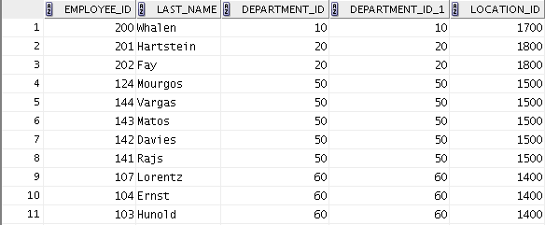
Retrieving Records with the ON Clause
SELECT e.employee_id, e.last_name, e.department_id,
d.department_id, d.location_id
FROM employees e JOIN departments d
ON (e.department_id = d.department_id);
…
Notes:
In this example, the DEPARTMENT_ID columns in the EMPLOYEES and DEPARTMENTS table are joined using the ON clause. Wherever a department ID in the EMPLOYEES table equals a department ID in the DEPARTMENTS table, the row is returned. The table alias is necessary to qualify the matching column_names.
You can also use the ON clause to join columns that have different names. The parentheses around the joined columns, as in the example in the slide, (e.department_id = d.department_id) is optional. So, even ON e.department_id = d.department_id will work.
Note: When you use the Execute Statement icon to run the query, SQL Developer suffixes a ‘_1’ to differentiate between the two department_ids.
Oracle Database 12c: SQL Workshop I 7 - <number>

Slide 17
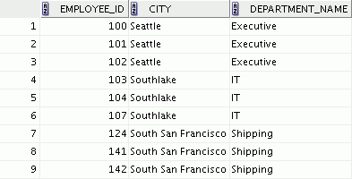
Creating Three-Way Joins
SELECT employee_id, city, department_name
FROM employees e
JOIN departments d
ON d.department_id = e.department_id
JOIN locations l
ON d.location_id = l.location_id;
…
Notes:
A three-way join is a join of three tables. Here, the first join to be performed is EMPLOYEES JOIN DEPARTMENTS. The first join condition can reference columns in EMPLOYEES and DEPARTMENTS but cannot reference columns in LOCATIONS. The second join condition can reference columns from all three tables.
Note: The code example in the slide can also be accomplished with the USING clause:
SELECT e.employee_id, l.city, d.department_name
FROM employees e
JOIN departments d
USING (department_id)
JOIN locations l
USING (location_id);
Oracle Database 12c: SQL Workshop I 7 - <number>

Slide 18
Applying Additional Conditions to a Join
Use the AND clause or the WHERE clause to apply additional conditions:
SELECT e.employee_id, e.last_name, e.department_id,
d.department_id, d.location_id
FROM employees e JOIN departments d
ON (e.department_id = d.department_id)
AND e.manager_id = 149 ;
Or
SELECT e.employee_id, e.last_name, e.department_id,
d.department_id, d.location_id
FROM employees e JOIN departments d
ON (e.department_id = d.department_id)
WHERE e.manager_id = 149 ;
Notes:
You can apply additional conditions to the join.
The example shown performs a join on the EMPLOYEES and DEPARTMENTS tables and, in addition, displays only employees who have a manager ID of 149. To add additional conditions to the ON clause, you can add AND clauses. Alternatively, you can use a WHERE clause to apply additional conditions.
Both the queries produce the same output.
Oracle Database 12c: SQL Workshop I 7 - <number>

Slide 19
Lesson Agenda
  Types of JOINS and their syntax
  Natural join
  Join with the USING clause
  Join with the ON clause
  Self-join
  Nonequijoins
  OUTER join:
    LEFT OUTER join
    RIGHT OUTER join
    FULL OUTER join
  Cartesian product
    Cross join
Notes:
Oracle Database 12c: SQL Workshop I 7 - <number>

Slide 20
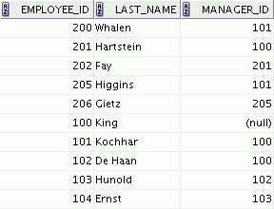
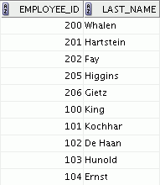
Joining a Table to Itself
EMPLOYEES (WORKER)
EMPLOYEES (MANAGER)
…
…
MANAGER_ID in the WORKER table is equal to EMPLOYEE_ID in the MANAGER table.
Notes:
Sometimes you need to join a table to itself. To find the name of each employee’s manager, you need to join the EMPLOYEES table to itself, or perform a self-join. For example, to find the name of Ernst’s manager, you need to:
Find Ernst in the EMPLOYEES table by looking at the LAST_NAME column
Find the manager number for Ernst by looking at the MANAGER_ID column. Ernst’s manager number is 103.
Find the name of the manager with EMPLOYEE_ID 103 by looking at the LAST_NAME column. Hunold’s employee number is 103, so Hunold is Ernst’s manager.
In this process, you look in the table twice. The first time you look in the table to find Ernst in the LAST_NAME column and the MANAGER_ID value of 103. The second time you look in the EMPLOYEE_ID column to find 103 and the LAST_NAME column to find Hunold.
Oracle Database 12c: SQL Workshop I 7 - <number>

Slide 21
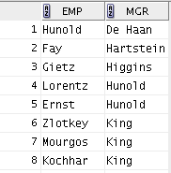
Self-Joins Using the ON Clause
SELECT worker.last_name emp, manager.last_name mgr
FROM employees worker JOIN employees manager
ON (worker.manager_id = manager.employee_id);
…
Notes:
The ON clause can also be used to join columns that have different names, within the same table or in a different table.
The example shown is a self-join of the EMPLOYEES table, based on the EMPLOYEE_ID and MANAGER_ID columns.
Oracle Database 12c: SQL Workshop I 7 - <number>

Slide 22
Lesson Agenda
  Types of JOINS and their syntax
  Natural join
  Join with the USING clause
  Join with the ON clause
  Self-join
  Nonequijoins
  OUTER join:
    LEFT OUTER join
    RIGHT OUTER join
    FULL OUTER join
  Cartesian product
    Cross join
Notes:
Oracle Database 12c: SQL Workshop I 7 - <number>

Slide 23
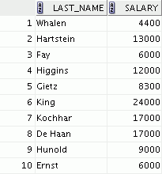
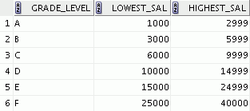

Nonequijoins
EMPLOYEES
JOB_GRADES
The JOB_GRADES table defines the LOWEST_SAL and HIGHEST_SAL range of values for each GRADE_LEVEL. Therefore, the GRADE_LEVEL column can be used to assign grades to each employee.
…
Notes:
A nonequijoin is a join condition containing something other than an equality operator.
The relationship between the EMPLOYEES table and the JOB_GRADES table is an example of a nonequijoin. The SALARY column in the EMPLOYEES table ranges between the values in the LOWEST_SAL and HIGHEST_SAL columns of the JOB_GRADES table. Therefore, each employee can be graded based on their salary. The relationship is obtained using an operator other than the equality (=) operator.
Oracle Database 12c: SQL Workshop I 7 - <number>

Slide 24
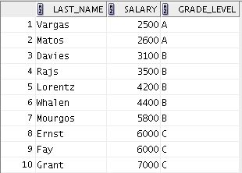
Retrieving Records with Nonequijoins
SELECT e.last_name, e.salary, j.grade_level
FROM employees e JOIN job_grades j
ON e.salary
BETWEEN j.lowest_sal AND j.highest_sal;
…
Notes:
The example in the slide creates a nonequijoin to evaluate an employee’s salary grade. The salary must be between any pair of the low and high salary ranges.
It is important to note that all employees appear exactly once when this query is executed. No employee is repeated in the list. There are two reasons for this:
None of the rows in the JOB_GRADES table contain grades that overlap. That is, the salary value for an employee can lie only between the low-salary and high-salary values of one of the rows in the salary grade table.
All of the employees’ salaries lie within the limits provided by the job grade table. That is, no employee earns less than the lowest value contained in the LOWEST_SAL column or more than the highest value contained in the HIGHEST_SAL column.
Note: Other conditions (such as <= and >=) can be used, but BETWEEN is the simplest. Remember to specify the low value first and the high value last when using the BETWEEN condition. The Oracle server translates the BETWEEN condition to a pair of AND conditions. Therefore, using BETWEEN has no performance benefits, but should be used only for logical simplicity.
Table aliases have been specified in the slide example for performance reasons, not because of possible ambiguity.
Oracle Database 12c: SQL Workshop I 7 - <number>

Slide 25
Lesson Agenda
  Types of JOINS and their syntax
  Natural join
  Join with the USING clause
  Join with the ON clause
  Self-join
  Nonequijoins
  OUTER join:
    LEFT OUTER join
    RIGHT OUTER join
    FULL OUTER join
  Cartesian product
    Cross join
Notes:
Oracle Database 12c: SQL Workshop I 7 - <number>

Slide 26
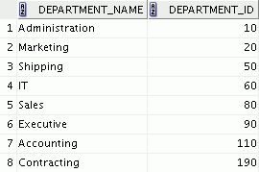
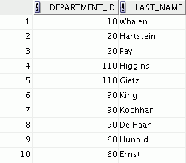

Returning Records with No Direct Match
Using OUTER Joins
DEPARTMENTS
Equijoin with EMPLOYEES
There are no employees in department 190.
Employee “Grant” has not been assigned a department ID.
…
Notes:
If a row does not satisfy a join condition, the row does not appear in the query result.
In the slide example, a simple equijoin condition is used on the EMPLOYEES and DEPARTMENTS tables to return the result on the right. The result set does not contain the following:
Department ID 190, because there are no employees with that department ID recorded in the EMPLOYEES table
The employee with the last name of Grant, because this employee has not been assigned a department ID
To return the department record that does not have any employees, or employees that do not have an assigned department, you can use an OUTER join.
Oracle Database 12c: SQL Workshop I 7 - <number>

Slide 27
INNER Versus OUTER Joins
  In SQL:1999, the join of two tables returning only matched rows is called an INNER join.
  A join between two tables that returns the results of the INNER join as well as the unmatched rows from the left (or right) table is called a left (or right) OUTER join.
  A join between two tables that returns the results of an INNER join as well as the results of a left and right join is a full OUTER join.
Notes:
Joining tables with the NATURAL JOIN, USING, or ON clauses results in an INNER join. Any unmatched rows are not displayed in the output. To return the unmatched rows, you can use an OUTER join. An OUTER join returns all rows that satisfy the join condition and also returns some or all of those rows from one table for which no rows from the other table satisfy the join condition.
There are three types of OUTER joins:
LEFT OUTER
RIGHT OUTER
FULL OUTER
Oracle Database 12c: SQL Workshop I 7 - <number>

Slide 28
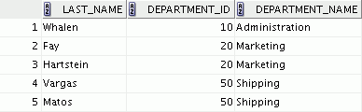
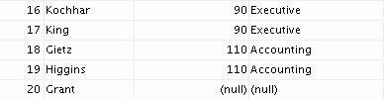
LEFT OUTER JOIN
SELECT e.last_name, e.department_id, d.department_name
FROM employees e LEFT OUTER JOIN departments d
ON (e.department_id = d.department_id) ;
…
Notes:
This query retrieves all the rows in the EMPLOYEES table, which is the left table, even if there is no match in the DEPARTMENTS table.
Oracle Database 12c: SQL Workshop I 7 - <number>

Slide 29
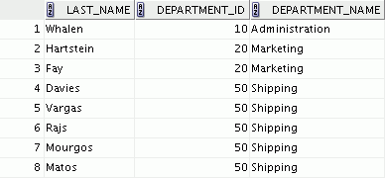

RIGHT OUTER JOIN
SELECT e.last_name, d.department_id, d.department_name
FROM employees e RIGHT OUTER JOIN departments d
ON (e.department_id = d.department_id) ;
…
Notes:
This query retrieves all the rows in the DEPARTMENTS table, which is the table at the right, even if there is no match in the EMPLOYEES table.
Oracle Database 12c: SQL Workshop I 7 - <number>

Slide 30
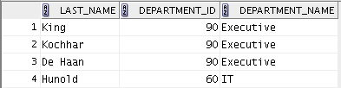
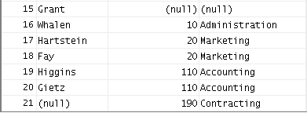
FULL OUTER JOIN
SELECT e.last_name, d.department_id, d.department_name
FROM employees e FULL OUTER JOIN departments d
ON (e.department_id = d.department_id) ;
…
Notes:
This query retrieves all rows in the EMPLOYEES table, even if there is no match in the DEPARTMENTS table. It also retrieves all rows in the DEPARTMENTS table, even if there is no match in the EMPLOYEES table.
Oracle Database 12c: SQL Workshop I 7 - <number>

Slide 31
Lesson Agenda
  Types of JOINS and their syntax
  Natural join
  Join with the USING clause
  Join with the ON clause
  Self-join
  Nonequijoins
  OUTER join:
    LEFT OUTER join
    RIGHT OUTER join
    FULL OUTER join
  Cartesian product
    Cross join
Notes:
Oracle Database 12c: SQL Workshop I 7 - <number>

Slide 32
Cartesian Products
  Cartesian product is a join of every row of one table to every row of another table.
  A Cartesian product generates a large number of rows and the result is rarely useful.
Notes:
A Cartesian product tends to generate a large number of rows and the result is rarely useful. You should, therefore, always include a valid join condition unless you have a specific need to combine all rows from all tables.
Cartesian products are useful for some tests when you need to generate a large number of rows to simulate a reasonable amount of data.
Oracle Database 12c: SQL Workshop I 7 - <number>

Slide 33
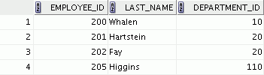
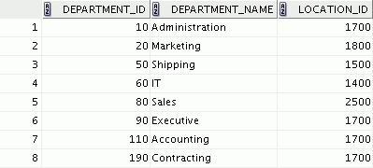




Generating a Cartesian Product
EMPLOYEES (20 rows)
DEPARTMENTS (8 rows)
…
Cartesian product:
20 x 8 = 160 rows
…
…
Notes:
A Cartesian product is generated if a join condition is omitted. The example in the slide displays the employee last name and the department name from the EMPLOYEES and DEPARTMENTS tables. Because no join condition was specified, all rows (20 rows) from the EMPLOYEES table are joined with all rows (8 rows) in the DEPARTMENTS table, thereby generating 160 rows in the output.
Oracle Database 12c: SQL Workshop I 7 - <number>

Slide 34
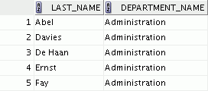

Creating Cross Joins
  A CROSS JOIN is a JOIN operation that produces the Cartesian product of two tables.
  To create a Cartesian product, specify the CROSS JOIN in your SELECT statement.
SELECT last_name, department_name
FROM employees
CROSS JOIN departments ;
…
Notes:
The example in the slide produces a Cartesian product of the EMPLOYEES and DEPARTMENTS tables.
It is a good practice to explicitly state CROSS JOIN in your SELECT when you intend to create a Cartesian product. Therefore, it is very clear that you intend for this to happen and it is not the result of missing joins.
Oracle Database 12c: SQL Workshop I 7 - <number>

Slide 35
Quiz
If you join a table to itself, what kind of join are you using?
  Nonequijoin
  Left OUTER join
  Right OUTER join
  Full OUTER join
  Self-join
  Natural join
  Cartesian products
Notes:
Answer: e
Oracle Database 12c: SQL Workshop I 7 - <number>

Slide 36
Summary
In this lesson, you should have learned how to :
  Write SELECT statements to access data from more than one table using equijoins and nonequijoins
  Join a table to itself by using a self-join
  View data that generally does not meet a join condition by using OUTER joins
  Generate a Cartesian product of all rows from two or more tables
Notes:
There are multiple ways to join tables.
Types of Joins
Equijoins
Nonequijoins
OUTER joins
Self-joins
Cross joins
Natural joins
Full (or two-sided) OUTER joins
Cartesian Products
A Cartesian product results in the display of all combinations of rows. This is done by either omitting the WHERE clause or specifying the CROSS JOIN clause.
Table Aliases
Table aliases speed up database access.
They can help to keep SQL code smaller by conserving memory.
They are sometimes mandatory to avoid column ambiguity.
Oracle Database 12c: SQL Workshop I 7 - <number>

Slide 37
Practice 7: Overview
This practice covers the following topics:
  Joining tables using an equijoin
  Performing outer and self-joins
  Adding conditions
Notes:
This practice is intended to give you experience in extracting data from more than one table using the SQL:1999–compliant joins.
Oracle Database 12c: SQL Workshop I 7 - <number>

