Slide 1
Oracle Software Installation Basics

Slide 2
Objectives
After completing this lesson, you should be able to:
  Plan an Oracle Database and Oracle Grid Infrastructure for standalone server software installation
  Use the Oracle RDBMS Pre-Install RPM
  Configure the Oracle software owner environment
  Invoke the appropriate Oracle Universal Installer (OUI)
Notes:
Oracle Database 12c: Admin, Install and Upgrade Accelerated 3 - <number>

Slide 3

Planning Your Installation
  What Oracle software are you installing?
  Does the hardware involved meet the minimum required specifications?
  Is there a recommended order of installation when multiple products are involved?
  Are there prerequisite steps that must be performed by someone other than the DBA?
Notes:
Before you begin installing Oracle software you should ask yourself the following questions to help you plan your installation:
What Oracle Software Are You Installing?
Perform an installation of Oracle Grid Infrastructure to install the components required for ASM as well as Oracle Restart.
Does the Hardware Involved Meet the Minimum Required Specifications?
Identify all hardware that will be involved in the installation process and ensure that the minimum suggested specifications are met.
Is There a Recommended Order of Installation When Multiple Products Are Involved?
Whenever possible it is recommended that the Oracle Grid Infrastructure software be installed before the Oracle Database software. Performing the installation in this order means that a newly created database can be configured to use ASM disk groups and this database is automatically registered with Oracle Restart. If Oracle Grid Infrastructure is installed after Oracle Database then manual configuration steps are required to register the database with Oracle Restart. Migration steps are required if you want this existing database to use ASM disk groups for storage.
Oracle Database 12c: Admin, Install and Upgrade Accelerated 3 - <number>

Slide 4
Notes:
Are There Prerequisite Steps That Must be Performed by Someone Other Than the DBA?
Following recommended separation of duty guidelines, the DBA is probably not responsible for configuring the hardware and storage devices that are to be used for your installation. Before installing Oracle Grid Infrastructure, there are required configuration steps that a Storage Administrator would perform to configure the required disk partitions. For more information, see the Oracle Database Installation Guide appropriate to your operating system.
In addition, if this is the first time Oracle software is installed on your system, specific operating system groups and users may need to be created. Additional information about the operating system groups and users is provided in later lessons.
Oracle Database 12c: Admin, Install and Upgrade Accelerated 3 - <number>

Slide 5
Configuring Oracle Linux with
Oracle RDBMS Pre-Install RPM
To configure a server using Oracle Linux and the Oracle RDBMS Pre-Install RPM:
  Install Oracle Linux.
  Register your Linux distribution with Oracle Unbreakable Linux Network (ULN), or download and configure the yum repository for your system.
  Install the RPM:
    Oracle RDBMS Pre-Install RPM for Oracle Linux 6
    Oracle Validated RPM with the RPM for Oracle Linux 5
Notes:
Oracle recommends that you install Oracle Linux 6 or Oracle Linux 5, and use Oracle RPMs to configure your operating systems for Oracle Database and Oracle Grid Infrastructure installations. For Oracle Linux 6, install the Oracle RDBMS Server 12c Release 1 Pre-Install RPM package. For Oracle Linux 5, install the Oracle Validated RPM.
Oracle RPMs automatically install any additional packages that are needed to install Oracle Grid Infrastructure and Oracle Database, and configure your server operating system automatically, including setting kernel parameters and other basic operating system requirements for installation.
Perform the following steps to configure a server using Oracle Linux and the Oracle RDBMS Pre-Install RPM:
1. Install Oracle Linux.
2. Register your Linux distribution with Oracle Unbreakable Linux Network (ULN), or download and configure the yum repository for your system using the Oracle public yum repository for your Oracle Linux release.
Install the Oracle RDBMS Pre-Install RPM or Oracle Validated RPM with the RPM for your Oracle Grid Infrastructure and Oracle Database releases, and update your Linux release.
Refer to the Oracle Database Installation Guide for additional information.
Oracle Database 12c: Admin, Install and Upgrade Accelerated 3 - <number>

Slide 6
Notes:
Note: Other platforms have pre-installation requirements that are described in the platform-specific installation guide.
Oracle Database 12c: Admin, Install and Upgrade Accelerated 3 - <number>

Slide 7
Operating System Groups and Users
Oracle Pre-Install RPM configures:
  oracle: Oracle Database installation owner
  oinstall: Oracle Inventory group
  dba: Oracle administrative privileges group
Notes:
The Oracle Pre-Install RPM configures the following operating system users and groups:
Oracle Database installation owner named oracle
Oracle Inventory group named oinstall
Oracle administrative privileges group named dba
You can use these users and groups for your installation, or create your own users and groups to enforce job role separation. Additional information about using job role separation is provided in the next two lessons.
Oracle Database 12c: Admin, Install and Upgrade Accelerated 3 - <number>

Slide 8
Environment Variables
The following Oracle environment variables are suggested by the OUI during installation:
  ORACLE_BASE: Base of the Oracle directory structure
  ORACLE_HOME: Oracle Grid Infrastructure home directory or Oracle Database home directory depending on the product that is being installed
Notes:
During the installation of Oracle software, you are prompted for values that determine the value of the following environment variables:
ORACLE_BASE: Specifies the base of the Oracle directory structure for all Oracle software and configuration-related files
ORACLE_HOME: Specifies the location for storing Oracle software files separate from configuration files
Oracle Database 12c: Admin, Install and Upgrade Accelerated 3 - <number>

Slide 9
Configuring the Oracle Software
Owner Environment
Prior to installing the Oracle software, configure the Oracle software owner environment:
  Set the default file mode creation mask (umask) to 022 in the shell startup file.
  Unset Oracle environment variables (ORACLE_HOME, ORACLE_BASE, ORACLE_SID, and TNS_ADMIN).
  Remove $ORACLE_HOME/bin from your PATH environment variable.
Notes:
If you have an existing Oracle installation on your system, and you are using the same user account to perform a new installation, unset the ORACLE_HOME, ORACLE_BASE, ORACLE_SID, TNS_ADMIN environment variables, and any other environment variables for Oracle software homes.
Oracle Database 12c: Admin, Install and Upgrade Accelerated 3 - <number>

Slide 10
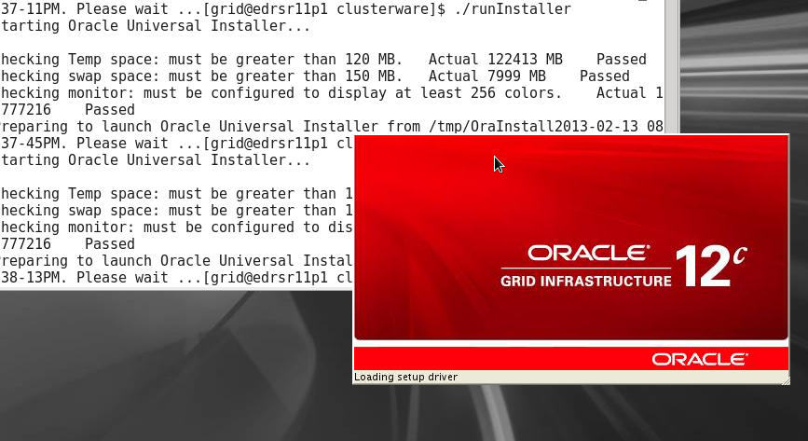
Using Oracle Universal Installer (OUI)
Notes:
Oracle Universal Installer (OUI) is a Java application that performs component-based installations and enables different levels of integrated bundle, suite, and Web-based installations as well as complex logic in a single package. The installation engine is easily portable across all Java-enabled platforms, and platform-specific issues can be encapsulated from the overall installation process.
OUI provides the following capabilities for addressing software management and distribution:
Automatic dependency resolution and complex logic handling
Installation from the Web
Component and suite installations
Support for multiple Oracle homes
NLS or globalization support
Support for distributed installations
Unattended “silent” installations that use response files
The example in the slide shows invoking OUI to install Oracle Grid Infrastructure.
Oracle Database 12c: Admin, Install and Upgrade Accelerated 3 - <number>

Slide 11


Installation Option: Silent Mode
To install and configure Oracle products with OUI in silent mode, perform the following steps:
  Prepare a response file by:
    Using one of the file templates that is delivered with the Oracle software
    Recording a response file during an installation process using the OUI by clicking Save Response File on the summary page
  Run OUI in silent or response file mode.
  ./runInstaller –silent –responsefile <filename>
  If required, run ASMCA, DBCA, and NetCA in silent mode.
Notes:
To install and configure Oracle products by using OUI in silent or response file mode:
1. Prepare a response file. This can be done using one of the file templates that are provided for each product and installation type, such as enterprise.rsp, standard.rsp, and netca.rsp. If these templates are not appropriate for your scenario, you can use OUI in interactive mode to record a response file that you can edit and then use to complete silent-mode or response file-mode installations. This is done by clicking Save Response File on the summary page during an interactive installation using the OUI.
2. Run OUI in silent or response file mode. Run $ORACLE_BASE/oraInventory/orainstRoot.sh and $ORACLE_HOME/root.sh at the end of the installation. If you completed a software-only installation, run Oracle Net Configuration Assistant (NetCA) and the Database Configuration Assistant (DBCA) in silent or noninteractive mode if required.
For more information, see your OS-specific Oracle Database Installation Guide.
Oracle Database 12c: Admin, Install and Upgrade Accelerated 3 - <number>

Slide 12
Quiz
The universal installer performs all required configuration for installing Oracle software.
  True
  False
Notes:
Answer: b
Quiz Comments
The operating system users and groups, for example, must be created on UNIX and Linux before installing.
Oracle Database 12c: Admin, Install and Upgrade Accelerated 3 - <number>

Slide 13
Quiz
A response file is:
  A binary file that can be edited using a binary editing program
  A binary file that can be created by the installer program
  A text file that cannot be edited, but can be created by the installer program
  A text file that can be edited with a text editor
Notes:
Answer: d
Oracle Database 12c: Admin, Install and Upgrade Accelerated 3 - <number>

Slide 14
Summary
In this lesson, you should have learned how to:
  Plan an Oracle Database and Oracle Grid Infrastructure for standalone server software installation
  Use the Oracle RDBMS Pre-Install RPM
  Configure the Oracle software owner environment
  Invoke the appropriate Oracle Universal Installer (OUI)
Notes:
Oracle Database 12c: Admin, Install and Upgrade Accelerated 3 - <number>

