Slide 1
Oracle Database Management Tools

Slide 2
Objectives
After completing this lesson, you should be able to:
  Use SQL*Plus to access the Oracle database
  Use Oracle Enterprise Manager Database Express to perform administrative tasks
  Use Oracle Enterprise Manager Cloud Control to manage the database instance
Notes:
Oracle Database 12c: Admin, Install and Upgrade Accelerated 6 - <number>

Slide 3
Oracle Database Management Tools: Introduction
  SQL*Plus provides an interface to your database so that you can:
    Perform database management operations
    Execute SQL commands to query, insert, update, and delete data in your database
  SQL Developer
    Is a graphical user interface for accessing your instance of Oracle Database
    Supports development in both SQL and PL/SQL
    Is available in the default installation of Oracle Database
  Oracle Enterprise Manager Database Express
  Oracle Enterprise Manager Cloud Control
Notes:
SQL*Plus is a command-line program that you use to submit SQL and PL/SQL statements to an Oracle database. You can submit statements interactively or as SQL*Plus scripts. SQL*Plus is installed with the database and is located in your $ORACLE_HOME/bin directory.
You can start SQL*Plus from the command line, or from the Start menu on a Windows client.
SQL Developer is a graphical user interface for accessing your instance of Oracle Database. SQL Developer supports development in both the SQL and PL/SQL languages. It is available in the default installation of Oracle Database.
With SQL Developer, you can browse database objects, run SQL statements and SQL scripts, and edit and debug PL/SQL statements. You can also run any number of provided reports, as well as create and save your own.
Oracle Database 12c: Admin, Install and Upgrade Accelerated 6 - <number>

Slide 4
Using SQL*Plus
SQL*Plus is:
  A command-line tool
  Used interactively or in batch mode
[oracle@EDRSR11P1 ~]$ sqlplus hr
SQL*Plus: Release 12.1.0.1.0 Production on Tue Jul 9 08:45:39 2013
Copyright (c) 1982, 2012, Oracle. All rights reserved.
Enter password:
Last Successful login time: Tue Jul 09 2013 08:45:30 +00:00
Connected to:
Oracle Database 12c Enterprise Edition Release 12.1.0.1.0 - 64bit Production
With the Partitioning, OLAP, Advanced Analytics and Real Application Testing options
SQL> SELECT last_name FROM employees;
LAST_NAME
-------------------------
Abel
Ande
…
Notes:
You can use the SQL*Plus command-line interface to execute SQL*Plus, SQL, and PL/SQL commands to:
Enter, edit, run, store, retrieve, and save SQL commands and PL/SQL blocks
Format, calculate, store, and print query results
List column definitions for any table
Send messages to and accept responses from an end user
Perform database administration
To start SQL*Plus:
1. Open a terminal window.
2. At the command-line prompt, enter the SQL*Plus command in the following form:
$ sqlplus <userid>/<pwd> or /nolog
3. If you use the NOLOG option, you must enter CONNECT followed by the username you want to connect as:
SQL> connect <username>
4. When prompted, enter the user’s password. SQL*Plus starts and connects to the default database.
Oracle Database 12c: Admin, Install and Upgrade Accelerated 6 - <number>

Slide 5
Calling SQL*Plus from a Shell Script
$ ./batch_sqlplus.sh
SQL*Plus: Release 12.1.0.1.0 Production on Thu Nov 15 09:10:48 2012
Copyright (c) 1982, 2012, Oracle. All rights reserved.
Last Successful login time: Wed Nov 14 2012 12:10:11 +00:00
Connected to:
Oracle Database 12c Enterprise Edition Release 12.1.0.1.0 - 64bit Production
With the Partitioning, OLAP, Advanced Analytics, Real Application Testing and Unified Auditing options
SQL>
COUNT(*)
----------
107
SQL>
107 rows updated.
SQL>
Commit complete.
SQL> Disconnected from Oracle Database 12c Enterprise Edition Release 12.1.0.1.0 - 64bit Production
With the Partitioning, OLAP, Advanced Analytics, Real Application Testing
and Unified Auditing options
$
Output
# Name of this file: batch_sqlplus.sh
# Count employees and give raise.
sqlplus hr/hr <<EOF
select count(*) from employees;
update employees set salary = salary*1.10;
commit;
quit
EOF
Notes:
You can call SQL*Plus from a shell script or BAT file by invoking sqlplus and using the operating system scripting syntax for passing parameters.
In this example, the SELECT, UPATE, and COMMIT statements are executed before SQL*Plus returns control to the operating system.
Oracle Database 12c: Admin, Install and Upgrade Accelerated 6 - <number>

Slide 6
Calling a SQL Script from SQL*Plus
script.sql
select * from departments where location_id = 1400;
quit
Output
$ sqlplus hr/hr @script.sql
SQL*Plus: Release 12.1.0.1.0 Production on Thu Nov 15 09:32:36 2012
Copyright (c) 1982, 2012, Oracle. All rights reserved.
Last Successful login time: Thu Nov 15 2012 09:30:49 +00:00
Connected to:
Oracle Database 12c Enterprise Edition Release 12.1.0.1.0 - 64bit Production
With the Partitioning, OLAP, Advanced Analytics, Real Application Testing
and Unified Auditing options
DEPARTMENT_ID DEPARTMENT_NAME MANAGER_ID LOCATION_ID
------------- ------------------------------ ---------- -----------
60 IT 103 1400
Disconnected from Oracle Database 12c Enterprise Edition Release 12.1.0.1.0 - 64bit Production
With the Partitioning, OLAP, Advanced Analytics, Real Application Testing
and Unified Auditing options
Notes:
You can call an existing SQL script file from within SQL*Plus. This can be done at the command line when first invoking SQL*Plus, as shown in the slide. It can also be done from inside a SQL*Plus session simply by using the “@” operator. For example, this example shows executing the script from within an already established SQL*Plus session:
SQL> @script.sql
Note: The default file extension for script files is .sql. When a script is saved from SQL*Plus by using the SAVE command, this extension is automatically supplied. Scripts with this extension can be executed without supplying the extension at execution time, as in the following example:
SQL> @script
Oracle Database 12c: Admin, Install and Upgrade Accelerated 6 - <number>

Slide 7
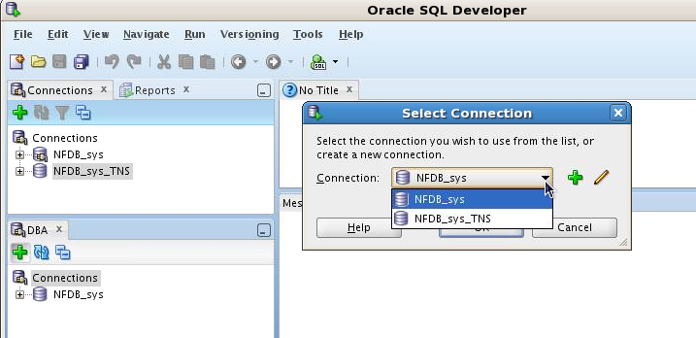
Oracle SQL Developer: Connections
Perform DBA operations in the DBA navigator by using DBA connections:
Notes:
Oracle SQL Developer is a tool that allows stand-alone graphical browsing and development of database schema objects, as well as execution of database administrative tasks.
SQL Developer enables users with database administrator privileges to view and edit certain information relevant to DBAs and perform DBA operations. To perform DBA operations, use the DBA navigator, which is similar to the Connections navigator in that it has nodes for all defined database connections. If the DBA navigator is not visible, select View, then DBA. You should add only connections for which the associated database user has DBA privileges, or at least privileges for the desired DBA navigator operations on the specified database.
Oracle Database 12c: Admin, Install and Upgrade Accelerated 6 - <number>

Slide 8
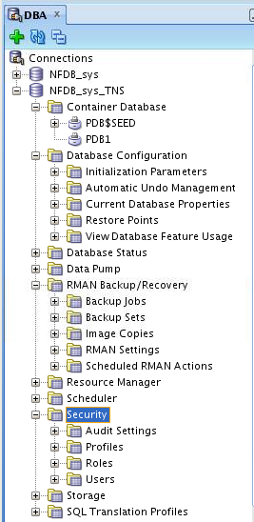
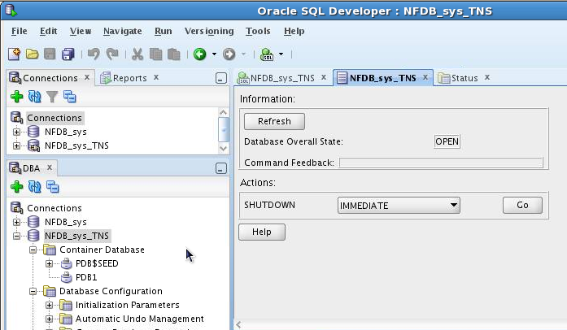
Oracle SQL Developer: DBA Actions
Using DBA features through DBA navigator
Performing DBA actions
Notes:
The DBA operations that can be performed are the following:
Database startup/shutdown
Database configuration: Initialization Parameters, Automatic Undo Management, Current Database Properties, Restore Points, View Database Feature Usage
Database status view
Data Pump export and import jobs
RMAN backup/recovery actions
Resource Manager configuration
Scheduler setting
Security configuration like audit settings, profiles, roles, and users
Storage configuration for archive logs, control files, data files, redo log groups, tablespaces, and temporary tablespace groups
Oracle Database 12c: Admin, Install and Upgrade Accelerated 6 - <number>

Slide 9


Oracle Enterprise Manager
Database Express Architecture
Listener
Console
Oracle Database Instance
Dispatcher
Shared
Server
Get Report
Common
Reporting
Framework
Request
Oracle Web Server
EM Express Servlet
Authentication
Session Management
Compression
Caching
File
Manager
Get shell files
Notes:
Oracle Enterprise Manager Database Express is a lightweight administration tool. It provides an out-of-box browser-based management solution for a single Oracle database (or database cluster), including performance monitoring, configuration management, administration, diagnostics and tuning.
Oracle Enterprise Manager Database Express uses a web-based console, communicating with the built-in web server available in XML DB.
As requests from the console are processed, the Enterprise Manager Database Express servlet handles the requests, including authentication, session management, compression, and caching. The servlet passes requests for reports to the Common Reporting Framework and actions requiring shell files to the File Manager.
Enterprise Manager Database Express is available only when the database is open. This means that Enterprise Manager Database Express cannot be used to start up the database. Other operations that require that the database change state, such as enable or disable ARCHIVELOG mode, are also not available in Enterprise Manager Database Express.
Oracle Database 12c: Admin, Install and Upgrade Accelerated 6 - <number>

Slide 10
Configuring Enterprise Manager
Database Express
  Configure an HTTP listener port for each database instance.
    Verify DISPATCHERS parameter.
    Use DBMS_XDB.setHTTPPort procedure.
    Launch Enterprise Manager Database Express:
  Use a different port for each instance.
  Browser requires Flash plug-in.
    dispatchers=(PROTOCOL=TCP)(SERVICE=sampleXDB)
    exec DBMS_XDB.setHTTPPort(5500)
    http://hostname:5500/em
Notes:
Oracle Enterprise Manager Database Express is configurable with a single click in Database Configuration Assistant (DBCA).
Enterprise Manager Database Express requires that the XMLDB components are installed. All Oracle version 12.1.0 databases have XMLDB installed.
To activate Enterprise Manager Database Express in a database, verify that the DISPATCHERS initialization parameter has at least one dispatcher configured for the XMLDB service with the TCP protocol.
Use the SETHTTPPORT procedure in the DBMS_XDB package to configure a port on the server. Connect to the Enterprise Manager Database Express console with the URL shown in the slide. Substitute the host name of the server and the port number you set by using the SETHTTPPORT procedure.
If you have multiple database instances to monitor on the same machine, set a different port for each. To find the port used for each database instance, execute the following statement:
SQL> SELECT dbms_xdb.gethttpport FROM DUAL;
Enterprise Manager Database Express uses Shockwave Flash (SWF) files, so the web browser must have the Flash plug-in installed.
Oracle Database 12c: Admin, Install and Upgrade Accelerated 6 - <number>

Slide 11
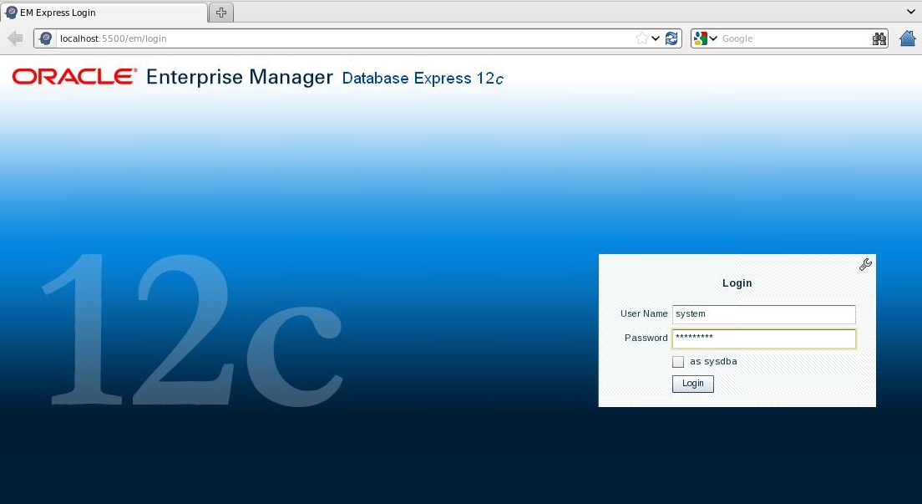
Logging In to Oracle Enterprise Manager Database Express
Notes:
Launch Enterprise Manager Database Express by using the configured HTTP port. Log in as the database user appropriate to the tasks you want to accomplish.
Oracle Database 12c: Admin, Install and Upgrade Accelerated 6 - <number>

Slide 12
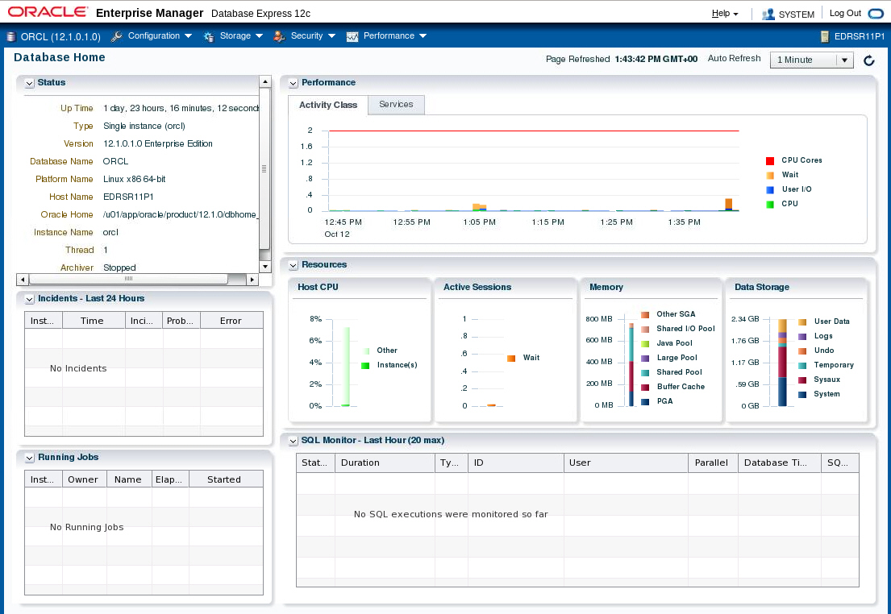
Using the Database Home Page
Notes:
The Enterprise Manager Database Express Home page presents an overall view of the database instance status and activity.
Oracle Database 12c: Admin, Install and Upgrade Accelerated 6 - <number>

Slide 13

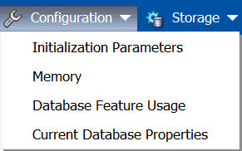
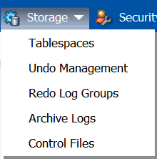
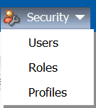
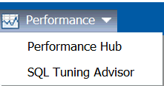
Using Enterprise Manager
Database Express Menus
Notes:
The menu layout for Enterprise Manager Database Express is shown in the slide. There are four main menu items: Configuration, Storage, Security, and Performance. The menu selections for each of the main items are shown.
The Configuration menu includes: Initialization Parameters, Memory, Database Feature Usage, and Current Database Properties. The Storage menu includes Tablespaces, Undo Management, Redo Log Groups, Archive Logs, and Control Files. The Security menu includes: Users, Roles, and Profiles. The Performance menu includes: Performance Hub and SQL Tuning Advisor.
In each of the menu areas, the menu selection directs you to a page that allows you to manage a particular area. For example, the Configuration => Initialization Parameters selection will display a page that allows you to search, view, and modify current and server parameter file (SPFILE) initialization parameters. In many of the pages, when you select an action, a pop-up dialog box enables you to specify parameters. A SQL command is then created to perform the action. You may view the SQL command before you submit it, or you can copy and paste the SQL command.
Oracle Database 12c: Admin, Install and Upgrade Accelerated 6 - <number>

Slide 14



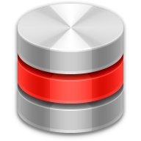









Oracle Enterprise Manager
Cloud Control Components
Oracle Management Agent
Target-specific plug-in
Managed Hosts
Oracle Management Service
Cloud Control Console
Oracle Management Repository
Notes:
Oracle Enterprise Manager Cloud Control is composed of four main components as illustrated in the slide:
Oracle Management Repository (OMR)
Oracle Management Service (OMS)
Oracle Management Agent (OMA or agent) with target-specific plug-ins
Cloud Control Console
The Oracle Management Agent runs on hosts, gathering metric data about those host environments as well as using plug-ins to monitor availability, configuration, and performance and to manage targets running on the host. The agents communicate with the Oracle Management Service to upload metric data collected by them and their plug-ins. In turn, the OMS stores the data it collects in the Oracle Management Repository where it can be accessed by the OMS for automated and manual reporting and monitoring. The OMS also communicates with the agents to orchestrate the management of their monitored targets. As well as coordinating the agents, the OMS runs the Cloud Control Console web pages that are used by administrators and users to report on, monitor, and manage the computing environment that is visible to Cloud Control via the agents and their plug-ins.
Oracle Database 12c: Admin, Install and Upgrade Accelerated 6 - <number>

Slide 15


Controlling the Enterprise Manager
Cloud Control Framework
WebLogic
EM
Repository
OMS
Agents
Component Control Utilities
Repository | OMS | Agent
SQL*Plus or Server Control | Enterprise Manager Control | Enterprise Manager Control
Listener Control
Notes:
Each component of the Enterprise Manager Cloud Control framework has its own utility or utilities that can be used to monitor, start, and stop the component. In many cases, these utilities also provide some capability to configure the component beyond the simple start-and-stop functionality.
RAC databases require the use of Server Control commands; for single instances, there is a choice between SQL*Plus and Server Control. Server Control can be used when Oracle Restart is installed and the database is registered with the OLR.
To start and stop the listener, either use the Server Control utility or the lsnrctl command.
Examples:
srvctl stop database -d orcl -o immediate
srvctl start database -d orcl -o open
Oracle Database 12c: Admin, Install and Upgrade Accelerated 6 - <number>

Slide 16

Starting the Enterprise Manager
Cloud Control Framework
To start the Cloud Control framework, perform the following steps:
  Start the repository database listener.
  Start the repository database instance.
  Start OMS.
  Start the agent on the OMS/repository server.
  Start the agents on the managed servers.
WebLogic
EM
OMS
OHS
Repository
Agents
Notes:
To start the whole Enterprise Manager Cloud Control framework, perform the following steps:
1. Start the repository listener:
$ORACLE_HOME/bin/lsnrctl start
2. Start the repository database instance:
$ORACLE_HOME/bin/sqlplus / as sysdba
SQL> startup
Start OMS (including OHS and WebLogic Managed Server):
$OMS_HOME/bin/emctl start oms
4. Start the agent (on OMS/repository host):
$AGENT_HOME/bin/emctl start agent
5. Start the agent on the managed servers:
$AGENT_HOME/bin/emctl start agent
Note: Use the SRVCTL command if you have a RAC instance for the repository or the repository is controlled by Oracle Restart.
Oracle Database 12c: Admin, Install and Upgrade Accelerated 6 - <number>

Slide 17

Stopping the Enterprise Manager
Cloud Control Framework
To stop the Enterprise Manager Cloud Control framework, perform the following steps:
  Stop the agents on managed servers.
  Stop the agent on the OMS/repository server.
  Stop OMS.
  Stop the repository database instance.
WebLogic
EM
Agents
OHS
OMS
Repository
Notes:
To stop the whole Enterprise Manager Cloud Control framework, perform the following steps:
1. Stop the agent on the managed servers:
$AGENT_HOME/bin/emctl stop agent
2. Stop the agent (on OMS/repository host):
$AGENT_HOME/bin/emctl stop agent
3. Stop OMS (including OHS and WebLogic Managed Server):
$OMS_HOME/bin/emctl stop oms
4. Stop the repository database instance:
$ORACLE_HOME/bin/sqlplus / as sysdba
SQL> shutdown immediate
Note: Use the SRVCTL command if you have a RAC instance for the repository.
Oracle Database 12c: Admin, Install and Upgrade Accelerated 6 - <number>

Slide 18
Types of Enterprise Manager
Cloud Control Targets
Enterprise Manager Cloud Control can monitor, administer, maintain, and manage different types of targets including:
  Oracle databases
  Oracle Database Listener
  Oracle Fusion Middleware products
  Oracle Application Server
  Oracle WebLogic Server
  Oracle applications, including E-Business Suite, SOA, Siebel, and PeopleSoft
  Exadata and Exalogic
  Cloud Control Components: OMR and OMS
  Third-party products
Notes:
Targets are the entities that Enterprise Manager Cloud Control manages. To do so, it uses target-type-specific plug-ins and host-specific agents.
Enterprise Manager Cloud Control can monitor, administer, maintain, and manage different types of targets as listed in the slide. As your environment changes, you can add and remove targets from Enterprise Manager Cloud Control as needed. The commonly used Oracle targets (including Enterprise Manager Cloud Control components, such as the OMR and OMS) are predefined as part of the base Enterprise Manager Cloud Control product, but Enterprise Manager Cloud Control has an open API that enables you to create custom targets.
Oracle Database 12c: Admin, Install and Upgrade Accelerated 6 - <number>

Slide 19
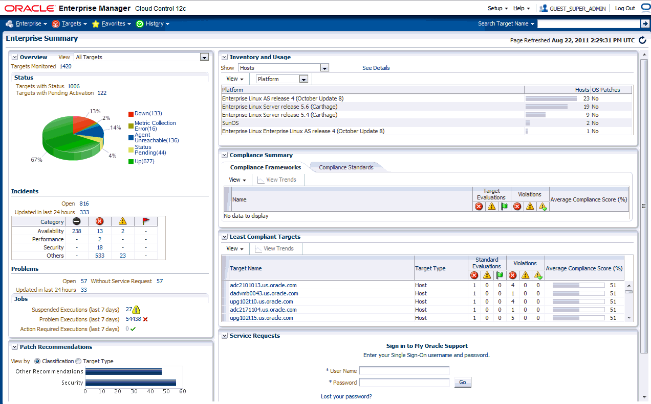
Enterprise Manager Cloud Control
Notes:
The slide shows the Enterprise Summary page of Oracle Enterprise Manager Cloud Control. The user interface (UI) functionality includes:
Information displayed in graphs and tables
Summary information with drilldown capability to relevant details
User-selected home page from a predefined set, or based on any page in the console
Menu-driven navigation
Global target search
History and favorites
Customizable target home pages (per-user basis)
Oracle Database 12c: Admin, Install and Upgrade Accelerated 6 - <number>

Slide 20
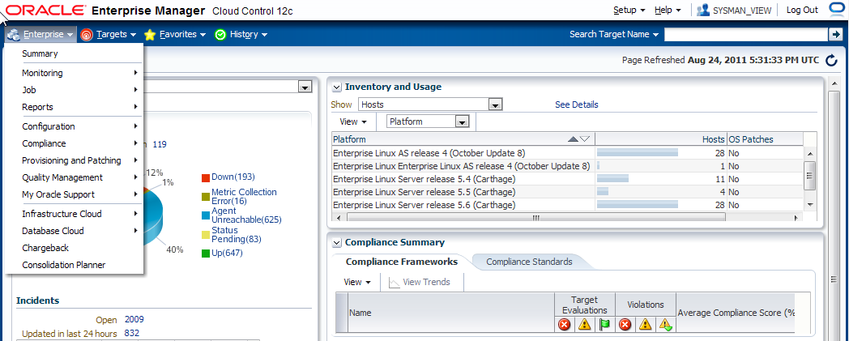
Using Enterprise Manager Cloud Control
  Predefined home page based on roles
  Any page can be set as home page
  Menu-based navigation
  Make any page “favorite” for quick access
Notes:
Use drop-down menus to navigate from one place to another in the product.
Choose your own home page: When you first log in to Enterprise Manager, you are provided with a selection of pre-defined home pages based on roles. If you are managing databases, you can choose the database home page.
If those are not suitable, you can select any page to be your home page instead.
Mark any page as a “favorite” for quick access. For example, if there are certain targets that you manage quite often, you can mark the page you manage them from as a favorite in much the same way you mark a favorite in a browser. However, because the favorites you mark in Enterprise Manager are stored in the repository, you can move from client machine to client machine and your favorites are still available to you.
Oracle Database 12c: Admin, Install and Upgrade Accelerated 6 - <number>

Slide 21
Quiz
Enterprise Manager Database Express can be used to manage many databases concurrently.
  True
  False
Notes:
Answer: b
Oracle Database 12c: Admin, Install and Upgrade Accelerated 6 - <number>

Slide 22
Summary
In this lesson, you should have learned how to:
  Use SQL*Plus to access the Oracle database
  Use Oracle Enterprise Manager Database Express to perform administrative tasks
  Use Oracle Enterprise Manager Cloud Control to manage the database instance
Notes:
Oracle Database 12c: Admin, Install and Upgrade Accelerated 6 - <number>

Slide 23
Practice 6
  6-1: Registering the orcl Database in Oracle Enterprise Manager Cloud Control
  6-2: Creating an Administrative User
  6-3: Logging In to Oracle Enterprise Manager Database Express
Notes:
Oracle Database 12c: Admin, Install and Upgrade Accelerated 6 - <number>

